Slide 1
New SID of Smart Grid APP
Su Zijian (suzijian@huawei.com)
Huawei

Slide 2
Services from SA1 for smart Grid

Slide 3
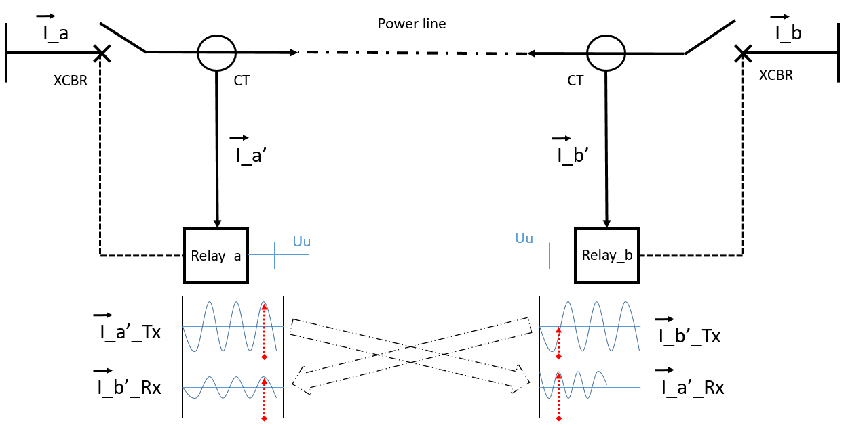
Use case of line current differential protection in power distribution grid (TR22.867 subclause 5.4)
5GS
Current line sample I_a’
Current line sample I_b’
Protection Relay_a
Protection Relay_b
Protection Relay (PR): Smart Grid Terminal used to measure the current and protect the power line, which can be seen as a UE of 5G
Data translate from Relay-a to Relay-b
Latency Information exposure from 5GS to Relay
Back Ground: PR_a and PR_b are not time synchronization UEs
PR_b should compare the current data with the data sampled at the SAME TIME by PR_a, with the latency information exposure by 5GS
PR_a take the current sample I_a’ at Time1
PR_a deliver the current data to PR_b by 5GS
5GS exposure the latency information of this service flow to PR_b
PR_b receive the current data I_a’ at Time2
PR_b calculate the Time1 by (Time2 – latency)
PR_b enquire the current sample I_b’ taked at Time1
PR_b compare the I_b’ with I_a’, to decide whether to turn off the switch
The 5G system shall provide a UE with communication channel latency from the remote UE, with an accuracy of the provided latency < 1ms.
Notes:
SLA
resource;

Slide 4
It requires:
The Grid APP on UE(e.g. Differential Protection of Current Line) needs the UE to UE latency as a parameter to process the Grid Service data.
There is a gap:
UE can not obtain the UE to UE latency from 5GS.
Potential Solution:
  5GS measure/predict the UE to UPF latency, and SEAL /enabler layer process the UE to UE latency and exposure to the UE.

Slide 5
Use case of line current differential protection in power distribution grid (TR22.867 subclause 5.4)
The 5G system shall provide the protection relay with timing information with the comparable precision as GNSS-based precision. The IEEE 1588 time master in NG-RAN should provide protection relays with IEC 61850-9-3 based power/utility profile.
gNB_a belong to PLMN_a
Protection Relay
Other Smart Grid Services Terminals
gNB_b belong to PLMN_b
Time synchronize between Portection Relay with gNB_a
Time synchronize between Portection Relay with gNB_b
gNB_a and gNB_b belong to different PLMNs. They adopt different IEEE 1588 time master profile. The protection relay complies with IEC 61850-9-3 based profile.
When the PLMN switch from a to b
  Protection Relay should synchronized time with gNB_b.
  Other Smart Grid Terminals connect to gNB_b with no requirements of time synchronization.
There is a gap:
gNB_b have no information about which UE require time synchronization and what time master profile should provide to the UE.
Potential Solutions:
An adaptation capability for re-configuring the 3GPP system for the time synchronization requirements based on the UE can be supported by SEAL/enabler layer.
Notes:
SLA
resource;

Slide 6
Potential Solution for Smart Grid APP on SA6
Smart Grid Communication Management Server
  Services KQI requirement
  Network Configuration request
  Services Incident report to MNOs
Smart Grid APP Enable Server / SEAL
  Services KQI（e.g. the UE to UE latency) analysis and mapping with service requirement indicator exposure to the UE
  Service KQI measurement and prediction
  Adaptation capability for Time Synchronizations of UEs requirements for Multiple PLMNs
  Combine Network performance and management exposure for Smart Grid
Smart Grid Application/Service
Smart Grid Communication Management Server（DSOs)
Smart Grid Enabler Server
GRIDAPP
SEAL
5GS
5G Control function
5G Mng function

Slide 7
Thank you

