Slide 1
Discussion on serving non-3GPP direct communication via MC gateway UE
BDBOS:
Frank Koersten
Dania Azem

Slide 2
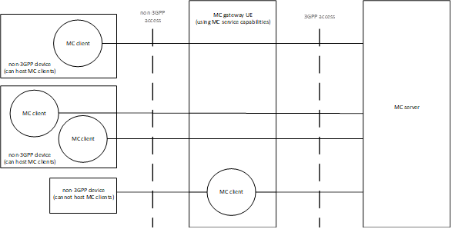
Functional Architecture in TS 23.280

Slide 3
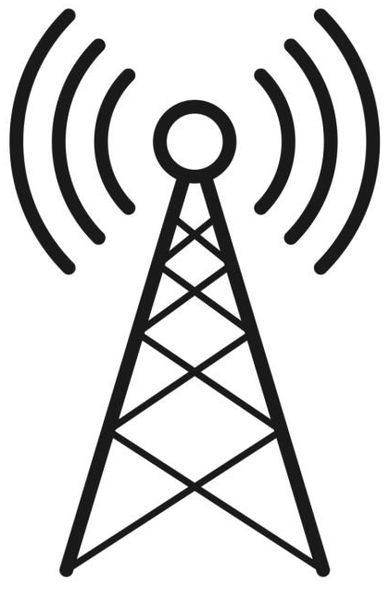

DMO support by MC gateway UE
MC System
Broadband
network
MC GW UE:
*MC clients*
*Non-3GPP
conversion unit*
new
Underground system:
No radio networks available
DMO
DMO
DMO

Slide 4
Outline
Extending the MC gateway UE capability to support non-IP capable devices behind the gateway e.g. Direct Mode Operation
MC gateway UE can host single/multiple MC service clients on behalf of such devices
Connecting Public Safety devices using legacy non-3GPP DMO transmission technologies (TETRA-DMO, P25-DMO, etc.) to MC services is desired by our users
Goal of CR: completing routing capabilities of the MC gateway UE, introduction of „N3GPP conversion unit“ to couple N3GPP devices to MC services

Slide 5
Benefits
Supporting of non-IP connectivity like in V2X (TS 23.287, clause 5.2.1)
Off-network case: filling the gap until ProSe capable devices are procured by PPDR organisations with well proven DMO technology
Benefitting from DMOs high transmit power (3W for handhelds up to 10W … for gateways*) and larger coverage** in daily operation
Current DMO capable devices stay in use even when legacy networks become EOL
DMO devices can be individually addressed behind the MC gateway UE
Group communication between DMO groups and MCX groups (Mapping) can be covered
*ETSI EN 300396-3 (clause 6.4.2)
** https://www.nist.gov/ctl/pscr/prose
Notes:
*ETSI EN 300396-3 (clause 6.4.2)
** https://www.nist.gov/ctl/pscr/prose

Slide 6
State of play
An MC gateway UE could provide/host a conversion unit between DMO and MCX
A simple and cost-effective solution for a protocol conversion unit that is attractive to many manufacturers.
Protocol conversion concept may adapt on already specified TS 23.283 “Interworking with Land Mobile Radio Systems” on the 3GPP Mission Critical side, but in this case client-client based
IP connection to the network behind the MC gateway UE is not necessary

Slide 7
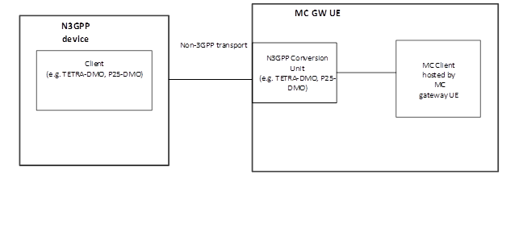
Proposed solution: N3GPP Conversion Unit 1/2
Non IP

Slide 8
Proposed solution: N3GPP Conversion Unit 2/2
The MC gateway UE provides the “N3GPP Conversion Unit” which is connected to the MC service client.
The MC traffic and media is exchanged over the MC service client to the N3GPP Conversion Unit.
The N3GPP Conversion Unit handles the authorization of the user at the MC gateway UE level, performs protocol conversion and couples N3GPP UEs with the corresponding MC service clients.
The binding between the N3GPP device and the MC service client is out of scope of 3GPP.

Slide 9
Summary
Completing the view on support of MC gateway UE for N3GPP devices which cannot host an MC service client in the 3GPP specification
Clarification that non-IP and IP networks /devices are both supported behind the MC gateway UE
Introducing the use case DMO usage behind the MC gateway UE
New clause “11.4.4 Support of non-IP network behind the MC gateway UE” in TS 23.280

