Slide 1
Discussion Paper on Relationship with CAMARA and related definition
Source: Alibaba

Slide 2
Background
On Rapporteur call 144e.1, several issues regarding exposure governance, Translation, filtering, abstraction, unique granular access have been discussed. It was suggested to figure out the relation with CAMARA and the definition of the aforementioned terms.
This discussion paper propose to figure out the relation with CAMARA and provide definition of the terms exposure governance, Translation, filtering, abstraction, unique granular access.

Slide 3
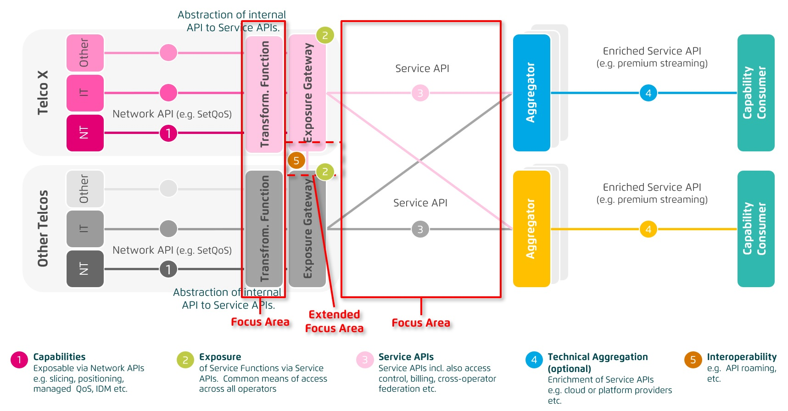
Overview of CAMARA(1/2)
CAMARA proposes to provide abstraction from Network APIs to Service APIs
To hide telco complexity making APIs easy to consume for customers with no telco expertise (user-friendly APIs).
To fulfil data privacy and regulatory requirements
To facilitate application to network integration

Slide 4
Overview of CAMARA(2/2)
The scope of the CAMARA Project is limited to the following activities
Collect API requirements from GSMA Operator Platform Group and other sources.
Define Service APIs.
Create test plan / cases / tools from an API consumer perspective
Develop and test Service APIs
Create developer friendly documentation for service APIs

Slide 5
CAMARA API backlog which is related to management service(1/2)
CAMARA targets at providing service API based on the existing capability offered by 3GPP, the capabilities related to OAM are listed below:
API family | Tags | Description of API family | Supporting capabilities
Baseline OAM | CRA: Administrator, Business manager TMF: Design, P2O, T2R MAPE: MA | It provides the customer with the ability to: - consume management data, including business related data (e.g., SLA, subscriber data, customer profile), and operation related data (e.g. PM/FM data, logs, trace, analytics reports, event notifications). NOTE 1: The management data feeds customer owned systems, and can be used for internal consumption (B2B) or made available to their own customers (B2B2X, e.g. hyperscaler enriches management data with additional information, and exposes them to their own customers via proprietary APIs). - gain access to Customer-Facing Service (CFS) catalog and inventory. NOTE 2: This includes catalog of APIs and inventory of edge nodes (features, location, availability) | - BSS (Rel-15, M): configuration of business related data. - OSS w/o slicing (Rel-15/16, M): configuration of operational related data, including batch format (file based reporting/streaming reporting) and reporting period. Availability of catalog and inventory following TMForum Open Digital Architecture (ODA). - OSS w/ slicing (Rel-17, O): provide operational related at network slice (subnet) level.

Slide 6
CAMARA API backlog which is related to management service(2/2)
API family | Tags | Description of API family | Supporting capabilities
Advanced OAM | CRA: Administrator TMF: T2R MAPE: ME | It provides the customer the ability to trigger day-2 activities, e.g. scaling in/out, policy injection for data collection, etc. NOTE: The operator always acts on behalf of the customer (customer is not granted with direct access to operator OSS capabilities). | - Baseline OAM availability - OSS Access control (Rel-18, M), enhancing OSS with authentication, authorization and audit capabilities

Slide 7
Potential supporting capabilities from FS_NSCE
Potential supporting capability from FS_NSCE
MnS discovery service for NSC.
Authorization procedure and provisioning of granular access.
Filtering.
NOTE: Exposure governance may include granular access and filtering.

Slide 8
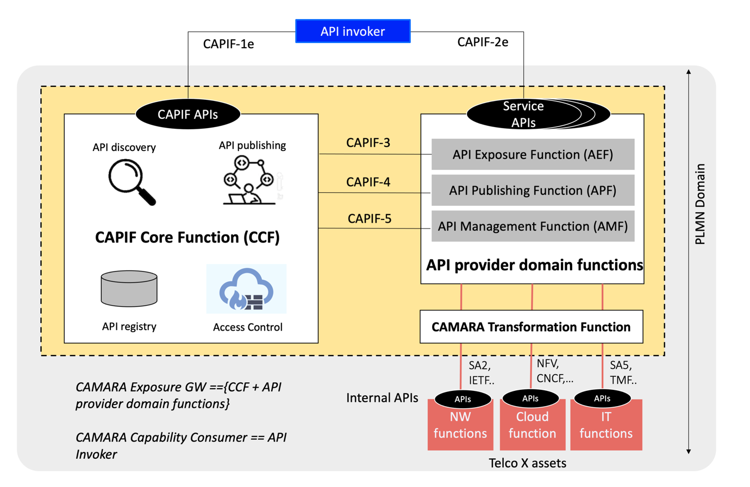
Relation with CAMARA
CAMARA focuses on abstraction,
1) hide telco complexity making API easy to consume for customer with no telco expertise, 2) fulfil data privacy and regulatory requirement, 3) to facilitate application to network
Translation is covered by abstraction.
FS_NSCE focuses on exposure governance, including,
Granular access control,
Filtering,

Slide 9
Definition
Exposure governance
Perform access control including Filtering and Granular access.
Translation
Translate certain information element within MnS into something which is more easier to understand for the external customer.
Filtering
Hide certain information elements of MnS which is not authorized or not interested to the customer.
Granular access
Access permission which is specifically for a respective external customer. For example, the permission of Read, write, the acquisition of notification for certain MnSs. The Granular Access can be used to support Filtering.

Slide 10
Proposal
The contribution proposes to endorse the following
Definition of Exposure Governance, Translation, Simplification, Filtering and Granular access;
Relations with CAMARA
CAMARA covers the abstraction, which also covers the translation.
FS_NSCE focuses on exposure governance, including Granular access control, Simplification, Filtering.

