Slide 1
Way Forward on Channel Modeling for FR2 HST
3GPP TSG-RAN WG4 Meeting #98-bis-e
Electronic Meeting, 12th – 20th April, 2021
Agenda: 8.7.2.3
R4-2106101
Document for: Approval
Nokia, Nokia Shanghai Bell

Slide 2
Background
The Rel-17 NR HST FR2 Enhancements WI is presented in WID RP-202118.
The Work plan of the WI, including RRM core and perfromance part can be found in R4-2016920.
This is the first meeting with a dedicated AI on the channel modelling. However, some issues regarding the channel model for link budget evaluation and channel modelling for performance requirements were already discussed at the previous meetings (e.g., see Way forward on Deployment Scenario and UE RF Requirement for FR2 HSTafter RAN#498-e, R4-2103240)
Corresponding Email summaries in RAN4#98-bis-e:
R4-2105993 Email discussion summary for [98-bis-e][322] NR_HST_FR2_Scenarios_Demod, first round
R4-2106146 Email discussion summary for [98-bis-e][322] NR_HST_FR2_Scenarios_Demod, second round

Slide 3
Channel Model for Scenario-B Link Budget Analysis
RAN4 to choose TS38.901 RMa LoS pathloss model also for the evaluation of Scenario-B

Slide 4
Channel Models for Demodulation Performance Requirements
The single tap propagation model can be assumed for each single Tx-Rx link for both scenario-A and scenario-B

Slide 5
Way forward on Uplink Channel Model for Performance Requirements
Channel Model for Uplink Uni-directional RRH deployment:
Option 1: Use single-tap propagation channel for UL uni-directional RRH deployment, as described below:
$\cos{θ}\left(t\right)=\frac{{D_{s}}/2−vt}{\sqrt{D_{min}^{2}+{\left({D_{s}}/2−vt\right)}^{2}}}$, $0≤t≤{D_{s}}/{2v}$ $\cos{θ}\left(t\right)=\frac{1.5D_{s}−vt}{\sqrt{D_{min}^{2}+{\left({1.5D}_{s−}vt\right)}^{2}}}$, ${D_{s}}/{2v}<t≤{D_{s}}/v$ $cosθ\left(t\right)= cosθ\left(t \text{mod}({D_{s}}/v)\right)$, $t>{D_{s}}/v$
Option 2: HST-DPS Channel for FR2 HST Uni-Directional RRH Deployment: Alt-1: UE Moving towards Serving Beam the cosine of angle θ(t) used in Doppler shift $f_{s}\left(t\right)=f_{d} cos{θ\left(t\right)}$ is provided as below
$\cos{θ\left(t\right)}=\frac{D_{s_offset}−vt}{\sqrt{D_{min}^{2}+{\left(D_{s_offset}−vt\right)}^{2}}}, 0<t≤\frac{D_{s}}{v}$ (eq. 1) $cosθ\left(t\right)=cosθ\left(t mod\left(\frac{D_{s}}{v}\right)\right), t>\frac{D_{s}}{v}$ (eq. 2) $where D_{s}≤D_{s_offset}<{2D}_{s}$ (eq. 3)
Value of $D_{s_offset}$ is FFS

Slide 6
Way forward on Uplink Channel Model for Performance Requirements (cont.)
Channel model for Uplink Bi-directional RRH deployment
Option 1: RAN4 to modify the single-tap propagation channel model for HST FR2 in UL to take into account the Doppler shift sign alternation in bi-directional setting when CPE is handing over from one RRH site to another.
$\cos{θ}\left(t\right)=\frac{{D_{s}}/2−vt}{\sqrt{D_{min}^{2}+{\left({D_{s}}/2−vt\right)}^{2}}}$, $0≤t≤{D_{s}}/v$, $cosθ\left(t\right)= cosθ\left(t \text{mod}({D_{s}}/v)\right)$, $t>{D_{s}}/v$.
Option 2: Reuse Single Tap Channel in TS38.104 for FR2 HST by updating parameters.
Other options are not precluded
Parameter | Value
 | Scenario-A-260 | Scenario-A-350 | Scenario-B-260 | Scenario-B-350
$$D_{s}$$ | 700 m | 700 m | 700 m | 700 m
$$D_{min}$$ | 10 m | 10 m | 150 m | 150 m
$$v$$ | 260 km/h | 350 km/h | 260 km/h | 350 km/h
$$f_{d}$$ | [14454] Hz | [19458] Hz | [14454] Hz | [19458] Hz

Slide 7
Downlink Channel Model for Performance Requirements
RAN4 agrees to use DPS channel model for both Uni-directional/Bi-directional for performance requirements.
Consider JT model for DL?
FFS: a need for JT/Full-SFN channel models for performance requirements

Slide 8
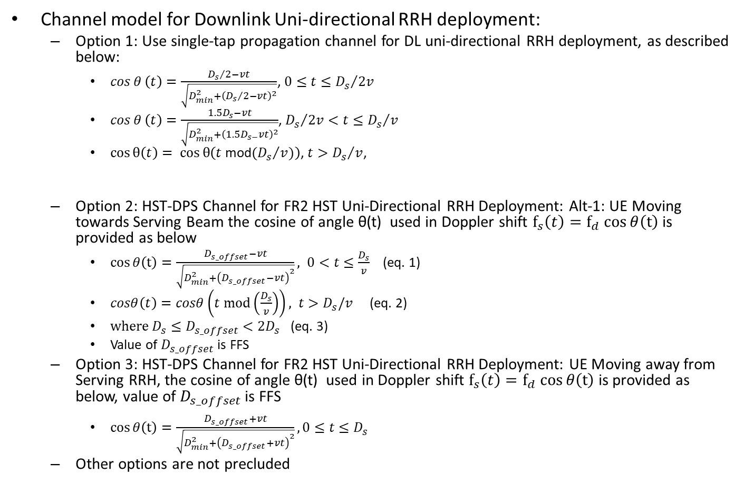
Downlink Channel Model for Performance Requirements (cont.)
Channel model for Downlink Uni-directional RRH deployment:
Option 1: Use single-tap propagation channel for DL uni-directional RRH deployment, as described below:
$\cos{θ}\left(t\right)=\frac{{D_{s}}/2−vt}{\sqrt{D_{min}^{2}+{\left({D_{s}}/2−vt\right)}^{2}}}$, $0≤t≤{D_{s}}/{2v}$
$\cos{θ}\left(t\right)=\frac{1.5D_{s}−vt}{\sqrt{D_{min}^{2}+{\left({1.5D}_{s−}vt\right)}^{2}}}$, ${D_{s}}/{2v}<t≤{D_{s}}/v$
$cosθ\left(t\right)= cosθ\left(t \text{mod}({D_{s}}/v)\right)$, $t>{D_{s}}/v$,
Option 2: HST-DPS Channel for FR2 HST Uni-Directional RRH Deployment: Alt-1: UE Moving towards Serving Beam the cosine of angle θ(t) used in Doppler shift $f_{s}\left(t\right)=f_{d} cos{θ\left(t\right)}$ is provided as below
$\cos{θ\left(t\right)}=\frac{D_{s_offset}−vt}{\sqrt{D_{min}^{2}+{\left(D_{s_offset}−vt\right)}^{2}}}, 0<t≤\frac{D_{s}}{v}$ (eq. 1)
$cosθ\left(t\right)=cosθ\left(t mod\left(\frac{D_{s}}{v}\right)\right), t>D_{s}/v$ (eq. 2)
$where D_{s}≤D_{s_offset}<{2D}_{s}$ (eq. 3)
Value of $D_{s_offset}$ is FFS
Option 3: HST-DPS Channel for FR2 HST Uni-Directional RRH Deployment: UE Moving away from Serving RRH, the cosine of angle θ(t) used in Doppler shift $f_{s}\left(t\right)=f_{d} cos{θ\left(t\right)}$ is provided as below, value of $D_{s_offset}$ is FFS
$\cos{θ\left(t\right)}=\frac{D_{s_offset}+vt}{\sqrt{D_{min}^{2}+{\left(D_{s_offset}+vt\right)}^{2}}}, 0≤t≤D_{s}$
Other options are not precluded
Parameter | Value
 | Scenario-A-260 | Scenario-A-350 | Scenario-B-260 | Scenario-B-350
$$D_{s}$$ | 700 m | 700 m | 700 m | 700 m
$$D_{min}$$ | 10 m | 10 m | 150 m | 150 m
$$v$$ | 260 km/h | 350 km/h | 260 km/h | 350 km/h
$$f_{d}$$ | [7227] Hz | [9729] Hz | [7227] Hz | [9729] Hz

Slide 9
Downlink Channel Model for Performance Requirements (cont.)
Channel model for Downlink Bi-directional RRH deployment
Option 1: RAN4 to modify the single-tap propagation channel model for HST FR2 in DL to take into account the Doppler shift sign alternation in bi-directional setting when CPE is handing over from one RRH site to another. Use this model in bi-directional DPS setting:
$\cos{θ}\left(t\right)=\frac{{D_{s}}/2−vt}{\sqrt{D_{min}^{2}+{\left({D_{s}}/2−vt\right)}^{2}}}$, $0≤t≤{D_{s}}/v$,
$cosθ\left(t\right)= cosθ\left(t \text{mod}({D_{s}}/v)\right)$, $t>{D_{s}}/v$.
Option 2: HST-DPS Channel for FR2 HST Bi-Directional RRH Deployment. the cosine of angle $θ\left(t\right)$used in Doppler shift $f_{s}\left(t\right)=f_{d} cos{θ\left(t\right)}$ is provided as below:
$\cos{θ\left(t\right)}=\frac{D_{s}−vt}{\sqrt{D_{min}^{2}+{\left(D_{s}−vt\right)}^{2}}}, 0<t≤{(0.5∗D}_{s})/v$ (eq. 7)
$\cos{θ\left(t\right)}=\frac{vt}{\sqrt{D_{min}^{2}+{\left(vt\right)}^{2}}}, {(0.5∗D}_{s})/v<t≤D_{s}/v$ (eq. 8)
$cosθ\left(t mod\left(\frac{D_{s}}{v}\right)\right), t>D_{s}/v$ (eq. 9)
Other options are not precluded
Parameter | Value
 | Scenario-A-260 | Scenario-A-350 | Scenario-B-260 | Scenario-B-350
$$D_{s}$$ | 700 m | 700 m | 700 m | 700 m
$$D_{min}$$ | 10 m | 10 m | 150 m | 150 m
$$v$$ | 260 km/h | 350 km/h | 260 km/h | 350 km/h
$$f_{d}$$ | [7227] Hz | [9729] Hz | [7227] Hz | [9729] Hz

Slide 10
Contributions List in RAN4#98-bis-e
T-doc No. | Title | Company
R4-2104678 | Channel model for FR2 HST scenario | Ericsson
R4-2105025 | Channel modeling for FR2 HST and TP to TR 38.854 | Samsung
R4-2106828 | Discussion on channel modeling for NR FR2 HST | Huawei, HiSilicon
R4-2106911 | On HST FR2 Channel Modelling | Nokia, Nokia Shanghai Bell

