Slide 1
WF on [307] NTN_Solutions_Part1 (NTN general part)
Moderator, THALES

Slide 2
Outline
Proposed way forward based on the outcomes of “Email discussion summary for [98-bis-e][307] NTN_Solutions_Part1”
See R4-2106147 (revision of R4-2105978)

Slide 3
Content
Topic #1: NTN Architecture Aspects
Topic #2: Generic Parameters
Topic #3: FR1 Generalities
Topic #4: FR2 Generalities
Topic #5: HAPS Aspects

Slide 4
Summary
List of proposals for each topics discussed
In “agreements” part
Proposals with “green” comments are agreeable.
In “open issues” part
Proposals with “purple” comments not agreeable.
Proposals with “orange” comments not agreeable:
If there is a GTW session and we could agree on some of them, this WF will be revised anyway;
Please also note that the “orange” proposals were the results of “agreed with changes” comments.
Proposals without any comment were not discussed.

Slide 5
Current agreements
(after GTW session and after 1st Round Discussion)

Slide 6
Topic #1 (1/2)
Baseline assumption: The linkage between NTN Gateway and non-NTN gNB is up to implementation and without 3GPP standardized solution
Pending on further check on the test feasibility of Rx requirements on gNB side of service link (refer to the figure in the next slide)
RAN4 to decide if there are any testing concerns for Satellite + feeder link + NTN-Gateway + gNB as a single entity, and why.
RAN4 shall take into account the inputs from companies to decide if the typical satellite implementation considers wired or non-wired connection with the GW.

Slide 7
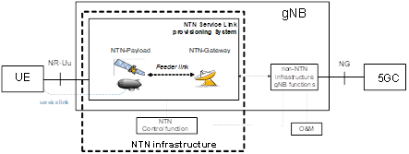
Topic #1 (2/2)
RAN4 shall consider the architecture defined by RAN3 as baseline and shall allow further potential modifications if required pending further check on test feasibility.
RAN4 shall consider the architecture defined by RAN3 as baseline for test setup pending on further check on test feasibility.

Slide 8
Topic #3 (1/2)
For NTN S-band, RAN4 shall consider 5, 10, 15, 20, 25, 30 MHz channel BW configurations.
Note1: This current agreement may evolve depending on operator requests.
Note2: This current agreement considers the possible band configuration for S-band (and can be different from the one used for the coexistence, which might be a subset).
For NTN S-band, RAN4 shall at least consider 1 DL spectrum + 1 UL spectrum in the range (1980 - 2010 MHz) and (2170 - 2200 MHz).

Slide 9
Topic #3 (2/2)
RAN4 shall continue discussion on NTN channel raster for S-Band, and L-band.
Option 1: 15 kHz
Option 2: 100 kHz
Other options not precluded
NTN operators’ input are encouraged for channel arrangements
RAN4 shall continue discussion to clarify L-band frequency range for NTN operation.
List candidate options if any.
RAN4 shall consider inputs from NTN operators for the NTN-NTN coexistence scenarios for MSS S-band.

Slide 10
Topic #5
RAN4 shall further refine FR1 NR band description for HAPS deployment at @2GHz for use in coexistence studies.
NR band n1 as example band for HAPS related coexistence studies at 2GHz.
Separate HAPS coexistence scenarios from Satellite coexistence scenarios.
Note: the two NTN systems may consider different bands, different simulation parameters

Slide 11
Open Issues

Slide 12
Open Issues - Allocated spectrum type for NTN
Satellite broadband communications is very important in Rel-17, and many NTN operators already showed interest.
Moderator note1: It seems that there is a disagreement on Ka ITU-R definition and operational purpose, but the argument by some companies is not supported by references.
Moderator note2: Companies are further encouraged to verify the provided references.
Moderator note3: A unanimous agreement is unlikely be reached in this RAN4 for the time being.
Moderator note4: Note that RAN-P decisions from RP-210791 can be used in RAN4:
Agreed Proposal NTN-1.1: “For frequencies above 10 GHz, any work can be limited to VSAT, ESIM service and terminals.”
Agreed Proposal NTN-1.2: “The Satellite Ka band refers to [17.3 – 20.2 GHz] on the downlink and [27.0 – 30.0 GHz] on the uplink as allocated by ITU-R to satellite services. Some of this range is designated as FSS and some as MSS.”

Slide 13
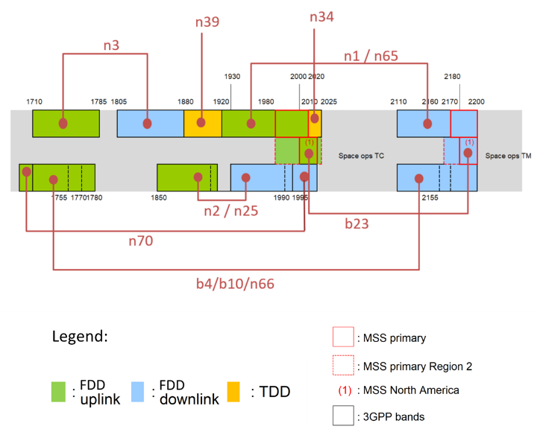
S-band information

