Slide 1
WF on [307] NTN_Solutions_Part1 (NTN general part)
Moderator, THALES

Slide 2
Outline
Proposed way forward based on the outcomes of “Email discussion summary for [98-bis-e][307] NTN_Solutions_Part1”
See R4-2106147 (revision of R4-2105978)

Slide 3
Content
Topic #1: NTN Architecture Aspects
Topic #2: Generic Parameters
Topic #3: FR1 Generalities
Topic #4: FR2 Generalities
Topic #5: HAPS Aspects

Slide 4
Summary
List of proposals for each topics discussed
In “agreements” part
Proposals with “green” comments are agreeable.
In “open issues” part
Proposals with “purple” comments not agreeable.
Proposals with “orange” comments not agreeable:
If there is a GTW session and we could agree on some of them, this WF will be revised anyway;
Please also note that the “orange” proposals were the results of “agreed with changes” comments.
Proposals without any comment were not discussed.

Slide 5
Agreements before GTW session
(and after 1st Round)

Slide 6
Current Agreements [98-bis-e][307] NTN_Solutions_Part1 – 16/04/2021
Proposal 3-1: For NTN S-band, RAN4 shall consider 5, 10, 15, 20, 25, 30 MHz channel BW configurations.
Note1: This current agreement may evolve depending on operator requests.
Note2: This current agreement considers the possible band configuration for S-band (and can be different from the one used for the coexistence, which might be a subset).
Proposal 3-2: For NTN S-band, RAN4 shall consider 1 DL spectrum + 1 UL spectrum in the range (1980 - 2010 MHz) and (2170 - 2200 MHz).
Proposal 5-3: Separate HAPS coexistence scenarios from Satellite coexistence scenarios.
Note: the two NTN systems may consider different bands, different simulation parameters, and/or different specifications

Slide 7
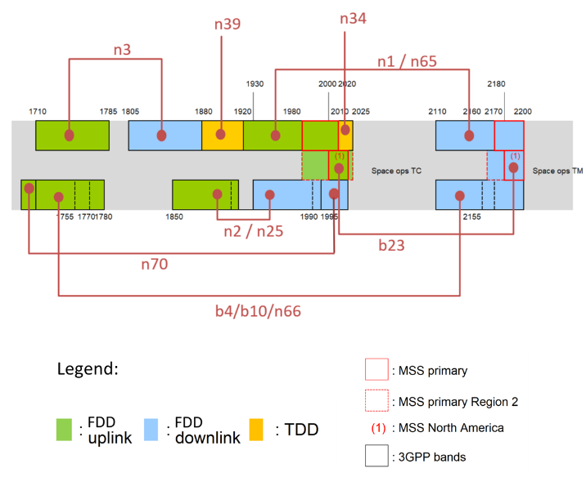

Slide 8
Proposals to be discussed during NTN GTW session and/or during 2nd Round

Slide 9
Topic #1: Current Proposals (1/4)
Proposal 1-1: RAN4 shall further clarify if there is a real need to specify GW-gNB interface.
Proposal 1-2: RAN4 to decide if there are any testing concerns for Satellite + feeder link + NTN-Gateway + gNB as a single entity, and why.
Proposal 1-3: RAN4 shall further clarify which one of the Options (Satellite + feeder link + NTN-Gateway as a single entity, or Satellite + feeder link + NTN-Gateway + gNB as a single entity) is easier to test in Rel-17 from RAN4 point of view.
Proposal 1-4: RAN4 shall further clarify which one of the Options (Satellite + feeder link + NTN-Gateway as a single entity, or Satellite + feeder link + NTN-Gateway + gNB as a single entity) is easier to specify in Rel-17 from RAN4 point of view.

Slide 10
Topic #1: Current Proposals (2/4)
Proposal 1-5: RAN4 RF shall focus on NTN service link as priority.
Proposal 1-6: Is implementation issue whether it is wired connection or wireless connection between the GW and the gNB.
Proposal 1-7: RAN4 shall prioritize only one potential implementation for GW-gNB interface in Rel-17.

Slide 11
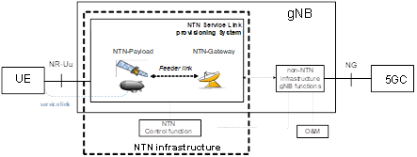
Topic #1: Current Proposals (3/4)
Proposal 1-8: RAN4 shall consider the architecture defined by RAN3 as baseline and shall allow further potential modifications if required.
Proposal 1-9: RAN4 shall consider the architecture defined by RAN3 as baseline for test setup.

Slide 12
Topic #1: Current Proposals (4/4)
Proposal 1-10: RAN4 shall take into account the inputs from companies to decide if the typical satellite implementation considers wired or non-wired connection with the GW.
Proposal 1-11: RAN4 shall prioritize the wired connection between NTN-Gateway and Non-NTN Infrastructure gNB functions in Rel-17.
Proposal 1-12: RAN4 shall decide if NTN can benefit or not from RAN4 NR Repeater WI in Rel-17.
Proposal 1-13: The definition of RF requirements for the linkage between NTN-Gateway and gNB should be optional. RAN4 shall focus on NTN service link from standard perspective.

Slide 13
Topic #2 & Topic #3: Current Proposals
Proposal 2-2: NTN GW parameters/requirements (e.g. NTN GW REFSENS) are implementation dependent.
Proposal 3-3: RAN4 shall continue discussion on NTN channel raster for S-Band.
Proposal 3-4: RAN4 shall continue discussion to clarify L-band frequency range for NTN operation.
Proposal 3-5: RAN4 shall consider inputs from NTN operators for the NTN-NTN coexistence scenarios for MSS S-band.
Proposal 3-6: RAN4 to select an already defined NR band, which can be repurposed or used as reference for satellite deployment simulations.

Slide 14
Topic #4 & Topic #5: Current Proposals
Proposal 4-1: RAN4 may continue Ka/FR2 NTN coexistence discussion in next RAN4 meetings depending on the NTN S-band coexistence simulations advancements.
Proposal 5-1: RAN4 shall further refine FR1 NR band description for HAPS deployment at @2GHz for use in coexistence studies.
Proposal 5-2: NR band n1 as example band for HAPS related coexistence studies at 2GHz.

Slide 15
Open Issues

Slide 16
Open Issues - Allocated spectrum type for NTN
Satellite broadband communications is very important in Rel-17, and many NTN operators already showed interest.
Moderator note1: It seems that there is a disagreement on Ka ITU-R definition and operational purpose, but the argument by some companies is not supported by references.
Moderator note2: Companies are further encouraged to verify the provided references.
Moderator note3: A unanimous agreement is unlikely be reached in this RAN4 for the time being.
Moderator note4: Note that RAN-P decisions from RP-210791 can be used in RAN4:
Agreed Proposal NTN-1.1: “For frequencies above 10 GHz, any work can be limited to VSAT, ESIM service and terminals.”
Agreed Proposal NTN-1.2: “The Satellite Ka band refers to [17.3 – 20.2 GHz] on the downlink and [27.0 – 30.0 GHz] on the uplink as allocated by ITU-R to satellite services. Some of this range is designated as FSS and some as MSS.”

