Slide 1
Way forward on MPR and AMPR PC2 for intra-band UL contiguous CA
3GPP TSG-RAN WG4 Meeting #98bis-e
Electronic meeting, 12 – 20 Apr. 2021
R4-210xxxx
Skyworks Solutions Inc., …

Slide 2
Background: April 15 GTW agreements
For BW class B contiguous allocation MPR
Inner allocation: Take the average value
Outer allocation: Take the average value (TBD for edge allocation)
For BW class C contiguous allocation MPR
Inner allocation: Take PC3 values ([7] for 256QAM)
Outer allocation: Take PC3 values ([7] for 256QAM)

Slide 3
WF: PC2 BW class B contiguous allocation MPR
Management of Edge allocation failing because of WOLA and lower guard band for class B CA:
Since it is a very corner case when there is only allocation in one CC this can be handled with the following note:
Note 1: When 1RB or 2RB are allocated at the lower edge of lowest CC or upper edge of upper CC, MPR for outer is 5.5dB
WF: Table on the left is adopted for the specification
Modulation |  | MPR for bandwidth class B(dB)
 |  | inner | outer¹
DFT-s-OFDM | Pi/2 BPSK | 2.0 | 4.0¹
 | QPSK | 2.0 | 4.0¹
 | 16QAM | 2.5 | 4.0¹
 | 64QAM | 3.0 | 4.5¹
 | 256QAM | 5.5 | 6.0
CP-OFDM | QPSK | 2.5 | 5.0¹
 | 16QAM | 3.0 | 5.0¹
 | 64QAM | 3.5 | 5.0¹
 | 256QAM | 6.5 | 6.5
Note 1: When 1 RB or 2 RB are allocated at the lower edge of lowest CC or upper edge of upper CC, MPR for outer is 5.5dB

Slide 4
WF: PC2 BW class C contiguous allocation MPR
Management of 256 QAM MPR:
Since there is only open question only for inner 256QAM this is only limited by EVM
Since EVM for CA is evaluated with only one CC allocated at the time, the 1CC MPR is enough to guarantee EVM (4.5dB for DFT-s-OFDM and 6.5dB). Note that Image leakage of 28dB would not allow to meet 256QAM EVM in most case.
WF: Table on the left is adopted for the specification without square brackets
Modulation |  | MPR for bandwidth class C (dB)
 |  | inner | outer
DFT-s-OFDM | Pi/2 BPSK | 2.5 | 7
 | QPSK | 2.5 | 7
 | 16QAM | 2.5 | 7
 | 64QAM | 5 | 7
 | 256QAM | [7] | 7.5
CP-OFDM | QPSK | 3.5 | 8
 | 16QAM | 3.5 | 8
 | 64QAM | 5 | 8
 | 256QAM | [7] | 8

Slide 5
WF: PC2 BW class B non-contiguous allocation MPR
BW class B |  | Inner |  |  |  |  |  |  |  | Outer1 |  |  |  |  |  |  |  | Outer 2
Modulation |  | PC3 | SKW | QC | HW | LGE | Avg | WC | WF | PC3 | SKW | QC | HW | LGE | Avg | WC | WF | PC3 | SKW | QC | HW | LGE | Avg | WC | WF
DFT | QPSK | 2 | 3 | 5.5 | 3 | 3 | 3 | 5.5 | 3 -> 4 3¹ | 5.5 | 6.5 | 5.5 | 7 | 6.5 | 6.5 | 7 | 6.5 | 11.5 | 13 | 11.5 | 13 | 13 | 13 | 13 | 13
 | 16QAM | 2.5 | 3 | 5.5 | 3 | 3 | 3 | 5.5 | 3 -> 4 3¹ | 5.5 | 6.5 | 5.5 | 7 | 6.5 | 6.5 | 7 | 6.5
 | 64QAM | 4.5 | 4.5 | 6 | 4.5 | 4.5 | 4.5 | 6 | 5 | 6 | 6.5 | 6 | 7 | 6.5 | 6.5 | 7 | 6.5
 | 256QAM | 6 | 6 | 6.5 | 6 | 6 | 6 | 6.5 | 6.5 | 6.5 | 6.5 | 6.5 | 7 | 6.5 | 7 | 7 | 7
CP | QPSK | 2.5 | 3 | 6.5 | 4 | 3 | 3.5 | 6.5 | 3.5 ->4 3.5¹ | 6.5 | 7 | 6.5 | 7.5 | 7 | 7 | 7.5 | 7 | 12 | 14 | 12 | 14 | 14 | 13.5 | 14 | 13.5 14.0
 | 16QAM | 3 | 3 | 7 | 4 | 3 | 3.5 | 7 | 3.5 ->4 3.5¹ | 7 | 7 | 7 | 7.5 | 7 | 7 | 7.5 | 7
 | 64QAM | 5 | 5 | 7 | 5 | 5 | 5 | 7 | 5 | 7 | 7 | 7 | 7.5 | 7 | 7 | 7.5 | 7
 | 256QAM | 7.5 | 7.5 | 7.5 | 7.5 | 7.5 | 7.5 | 7.5 | 7.5 | 7.5 | 7.5 | 7.5 | 7.5 | 7.5 | 7.5 | 7.5 | 7.5
For inner, Qualcomm WC input is linked to the merge of inner and outer1
This is not acceptable because it makes PC2 inner 3dB lower than PC3 which cannot be justified as it makes PC2 best power capability no better than PC3
Without Qualcomm input there is good alignment and average can be taken
WF: To accommodate the issue, Note 1 is added allowing 4dB MPR for total allocations BW <1MHz
For Outer 1and outer 2 since most inputs are within 0.5dB of the average in most cases, the average is proposed
WF: values in the WF column for inner, outer 1 and outer 2 is adopted for the specification including Note 1

Slide 6
WF: PC2 BW class C non-contiguous allocation MPR
BW class C |  | Inner |  |  |  |  |  |  |  | Outer1 |  |  |  |  |  |  |  | Outer 2
Modulation |  | PC3 | SKW | QC | HW | LGE | Avg | WC | WF | PC3 | SKW | QC | HW | LGE | Avg | WC | WF | PC3 | SKW | QC | HW | LGE | Avg | WC | WF
DFT | QPSK | 2.5 | 3 | 5.5 | 3.5 | 3 | 3 | 5.5 | 3 -> 4 3¹ | 6 | 6.5 | 8.5 | 8 | 6.5 | 7.5 | 8.5 | 7.5 | 13 | 13 | 13 | 15 | 13 | 13.5 | 15 | 13.5
 | 16QAM | 3 | 3 | 5.5 | 3.5 | 3 | 3 | 5.5 | 3 -> 4 3¹ | 6 | 6.5 |  | 8 | 6.5 | 7.5 | 8.5 | 7.5
 | 64QAM | 5 | 5 | 5.5 | 5 | 5 | 5 | 5.5 | 5 | 6 | 6.5 |  | 8 | 6.5 | 7.5 | 8.5 | 7.5
 | 256QAM | 6.5 | 6 | 6.5 | 6.5 | 6.5 | 6.5 | 6.5 | 6.5 | 6.5 | 6.5 |  | 8 | 6.5 | 7.5 | 8.5 | 7.5
CP | QPSK | 3.5 | 3.5 | 5.5 | 3.5 | 3.5 | 3.5 | 5.5 | 3.5 ->4 3.5¹ | 7 | 7 | 8.5 | 8.5 | 7 | 8 | 8.5 | 8 | 14 | 14 | 14 | 15 | 14 | 14.5 | 14 | 14.5
 | 16QAM | 3.5 | 3.5 | 5.5 | 3.5 | 3.5 | 3.5 | 5.5 | 3.5 ->4 3.5¹ | 7 | 7 |  |  | 7 | 8 | 8.5 | 8
 | 64QAM | 5 | 5 | 5.5 | 5 | 5 | 5 | 5.5 | 5 | 7 | 7 |  |  | 7 | 8 | 8.5 | 8
 | 256QAM | 7.5 | 7.5 | 7.5 | 7.5 | 7.5 | 7.5 | 7.5 | 7.5 | 7.5 | 7.5 |  |  | 7.5 | 8 | 8.5 | 8
For inner, Qualcomm WC input is linked to the merge of inner and outer1
This is not acceptable because it makes PC2 inner 3dB lower than PC3 which cannot be justified as it makes PC2 best power capability no better than PC3
Without Qualcomm input there is good alignment and average can be taken
WF: To accommodate the issue, Note 1 is added allowing 4dB MPR for total allocations BW <1MHz
For Outer 1and outer 2 since all inputs are within 1dB of the average in most cases, the average is proposed
WF: values in the WF column for inner, outer 1 and outer 2 is adopted for the specification including Note 1

Slide 7
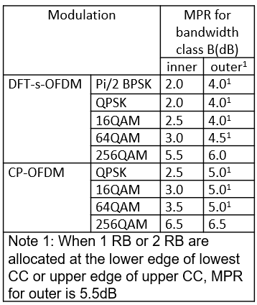
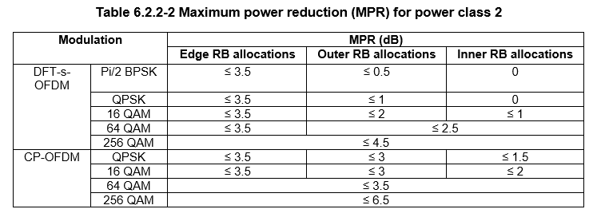
A example for UL CA PC2
Class B with contigous allocation: assume two CCs with full allocation, DFTS QPSK and that the UE uses full MPR, neglect terms like ΔT_{IB},
MPR = 4 dB, P_{CMAX} = 26 dBm – 4 dB = 22 dBm (max total UE power)
For the Pcell and Scell: P_{CMAX,c} = 26 dBm – 1 dB = 25 dBm (MOP per serving cell)
In conformance testing with UP commands on all cells
The Pcell will reach up to 22 dBm as limited by P_{CMAX}, no power left for the Scell that is reduced in power or dropped
In the field
Same behaviour unless the CC UL power can be adjusted by power control such that there is 19 dBm on each CCs (7 dB below the power class per carrier)
Reconfiguring the UE for single CC allows P_{CMAX,c} = 26 dBm – 2.5 dB = 23.5 dB with 64QAM... (sic)
Apply the single-CC MPR for the Pcell when the Scells are dropped? Or a similar value? But... see above
Same behaviour for other cases since MPR for CA is (much) larger than that for a single CC, similarly behaviour for PC3 [3]

Slide 8
References:
[1] R4-2104655 FR1 PC2 Contiguous UL CA Simulation Results, Nokia Corporation, R4#98bis-e
[2] R4-2104994 MPR initial simulation results for NR intra-band contiguous CA according to candidate RF architectures, LG Electronics France, R4#98bis-e
[3] R4-2105088 Power capability and back-off for NC (and contiguous) intra-band CA, Ericsson, R4#98bis-e
[4] R4-2106304 PC2 Class C UL CA UE Architecture and MPR/A-MPR evaluation, Skyworks Solutions Inc. , R4#98bis-e
[5] R4-2107260 on HPUE intra-band contiguous CA MPR, HiSilicon Technologies Co. Ltd, R4#98bis-e
[6] R4-2107370 HPUE MPR with 1PA architecture, Qualcomm Incorporated, R4#98bis-e

