Slide 1
Way Forward on NR-U UE demodulation requirements
3GPP TSG-RAN4 Meeting #98-bis-e
Online, Apr 12-20, 2021Agenda Item: 5.1.4.1/2/3
Tdoc Num: R4-2106007
Qualcomm

Slide 2
Test Scope
Semi-static Channel Access Devices v/s Dynamic Channel Access Devices
Prioritize Define test cases agnostic to semi-static and dynamic channel access devices if it is feasible.
Do not define additional test cases dedicated to FBE/LBE devices.
Tests with SMTC duration larger than COT duration should be deprioritized.

Slide 3
Test Scope
Requirement definition according to UE optional capabilities
For PDSCH Demodulation and CQI Reporting, define requirements only for UE supporting the optional capability ‘csi-RS-ValidationWith-DCI’, no applicable test is defined for UEs that do not support this capability.
Do not introduce requirements based on optional capability typeB-PDSCH-length-r16.

Slide 4
Test Scope
Test Scenarios and related requirements 1/2
A single set of PDSCH Requirements is defined for the unlicensed CC, and applied to both Scenario A and C.
For reference:
  Scenario A (Carrier aggregation between licensed band NR (PCell) and NR-U (SCell))
  Scenario C (Stand-alone NR-U (PCell))

Slide 5
Test Scope
Test Scenarios and related requirements 2/2
Applicable to Scenario A only:
PDSCH Performances on the NR PCell CC will not be verified;
NR PCell configuration is defined according to 38.101-4, Table 5.2-1 (TDD), using 30kHz SCS and:
  Only consider the bandwidth combination of 1 Pcell CC (license band)+ 1 Scell CC(unlicense)
  [20,40] MHz CBW;
  NR Pcell bandwwidth configuration:
    [20, 40] MHz
  After selecting the largest NR-U supported CBW by the UE, configure NR Pcell with the largest supported CBW in combination with selected NR-U CBW;
  Test applicability rules:
    Option 1: After selecting the largest NR-U supported CBW by the UE, configure NR Pcell with the largest supported CBW in combination with selected NR-U CBW;
    Option 2: After selecting the largest NR-U supported CBW by the UE, configure NR Pcell with 20MHz CBW in combination with selected NR-U CBW;
[TBD: Time and Frequency Offset Error of unlicensed to licensed CC]

Slide 6
Test Scope
CBW to be used for requirements definition
Define requirements for Scenario A for BW {20,40,60,80} MHz, and reuse the applicability rule in Rel-15 CA to test the largest supported BW only.
Define requirements for Scenario C for BW {20,40,60,80} MHz and test the largest supported BW only

Slide 7
Test Setup Details
Other test setup details
Define tests with fixed DRS window duration set to 1ms.
Do not consider UL LBT Failure in DL Tests.

Slide 8
Test Setup Details, CQI Performance tests
CQI Performance tests setup
The test is setup with two sets of burst transmissions each with distinct transmission power level and keeping the interference level constant during the test
If two transmission power level boosts are used:
  Use randomly per each DL period [0, +6]dB with equal probability;
  Determine PDSCH transport format for each transmission power level boost independently, depending on the boost applied to the resources measured by the UE to produce the CQI reports received;
  Collect PDSCH and CQI reporting results separately per each transmission power level boost;

Slide 9
Test Setup Details, CQI Performance tests
CQI Performance tests setup
UE reporting following a scheduled CSI-RS transmission cancelled due to LBT failure is expected to be disregarded and to be ignored for test pass/fail statistics.
The test metrics will include CQI distribution statistics, PDSCH BLER, minimum difference in median CQI between sets collected per each transmission power level boost.

Slide 10
Test Setup Details, CQI Performance tests
CQI Performance tests setup
CSI-RS Resource Scheduling is periodic with 10 slots periodicity and 1 slot offset, within the same DL periodicity in which CSI-RS for CSI acquisition CQI reporting was received (no Cross-COT reporting).
CQI reporting scheduling is [aperiodic/periodic].
The LBT model to be used in the CQI Reporting test is the same as the one used in PDSCH Demodulation Requirements.

Slide 11
Test Setup Details, CQI Performance tests
CQI Performance tests setup
Companies will agree on one SNR pair, with the condition that satisfying the requirement on one SNR point is sufficient to pass successfully the test.
  SNR points can include but are not limited to [8,9] dB (these values do not include the power boost [+0,+6]dB if that setup is agreed)
The channel model will include AWGN channel only.

Slide 12
Downlink Transmission Model
Use a fixed DL Transmission Periodicity (or FFP in Dynamic Channel Access) of 5 ms (10 slots).
The Maximum COT duration in the DL periodicity is 4.5 ms (9 slots, the last slot in each DL periodicity is idle).
For each DL periodicity, the DL transmission duration will be randomly selected between {2,4,6,7} Slots, with equal probability.
PDSCH allocation in the DL transmission slots is described in the next slide.
Note: All values in slots refer to 30kHz SCS.

Slide 13
Downlink Transmission Model
Details on PDSCH allocation within the DL Transmission duration
In every slot included in the random downlink transmission duration, allocate PDCCH in Symbols 0 and 1;
In every slot within the DL Transmission duration allocate PDSCH from Symbol 2 to Symbol 13, except for the last slot of the DL Transmission;
For the last slot of the DL Transmission, allocate PDSCH:
  If DL Transmission duration is 2 Slot, from Symbol 2 to Symbol 13
  If DL Transmission duration is larger than 2 Slot, from Symbol 2 to Symbol {5, 8, 11, 13} with equal probability.

Slide 14
Downlink Transmission Model
Details on UL allocation within the COT for PDSCH
Always schedule UL Slot within the DL Transmission Periodicity/FFP to avoid Cross-COT HARQ, assuming a minimum timing K1 sufficient after the end of PDSCH allocation according to spec (assuming 1 slot is sufficient).
TDD Pattern is 7D-1S-2U, with the last slot idle to fulfil static channel access requirements.

Slide 15
LBT Parameters
Model LBT Failure as part of the Downlink Transmission model;
Apply the Downlink Transmission model to all DL signals in unlicensed carrier (including SSB and TRS transmission);
Define a single LBT model, to be used for both ‘dynamic’ and ‘semi-static’ Channel Access;
Do not define tests with sub-band LBT failure (either all sub-bands are transmitted, or no sub-band is transmitted);
Do not define a specific LBT model for UEs that do not support CSI-RS validation optional capabilities;
Use the same probability of LBT Failure for Scenario C and Scenario A, p_{LBT} is 0.25.

Slide 16
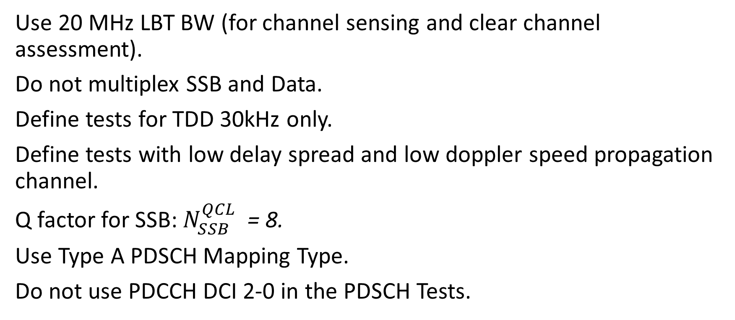
Simulation Assumptions for PDSCH Tests
Use 20 MHz LBT BW (for channel sensing and clear channel assessment).
Do not multiplex SSB and Data.
Define tests for TDD 30kHz only.
Define tests with low delay spread and low doppler speed propagation channel.
Q factor for SSB: $N_{SSB}^{QCL}$= 8.
Use Type A PDSCH Mapping Type.
Do not use PDCCH DCI 2-0 in the PDSCH Tests.

Slide 17
Detailed Simulation assumptions [1/3]
Test num. | Reference channel | Bandwidth (MHz) / Subcarrier spacing (kHz) | Modulation format and code rate | Slot Pattern | Propagation condition | Correlation matrix and antenna configuration | Reference value
 |  |  |  |  |  |  | Fraction of maximum throughput (%) | SNR (dB)
1-1 | NR-U DL Transmission Model | [20, 40, 60, 80]/30 | 16 QAM, 0.48 | According to NR-U DL Transmission Model | TDLA30-10 | 2x2, ULA Low | 70 | [TBD]
Test num. | Reference channel | Bandwidth (MHz) / Subcarrier spacing (kHz) | Modulation format and code rate | Slot Pattern | Propagation condition | Correlation matrix and antenna configuration | Reference value
 |  |  |  |  |  |  | Fraction of maximum throughput (%) | SNR (dB)
2-1 | NR-U DL Transmission Model | [20, 40, 60, 80]/30 | 16 QAM, 0.48 | According to NR-U DL Transmission Model | TDLA30-10 | 2x4, ULA Low | 70 | [TBD]

Slide 18
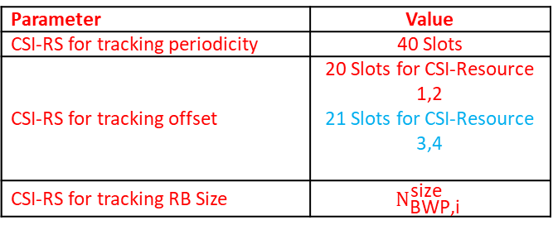
Detailed Simulation assumptions [2/3]
Parameter |  | Value
Active DL BWP index |  | 1
Slot Pattern |  | [TBD] 7D1S2U
LBT failure probability |  | 0.25
Common serving cell parameters | Physical Cell ID | 0
 | SSB position in burst | The first SSB
 | SSB Q factor | 8
PDSCH configuration | Mapping type | Type A
 | k0 | 0
 | Starting symbol (S) | 2
 | Length (L) | According to DL Transmission Model
 | PDSCH aggregation factor | 1
 | PRB bundling type | Static
 | PRB bundling size | 2
 | Resource allocation type | Type 0
 | RBG size | Config2
 | VRB-to-PRB mapping type | Non-interleaved
 | VRB-to-PRB mapping interleaver bundle size | N/A
PDSCH DMRS configuration | DMRS Type | Type 1
 | DMRS Additional Position | pos1
 | Maximum number of OFDM symbols for DL front loaded DMRS | 1
RB Allocation |  | Full BW
MIMO Layers |  | 2
Number of HARQ Processes |  | 8
TX EVM |  | 6%
Parameter | Value
CSI-RS for tracking periodicity | 40 Slots
CSI-RS for tracking offset | 20 Slots for CSI-Resource 1,2 21 Slots for CSI-Resource 3,4
CSI-RS for tracking RB Size | $$N_{\text{BWP}\text{,}\text{i}}^{\text{size}}$$

Slide 19
Detailed Simulation assumptions [3/3]

Slide 20
CR Work Split
Item List | Description | Company
1 - CR Work | PDSCH Performance Requirements for Scenario A (Can be split in 2/4 RX if needed) | Ericsson
2 - CR Work | PDSCH Performance Requirements for Scenario C (Can be split in 2/4 RX if needed) | MediaTek
3 - CR Work | CQI Requirements for Scenario A | Apple
4 - CR Work | CQI Requirements for Scenario C | Huawei
5 - CR Work | Introduction of new Fixed Reference Channel and TDD Pattern | Huawei
6 - CR Work | Introduction of new Downlink Transmission Model | Qualcomm
7 – Simulation Work | Collect and Organize Simulation results. | Apple

Slide 21
CQI Reporting simulation assumptions
CQI Reporting Baseline Simulation Assumptions
Simulation parameters from the DL Transmission Model used for PDSCH demodulation tests can be reused.
Companies are encouraged to present alignment results including at least: SNR pair for the simulation, minimum delta across CQI for different transmission power level boost.
Parameters |  | Unit | Value
NZP CSI-RS for CSI acquisition | CSI-RS resource Type |  | Periodic
 | Number of CSI-RS ports |  | [2]
 | CDM Type |  | [FD-CDM2]
 | Density (ρ) |  | [1]
 | First subcarrier index in the PRB used for CSI-RS (k0, k1 ) |  | [Row 3,(6,-)]
 | First OFDM symbol in the PRB used for CSI-RS (l0) |  | [13]
 | NZP CSI-RS-timeConfig periodicity and offset | slot | 10/1
ReportConfigType |  |  | [Periodic/Aperiodic]

