Slide 1
3GPP TSG-RAN WG4 Meeting #98-bis-e
Electronic Meeting, 12 – 20 April, 2021
R4-21xxxxx
WF on NR Positioning Performance Requirements
Intel

Slide 2
Agreements in the 1st round/GTW
Agreements in the 2nd round
open for 2nd round discussion
Still open for discussion

Slide 3
Measurement Accuracy Requirements for RSTD(1)
Applicable accuracy requirements are not impacted by HO.
Applicable propagation channel for accuracy requirement:
    PRS-RSTD and UE Rx-Tx measurement accuracy requirements
      Option 1: Single set of requirements is defined for AWGN and fading conditions
      Option 2: Two set of requirements are defined for AWGN and fading conditions
    Test cases for accuracy requirements are defined for
      AWGN conditions
      FFS: fading conditions for FR1
FFS on the group delay calibration margin.
  Option 1.
    margin equals to zero if the reference and neighbouring resources are on the same frequency layer in FR1
    32Tc, reference resource and neighbour resource are on different PRS layer
  Option 2. Add a non-zero group delay calibration margin to the RSTD accuracy requirements in FR1 and FR2
    FFS on the exact value
FFS on frequency drift margin

Slide 4
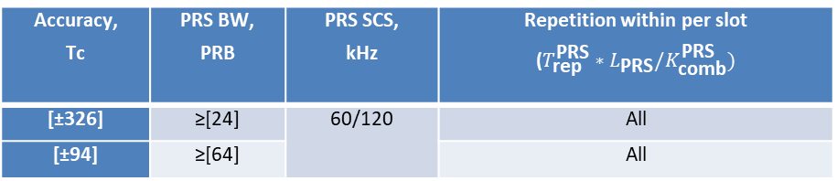
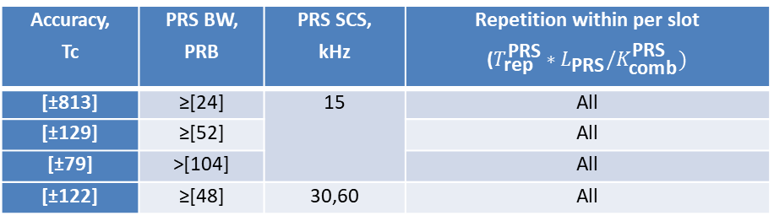
Measurement Accuracy Requirements for RSTD(2)
The following tables can be taken as the baseline to define RSTD requirements
Table 1: RSTD accuracy in FR1
Accuracy, Tc | PRS BW, PRB | PRS SCS, kHz | Repetition within per slot ($T_{\text{rep}}^{\text{PRS}}∗L_{\text{PRS}}/K_{\text{comb}}^{\text{PRS}})$
[±813] | ≥[24] | 15 | All
[±129] | ≥[52] |  | All
[±79] | >[104] |  | All
[±122] | ≥[48] | 30,60 | All
Table 2: RSTD accuracy in FR2
Accuracy, Tc | PRS BW, PRB | PRS SCS, kHz | Repetition within per slot ($T_{\text{rep}}^{\text{PRS}}∗L_{\text{PRS}}/K_{\text{comb}}^{\text{PRS}})$
[±326] | ≥[24] | 60/120 | All
[±94] | ≥[64] |  | All

Slide 5
Measurement Accuracy Requirements for PRS RSRP(1)
PRS-RSRP SINR side condition #1 is -3 dB.
when SINR >[-3dB] ,
  single set requirement for all parameter sets
when SINR >[-13dB]
  multiple requirements depending on PRS BW (in PRBs )
RF calibration margin:
  2.5dB for FR1 absolute accuracy requirements
  4dB for FR2 absolute accuracy requirements
  FFS the calibration error margins for PRS-RSRP relative accuracy requirements for FR1 and FR2

Slide 6
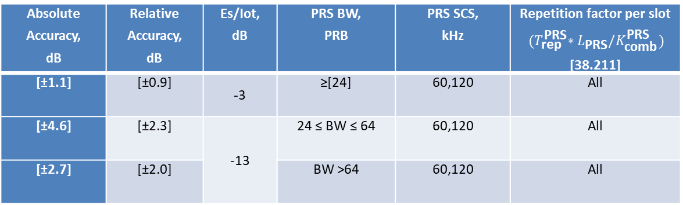
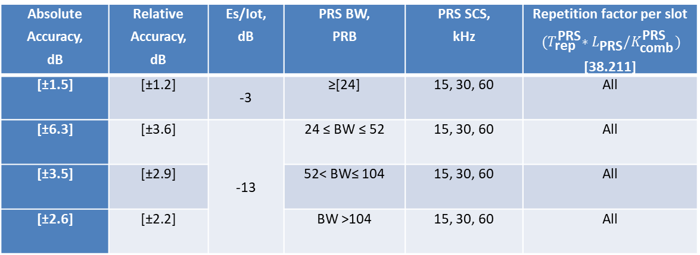
Measurement Accuracy Requirements for PRS RSRP(2)
PRS-RSRP accuracy requirements
Table 1: PRS-RSRP accuracy in FR1
Absolute Accuracy, dB | Relative Accuracy, dB | Es/Iot, dB | PRS BW, PRB | PRS SCS, kHz | Repetition factor per slot ${(T}_{\text{rep}}^{\text{PRS}}∗L_{\text{PRS}}/K_{\text{comb}}^{\text{PRS}})$ [38.211]
[±1.5] | [±1.2] | -3 | ≥[24] | 15, 30, 60 | All
[±6.3] | [±3.6] | -13 | 24 ≤ BW ≤ 52 | 15, 30, 60 | All
[±3.5] | [±2.9] |  | 52< BW≤ 104 | 15, 30, 60 | All
[±2.6] | [±2.2] |  | BW >104 | 15, 30, 60 | All
Table 2: PRS-RSRP accuracy in FR2
Absolute Accuracy, dB | Relative Accuracy, dB | Es/Iot, dB | PRS BW, PRB | PRS SCS, kHz | Repetition factor per slot ${(T}_{\text{rep}}^{\text{PRS}}∗L_{\text{PRS}}/K_{\text{comb}}^{\text{PRS}})$ [38.211]
[±1.1] | [±0.9] | -3 | ≥[24] | 60,120 | All
[±4.6] | [±2.3] | -13 | 24 ≤ BW ≤ 64 | 60,120 | All
[±2.7] | [±2.0] |  | BW >64 | 60,120 | All

Slide 7
Measurement Accuracy Requirements for UE Rx-Tx time difference(1)
SINR side conditions for #1 is -3dB
Applicability of accuracy requirements in the case of NTA_offset change : FFS
  Option 1: Clarify in section 10.1.25.2 in TS 38.133: “UE Rx-Tx time difference accuracy requirements shall not apply if N_{TA_offset} defined in Table 7.1.2-2 in 38.133 changes during the UE Rx-Tx measurement period.”
  Option 2 :Capture in the specification that UE Rx-Tx accuracy requirements do not apply in case the UE UL timing changes during the measurement period
Applicability of accuracy requirements under TA adjustment : FFS
  Option 1 : UE Rx-Tx measurement accuracy requirements shall not apply if the uplink transmission timing changes during the UE Rx-Tx measurement period due to autonomous adjustment or based on network-configured TA
  Option 2:
    UE Rx-Tx measurement accuracy requirements shall not apply if the uplink transmission timing changes during the UE Rx-Tx measurement period due to network-configured TA command.
    UE Rx-Tx measurement accuracy requirements shall apply if the uplink transmission timing changes during the UE Rx-Tx measurement period due to autonomous adjustment
  Option 3: Capture in the specification that UE Rx-Tx accuracy requirements do not apply in case the UE UL timing changes during the measurement period

Slide 8
Measurement Accuracy Requirements for UE Rx-Tx time difference(2)
Applicable propagation channel for accuracy requirement: Follow the same principle of RSTD accuracy requirements
Applicable accuracy requirement in case of other (non-HO) serving cell changes: FFS
  Option 1 :The UE shall continue and complete a UE Rx-Tx measurement while meeting UE Rx-Tx measurement accuracy requirements in clause 10.1.23, when a serving cell change (including SCell change, addition, release, activation, or deactivation, or PSCell change, addition, or release) occurs during the measurement, provided the cell change does not impact the configuration of the SRS used for the measurement
  Option 2: Accuracy requirements apply with serving cell change, provided that the serving cell change does not impact the UL timing. No need to capture this in the spec

Slide 9
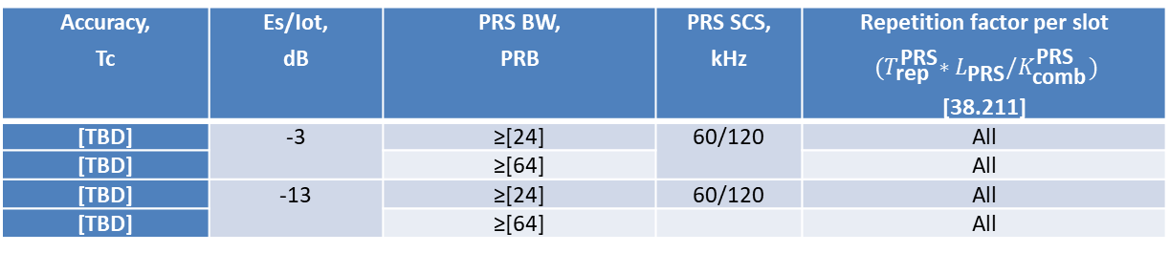
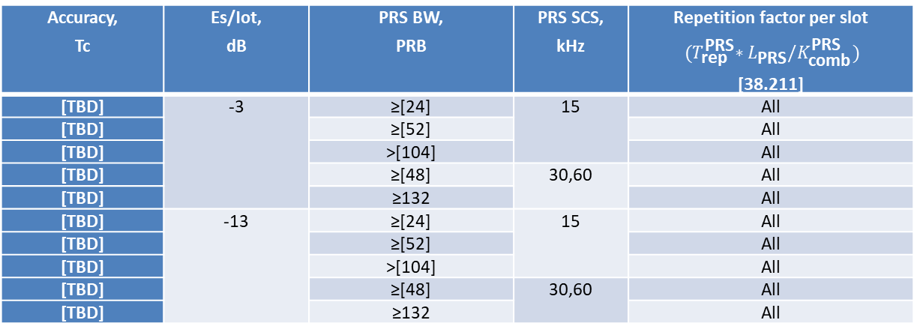
Measurement Accuracy Requirements for UE Rx-Tx time difference(3)
UE Rx-Tx time difference measurement accuracy requirements
Table 1: UE Rx-Tx accuracy in FR1
Accuracy, Tc | Es/Iot, dB | PRS BW, PRB | PRS SCS, kHz | Repetition factor per slot ${(T}_{\text{rep}}^{\text{PRS}}∗L_{\text{PRS}}/K_{\text{comb}}^{\text{PRS}})$ [38.211]
[TBD] | -3 | ≥[24] | 15 | All
[TBD] |  | ≥[52] |  | All
[TBD] |  | >[104] |  | All
[TBD] |  | ≥[48] | 30,60 | All
[TBD] |  | ≥132 |  | All
[TBD] | -13 | ≥[24] | 15 | All
[TBD] |  | ≥[52] |  | All
[TBD] |  | >[104] |  | All
[TBD] |  | ≥[48] | 30,60 | All
[TBD] |  | ≥132 |  | All
Table 2: UE Rx-Tx accuracy in FR2
Accuracy, Tc | Es/Iot, dB | PRS BW, PRB | PRS SCS, kHz | Repetition factor per slot ${(T}_{\text{rep}}^{\text{PRS}}∗L_{\text{PRS}}/K_{\text{comb}}^{\text{PRS}})$ [38.211]
[TBD] | -3 | ≥[24] | 60/120 | All
[TBD] |  | ≥[64] |  | All
[TBD] | -13 | ≥[24] | 60/120 | All
[TBD] |  | ≥[64] |  | All

Slide 10
Test case design principles(1)
Only need to define the test cases for SA
Test cases for the different SINR side condition for UE Rx-Tx time difference
  UE Rx-Tx tests: Both SINR side conditions are tested in the same test with two cells.
  PRS-RSRP test: FFS
    Option 1: there can be separate tests (e.g., Test 1, Test 2, …) inside the test case, one for each side condition.
    Option 2: Both SINR side conditions are tested in the same test with two cells
No need to define test cases for the serving carrier frequencies and non-serving carrier frequencies.
Absolute measurement reporting in test cases: FFS
  Option 1 :Absolute measurement reporting is tested for all PRS measurements
  Option 1a:Do not define RSTD accuracy tests with differential RSTD. No need to limit the reporting format for the test cases.
  Option 2:
    For RSTD and UE Rx-Tx define test cases with absolute reporting.
    For PRS-RSRP define test cases with differential reporting and optionally with absolute reporting.

Slide 11
Test case design principles(2)
General PRS configuration for NR Positioning test case (e.g. PRS periodicity, combsize ,e.t.c)
  Use 160 ms PRS periodicity as baseline for all tests. Offsets may be specified in each test case in order to achieve orthogonality between PRS resources from multiple TRPs
  Combination of Comb size, number of symbol , slot repetition factor can be FFS up to the discussion of PRS accuracy requirements.
  PRS BW:
    10MHz for 15kHz SCS, 40MHz for 30kHz SCS and 100MHz for 120kHz SCS for delay tests.
    For accuracy tests, the BWs to be tested needs to be further discussed based on outcome of accuracy requirements
SRS configuration for NR Positioning test case: FFS
Number of cells/TRPs for NR Positioning test case :
  two TRPs in the test case
Number of positioning frequency layers :
  Test Case 1 or Case 2 for delay tests and RSTD accuracy tests. Test Case 1 for PRS-RSRP and UE Rx-Tx accuracy tests
    Case 1: 1 PFL, and all cells are on the same PFL
    Case 2: 2 PLFs, and cells are distributed on two PFLs
  UE supporting more than one PFL only needs to pass tests for Case 2.
Synchronous/Asynchronous cells : FFS
Muting pattern :FFS
Testing procedure: FFS

Slide 12
Test case design principles(3)
Subsets of accuracy tests :
  Test two PRS BW configurations per test
    The first configuration could be the minimum PRS BW supported (PRBs = [24]) paired with the smallest SCS for the FR being tested, i.e. SCS = 15 kHz for FR1 and SCS = 60 kHz for FR2.
    The second configuration could be the highest PRS BW (num. PRBs) supported by the UE among the PRS reference configurations, paired with the highest SCS for the FR being tested (SCS = 30 kHz for FR1 and SCS = 120 kHz for FR2).
Supported test configurations in FR1 and FR2 : FFS

