Slide 1
3GPP TSG-RAN WG4 Meeting #98-bis-e
Electronic Meeting, 12 – 25 April, 2021
R4-210xxxx
WF on UE PRS measurement requirements
Huawei, HiSilicon

Slide 2
Measurement period for RSTD (1)
If muting option 1 is applied, the periodicity of a PRS resource is scaled by N_muting where N_muting is X * dl-prs-MutingBitRepetitionFactor, and
  Option 1: X is the size of NR-MutingPattern-r16 for mutingOption1-r16.
  Option 2: X is the [maximum] number of consecutive zeros of NR-MutingPattern-r16 for mutingOption1-r16
  Note: the decision to be done in RAN4 #98-bis-e
For the purpose of calculating T_{PRS,i}, only the PRS resources fully or partially with the MG are considered
  Definition of a PRS resource being fully covered or partially with the MG can be FFS and depending on the outcome of Issue 2-2-2.
PRS periodicity is not restricted to be a multiple of 5 ms
Redefine T_{last} as T_{last} = T_{i} + T_{available_PRS,i}

Slide 3
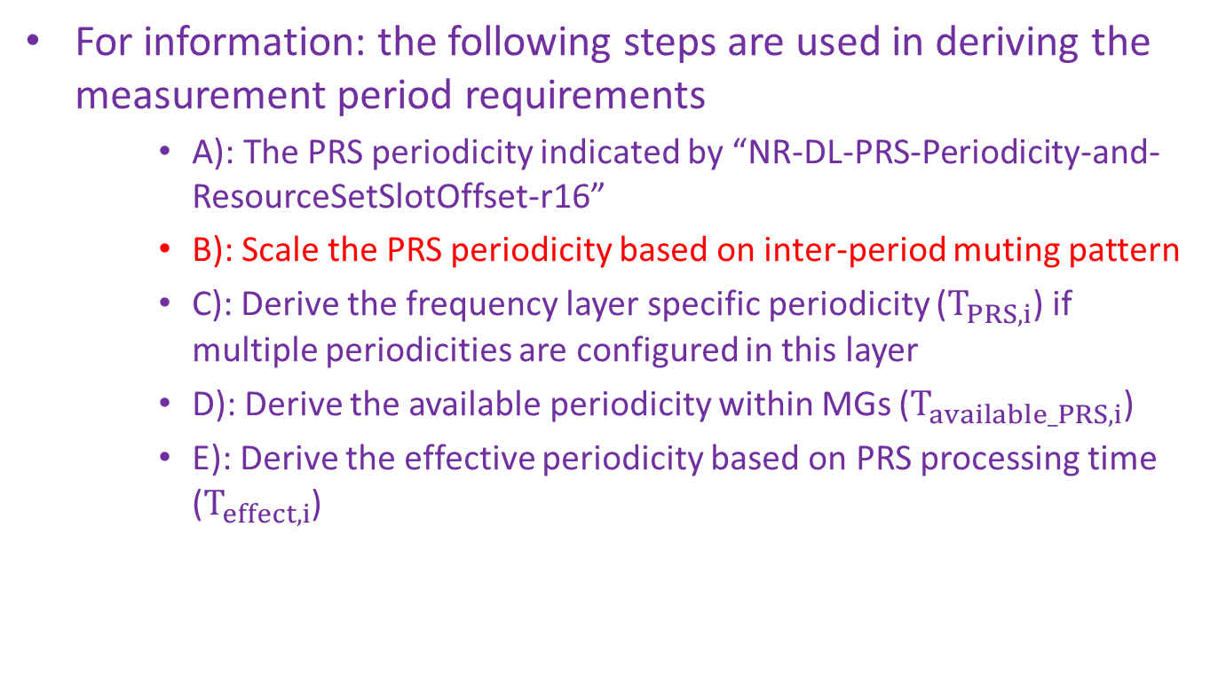
Measurement period for RSTD (2)
For information: the following steps are used in deriving the measurement period requirements
    A): The PRS periodicity indicated by “NR-DL-PRS-Periodicity-and-ResourceSetSlotOffset-r16”
    B): Scale the PRS periodicity based on inter-period muting pattern
    C): Derive the frequency layer specific periodicity ($T_{PRS,i}$) if multiple periodicities are configured in this layer
    D): Derive the available periodicity within MGs ($T_{available_PRS,i}$)
    E): Derive the effective periodicity based on PRS processing time ($T_{effect,i}$)

Slide 4
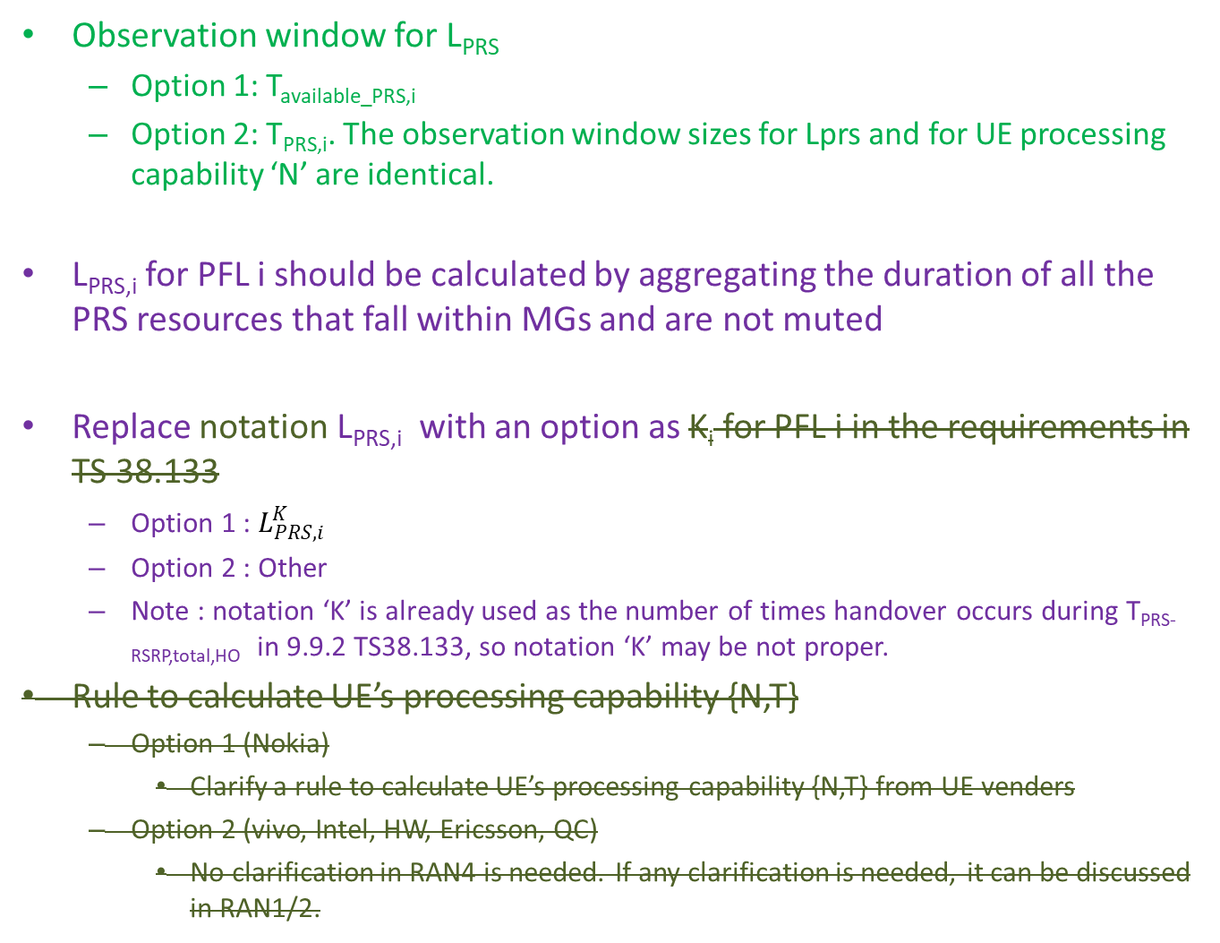
Measurement period for RSTD (3)
Observation window for L_{PRS}
  Option 1: T_{available_PRS,i}
  Option 2: T_{PRS,i}. The observation window sizes for Lprs and for UE processing capability ‘N’ are identical.
L_{PRS,i} for PFL i should be calculated by aggregating the duration of all the PRS resources that fall within MGs and are not muted
Replace notation L_{PRS,i} with an option as K_{i} for PFL i in the requirements in TS 38.133
  Option 1 : $L_{PRS,i}^{K}$
  Option 2 : Other
  Note : notation ‘K’ is already used as the number of times handover occurs during T_{PRS-RSRP,total,HO} in 9.9.2 TS38.133, so notation ‘K’ may be not proper.
Rule to calculate UE’s processing capability {N,T}
  Option 1 (Nokia)
    Clarify a rule to calculate UE’s processing capability {N,T} from UE venders
  Option 2 (vivo, Intel, HW, Ericsson, QC)
    No clarification in RAN4 is needed. If any clarification is needed, it can be discussed in RAN1/2.

Slide 5
Measurement period for RSTD (4)
Measurement period when configured with PRS-RSRP: PRS-RSRP configured for DL-TDOA
  Option 1 (CATT, QC, Intel, OPPO, vivo, HW)
    RSTD measurement period is not impacted by PRS-RSRP measurement.
  Option 2 (Ericsson, Nokia)
    UE behavior when RSTD is configured together with PRS-RSRP and the required PRS-RSRP measurement period is longer than that for RSTD (configured without RSTD): the RSTD measurement continues over the entire PRS-RSRP measurement period
  Option 3 (Ericsson)
    Clarify in the spec that when PRS-RSRP is configured for DL-TDOA then the measurement period of RSTD and PRS-RSRP shall be the same.

Slide 6
Measurement period for RSTD (5)
Measurement period when configured with PRS-RSRP: PRS-RSRP configured for another positioning method
  Option 1 (CATT, Intel, OPPO, vivo)
    RSTD measurement period is not impacted by PRS-RSRP measurement.
  Option 2 (HW, CATT)
    RSTD measurement period is not impacted by the PRS-RSRP measurement configured for another positioning method, if they are measured on the same set of PRS resources.
    PRS measurement requirements do not apply when UE is configured PRS measurement for more than one positioning methods with different sets of PRS resources to measure.
  Option 3 (Ericsson, Nokia)
    UE behavior when RSTD is configured together with PRS-RSRP and the required PRS-RSRP measurement period is longer than that for RSTD (configured without RSTD): the RSTD measurement continues over the entire PRS-RSRP measurement period
  Option 4 (QC, vivo, Nokia)
    Measurement periods for different positioning methods are independent.
  Option 5 (Ericsson)
    Clarify in the spec that when PRS-RSRP and RSTD are configured using separate OTDOA assistance data then the measurement periods of RSTD and PRS-RSRP may be different.

Slide 7
Measurement period for RSTD (6)
No further clarification for measurement period with HO is needed
Clarification for measurement period with HO
  Option 1 (CATT, QC, OPPO, Nokia, HW)
    No further clarification is needed.
  Option 2 (Ericsson)
    Clarify in the spec that “If intra-frequency or inter-frequency handover occurs…”, to exclude the case of inter-RAT HO.

Slide 8
Measurement period for RSTD (7)
MG reconfiguration per UE request
  Option 1 (QC, CATT, HW, Ericsson)
    Add the following text to TS 38.133 sections 9.9.2.5, 9.9.3.5 and 9.9.4.5: “If during the measurement period of one or more positioning frequency layers, the MG pattern is reconfigured (at most once for each positioning frequency layer) to enable UE to measure DL PRS resources, the measurement period can be longer.”
  Option 2a (CATT)
    FFS whether to specify precisely how much to extend the measurement period when MGs are reconfigured during the measurement period.
  Option 2b (HW, Ericsson, QC)
    Do not specify the exact extension due to MG reconfiguration.
  Option 3 (vivo, OPPO, Nokia)
    Measurement period may be prolonged or restarted, and more discussions are needed.

Slide 9
Measurement period for RSTD (8)
MG reconfiguration not per UE request
  Option 1 (QC)
    Measurement requirements do not apply.
  Option 1a (CATT, HW)
    Measurement requirements do not apply if UE cannot perform the PRS measurement after the MG reconfiguration.
  Option 2 (vivo, Intel, Nokia, Ericsson)
    Same requirements as MG reconfiguration based on UE request.

Slide 10
CSSF (1)
PRS frequency layer and SSB frequency layer are always handled as separated frequency layers in CSSF calculation
A PFL is counted as candidate for a MG occasion if at least one PRS resource on that PFL is fully covered by the MGL excluding RF switching time.
  Definition of a PRS resource being fully covered by MGL can be FFS and depending on the outcome of Issue 2-2-2.
Candidate PFL for an MG occasion
  Option 1 (QC, vivo, HW, OPPO, Nokia, Intel)
    PFL is counted as candidate for a MG occasion if at least one PRS resource on that PFL is fully covered by the MGL excluding RF switching time.
  Option 2 (CATT)
    A PFL is counted as candidate for a MG occasion if a sufficient number of PRS symbols are contained within MGL excluding RF switching time.

Slide 11
CSSF (2)
  Selection of one PFL in CSSF calculation
  Option 1 (QC)
    Selection of the one PRS frequency layer for measurement is up to UE implementation
    For RRM frequency layers, N intermediate CSSF values would be calculated, where N is the number of PFLs and each intermediate CSSF value accounts for only one of the PFLs.
    FFS: The CSSF value for a RRM frequency layer could be the highest among the N intermediate CSSF values or chosen depending on [which] PFL is being processed at the time.
  Option 2a (vivo, Intel)
    CSSF should be defined on per MG occasion basis, i.e., only one PRS frequency layer is counted as candidate for a MG occasion if at least one PRS resource occasion is fully covered by the MGL excluding RF switching time.
  Option 2b (HW, vivo, Nokia, Intel)
    CSSF is derived in Rel-15 approach, and any PFL is counted as a candidate for a MG occasion as long as at least one PRS resource on that PFL is fully covered by the MGL excluding RF switching time
  Option 3 (vivo)
    Any PFL is counted as a candidate for a MG occasion as long as at least one PRS resource on that PFL is fully covered by the MGL excluding RF switching time. Selection of the one PFL for measurement for the MG occasion is up to UE implementation

Slide 12
CSSF (3)
  Definition of long periodicity measurement
  Option 1 (QC)
    max(Tprs * X * dl-prs-MutingBitRepetitionFactor) ≥ 160 ms, where X is the length of NR-MutingPattern-r16 for mutingOption1-r16
  Option 2 (OPPO, vivo, HW, CATT, Intel)
    T_{available_PRS,i} >= 320 ms
  Option 3 (QC)
    min(Tprs * X * dl-prs-MutingBitRepetitionFactor) > 160 ms, where X is the length of NR-MutingPattern-r16 for mutingOption1-r16
  Restriction on PRS resource periodicities on a PFL
  Option 1 (HW, OPPO)
    Measurement requirements apply provided that the resource periodicities after muting are either <= 160ms for all PRS resources on the PFL, or > 160ms for all PRS resources on the PFL
  Option 2 (vivo, Nokia)
    Need for the restriction needs more discussion
  Option 3 (QC)
    Modify the definition of long-periodicity measurement as min(Tprs * X * dl-prs-MutingBitRepetitionFactor) > 160 ms

Slide 13
CSSF (4)
  Parameter Ri
  Option 1 (OPPO)
    As for counting the number of actually available MGs for short-periodicity PRS layer i (the denominator of Ri), the candidate MG #j should be excluded under the following conditions:
      Case-1: when MG #j is within the processing time of any long-periodicity PRS in another MG #j-n, as illustrated in Figure 1, or
      Case-2: when any long-periodicity PRS in another MG #j+n is within the processing time of PRS layer i in MG #j, as illustrated in Figure 2, or
      Case-3: when MG #j contains any long-periodicity PRS, which is already captured in the spec above
  Option 2 (HW, vivo, Nokia, Intel)
    Same as current Ri definition

Slide 14
Requirements applicability considering UE capability (1)
  Time span of PRS resource instance > N
  Option 1 (QC)
    The measurement requirements do not apply for a PRS resource, if time span of the PRS resource instance (including at least the minimum number of repetitions specified in the accuracy requirements) is greater than UE reported capability N
  Option 2 (OPPO, HW, Intel)
    Measurement requirements do not apply for a PRS resource when the time span of PRS resource instance > N
  Option 3 (vivo, Nokia)
    If time span of the PRS resource instance within MG is greater than UE reported capability N, measurement period requirements shall apply

Slide 15
Requirements applicability considering UE capability (2)
  Time span of PRS resource instance > MGL
  Option 1 (QC)
    The measurement requirements do not apply for a PRS resource, if the time span of a DL PRS resource instance (including at least the minimum number of repetitions specified in the accuracy requirements) is greater than the configured measurement gap length.
  Option 2 (OPPO, vivo, HW, CATT, Intel)
    Measurement requirements do not apply for a PRS resource when the time span of PRS resource instance > MGL
  The measurement requirements do not apply for a PRS resource, if the PRS resource is across two sampling duration of N within duration Lprs
  Focus on the exact cases, and no further discussion on the generic principle

Slide 16
MG
  Remove MG pattern #25 as an applicable pattern for LTE measurement
  Whether MG pattern #25 is an applicable pattern for LTE measurement
  Option 1 (QC, OPPO, vivo, HW, Intel, Ericsson)
    Remove MG pattern #25 as an applicable pattern for LTE measurement
  Option 2 (Nokia)
    no change is needed to the current specification unless a UE has specific limitation to measure LTE cells with MGRP=160ms
  UE is not required to perform LTE measurements for longer than 5ms per MG gap instance when MG pattern #24 is configured, and there is no limit on which 5ms within the MGL UE measures
  Measurement window when MG pattern #24 is used for LTE measurement
  Option 1 (QC)
    When MG pattern #24 is used for LTE measurements, the measurement window is defined as the first 5ms after the RF re-tuning time and Tinter1 = 30 ms
  Option 2 (OPPO, vivo, HW, CATT, Nokia, Ericsson)
    not to limit this to 5 ms, and how to use MG pattern #24 for LTE measurement is up to UE implementations

Slide 17
Terminology
  The term “positioning frequency layer” will be used in 38.133

Slide 18
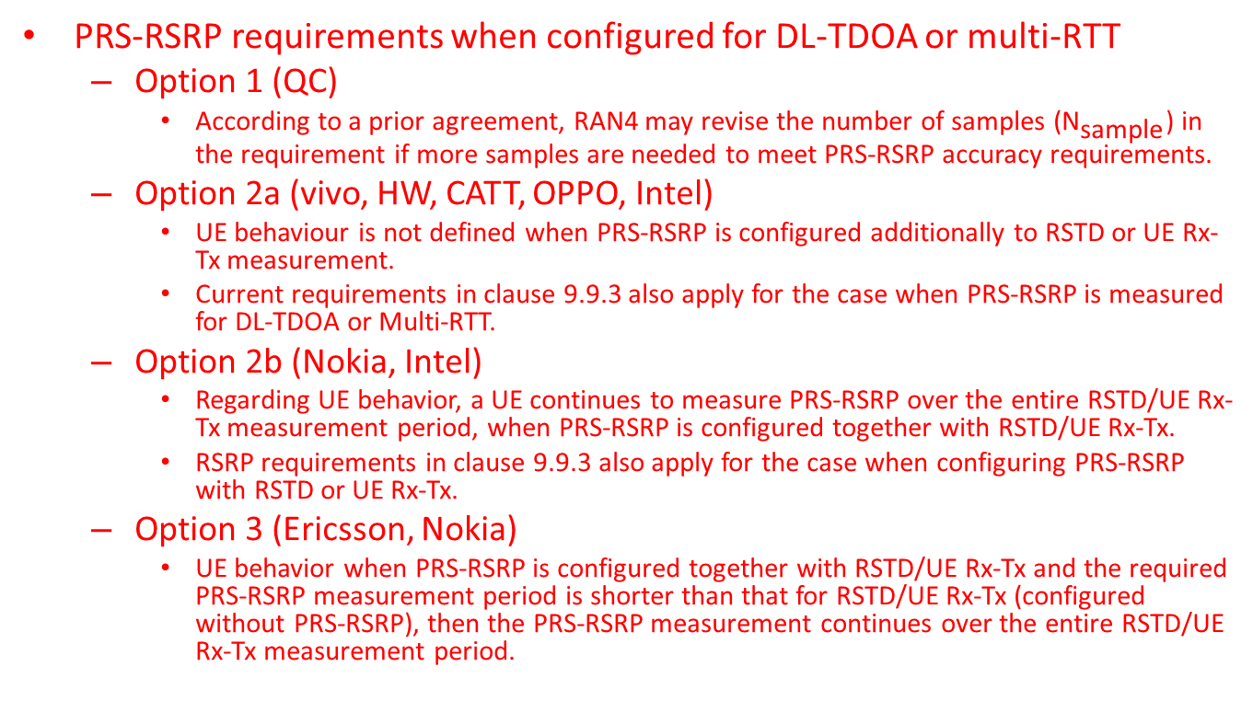
Measurement period for PRS-RSRP
PRS-RSRP requirements when configured for DL-TDOA or multi-RTT
  Option 1 (QC)
    According to a prior agreement, RAN4 may revise the number of samples (${\text{N}}_{\text{sample}}$) in the requirement if more samples are needed to meet PRS-RSRP accuracy requirements.
  Option 2a (vivo, HW, CATT, OPPO, Intel)
    UE behaviour is not defined when PRS-RSRP is configured additionally to RSTD or UE Rx-Tx measurement.
    Current requirements in clause 9.9.3 also apply for the case when PRS-RSRP is measured for DL-TDOA or Multi-RTT.
  Option 2b (Nokia, Intel)
    Regarding UE behavior, a UE continues to measure PRS-RSRP over the entire RSTD/UE Rx-Tx measurement period, when PRS-RSRP is configured together with RSTD/UE Rx-Tx.
    RSRP requirements in clause 9.9.3 also apply for the case when configuring PRS-RSRP with RSTD or UE Rx-Tx.
  Option 3 (Ericsson, Nokia)
    UE behavior when PRS-RSRP is configured together with RSTD/UE Rx-Tx and the required PRS-RSRP measurement period is shorter than that for RSTD/UE Rx-Tx (configured without PRS-RSRP), then the PRS-RSRP measurement continues over the entire RSTD/UE Rx-Tx measurement period.

Slide 19
Measurement period for UE Rx-Tx (1)
SRS periodicity is not accounted in UE Rx-Tx measurement period, and the SRS impact may be accounted by SRS/PRS proximity
SRS dropping is not accounted in UE Rx-Tx measurement period, and the existing requirements apply
The measurement requirements is applicable only if any SRS transmission is within [-X, X] msec of at least one DL PRS resource of each of the TRPs in the assistance data.
  Accuracy requirements are independent of PRS and SRS separation
  X = FFS between 160ms or 80ms
  FFS if UE still measures and reports UE Rx-Tx measurement or not if PRS/SRS proximity condition is not met
PRS/SRS proximity
  Option 1 (CATT, QC, Intel, OPPO, vivo, HW, Ericsson)
    The measurement requirements is applicable only if any SRS transmission is within [-X, X] msec of at least one DL PRS resource of each of the TRPs in the assistance data.
    Accuracy requirements are independent of PRS and SRS separation
      X = 160 (CATT, Intel, OPPO, vivo, HW, Ericsson, Nokia)
      X=80 (QC, HW)
  Option 2 (Ericsson)
    The requirements for UE Rx-Tx apply provided MIN(Tsrs, Tprs) ≤ 2*X; X = FFS (e.g. X = 160 ms).
A UE behavior still measures and reports UE RX-TX measurements no matter to PRS/SRS proximity.
  Option 1 : Yes (Nokia)
  Option 2 : No

Slide 20
Measurement period for UE Rx-Tx (2)
TA change due to TA command
  Proposals for UE behaviour
    Option 1 (CATT, Intel, HW, Nokia)
      UE shall continue UE Rx-Tx time difference measurement
    Option 2 (QC, OPPO, Ericsson)
      Up to UE implementation
    Option 2 (OPPO, vivo, Ericsson)
      UE shall discard the UE Rx-Tx time difference measurement
  Proposals for requirements
    Option 1 (CATT, QC, OPPO, vivo, Intel, Ericsson)
      UE Rx-Tx time difference measurement requirements may not apply
    Option 2 (HW, Nokia)
      UE Rx-Tx measurement period is not impacted by UL timing change
    Option 3 (Ericsson)
      Address the issue in accuracy requirements

Slide 21
Measurement period for UE Rx-Tx (3)
UE continues UE Rx-Tx time difference measurement and the current measurement requirements apply when UL timing change due to UE autonomous adjustment occurs during the measurement period
TA change due to NTA_offset change
  Option 1 (CATT, HW, QC)
    No need to clarify UE Rx-Tx measurement requirements in case of NTA_offset change
  Option 2a (QC, OPPO, vivo, Ericsson)
    It is clarified in UE Rx-Tx measurement requirements (section 9.9.4 in TS 38.133) that measurement requirements are not applicable if the NTA_offset changes during the measurement period
  Option 2b (Ericsson, Nokia)
    It is clarified in UE Rx-Tx measurement requirements (section 9.9.4 in TS 38.133) that the UE shall discard the UE Rx-Tx measurement if the NTA_offset changes during the measurement period.
  Option 3 (Ericsson)
    Address the issue in accuracy requirements

Slide 22
Measurement period for UE Rx-Tx (4)
Measurement period requirements with cell change impacting SRS
  Option 1 (QC)
    UE Rx-Tx measurement requirements do not apply. The UE may resume the measurements after SRS is configured in the target cell
  Option 2 (OPPO, vivo, HW, Ericsson, Nokia)
    UE shall restart the UE Rx-Tx time difference measurement after the SRS reconfiguration on the target cell is complete
Measurement period requirements with cell change not impacting SRS
  Option 1 (QC)
    FFS, may depend on exact cases
  Option 2 (OPPO)
    UE shall continue the on-going UE Rx-Tx time difference measurement, and longer measurement period is expected.
  Option 3 (vivo, HW, Ericsson, Nokia)
    UE shall continue the on-going UE Rx-Tx time difference measurement and the current measurement period and accuracy apply.

