Slide 1
WF on UE RF requirements for R17 NB-IoT 16QAM
3GPP TSG-RAN WG4 Meeting # 98-bis-e
Electronic Meeting, 12 – 20 April 2021
Agenda Item: 10.9
R4-210xxxx
Nokia

Slide 2
Background
Contributions on UE RF requirements for R17 NB-IoT 16QAM in RAN4#98-bis-e have a variety of proposals:
[1] R4-2104651 MPR for NB-IoT 16-QAM Nokia Corporation
[2] R4-2107246 UE RF impact analysis on R17 NB_IoT Ericsson
[3] R4-2107258 MPR Simulation Assumptions for 16QAM NB-IoT Uplink Huawei, HiSilicon
The Way Forward from the discussion of the contributions are summarized in the following slides.

Slide 3
Way forward on EVM limit
RAN4 will decide whether to set the limit to 12.5%.

Slide 4
Way forward on In-band Emission limit
RAN4 will decide whether to change the current IBE mask and include the EVM limit.

Slide 5
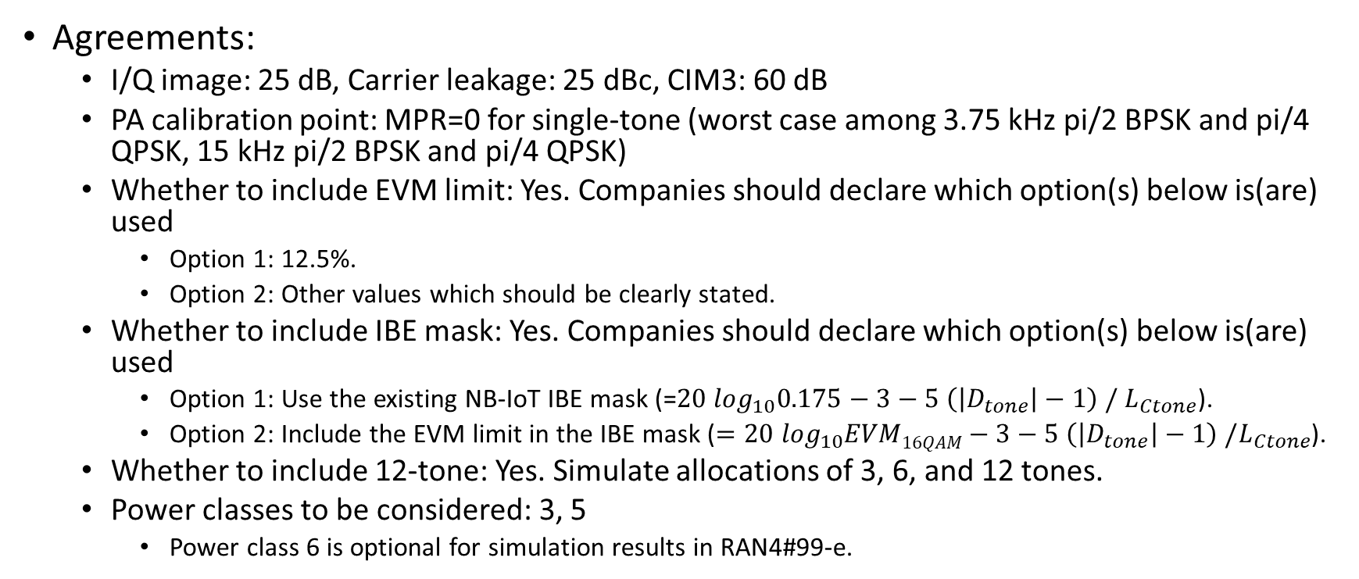
Way forward on MPR simulation assumptions
Agreements:
I/Q image: 25 dB, Carrier leakage: 25 dBc, CIM3: 60 dB
PA calibration point: MPR=0 for single-tone (worst case among 3.75 kHz pi/2 BPSK and pi/4 QPSK, 15 kHz pi/2 BPSK and pi/4 QPSK)
Whether to include EVM limit: Yes. Companies should declare which option(s) below is(are) used
Option 1: 12.5%.
Option 2: Other values which should be clearly stated.
Whether to include IBE mask: Yes. Companies should declare which option(s) below is(are) used
Option 1: Use the existing NB-IoT IBE mask (=$20 \log_{10}0.175−3−5 \left(\left|D_{tone}\right|−1\right) / L_{Ctone}$).
Option 2: Include the EVM limit in the IBE mask ($=20 \log_{10}EVM16QAM−3−5 \left(\left|D_{tone}\right|−1\right) /L_{Ctone}$).
Whether to include 12-tone: Yes. Simulate allocations of 3, 6, and 12 tones.
Power classes to be considered: 3, 5
Power class 6 is optional for simulation results in RAN4#99-e.

