Slide 1
[98e][301] Introduction of new BS capability set for NR+EUTRA+UTRA
GTW (Jan. 29)

Slide 2
Introduction of new BS capability set for NR+EUTRA+UTRA
CRs in question
General relation among MSR BS and AAS BS specifications
37-series are MSR specification, i.e. both 37.104 and 37.105 are to be aligned as much as possible. This was always the assumption.
OBUE applicability table
NEC: comment on Cat. A limits not listed in the applicability table
The same text exists in both MSR and AAS specifications
Clarification: OBUE requirements for MSR are not referring to Category A/B limits. The only place there Category B limits are mentioned for MSR OBUE limits is the table below
R4-2102563 | CR to TS 37.105: Introduction of new BS capability set for NR+EUTRA+UTRA, Rel-16/17 | Huawei, China Unicom
R4-2102565 | CR to TS 37.145-1: Introduction of new BS capability set for NR+EUTRA+UTRA, Rel-16/17 | Huawei, China Unicom
R4-2102567 | CR to TS 37.145-2: Introduction of new BS capability set for NR+EUTRA+UTRA, Rel-16/17 | Huawei, China Unicom
Notes:
NEC: I don’t remind if we have any specific for. Cat.A limit. If we only include Cat.B, will loss coverage for regional Cat.A limit. We have such concern on missing cat A here.
Huawei: I agree with you for some observations. The wording not so clear. If we want to improve the wording in existing AAS and MSR specification. We can further work on that in future RAN4 meetings.
NEC: We think we can continue to further discuss the issues in next meetings for existing specification texting “note 2 above”.

Slide 3
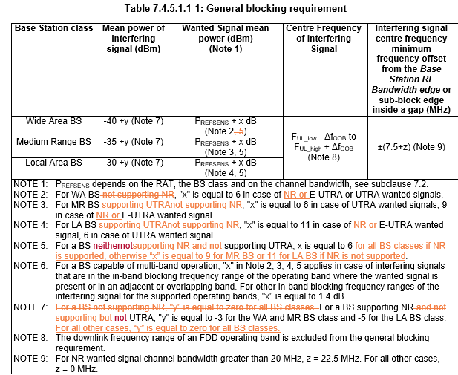
Introduction of new BS capability set for NR+EUTRA+UTRA
OBUE table headers (and overlapping CRs)
Proposal: align with OBUE table headings modifications in R4-2102853/56/59
Additional corrections for AAS specifications, e.g. remove GSM/EDGE
Wording improvements in notes for blocking and IMD tables
Issue related to both MSR and AAS specifications
Proposal: improve wording for both MSR and AAS next meeting
Additional OBUE table added for TS 37.145-1
One OBUE Table 6.6.5.5.2-2c was found as not captured in TS 37.145-1 specification
Table 6.6.5.5.2-2c: Wide Area operating band unwanted emission mask (UEM) for BC1 and BC3 above 3GHz, option 1
Proposal: we can remove this modification from CRs this meeting – companies can check more for the next meeting
R4-2102853 | CR to 37.105 on OBUE table headings and applicability | Ericsson
R4-2102856 | CR to 37.145-1 on OBUE table headings and applicability | Ericsson
R4-2102859 | CR to 37.145-2 on OBUE table headings and applicability | Ericsson
Notes:
E///: With Rel-16/17 CRs, Huawei to take into account this changes from E/// for table headers proposing. Rel-15/16 CAT F CRs, Rel-17 CAT A CRs
Rel-15 CAT F CR from E///
Rel-16/Rel-17 CR from Huawei
We are fine with the proposal for issue 1.
E///: I would like to double check for issue 2. This direction we can consider.
Nokia: For issue 2, our preference to improve the wording for both MSR and AAS in same meeting.
E///: For issue 3, I try to match among core and test spec , the table title format not found. We are fine to do this in another CR or in future meeting.
I found another potential overlapping CR.

