Slide 1
Way Forward on NR TxD & Power Class
3GPP TSG-RAN WG4 Meeting # 98-e
Electronic Meeting, 25 Jan - 5 Feb., 2021
R4-210xxxx
vivo

Slide 2
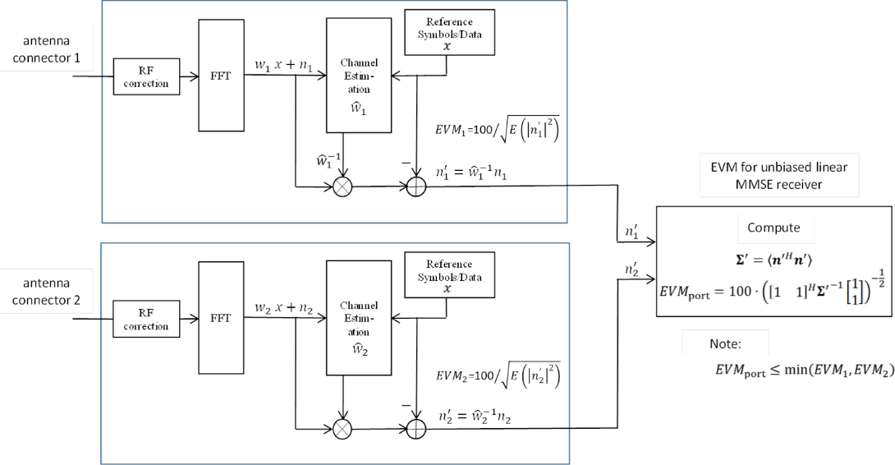
EVM for Transparent TxD
Proposals:
Option 1: As in agreed WF R4-2008465
$EVM=\sqrt{(P_{1}∗{EVM}_{1}^{2}+ P_{2}∗{EVM}_{2}^{2})/(P1 + P2)}$
Option 2: As has been provided in R4-2016288:
Option 2a.
${EVM}_{port}=100∙ {\left({\left[\begin{matrix}1 & 1\end{matrix}\right]}^{H}{Σ^{′}}^{−1}\left[\begin{matrix}1 \\ 1\end{matrix}\right]\right)}^{−\frac{1}{2}}$where $Σ^{′}=〈n^{′} n^{′H}〉 .$
Option 2b.
${EVM}_{port}=min\left({EVM}_{1},{EVM}_{2}\right)$
Option 3: As has been provided in R4-2102917:
Option 3a.
${EVM}_{port, ρ}≤\frac{1}{P_{1}+P_{2}}\sqrt{ P_{1}^{2}{ EVM}_{1}^{2}+P_{2}^{2} {EVM}_{2}^{2}+2 ρ P_{1} P_{2} {EVM}_{1}{EVM}_{2} }$ where $ρ$ is the
correlation coefficient of the transmitter noise
Option 3b.
${EVM}_{port, ρ=1}=\frac{P_{1}{ ∙EVM}_{1}+{P_{2} ∙EVM}_{2}}{P_{1}+P_{2}}$
Recommended WF:
[Option 1]

Slide 3
UE Behavior under Conformance Testing
Background: Motivation is to guide how to test requirements that require power changes such as relative power control.
Proposals:
Option 1a: UE will keep the tx diversity status unchanged in conformance testing.
Option 1b: Test mode signalling is implemented to instruct UE to keep TX div status unchanged
Option 2a: TE will detect and sum for every power step and change in condition from declared connector, with no precondition
Option 2b: TE will detect and sum for every power step and change in condition from declared connector, based on pre-condition that a repeatability of TxD activation/deactivation timing in a UE is maintained can be fulfilled.

Slide 4
Power Splitting Behavior
Background: Motivation is to guide how to test requirements that require power changes such as relative power control
Question 1: What would be the impact for the requirements and testability with tentative equal power split restriction?
Proposals:
Option 1: Only allow equal power split between connectors
Excludes 17+17+20 dBm implementations
Excludes power control optimizations
Option 1a: Per instructed as test mode, UE should keep equal power split between connectors in all cases.
Option 2: Allow any power split between connectors
Recommended WF:
[TBD]

Slide 5
Applicability of Transparent TxD Requirement
The applicability of the newly introduced test procedure (if any) and specific requirement (if any) for transparent TxD UE :
•whether or not applicable to UE implementation without transparent TxD
Proposals
Option 1: Not applicable
Option 2: Applicable
Recommended WF
[Option 1]

Slide 6
Signaling for Transparent TxD
Whether and how RAN4 introduce signalling for transparent TxD:
Option 1: Introduce some sort of signaling by UE
Option 1a. Use ModifiedMPRbehavior bits to signal additional relaxations;
Option 1b: Introducing a new ( per band capability) signalling for TxD together with existing power classes
Capability reporting for supporting TxD
[Capability reporting for TxD Enable/Disable status]
Option 1c: Introducing a new power class (e.g. PC2.5) for TxD
Option 2: Based on UE vendor declaration.
Option 3: Using existing signalling to indicate the 2Tx implementation capability.
Recommended WF
For R15 UEs, UE vendor declaration can be used in testing
For R16 UEs, new signaling, i.e. 1b, is needed to inform the network of the support of TxD. If the signaling can be made to enable release-independent support of TxD from R15 can be consulted with RAN2

Slide 7
CDD-related Requirement
For transparent TxD UE, necessity of CDD related requirements, e.g. requirement on TAE+CDD, is need to be further studied:
Proposals
Option 1: Yes
Option 2: No.
Option 2b. No at least for Rel-16
Recommended WF
[TBD]

Slide 8
Rel-15 NSA power class
Proposals
Option 1: The Pcmax for NR is modified according to the declared NR power capability for NSA so that the PHR becomes correct. (Based on R4-2015976 & R4-2015977)
Option 2: Introduce the Rel-16 defined power class UE capability for Rel-15, and Indication of UE implementation by declaration. (Based on R4-2016479 observation 1)
Option 3: The Pcmax for NR is modified to use the lower possible power class to decide the lower bound of the configured power. (Based on R4-2016479 observation 3 & R4-2016482, & R4-2102385)
Option 4: Any other combined/refined revision.
Option 5: Further revision not needed.
Recommended WF
TBA

Slide 9
Impact of Applicability of TxD to Rel-15 NSA power class
Whether applicability of TxD for Rel-15 would impact the previous Issue for NSA.
Proposals
Option 1:Yes;
Option 2: No.
Recommended WF
TBA

Slide 10
Power class fall back for SA UL-MIMO in Rel-15
Background & motivation:
Rel-15: “If UE is scheduled for single antenna-port PUSCH transmission by DCI format 0_0 or by DCI format 0_1 for single antenna port codebook based transmission, the requirements in clause 6.2.1 apply.”
Rel-16: “If UE is scheduled for single antenna-port PUSCH transmission by DCI format 0_0 or by DCI format 0_1 for single antenna port codebook based transmission, the requirements in clause 6.2.1 apply for the power class as indicated by the ue-PowerClass field in capability signalling.”
Proposals
Option 1: Rel-15 is the same to Rel-16;
Option 2: Rel-15 can still have different explanation compared to Rel-16.
Recommended WF
TBA

