Slide 1
Way Forward on NR TxD & Power Class
3GPP TSG-RAN WG4 Meeting # 98-e
Electronic Meeting, 25 Jan - 5 Feb., 2021
R4-210xxxx
vivo

Slide 2
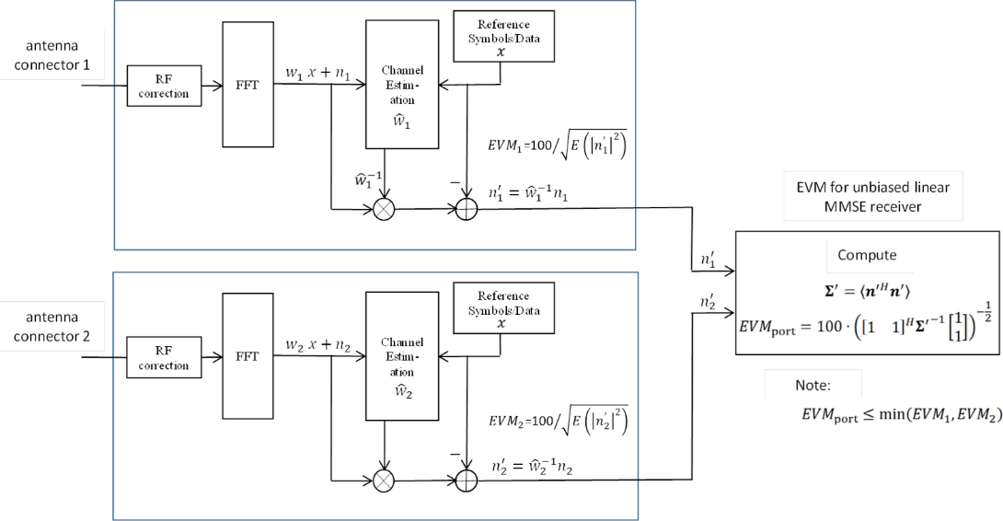
EVM for Transparent TxD
Proposals:
Option 1: As in agreed WF R4-2008465
$EVM=\sqrt{(P_{1}∗{EVM}_{1}^{2}+ P_{2}∗{EVM}_{2}^{2})/(P1 + P2)}$
Option 2: As has been provided in R4-2016288:
Option 2a.
${EVM}_{port}=100∙ {\left({\left[\begin{matrix}1 & 1\end{matrix}\right]}^{H}{Σ^{′}}^{−1}\left[\begin{matrix}1 \\ 1\end{matrix}\right]\right)}^{−\frac{1}{2}}$where $Σ^{′}=〈n^{′} n^{′H}〉 .$
Option 2b.
${EVM}_{port}=min\left({EVM}_{1},{EVM}_{2}\right)$
Recommended WF:
[Option 1]

Slide 3
UE Behavior under Conformance Testing
Background: Motivation is to guide how to test requirements that require power changes such as relative power control.
Proposals:
Option 1a: UE will keep the tx diversity status unchanged in conformance testing.
Option 1b: Test mode signalling is implemented to instruct UE to keep TX div status unchanged
Option 2a: TE will detect and sum for every power step and change in condition from declared connector, with no precondition
Option 2b: TE will detect and sum for every power step and change in condition from declared connector, based on pre-condition that a repeatability of TxD activation/deactivation timing in a UE is maintained can be fulfilled.

Slide 4
Power Splitting Behavior
Background: Motivation is to guide how to test requirements that require power changes such as relative power control
Question 1: What would be the impact for the requirements and testability with tentative equal power split restriction?
Proposals:
Option 1: Only allow equal power split between connectors
Excludes 17+17+20 dBm implementations
Excludes power control optimizations
Option 1a: Per instructed as test mode, UE should keep equal power split between connectors in all cases.
Option 2: Allow any power split between connectors
Recommended WF:
[TBD]

Slide 5
Applicability of Transparent TxD Requirement
The applicability of the newly introduced test procedure (if any) and specific requirement (if any) for transparent TxD UE :
•whether or not applicable to UE implementation without transparent TxD
Proposals
Option 1: Not applicable
Option 2: Applicable
Recommended WF
[Option 1]

Slide 6
Signaling for Transparent TxD
Whether and how RAN4 introduce signalling for transparent TxD:
Option 1: Introduce some sort of signaling by UE
Option 1a. Use ModifiedMPRbehavior bits to signal additional relaxations;
Option 1b: Introducing a new (capability) signalling for TxD
Capability reporting for supporting TxD
[Capability reporting for TxD Enable/Disable status]
Option 1c: Introducing a new power class (e.g. PC2.5) for TxD
Option 2: Based on UE vendor declaration.
Option 3: Using existing signalling to indicate the 2Tx implementation capability.
Recommended WF
[TBD]

Slide 7
CDD-related Requirement
For transparent TxD UE, necessity of CDD related requirements, e.g. requirement on TAE+CDD, is need to be further studied:
Proposals
Option 1: Yes
Option 2: No.
Option 2b. No at least for Rel-16
Recommended WF
[TBD]

Slide 8
Rel-15 NSA power class
Proposals
Option 1: The Pcmax for NR is modified according to the declared NR power capability for NSA so that the PHR becomes correct. (Based on R4-2015976 & R4-2015977)
Option 2: Introduce the Rel-16 defined power class UE capability for Rel-15, and Indication of UE implementation by declaration. (Based on R4-2016479 observation 1)
Option 3: The Pcmax for NR is modified to use the lower possible power class to decide the lower bound of the configured power. (Based on R4-2016479 observation 3 & R4-2016482, & R4-2102385)
Option 4: Any other combined/refined revision.
Option 5: Further revision not needed.
Recommended WF
TBA

Slide 9
Impact of Applicability of TxD to Rel-15 NSA power class
Whether applicability of TxD for Rel-15 would impact the previous Issue for NSA.
Proposals
Option 1:Yes;
Option 2: No.
Recommended WF
TBA

Slide 10
Power class fall back for SA UL-MIMO in Rel-15
Background & motivation:
Rel-15: “If UE is scheduled for single antenna-port PUSCH transmission by DCI format 0_0 or by DCI format 0_1 for single antenna port codebook based transmission, the requirements in clause 6.2.1 apply.”
Rel-16: “If UE is scheduled for single antenna-port PUSCH transmission by DCI format 0_0 or by DCI format 0_1 for single antenna port codebook based transmission, the requirements in clause 6.2.1 apply for the power class as indicated by the ue-PowerClass field in capability signalling.”
Proposals
Option 1: Rel-15 is the same to Rel-16;
Option 2: Rel-15 can still have different explanation compared to Rel-16.
Recommended WF
TBA

