Slide 1
Way forward on multiple link tests for NR V2X demodulation performance
3GPP TSG-RAN WG4 Meeting #97-e
E-meeting, 2 – 13 November 2020
Agenda Item: 7.3.7.3
R4-2017471
Intel Corporation, …

Slide 2
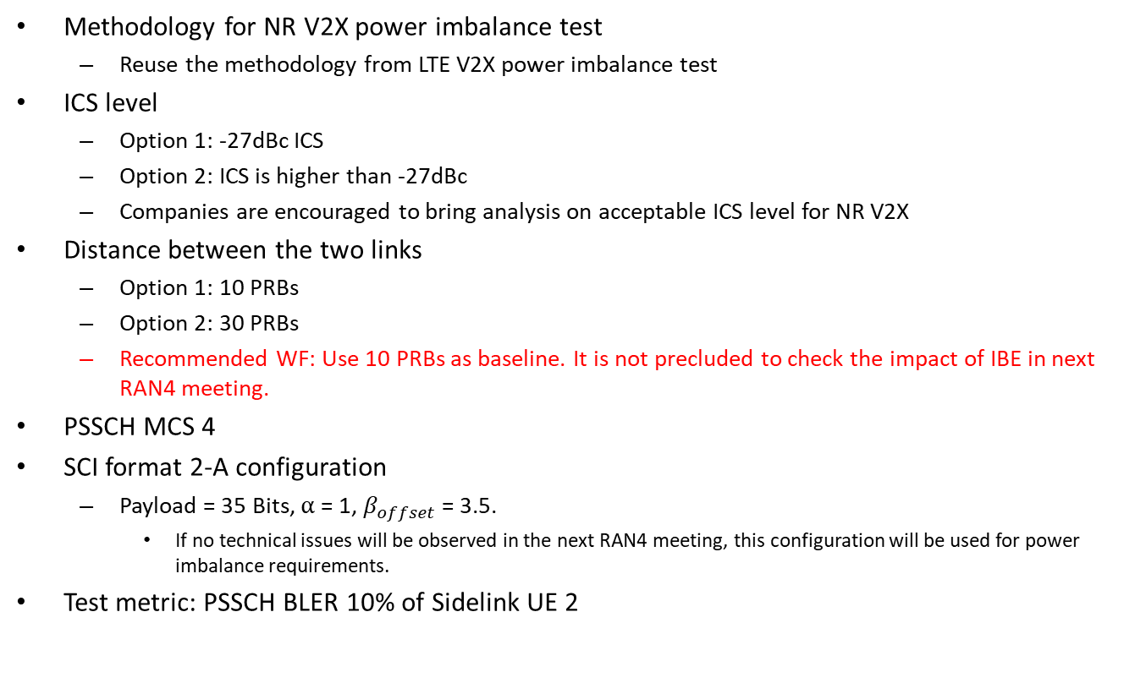
Power imbalance requirements
      Methodology for NR V2X power imbalance test
  Reuse the methodology from LTE V2X power imbalance test
      ICS level
  Option 1: -27dBc ICS
  Option 2: ICS is higher than -27dBc
  Companies are encouraged to bring analysis on acceptable ICS level for NR V2X
      Distance between the two links
  Option 1: 10 PRBs
  Option 2: 30 PRBs
  Recommended WF: Use 10 PRBs as baseline. It is not precluded to check the impact of IBE in next RAN4 meeting.
      PSSCH MCS 4
      SCI format 2-A configuration
  Payload = 35 Bits, $α$ = 1, $β_{offset}$ = 3.5.
    If no technical issues will be observed in the next RAN4 meeting, this configuration will be used for power imbalance requirements.
      Test metric: PSSCH BLER 10% of Sidelink UE 2

Slide 3
HARQ buffer soft combining test
      Test purpose
  Option 1: Verify HARQ buffer capability
  Option 2: Introduce soft buffer test to verify following features:
    Soft buffer size: Total number of bits and tbSize must be as large as possible
    Soft combining: We should set the simulation assumptions that we can find one SNR point satisfying the condition that first transmission BLER is 100% when retransmission BLER is x% (In LTE V2V x=5).
    Soft management: The interval between transmission and retransmission must be as much as possible.
  Recommended WF: The main test purpose is to verify HARQ buffer combining. Configuring of high MCS and long interval between transmission and retransmission is not precluded.
      Test design
  CBW: 20 MHz
  Sub-channel size: 10 or 15
  For verification of n16 and n24, 16 or 24 UEs transmit signal one by one circularly for every slot and in the first subchannel.
  For verification of n32, the first 31 UEs transmit signal one by one circularly for every slot and in the first subchannel. The 32nd UE transmit signal in the same slot as the first UE but in the second subchannel.
  For verification of n64, first 31 UEs transmit signal one by one circularly for every slot and in the first subchannel, the next 31 UEs transmit signal one by one circularly for every slot and in the second subchannel, the last 2 UEs transmit signal in the same slot as the first two UEs but in the third subchannel.

Slide 4
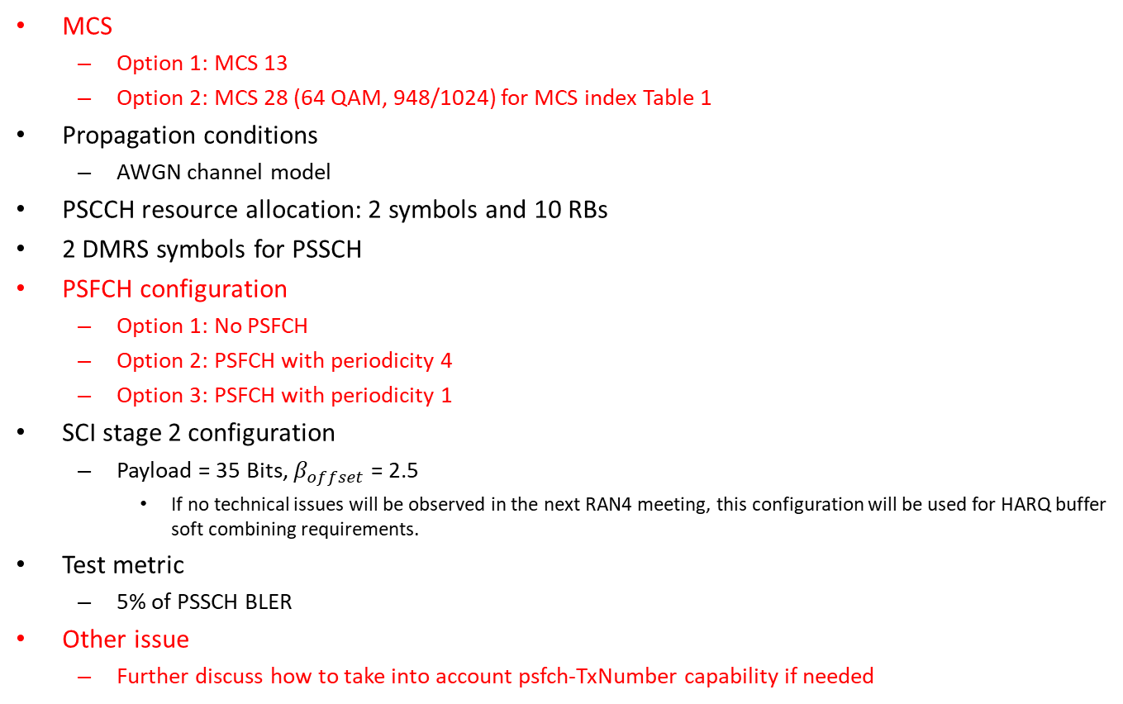
HARQ buffer soft combining test
      MCS
  Option 1: MCS 13
  Option 2: MCS 28 (64 QAM, 948/1024) for MCS index Table 1
      Propagation conditions
  AWGN channel model
      PSCCH resource allocation: 2 symbols and 10 RBs
      2 DMRS symbols for PSSCH
PSFCH configuration
  Option 1: No PSFCH
  Option 2: PSFCH with periodicity 4
  Option 3: PSFCH with periodicity 1
SCI stage 2 configuration
  Payload = 35 Bits, $β_{offset}$ = 2.5
    If no technical issues will be observed in the next RAN4 meeting, this configuration will be used for HARQ buffer soft combining requirements.
      Test metric
  5% of PSSCH BLER
      Other issue
  Further discuss how to take into account psfch-TxNumber capability if needed

Slide 5
PSCCH/PSSCH decoding capability test
      CBW/SCS
  Need to further check on the supporting CHBW sets on V2X band, mandatory or optional and typical deployment scenarios, RAN4 planed to make decision among 40MHz and 20MHz in RAN4#98e.
      PSFCH configuration
  Option 1: No PSFCH
  Option 2: PSFCH with periodicity 1
      DMRS configuration: 2 DMRS symbols
      MCS 4
      Propagation conditions: Static propagation condition without external noise
      Test metric: Probability of missed PSCCH 1%
      Other issues
  Further discuss how to take into account psfch-TxNumber capability if needed
  Further discuss whether to verify 2*floor(NRB /10 RBs) capability

Slide 6
PSFCH decoding capability test
      Test design
  N UEs transmit PSFCH one by one following procedure from Section 16.3 of TS 38.1213
  N is {5, 15, 25, 32, 35, 45, 50, 64} depending on UE capability
  Example for 20 MHz, 1 sub-channel and PSFCH periodicity 1
    When N is not larger than 51, all N UEs should transmit one by one from RB 0 to A-1 with CS pair index 0. When N=64, UE i, 0≤i≤50 should transmit PSFCH one by one from RB 0 to 50 with CS pair index 0, the remaining 13 UEs (i.e. UEi, 51≤i≤63) should transmit PSFCHs from RB 0 to RB 12 with CS pair index 3.
      CBW/SCS
  Option 1: 20 MHz, 30 kHz
  Option 2: 40 MHz, 30 kHz
      Number of sub-channels
  Option 1: 1
  Option 2: Maximum possible for considered scenario (i.e. 5 for 20 MHz and 10 for 40 MHz)
      PSFCH periodicity
  Option 1: 1
  Option 2: 4

Slide 7
PSFCH decoding capability test
      Feedback mode: ACK/NACK
      Propagation conditions
  Static propagation condition without external noise
      Test metric
  Pr(DTX to ACK)<1% and Pr(ACK miss)<1%
  Further discus introduction of additional test metric as Pr(NACK to ACK)

Slide 8
SDR with active sidelink test
      Whether to define the SDR test with active sidelink?
  Option 1: Yes
  Option 2: No

