Slide 1
Way Forward on NR-U UE demodulation requirements
3GPP TSG-RAN4 Meeting #97-e
November 2 - 13 2020
Agenda Item: 7.1.8.1/2/3
Tdoc Num: R4-2017465
Qualcomm

Slide 2
Test Scope
Semi-static Channel Access Devices v/s Dynamic Channel Access Devices
Prioritize test cases agnostic to semi-static and dynamic channel access devices if it is feasible.
Do not define additional test cases dedicated to FBE/LBE devices.

Slide 3
Test Scope
Test Scenarios
Define requirements for the unlicensed CC, and apply to both Scenario A and C;
FFS: Details of the test set-up for scenario A and C;
For reference:
  Scenario A (Carrier aggregation between licensed band NR (PCell) and NR-U (SCell))
  Scenario C (Stand-alone NR-U (PCell))

Slide 4
Test Scope
Define tests with fixed DRS window duration set to 1ms;
FFS: Deprioritize tests with COT duration larger than SMTC duration for dynamic channel access devices

Slide 5
Test Scope
Bandwidth to be used for Requirements definition
  Option 1: 20 and 80 MHz;
  Option 2: 20, 40, 60 and 80 MHz with applicability rule to test the largest supported BW;
  Option 3: 40MHz (as in rel-15 TDD Demod);
  Option 4: 20 MHz;
  Option 5a: 20 and 40 MHz;
  Option 5b: 20 and 40 MHz, with applicability rule to test the largest supported BW;

Slide 6
Test Scope
Do not define tests for NR-U Demod PDCCH demodulation requirements;
FFS whether to define CQI Requirements, discuss the parameters and UE behaviour for CQI reporting tests;

Slide 7
Downlink Transmission Model
Use Burst Transmission Model for LAA (36.101-4, B.8) as a starting point.
Option 1:
  Select the number of slots randomly from a given set of the number of slots [TBD] with equal probability as the total length of burst transmission format. The length includes both occupied OFDM symbols and non-occupied OFDM symbols within the burst format.
  The starting position for the first slot is randomly selected from OFDM symbol S1: {0, 7} with equal probability.
    For PDSCH type A test: if 0 is selected, the PDSCH type A is transmitted from symbol 2 of the first slot. If 7 is selected, the PDSCH type A is transmitted from OFDM symbol 2 of second slot.
    For PDSCH type B test: if 0 is selected, the PDSCH type B is transmitted from symbol 2 of the first slot. If 7 is selected, the PDSCH type B is transmitted from symbol 7 of the first slot.
  In the last slot, PDSCH is transmitted ending with position of OFDM symbol randomly selected from OFDM symbol S2: [TBD] with equal probability
  A uniform random variable from [0, 1] is generated. If the random variable is less than p which is given per test case,
    If both the last slot of previous burst and first slot of new burst format are fully occupied, start burst transmission after deferring one slot from the last slot of previous burst. Otherwise, start burst transmission at the end of last slot of previous burst.
  Otherwise, the burst transmission is muted and the muting duration is the same as the number of slots for determined burst format.
Option 2;
  Compute COT and Unoccupied duration as specified by Test Parameters, then repeat it periodically for the entire test;
  Fully allocate PDCCH and PDSCH in COT, except for Guard and UL Symbols at the end of COT as specified by Test Parameters;
  Use a threshold p_{LBT} to control randomized LBT failures;

Slide 8
LBT Parameters Test Scope
Define tests with fixed DL Transmission (COT) duration
  Option 1: No, use random COT from a set of values;
  Option 2: Yes, using 2ms duration;
Values for random COT (if option 1 is agreed)
  Option 1a: for SCS 30kHz, S₁ = {2, 6, 10, 16}, S₂ = {4, 7, 10, 12}
  Option 1b: for SCS 30kHz, S₁ = {1, 2, 3, 4}, S₂ = {4, 7, 10, 12}
  Option 2: {1,3,5,8} for SCS 15kHz, {1,6,10,16} for SCS 30kHz;
Length of the last Slot in the burst
  Option 1: Random length, {6, 9, 12, 14} Symbols with the first 2 symbols allocated for PDCCH transmission;
  Option 2: Fixed length according to proposed model;

Slide 9
LBT Parameters
Probability of LBT Failure for Scenario C:
  Option 1: 0 (always clear channel);
  Option 2: Same probability as Scenario A;
  Option 3: TBD>0 (probability of occupied channel);
Probability of LBT Failure for Scenario A:
  Option 1: TBD>0 (probability of occupied channel)

Slide 10
LBT Parameters Downlink Transmission Model
Slot format
  Option 1: For 30kHz, 2ms, DDDS (S=7D:2G:2U) derived from the DL Model;
  Option 2: For 30kHz, 7D -1S-2U;
  Option 3: For 30kHz, {D, DS, DDS, DDDS} derived from the DL Model;
  Other options
Other Parameters
Option 1:
Other options not precluded
DL Transmission Model (Note 1) | Maximum COT Duration | ms | 1.9
 | Minimum Idle Time after COT | ms | 0.1
 | Fixed Frame Period (Note 2) | ms | 2
 | Probability of LBT Failure p_{LBT} |  | [TBD]
 | Guard Symbols |  | 2 Symbols
 | UL Symbols |  | 2 Symbols
 | Number of slots between PDSCH and corresponding HARQ-ACK information |  | 3 if mod(i,4) = 0 2 if mod(i,4) = 1 5 if mod(i,4) = 2 4 if mod(i,4) = 3
Notes: According to the definition proposed in [2] This Parameter applies only for ChannelAccessType-r16 = ‘semistatic’.

Slide 11
LBT Parameters
Model LBT Failure as part of the Downlink Transmission model;
Apply the Downlink Transmission model to all DL signals in unlicensed carrier (including SSB and TRS transmission);
FFS whether is needed to define a separate LBT model for FBE and LBE;
Do not define tests with sub-band LBT failure (either all sub-bands are transmitted or no sub-band is transmitted).

Slide 12
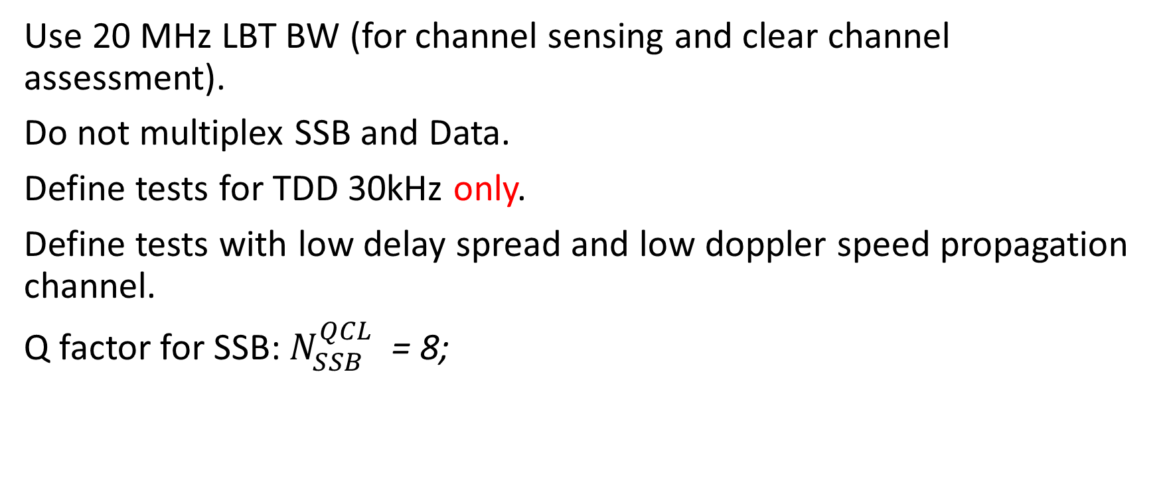
Simulation Assumptions for PDSCH Tests
Use 20 MHz LBT BW (for channel sensing and clear channel assessment).
Do not multiplex SSB and Data.
Define tests for TDD 30kHz only.
Define tests with low delay spread and low doppler speed propagation channel.
Q factor for SSB: $N_{SSB}^{QCL}$= 8;

Slide 13
Simulation Assumptions for PDSCH Tests
Test Design
  Option 1: Use NR PDSCH Demod Performance Tests as a starting point (R16 NR CA for Scenario A, R15 PDSCH for Scenario C);
  Option 2: Use LTE LAA Demod Performance Test setup as a starting point for scenario A

Slide 14
Simulation Assumptions for PDSCH Tests
PDSCH Type
  Option 1: Type A only;
  Option 2: Type B only for UE with capability, Type A otherwise;
  Option 3: Type A plus Rel-15 Type B for partial slots, dedicated test to verify typeB-PDSCH-length-r16 capability with corresponding applicability rule;
PDSCH Type B Start and Length for PDSCH Performance Tests (if agreed to use PDSCH mapping Type B)
  Option 1: Subset of fixed [start, length] values: [2,4], [2,12];
  Option 2: Random start in Symbol {2, 9} and length {12, 5} for first slot of burst. Start in Symbol 2 and length {4, 7, 10, 12} for last slot of burst. Start in Symbol 2 and length 12 for other slots;
  Option 3: Start in Symbol {7} and length {4} symbols;

Slide 15
Simulation Assumptions for PDSCH Tests
PDCCH Format to be used
  Option 1: Format 2-0, using CO-DurationPerCell-r16 to indicate the COT duration (Apple);
  Option 2: Do not use DCI Format 2-0 (Qualcomm, Ericsson);

