Slide 1
3GPP TSG-RAN WG4 Meeting #97-e
Electronic Meeting, 2– 13 Nov, 2020
R4-2017372
WF on UE PRS measurement requirements
Huawei, HiSilicon

Slide 2
Measurement period for RSTD (1)
Measurement period extension due to SSB collision
  Existing RSTD measurement period is defined for cases when PRS samples are not dropped.
  UE is allowed to extend the RSTD measurement period if one or more PRS samples are dropped due to SSB collision, but the exact value is not specified.

Slide 3
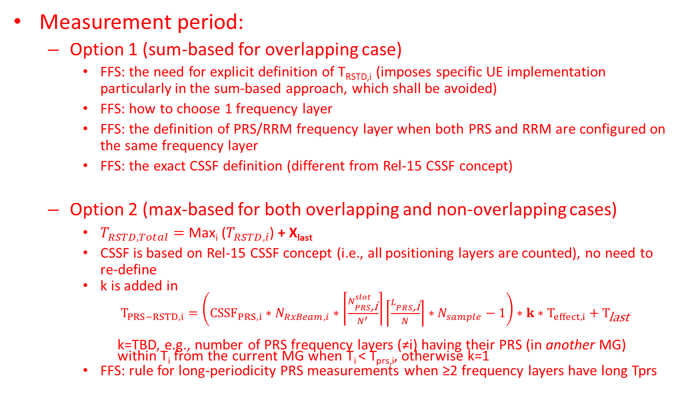
Measurement period for RSTD (2)
Measurement period:
  Option 1 (sum-based for overlapping case)
    FFS: the need for explicit definition of T_{RSTD,i} (imposes specific UE implementation particularly in the sum-based approach, which shall be avoided)
    FFS: how to choose 1 frequency layer
    FFS: the definition of PRS/RRM frequency layer when both PRS and RRM are configured on the same frequency layer
    FFS: the exact CSSF definition (different from Rel-15 CSSF concept)
  Option 2 (max-based for both overlapping and non-overlapping cases)
    $T_{RSTD,Total}=$Max_{i} ($T_{RSTD,i}$) + X_{last}
    CSSF is based on Rel-15 CSSF concept (i.e., all positioning layers are counted), no need to re-define
    k is added in
      $T_{PRS−RSTD,i}={\left({{CSSF}_{PRS,i}∗N}_{RxBeam,i}∗\left\lceil \frac{N_{PRS\text{,}\text{i}}^{slot}}{N^{′}}\right\rceil \left\lceil \frac{L_{PRS\text{,}\text{i}}}{N}\right\rceil ∗N_{sample}−1\right)∗k∗T}_{effect,i}+T_{\text{last}}$
      k=TBD, e.g., number of PRS frequency layers (≠i) having their PRS (in another MG) within T_{i} from the current MG when T_{i} < T_{prs,i}, otherwise k=1
    FFS: rule for long-periodicity PRS measurements when ≥2 frequency layers have long Tprs

Slide 4
Measurement period for RSTD (3)
Open issues to be discussed at RAN4#98-e
  Lprs definition in 38.133
  Calculation of PRS sample duration
    Option 1: The calculation of PRS sample duration should be based on the type (type 1 or type 2) as UE used to report {N,T}
    Option 2: Do not agree with option 1. The sample parameters (e.g., number of repetitions, number of PRS symbols in slot, etc.) are to be defined in the accuracy requirements
  Multiple PRS periodicities
    Option 1: Use the maximum PRS resource periodicity among all PRS resources in a single positioning frequency layer
    Option 2: Use the least common multiple of PRS periodicities among all PRS resources in a single positioning frequency layer
    Option 3: In Rel-16, RAN4 requirements should apply only for PRS periodicities that are multiples of 5 ms
    Option 4: FFS, consider the case where e.g. not all PRS resources or resource sets are in gaps.

Slide 5
Measurement period for RSTD (4)
Open issues to be discussed at RAN4#98-e
  Measurement period when configured with PRS-RSRP
    Option 1: RSTD measurement period shall not be impacted by PRS-RSRP measurement.
    Option 2: When RSTD is configured together with PRS-RSRP and the required PRS-RSRP measurement period is longer than that for RSTD (configured without RSTD), then the RSTD measurement continues over the entire PRS-RSRP measurement period
    Option 3: PRS-RSRP measurement period is the same as that for RSTD, while the accuracy requirements are met for both PRS-RSRP and RSTD.
    Consider the following two scenarios:
      Scenario 1: UE being configured to do DL-TDOA only
      Scenario 2: UE being configured to do both DL-TDOA and DL-AoD

Slide 6
Measurement period for RSTD (5)
Open issues to be discussed at RAN4#98-e
  Measurement period of multiple PRS layers – overlapping case
    Option 1
      Measurement period of multiple PRS layers is defined as summation of the measurement period in each frequency layer
      CSSF is only for the MG sharing between PRS and RRM layers. Count only a single PRS layer for a gap occasion in CSSF calculation for both PRS and RRM layers.
    Option 2
      CSSF is used for PRS measurements as for other NR measurements
      Measurement period
    T_{RSTD, Total} = maxi (T_{RSTD,i}).
  Measurement period of multiple PRS layers – non-overlapping case
    Option 1: If such scenario is considered as a rare case, then adopt the sum approach; If such scenario is considered as a typical case, then adopt the max approach to reduce the measurement delay
    Option 2: Same requirements as for overlapping case (sum approach)
    Option 3: CSSF is used for PRS measurements as for other NR measurements. Measurement period for the non-sharing case shall be:
    T_{RSTD, Total} = maxi (T_{RSTD,i})

Slide 7
Measurement period for PRS-RSRP (1)
Measurement period extension due to SSB collision
  Follow the same conclusion for RSTD
Measurement period of multiple PRS layers – overlapping case
  Follow the same conclusion for RSTD.
Measurement period of multiple PRS layers – non-overlapping case
  Follow the same conclusion for RSTD.
Measurement period of PRS-RSRP when configured with RSTD or UE Rx-Tx
  Follow the same conclusion for RSTD

Slide 8
Measurement period for UE Rx-Tx time difference (1)
Measurement period extension due to SSB collision
  Follow the same conclusion for RSTD
Measurement period when configured with PRS-RSRP
  Follow the same conclusion for RSTD
Measurement period of multiple PRS layers – overlapping case
  Follow the same conclusion for RSTD.
Measurement period of multiple PRS layers – non-overlapping case
  Follow the same conclusion for RSTD.
SRS/PRS being in same band
  Option 2: Basic requirements for UE Rx-Tx time difference measurements shall be based on the assumption that positioning SRS resources are in the same band as PRS frequency layer

Slide 9
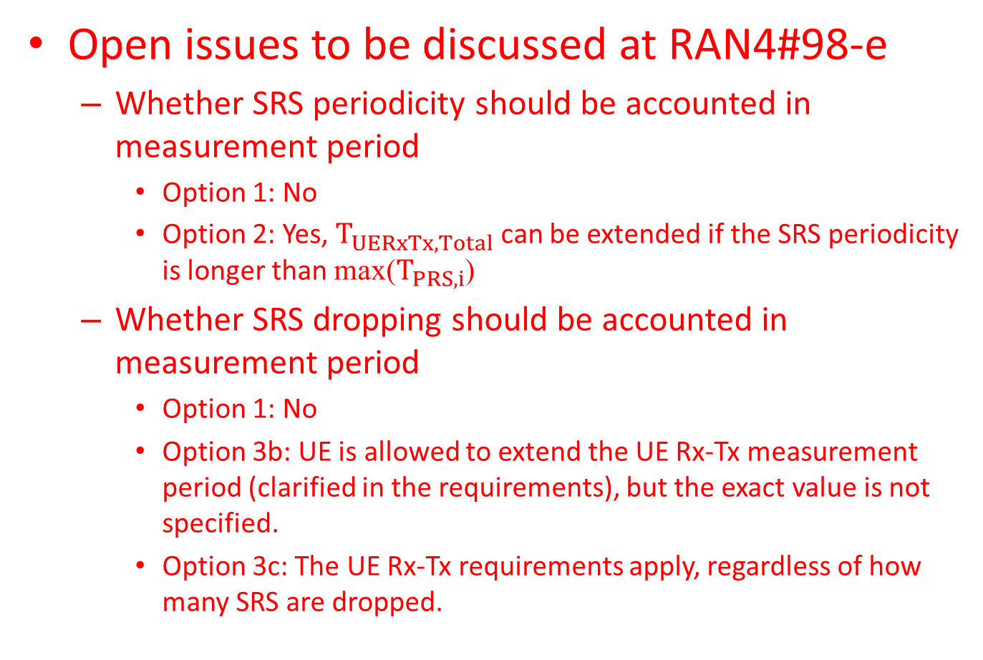
Measurement period for UE Rx-Tx time difference (2)
Open issues to be discussed at RAN4#98-e
  Whether SRS periodicity should be accounted in measurement period
    Option 1: No
    Option 2: Yes, $T_{UERxTx,Total}$ can be extended if the SRS periodicity is longer than max($T_{PRS,i}$)
  Whether SRS dropping should be accounted in measurement period
    Option 1: No
    Option 3b: UE is allowed to extend the UE Rx-Tx measurement period (clarified in the requirements), but the exact value is not specified.
    Option 3c: The UE Rx-Tx requirements apply, regardless of how many SRS are dropped.

Slide 10
Measurement period for UE Rx-Tx time difference (3)
Open issues to be discussed at RAN4#98-e
  SRS/PRS proximity
    Option 1: The measurement requirements are applicable only if any SRS transmission is within [-X, X] msec of at least one DL PRS resource of each of the TRPs in the assistance data. Accuracy requirements is independent of PRS and SRS separation.
      Option 1a: X=50ms
      Option 1b: X=160ms
      Option 1c: X=25ms
      Option 1d: X=80ms
    Option 2: The requirements for UE Rx-Tx apply regardless of the time separation between SRS and PRS (LTE approach)
    Option 3: The requirements for UE Rx-Tx apply provided MIN(Tsrs, Tprs) ≤ 2*X; X = FFS (we can accept X = 160 ms).

Slide 11
Measurement period for UE Rx-Tx time difference (4)
Open issues to be discussed at RAN4#98-e
  Measurement period in case of TA change (due to TA command)
    Option 1: UE should continue Rx-Tx time difference measurement (existing requirements are applicable)
    Option 2a: UE shall discard the UE Rx-Tx time difference measurement if the uplink transmission timing (autonomous or based on network-configured TA) changes during the UE Rx-Tx measurement period
    Option 2b: UE Rx-Tx time difference measurement requirements are not applicable if TA change is received during the measurement period.
  Measurement period in case of TA change (due to UE autonomous adjustment)
    Option 1: UE should continue Rx-Tx time difference measurement (existing requirements are applicable)
    Option 2: UE shall discard the UE Rx-Tx time difference measurement if the uplink transmission timing (autonomous or based on network-configured TA) changes during the UE Rx-Tx measurement period
    Option 3: follow the same conclusion from sub-topic 3-10.

Slide 12
Measurement period for UE Rx-Tx time difference (5)
Open issues to be discussed at RAN4#98-e
  Measurement period in case of N_{TA_offset} change
    Option 1: No need to clarify UE Rx-Tx measurement requirements in case of N_{TA_offset} change
    Option 2: It is clarified in UE Rx-Tx measurement requirements (section 9.9.4 in TS 38.133) that the UE shall discard the UE Rx-Tx measurement if the N_{TA_offset} changes during the measurement period.
  UE Rx-Tx at cell change
    Option 1: The UE Rx-Tx time difference measurement is restarted if the serving cell (PCell, PSCell, or SCell) configured with the SRS for positioning changes during the measurement period. In this case, the UE shall restart the UE Rx-Tx time difference measurement after the SRS reconfiguration on the target cell is complete. Otherwise, the UE shall continue the on-going UE Rx-Tx time difference measurement after the serving cell change
    Other options not precluded

Slide 13
Measurement capability
Open issues to be discussed at RAN4#98-e
  Applicability conditions related to measurement capability
    Option 1: The measurement requirements do not apply for a PRS resource, if time span of the PRS resource instance is greater than UE reported capability N.
    Option 2: The measurement requirements do not apply for a PRS resource, if the time span of a DL PRS resource instance is greater than the configured measurement gap length
    Option 3: The measurement requirements do not apply for a PRS resource, if the PRS resource is across two sampling duration of N within duration Lprs
    Option 4: none of option 1~3 is needed. It’s already clear from 38.133 that the measurements are performed within the UE capability.
    Note: option 1~3 are not exclusive with each other

Slide 14
CSSF when configured with PRS measurement (1)
Define CSSF based on the following principles unless technical issues are identified.
  In case PRS measurement in the positioning frequency layer is considered as a long periodicity measurement, then the CSSF for this frequency layer is equal to one
    Exact definition and criteria for long periodicity PRS measurements are FFS
  Otherwise the positioning frequency layer would compete for MG with other gap-based RRM and/or PRS measurements from other frequency layers
    Option 1: frequency layer would compete for MG with other gap-based RRM measurements
    Option 2: frequency layer would compete for MG with other gap-based RRM and PRS measurements

Slide 15
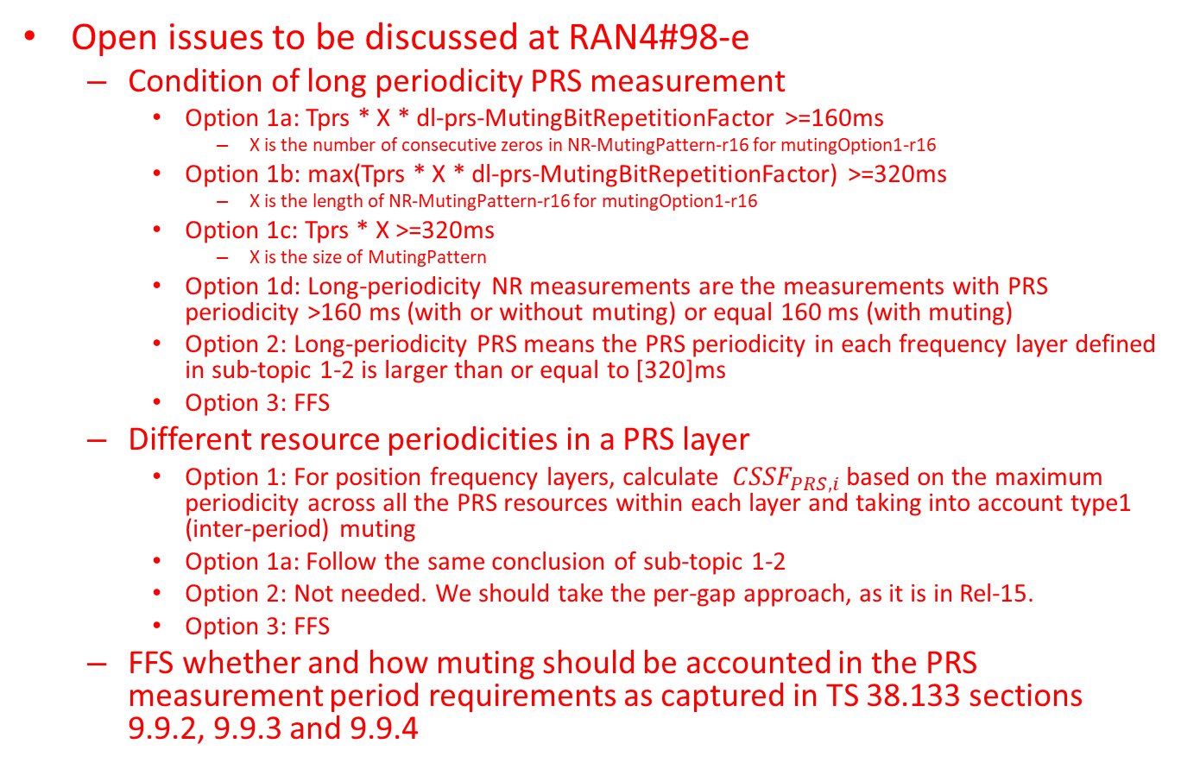
CSSF when configured with PRS measurement (2)
Open issues to be discussed at RAN4#98-e
  Condition of long periodicity PRS measurement
    Option 1a: Tprs * X * dl-prs-MutingBitRepetitionFactor >=160ms
      X is the number of consecutive zeros in NR-MutingPattern-r16 for mutingOption1-r16
    Option 1b: max(Tprs * X * dl-prs-MutingBitRepetitionFactor) >=320ms
      X is the length of NR-MutingPattern-r16 for mutingOption1-r16
    Option 1c: Tprs * X >=320ms
      X is the size of MutingPattern
    Option 1d: Long-periodicity NR measurements are the measurements with PRS periodicity >160 ms (with or without muting) or equal 160 ms (with muting)
    Option 2: Long-periodicity PRS means the PRS periodicity in each frequency layer defined in sub-topic 1-2 is larger than or equal to [320]ms
    Option 3: FFS
  Different resource periodicities in a PRS layer
    Option 1: For position frequency layers, calculate ${CSSF}_{PRS,i}$ based on the maximum periodicity across all the PRS resources within each layer and taking into account type1 (inter-period) muting
    Option 1a: Follow the same conclusion of sub-topic 1-2
    Option 2: Not needed. We should take the per-gap approach, as it is in Rel-15.
    Option 3: FFS
  FFS whether and how muting should be accounted in the PRS measurement period requirements as captured in TS 38.133 sections 9.9.2, 9.9.3 and 9.9.4

