Slide 1
WF on NR-U RRM Core Requirements all agreements in RAN4#97-e in email thread:
[97e][205] NR_unlic_RRM_1
3GPP TSG-RAN WG4 Meeting #97-e R4-2017080
Electronic Meeting, 2nd – 13th November, 2020
Agenda Items: 7.1.6
Ericsson

Slide 2
Agreements from the 1st round
Agreements from the 1st GTW session
Agreements from the 2nd round

Slide 3
General
Number of candidate SSBs for cell detection
  For cell detection the requirements are defined under assumption that UE monitors at least 1 candidate SSB position in one SSB block burst.
    Note: 1 candidate SSB position for detection should not be impacted by what UE is already monitoring within the current measurement period of the on-going measurements
Exact candidate SSB positions
  Do not fix exact SSB positions for cell detection
Set of candidate SSB positions in RRM requirements
  Except cell detection, RRM core requirements are defined under assumption what UE monitors the first 2 successive QCL’ed candidate SSB positions (i.e. N1 = N2 = 2). For a certain SSB index which has only one configured candidate SSB position in the SSB burst, UE monitors 1 candidate SSB position for this SSB in one SSB burst.

Slide 4
General (cont.)
Terminology updates for the case without DRX, MGRP, etc. for 38.133
  The terminology needs to be updated in the following sections of TS 38.133, to capture the agreements from R4-2012249:
    4.2A Cell Re-selection when CCA is used
    6.1A Handover when CCA is used at least in the target cell
    6.2.1A RRC Re-establishment with CCA
    6.2.3A RRC Connection Release with Redirection with CCA
    7.1 UE transmit timing
    8.1A Radio Link Monitoring with CCA on target frequency
    8.3A Activation and Deactivation Delay of SCell operating with CCA
    8.5A Link Recovery Procedures when CCA is used on target frequency
    8.10A Active TCI state switching delay when CCA is used on target frequency
    9.2A NR intra-frequency measurements when CCA is used
    9.3A NR inter-frequency measurements when CCA is used
    9.5.4A L1-RSRP measurement requirements (with CCA on serving cell)

Slide 5
General (cont.)
Terminology updates for the case without DRX, MGRP, etc. for 36.133
  The terminology needs to be updated in the following sections of TS 36.133, to capture the agreements from R4-2012249:
    4.2.2.5.7 Measurements of NR cells operating with CCA (CCA requirements for interRAT reselection)
    5.3.4A E-UTRAN - NR FR1 Handover when CCA is used in the target cell
    6.3.2.4A RRC connection release with redirection to NR with CCA
    7.31A Addition and Release Delay of NR PSCell operating with CCA for E-UTRA - NR Dual Connectivity
    8.1.2.4.21A E-UTRAN FDD – NR measurements when CCA is used
    8.17.2.2.a SFTD Measurement requirements with CCA on target frequency
    8.17.4A E-UTRA Inter-RAT NR Measurements when Configured with E-UTRA-NR Dual Connectivity Operation when CCA is used
FFS: The need for further terminology updates for the case with DRX, MGRP, etc.

Slide 6
RRC Re-Establishment
Cell search delay for unknown intra-frequency cell
  The cell search delay for unknown intra-frequency cell when serving cell SSB Ês/Iot < -8 dB is (800+ 20 x K₁ )
Cell search delay for unknown inter-frequency cell
  The cell search delay for unknown inter-frequency cell when serving cell SSB Ês/Iot < -8 dB is (800+ 20 x K_{2,i})

Slide 7
Random Access
Specification structure for section 6.2.2A
  6.2.2A Random access with CCA
  6.2.2A.1 Introduction
  6.2.2A.2 Requirements [at least for 4-step RA]
      FFS: whether 6.2.2A.2 covers only 4-step RA or (if RAN4 will specify requirements for 2-step for NR-U) 6.2.2A.2 is further split to cover 4-step and 2-step RA or a separate section on the same level (e.g. 6.2.2A.3) is introduced for 2-step RA requirements
4-step RA type
  The requirements are not the same as in Rel-15
  The requirements will include requirements for contention-based and non-contention based RA
  The requirements for 4-step RA for NR-U will not cover supplementary UL
2-step RA type
  RAN4 will define in Rel-16 NR-U RA requirements for 2-step RA
  RAN4 will investigate and discuss in RAN4#98-e the impacts of 2-step RA on other sections/requirements

Slide 8
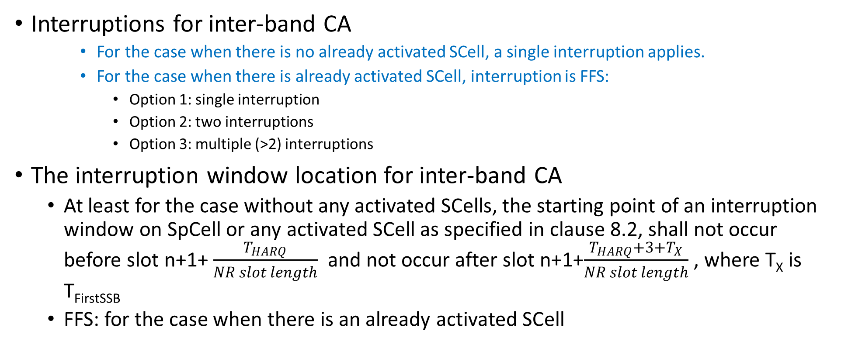
SCell Activation: Interruptions with Inter-Band CA
Interruptions for inter-band CA
    For the case when there is no already activated SCell, a single interruption applies.
    For the case when there is already activated SCell, interruption is FFS:
      Option 1: single interruption
      Option 2: two interruptions
      Option 3: multiple (>2) interruptions
The interruption window location for inter-band CA
  At least for the case without any activated SCells, the starting point of an interruption window on SpCell or any activated SCell as specified in clause 8.2, shall not occur before slot n+1+ $\frac{T_{HARQ}}{NR slot length}$ and not occur after slot n+1+$\frac{T_{HARQ}+{3+T}_{X}}{NR slot length}$ , where T_{X} is T_{FirstSSB}
  FFS: for the case when there is an already activated SCell

Slide 9
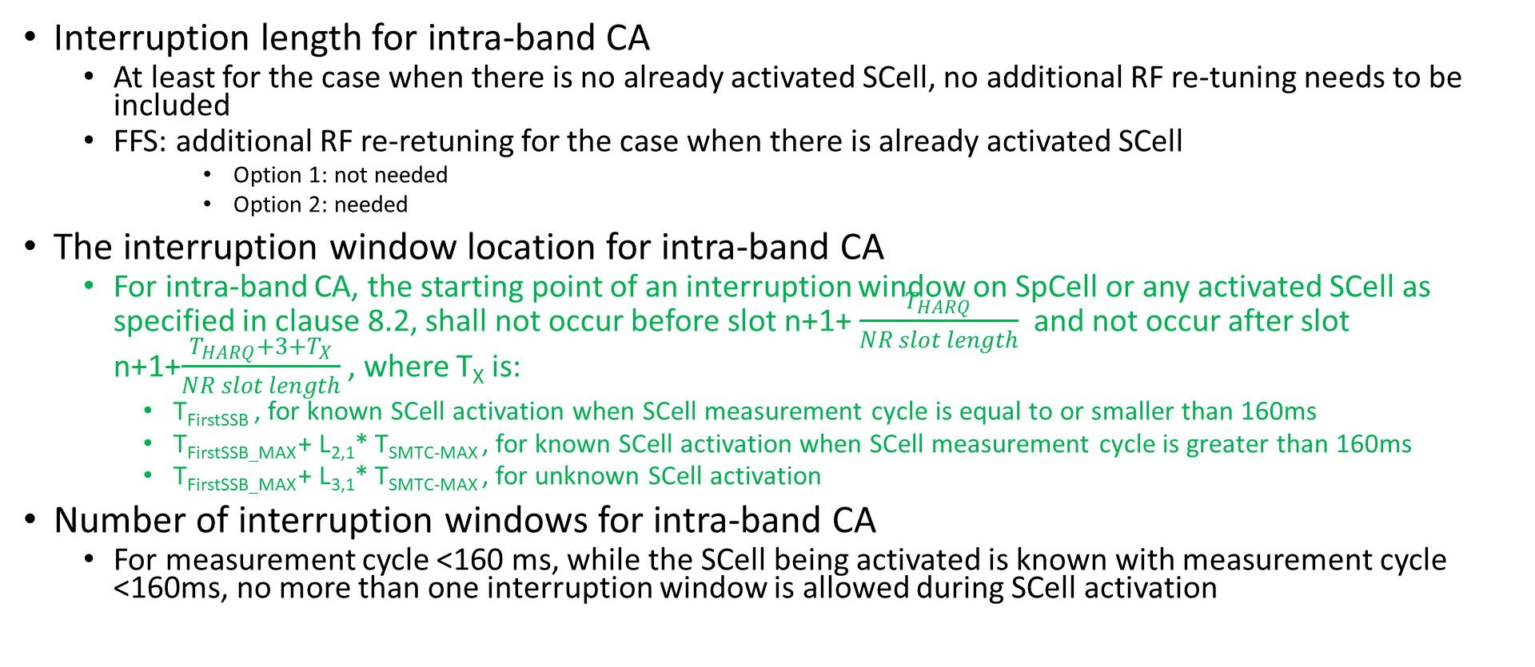
SCell Activation: Interruptions with Intra-Band CA
Interruption length for intra-band CA
  At least for the case when there is no already activated SCell, no additional RF re-tuning needs to be included
  FFS: additional RF re-retuning for the case when there is already activated SCell
      Option 1: not needed
      Option 2: needed
The interruption window location for intra-band CA
  For intra-band CA, the starting point of an interruption window on SpCell or any activated SCell as specified in clause 8.2, shall not occur before slot n+1+ $\frac{T_{HARQ}}{NR slot length}$ and not occur after slot n+1+$\frac{T_{HARQ}+{3+T}_{X}}{NR slot length}$ , where T_{X} is:
    T_{FirstSSB} , for known SCell activation when SCell measurement cycle is equal to or smaller than 160ms
    T_{FirstSSB_MAX} + L_{2,1}* T_{SMTC-MAX} , for known SCell activation when SCell measurement cycle is greater than 160ms
    T_{FirstSSB_MAX} + L_{3,1}* T_{SMTC-MAX} , for unknown SCell activation
Number of interruption windows for intra-band CA
  For measurement cycle <160 ms, while the SCell being activated is known with measurement cycle <160ms, no more than one interruption window is allowed during SCell activation

Slide 10
SCell Activation: Conditions for measuring CSI-RS during SCell activation
Background - Agreement from RAN4#96-e (R4-2012249):
  When P/SP-CSI-RS is used for CSI report during the SCell activation, it is assumed one of the RRC parameters CO-DurationPerCell-r16, SlotFormatIndicator, and CSI-RS-ValidationWith-DCI-r16 is configured for a UE and the UE supports the corresponding capability, except for the cases when the UE cancels the reception [TS 38.213]
Send LS to RAN1 (R4-2017083 or its revision) to inform about the current RAN4 assumption regarding CSI-RS measurements during the SCell activation procedure. Unless RAN1 responds with something different, do not change the RAN4 assumption

Slide 11
SCell Activation: sCellDeactivationTimer
When sCellDeactivationTimer is NOT configured
  Applicability of SCell activation requirements when sCellDeactivationTimer is NOT configured
    The SCell activation requirements for NR-U do not apply when the sCellDeactivationTimer is not configured
  Applicability of SCell deactivation requirements when sCellDeactivationTimer is NOT configured
    The SCell deactivation requirements for NR-U do not apply when the sCellDeactivationTimer is not configured
When sCellDeactivationTimer IS configured
  UE behaviour with respect to the timer when sCellDeactivationTimer IS configured
    UE shall not stop sCellDeactivationTimer before UE successfully transmits the HARQ feedback for the deactivation command when sCellDeactivationTimer has not expired

Slide 12
Active TCI State Switching
Enhancements in Rel-17
  Do not further discuss this proposal under this Rel-16 WI, consider bringing the proposal in the plenary instead

Slide 13
Beam Management
A new clause for L1-RSRP reporting under CCA in TS 38.133
  Introduce new clause 9.5A in TS38.133 for L1-RSRP reporting under CCA
UE behavior when UE cannot transmit HARQ-ACK for MAC-CE deactivation of semi-persistent CSI reporting
  RAN4 should wait for LS response from RAN1 on the UE behavior when UE cannot transmit HARQ-ACK for MAC CE deactivation for semi-persistent CSI reporting due to UL LBT failure
  Once RAN4 receives the LS response from RAN1, RAN4 should resume the discussion and capture the UE behavior in TS 38.133 if necessary
  Based on the most recent RAN1 agreements and the LS to RAN4, clarify in 38.133:
    When CCA is used on target frequency, the UE shall stop semi-persistent L1-RSRP measurement reports on PUCCH, when the UE cannot transmit a PUCCH with HARQ-ACK information in slot n corresponding to the PDSCH carrying the deactivation command

Slide 14
Measurement Requirements: RSSI
Scheduling restrictions – 1 symbol before the first/after the last RSSI measurement symbol
  It is not necessary to include the restriction on 1 data symbol before the first RSSI measurement symbol configured by RMTC, and 1 data symbol after the last RSSI measurement symbol configured by RMTC
  FFS: need to clarify the reference timing for intra-frequency RSSI/CO measurements in unlicensed spectrum
Scheduling restrictions – further clarification in TS 38.133
  Add clarification for UL scheduling restriction as “The UE is not expected to transmit PUCCH/PUSCH/SRS on the UL symbols which are overlapping in time with the RSSI measurement symbols configured by RMTC”

Slide 15
Measurement Requirements: Intra-/Inter-Frequency
Scheduling restrictions for inter-band CA
  In FR1 inter-band CA, the scheduling restriction due to one CC shall not apply to other CCs on the other bands

Slide 16
Measurement Requirements: SFTD
SFTD measurement capability and the corresponding feature in the Rel-16 feature list
  The decision is to be taken in RAN2, do not discuss further in RAN4 [moderator: exact wording will be used here once the chairman’s notes are available]

Slide 17
Measurement Requirements: CSSF
CSSF outside gap
  FFS: CSSF outside gaps (CSSF_{outside_gap,i}) should be additionally increased if one MO configured both for RSSI measurement with gap and SSB-based measurement gap
CSSF within gap
  FFS: CSSF within measurement gaps (CSSF_{within_gap,i} ) needs also to be adapted to account for inter-frequency RSSI/CO measurements and intra-frequency RSSI/CO measurements with gaps
  FFS: Regarding the CSSF within measurement gaps (CSSF_{within_gap,i} ), a MO should be counted twice, if the MO with both SSB based measurement and RSSI/CO measurement which are candidates to be measured in gap j where the measurement object i is also a candidate

Slide 18
UE Transmit Timing
Reference Cell Definition
  In the requirements of clause 7.1.2, the term reference cell on a carrier frequency subject to CCA is not available at the UE refers to when at least one SSB is configured by gNB, but the first two successive candidate SSB positions for the same SSB index within the discovery burst transmission window are not available at the UE due to DL CCA failures at gNB during the last 160 ms; otherwise the reference cell on the carrier frequency subject to CCA is considered as available at the UE
DRX case: FFS, unless this can also be solved in RAN4#97-e

