Slide 1
WF on multi-band relaxation of n262
3GPP TSG-RAN WG4 Meeting #97-e
Electronic meeting, 2nd Nov – 13 Nov 2020
R4-200xxxx
Apple

Slide 2
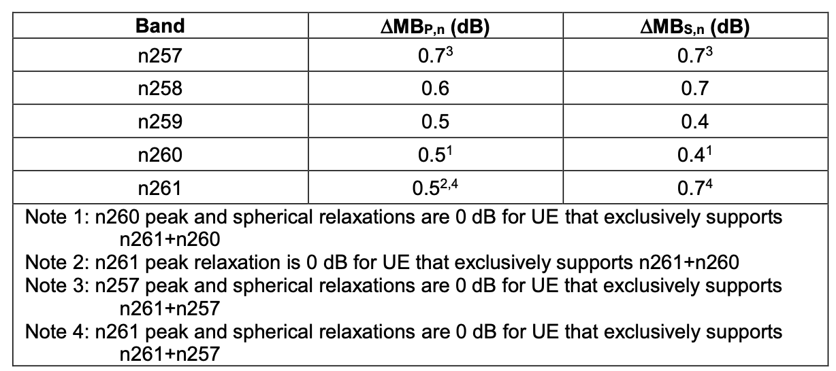

Background
For UEs that support multiple FR2 bands, minimum requirement for peak EIRP/EIS and EIRP/EIS spherical coverage shall be decreased per band by:
The peak EIRP/EIS relaxation parameter $Δ$MBP,n
The EIRP/EIS spherical coverage relaxation parameter $Δ$MBS,n
Extension of the scope of the UE multi-band support in Rel-17 (n257, n258, n261, n260, n259, and now including band n262).

Slide 3
WF – Multi-band relaxation (MBR) for n262
Regardless of the transceiver architecture, UE implementation with antenna arrays that span frequency range 37 – 48.2 GHz is anticipated
Companies are encouraged to study and quantify RF impairments associated to such an antenna array implementation, including considerations for antenna element spacing and form factor integration trade-offs.
Open issues:
Companies are encouraged to consider band grouping scenarios and architecture options, and their impact on MBR.
Companies are encouraged to provide values for MBR for n262 based on the above considerations in the next RAN4 meeting.

