Slide 1
Way Forward on NR TxD & Power Class
3GPP TSG-RAN WG4 Meeting # 97-e
Electronic Meeting, 2nd – 13th Nov., 2020
R4-20xxxxx
vivo

Slide 2
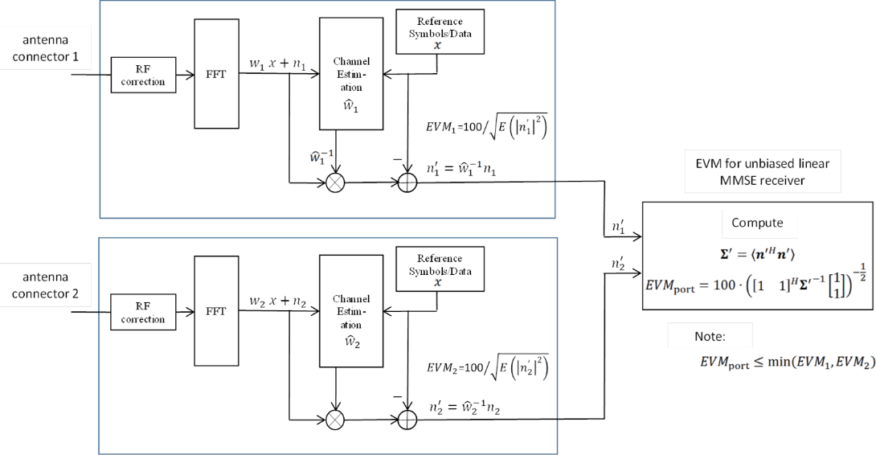
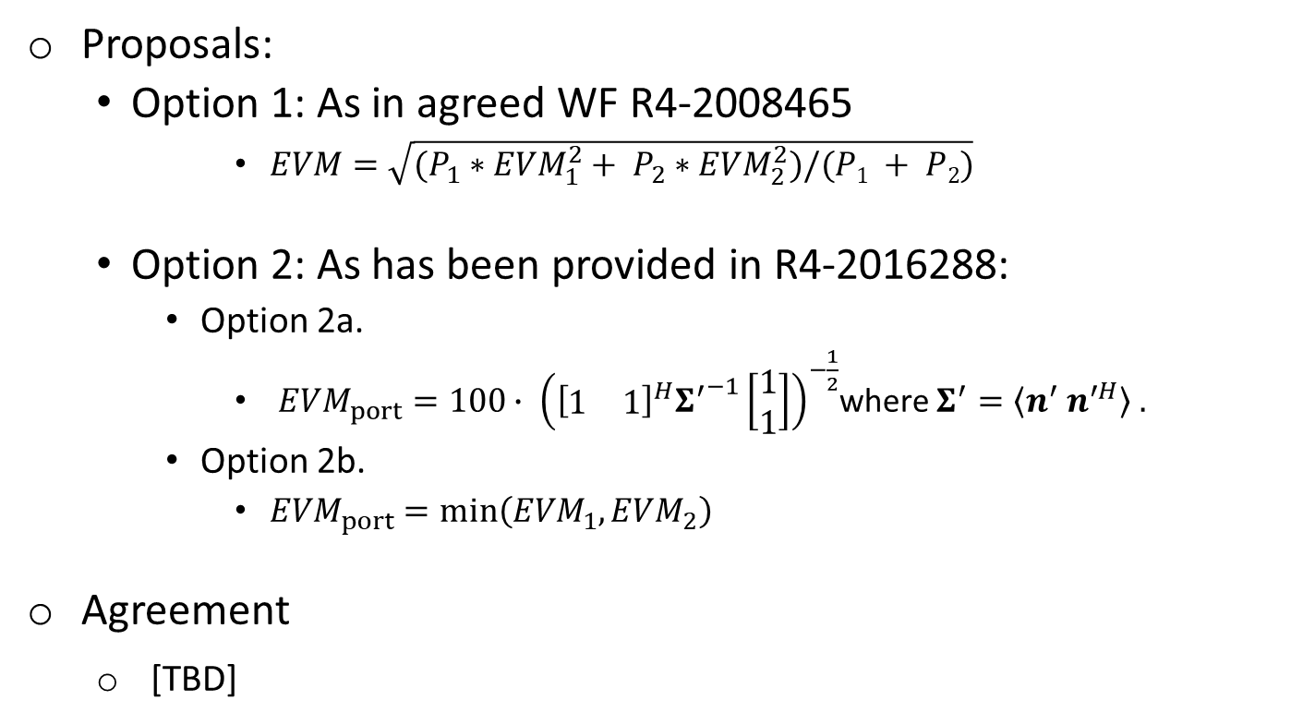
EVM for Transparent TxD
Proposals:
Option 1: As in agreed WF R4-2008465
$EVM=\sqrt{(P_{1}∗{EVM}_{1}^{2}+ P_{2}∗{EVM}_{2}^{2})/(P1 + P2)}$
Option 2: As has been provided in R4-2016288:
Option 2a.
${EVM}_{port}=100∙ {\left({\left[\begin{matrix}1 & 1\end{matrix}\right]}^{H}{Σ^{′}}^{−1}\left[\begin{matrix}1 \\ 1\end{matrix}\right]\right)}^{−\frac{1}{2}}$where $Σ^{′}=〈n^{′} n^{′H}〉 .$
Option 2b.
${EVM}_{port}=min\left({EVM}_{1},{EVM}_{2}\right)$
Agreement
[TBD]

Slide 3
Declaration for Default TX Connector
Agreement
UE declares which connectors will be active per band under test. TE needs to detect ACK and NACK and any other expected response from UE from all declared TX antenna connectors.
The word “active” can be replaced by “used for TxD during one test procedure”. (Not necessarily to have transmission all the time.)
UE declaration needs to describe exact two antenna connectors under test.

Slide 4
UE Behavior under Conformance Testing
Background: Motivation is to guide how to test requirements that require power changes such as relative power control.
Proposals:
Option 1a: UE will keep the tx diversity status unchanged in conformance testing.
Option 1b: Test mode signalling is implemented to instruct UE to keep TX div status unchanged
Option 2: TE will detect and sum for every power step and change in condition from all connector
Agreement
[TBD]

Slide 5
Power Splitting Behavior
Background: Motivation is to guide how to test requirements that require power changes such as relative power control
Proposals:
Option 1: Only allow equal power split between connectors
Excludes 17+17+20 dBm implementations
Excludes power control optimizations
Option 1a: Per instructed as test mode, UE should keep equal power split between connectors in all cases.
Option 2: Allow any power split between connectors
Two basic Questions:
Whether or not unequal power splitting would exist in TxD implementation?
Whether or not equal power splitting is needed for the test?
Agreement
[TBD]

Slide 6
MPR for Transparent and UL MIMO
Whether 2 Tx MPR should be the same MPR requirement for TX Diversity and UL MIMO for the same power class.
Proposals
Option 1: Yes
Option 2: No.
Agreement
Option 1

Slide 7
Signaling for Transparent TxD
Whether and how RAN4 introduce signalling for transparent TxD:
Option 1: Introduce some sort of signaling by UE
Option 1a. Use ModifiedMPRbehavior bits to signal additional relaxations;
Option 1b: Introducing a new (capability) signalling for TxD
Option 1c: Introducing a new power class (e.g. PC2.5) for TxD
Option 2: Based on UE vendor declaration.
Option 3: Using existing signalling to indicate the 2Tx implementation capability.
Two basic questions:
For testing purpose, whether UE declaration is sufficient for differentiation of different e.g. MPR, requirements or not?
Whether UE TxD structure/implementation need to be reported to network or not? And what is the pros and cons to do so?
Agreement
[TBD]

Slide 8
Applicability of Transparent TxD Requirement
The applicability of the newly introduced test procedure (if any) and specific requirement (if any) for transparent TxD UE :
FFS whether or not applicable to UE implementation without transparent TxD
If requirements are embedded in to general requirements or distinguished in to TxD dedicated requirements is FFS

Slide 9
CDD-related Requirement
For transparent TxD UE, necessity of CDD related requirements, e.g. requirement on TAE+CDD, is need to be further studied:
Proposals
Option 1: Yes
Option 2: No.
Agreement
[TBD]

Slide 10
Rel-15 NSA power class
Proposals
Option 1: The Pcmax for NR is modified according to the declared NR power capability for NSA so that the PHR becomes correct. (Based on R4-2015976 & R4-2015977)
Option 2: Introduce the Rel-16 defined power class UE capability for Rel-15, and Indication of UE implementation by declaration. (Based on R4-2016479 observation 1)
Option 3: The Pcmax for NR is modified to use the lower possible power class to decide the lower bound of the configured power. (Based on R4-2016479 observation 3 & R4-2016482)
Option 4: Any other combined/refined revision.
Option 5: Further revision not needed.
Agreement
[Keep the spec unchanged for this issue in this meeting.]
[Confirm that if TxD cannot applied to Rel-15, then the ambiguity issue would no longer exist. ]
[Further study the impact and feasibility for option 1/2/3.]

