Slide 1
3GPP TSG-RAN WG4 Meeting RAN4#96-e R4-2012713 Online, 17th – 28th August, 2020
WF on the high DL power and low UL power test cases objective
Apple Inc.

Slide 2
EnhancedSpecialized test systems
Investigate non-permitted test systems, such that the test case applicability of these test systems under investigations is according to WF in R4-1913070 (i.e. such test systems are not required to verify all requirements in TS38.101-2).
The list of candidate non-permitted test systems is limited to NFTF and DNF NF based solutions
Whether non-permitted test systems under investigation shall be capable of beam peak search and spherical coverage evaluation is FFS.
For non-permitted test systems under investigation, text proposals on test setup descriptions, gains from the enhancements relative to permitted methods in TR38.810, impact on test time, and preliminary MU are needed for the next RAN4 meeting.

Slide 3
Enhancements to permitted methods
For the permitted methods in TR38.810, text proposals on test setup descriptions, gains from the enhancements relative to permitted methods in TR38.810, impact on test time, and preliminary MU are needed for the next RAN4 meeting.
If no such proposals are submitted by the next RAN4 meeting, then RAN4 agrees that no enhancement of permitted methods is feasible.

Slide 4
Manufacturer declarations
The list of potential candidate vendor declarations and how they map to a particular test system parameter includes the following:
Location of the active panels that yields the TX and RX beam peaks (applicable if the enhanced test methodology does not need to perform beam peak search)
Location of the active panels in any UL/DL test direction and the detailed locations of the panels within the DUT (applicable if the enhanced test methodology does need to perform beam peak search)
Whether vendor declarations can be restricted to test cases based on single direction is FFS (to be determined next RAN4 meeting)
Whether vendor declarations, based on the above proposals, can be adopted as methodology enhancements is FFS (to be determined next RAN4 meeting)

Slide 5
Study of UE beam management sensitivity to magnitude/phase variation of the DL signal
If beam peak direction and UBF activation are performed based on FF method and then perform other TCs based on NF method, then the beam management study is not necessary.
For the DNF system, and assuming it needs to perform beam peak search, such that the DUT is enabled to form its UL beam in the direction of the DL signal, a study of UE beam management sensitivity to magnitude/phase variation of the DL signal needed.
Simulation assumptions are provided in the following slides

Slide 6
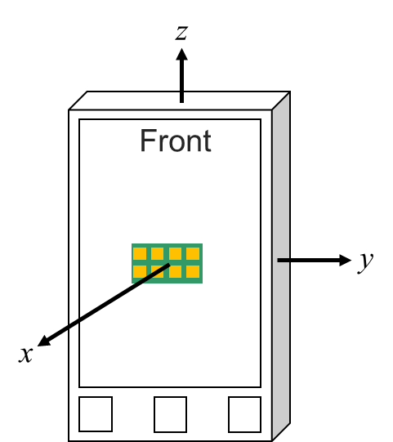
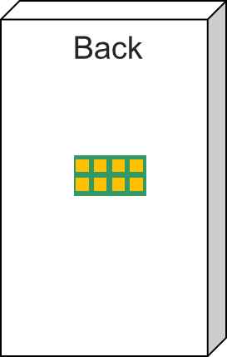
Antenna Assumptions for Rel-15 in TR38.810
G.3 Spherical coverage Measurement Grids
G.3.1 Assumptions
The simulation assumptions for the spherical coverage grids are the same as outlined in Annex G.1.1.
Regarding the antenna implementation and beamformer, the following assumptions have been made (refer to Figure G.3.1-1):
Two 8x2 antenna arrays are integrated in the UE for the spherical coverage analyses
The implementation loss for the antenna near the front is 5dB less than that for the antenna near the back
For Beam Steering Assumptions
In the xz plane, 45º beam steering granularity (from 45º to 135º) has been used
In the xy plane, 22.5o beam steering granularity (from -90º to 90º) has been used
No offset antennas
Figure G.3.1-1: Illustration of the two antenna arrays integrated in the UE.

Slide 7
New Antenna Assumptions for Rel-17 Enh Test SI
z
y_{offset}
Front
z_{offset}
G.3 Spherical coverage Measurement Grids
G.3.1 Assumptions
For 8x2 array, the simulation assumptions for the spherical coverage grids are the same as outlined in Annex G.1.1 in TR38.810. For 4x1 array, the grids shall be reduced accordingly.
Regarding the antenna implementation and beamformer, the following assumptions have been made (refer to Figure G.3.1-1 in TR38.810):
Two antenna arrays are integrated in the UE for the spherical coverage analyses
Antenna panels are studied with N_{z} x N_{y} with N_{z}>N_{y}, e.g., 8x2 corresponds to N_{z} = 8 and N_{y} = 2
The implementation loss for the antenna near the front is 0dB less than that for the antenna near the back
The antenna in the back is on the opposite side of the UE (mirrored around (0,0,0)).
For Beam Steering Assumptions
In the xy plane, assume 45º beam steering granularity (AZ from -45º to +45º)
In the xz plane, assume 22.5º beam steering granularity (EL from -90º to 90º)
Front and back figures in this page are example positions of two antenna arrays
y
x
Back
Illustration of the two antenna arrays integrated in the UE, for Rel-17 simulation

Slide 8
New Simulation Assumptions for Rel-17 Enh Test SI
Offsets:
Various antenna offsets (y_{offset}, z_{offset}) beyond 7.5cm in radius (12.5cm max)
Offset is defined with respect to the center of antenna array
Antenna Array:
8x2 and 4x1
Element near-field assumption is implementation specific
Range Lengths (distance between centre of QZ/positioning axes and measurement probe):
30cm, 20cm (more range lengths are not precluded)
Goal is to eventually determine min. range length and MU for performing spherical coverage tests in DNF
Test Methodology:
DNF (while taking path loss offsets into account)
Sampling Grid:
Study finer than 7.5deg step size for constant-step size grids (both MVG/Sony and KS agree to parametric studies to show convergence for the selected assumption)
Notes:
Samsung: 20m is a typo of 20cm?

Slide 9
Path loss comparison across system types
The path loss comparison across IFF/DFF and NF system types below is taken as a starting point, and companies are encouraged to bring proposals to the next RAN4 meeting with corrections and/or improvements
f [GHz] | Antenna Config. 1, 2, and 3 - BLACK BOX - (PC3 Devices: D=5cm) |  | Antenna Config. 1 and 2 - WHITE BOX - (PC3 Devices: D=5cm)
 | IFF/DFF | NF | DFF | NF
 | Path Loss with 1m range length | Path Loss with 0.22m range length | Path Loss with 0.88m range length | Path Loss with 0.28m range length
24.25 | 60.16 | 46.86 | 59.01 | 48.93
30 | 62.01 | 48.71 | 60.85 | 50.78
40 | 64.51 | 51.21 | 63.35 | 53.28
43.5 | 65.24 | 51.94 | 64.08 | 54.00
52.6 | 66.89 | 53.59 | 65.73 | 55.65

Slide 10
References
Ref | T-doc number | Title | Company
[1] | R4-2009960 | Remaining issues with the test methodology for high DL power and low UL power test cases | Apple Inc.
[2] | R4-2010856 | Summary and Further Results on Impact of phase variation on beam pattern for NF test method | MVG Industries, Sony
[3] | R4-2011218 | On Test methodology for high DL power and low UL power test cases | Keysight Technologies
[4] | R4-2011281 | Views on test methods for high DL power and low UL power TCs | Rohde & Schwarz
[5] | R4-2011456 | FR2 testability enhancement for UE emissions | Qualcomm Incorporated
[6] | R4-2012561 | Email discussion summary for [96e][330] FR2_enhTestMethods | Moderator (Apple Inc.)

