Slide 1
Clarification on the network and UE behaviors between “Only single switched UL” and “SUO/SUO allowed”
3GPP TSG-RAN WG4 Meeting #96-e R4-200xxxx
Electronic Meeting, 25 May – 5 June, 2020
Agenda item: 7.5.2
Source: Huawei, HiSilicon

Slide 2
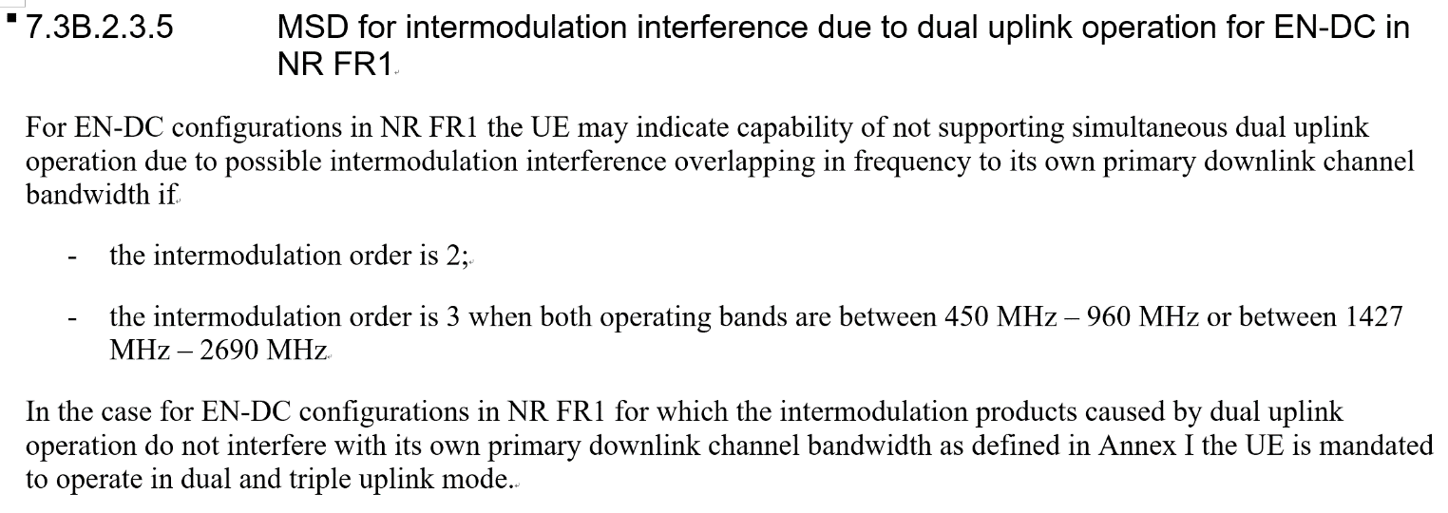
Current Agreement about the existing “singleUL-Transmission”
Based on the RAN plenary agreement [1][2], the agreement is copied here:
UE capability indicates that the UE does not allow 2 simultaneous UL transmission for the RAN4 specified channel allocations in a given band combination. If the network chooses to operate the UE in a way that is not consistent with this capability indication then the UE behavior is not specified and the UE might not meet the performance criteria.
The rule for ENDC band combination that UE can indicate “singleUL-Transmission”. This is copied in 7.3B.2.3.5 from TS 38.101-3.

Slide 3
Clarification on “SUO/SUO allowed”
1) When UE indicates the capability “singleUL-Transmission” for specific ENDC band combinations.
2) Network behaviours:
There is no restriction on Network. Network can choose single UL or dual UL Transmission when scheduling UE.
3) UE behaviours:
Indicates whether the UE supports the tdm-PatternConfig for single UL-transmission associated functionality, as specified in TS 36.331
UE expects to be scheduled with single switched UL and TDM pattern by Network.
If the network chooses to operate the UE in a way that is not consistent with this capability indication then the UE behavior is not specified and the UE might not meet the performance criteria.

Slide 4
Background on “only single switched UL”
Currently, there is no capability to indicate “only single switched UL”.
In Rel-15, for DC_3A_n3A intra-band non-contiguous EN-DC combination, only single switched UL is supported.
In Rel-16, only single switched UL is supported by some ENDC band combinations, such as DC_2A_n2A, DC_5A_n5A, DC_7A_n7A, DC_48A_n48A, DC_66A_n66A, DC_(n)5AA, DC_(n)12AA, DC_(n)38AA, DC_(n)48AA and DC_12A_n71A.
It can be foreseen that more and more ENDC band combinations have to be operated with only single switched UL in the future.
There is no clear definition about “only single switched UL” in current specifications.

Slide 5
Clarification on “only single switched UL”
1) Option 1:
Network behaviours: Restricting NW’s behavior that only single UL band (LTE band or NR band) can be scheduled in one slot/occasion. It is mandatory to use TDM-pattern when scheduling the specific UE.
UE behaviours: UEs which can’t support dual Transmission have to switch UL band following BS’s scheduling.
2) Option 2:
Network behaviours: There is no restriction on NW’s behavior for only single switched UL operation.
UE behaviours:
Indicates whether the UE supports the tdm-PatternConfig for single UL-transmission associated functionality, as specified in TS 36.331
UE expect to be scheduled with single switched UL and TDM pattern by Network.
However, UEs which can’t support dual Transmission can drop NR transmission when LTE and NR transmissions collide.

Slide 6
Solution on “only single switched UL”
1) If the Option 1 is the WG’s common understanding about “only single switched UL”:
Solution 1-1: specify a new capability ‘Only supporting single switched UL’.
Note: The specific description about the capability can be found in the last slide. The capability is applicable to both inter-band and intra-band ENDC combinations, so “inter-band” is removed)
Solution 1-2: implicit indication of SUO as proposed in R4-2011524.
Cons:
1) Forward compatibility issue. UE may improve the capability in the future release, such as DC_3_n3;
2) NW schedulers have to update the list again and again once new ENDC band combinations with “only single switched UL” are introduced;
3) From standardization perspective and vendors’ implementation, a general way is beneficial instead of individual case by case with implication in the spec.
Solution 1-3: Send a LS to RAN2 and ask RAN2 make the final decision if RAN4 doesn’t reach a agreement.
2) If the Option 2 is the WG’s common understanding about “only single switched UL”:
Solution 2-1: The existing capability “singleUL-Transmission” can be reused since there is no difference from network perspective/behavior.

Slide 7
Reference
[1] RP-172064, Single Tx switched UL, Qualcomm, Intel
[2] RP-172085, Signalling for Single/Dual UL Tx, RAN2 Chairman

Slide 8
FG [6-2] ’ Only supporting single switched UL ’
[6-2] | Only supporting single switched UL | Only supporting single switched UL for specific inter-band ENDC combination | N/A | Yes | N/A | UE can’t support the specific inter-band ENDC combination | Per BC | No | FR1 only | N/A | This capability is restricted to specific band combinations. If this capability isn’t supported for the specific inter-band ENDC combination, the UE can support simultaneous UL transmissions when the inter-band ENDC combination is supported. UE can’t simultaneously report this capability and IE “singleUL-Transmission” for the specific inter-band ENDC combination. IE “tdm-Pattern” will be reused to indicate whether the UE supports the tdm-PatternConfig for this capability associated functionality. The field doesn’t apply to any other fallback band combinations. For super set combination, the UL configuration can refer to sub-clause 5.5B.4.1 from 38.101-3. | Optional with capability signalling

