Slide 1
Remote participation setup MS Teams
MCC

Slide 2
How to setup MS Teams meeting without lobby
This is more important for breakout rooms where MCC is not present.
This way, anyone can start the meeting and no need to admit delegates from the lobby every time they join.
Once the meeting is created (Note: It is suggested to use the same meeting for the whole week), you can change the meeting options:
In Teams app:
In the Teams app calendar , double-click on the meeting that is created.
Then click on Meeting options
In the pop-up that opens, set “Who can bypass the lobby” to “Everyone”

Slide 3
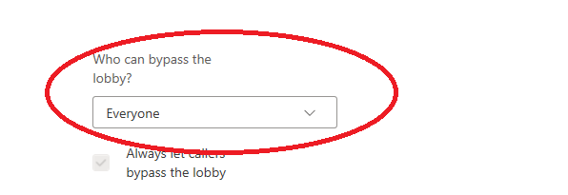
How to setup MS Teams meeting without lobby (Cont.)
In Outlook:
In Outlook’s calendar, double click on the meeting created.
Then click on Meeting options
In the pop-up that opens, set “Who can bypass the lobby” to “Everyone”

Slide 4
Breakout + Teams + Ad-hoc Chair laptop
Configuration:
Tasks:
The ad-hoc chair can start the Teams meeting on their own laptop from the invitation.
Make sure the audio (e.g., DI-Box if used at conference centre) is correctly connected to the ad-hoc chair’s laptop
Breakout | Conferencing tool | Ad-hoc Chair laptop
Breakout | Teams | Yes

