Slide 1
Meeting rooms Layout

Slide 2
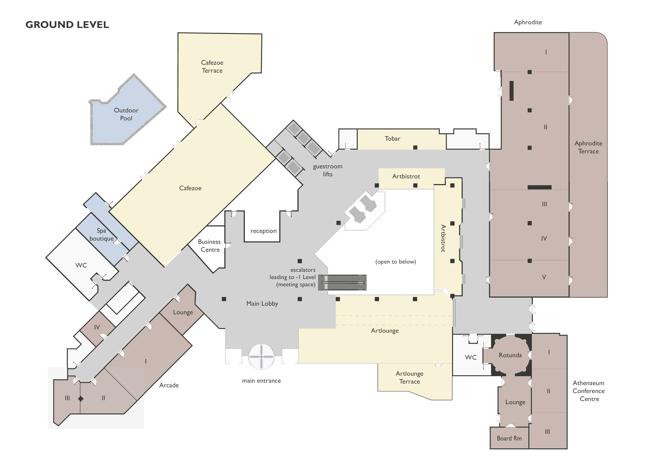
Aphrodite I,II
RAN4
Aphrodite III,IV
RAN2
Aphrodite V
RAN4
Athenaeum
Conference
RAN1
Arcade I,II
RAN4

Slide 3
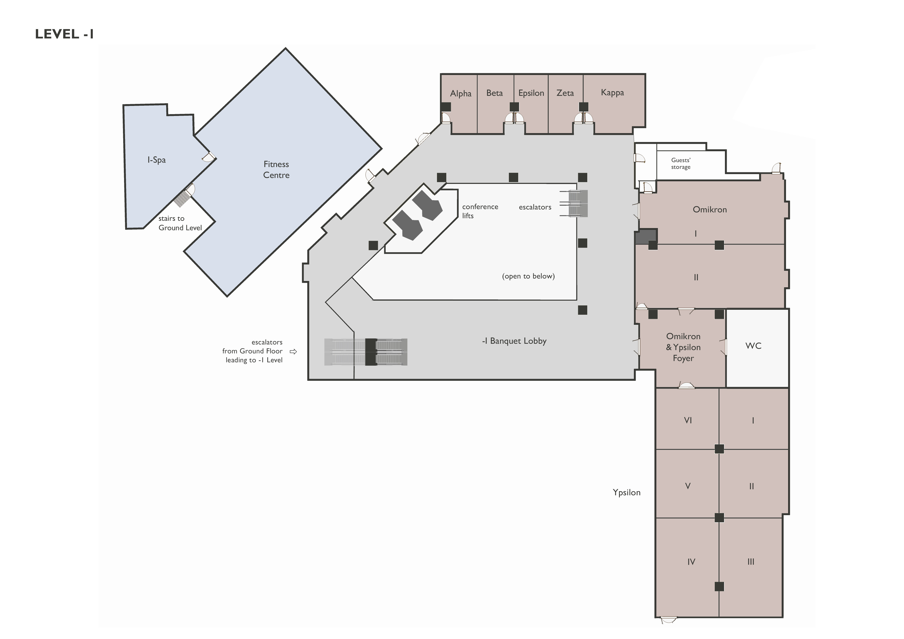
Omikron I
RAN5
Omikron II
RAN2
Ypsilon I,II,III
RAN3
Ypsilon IV,V
RAN5

Slide 4
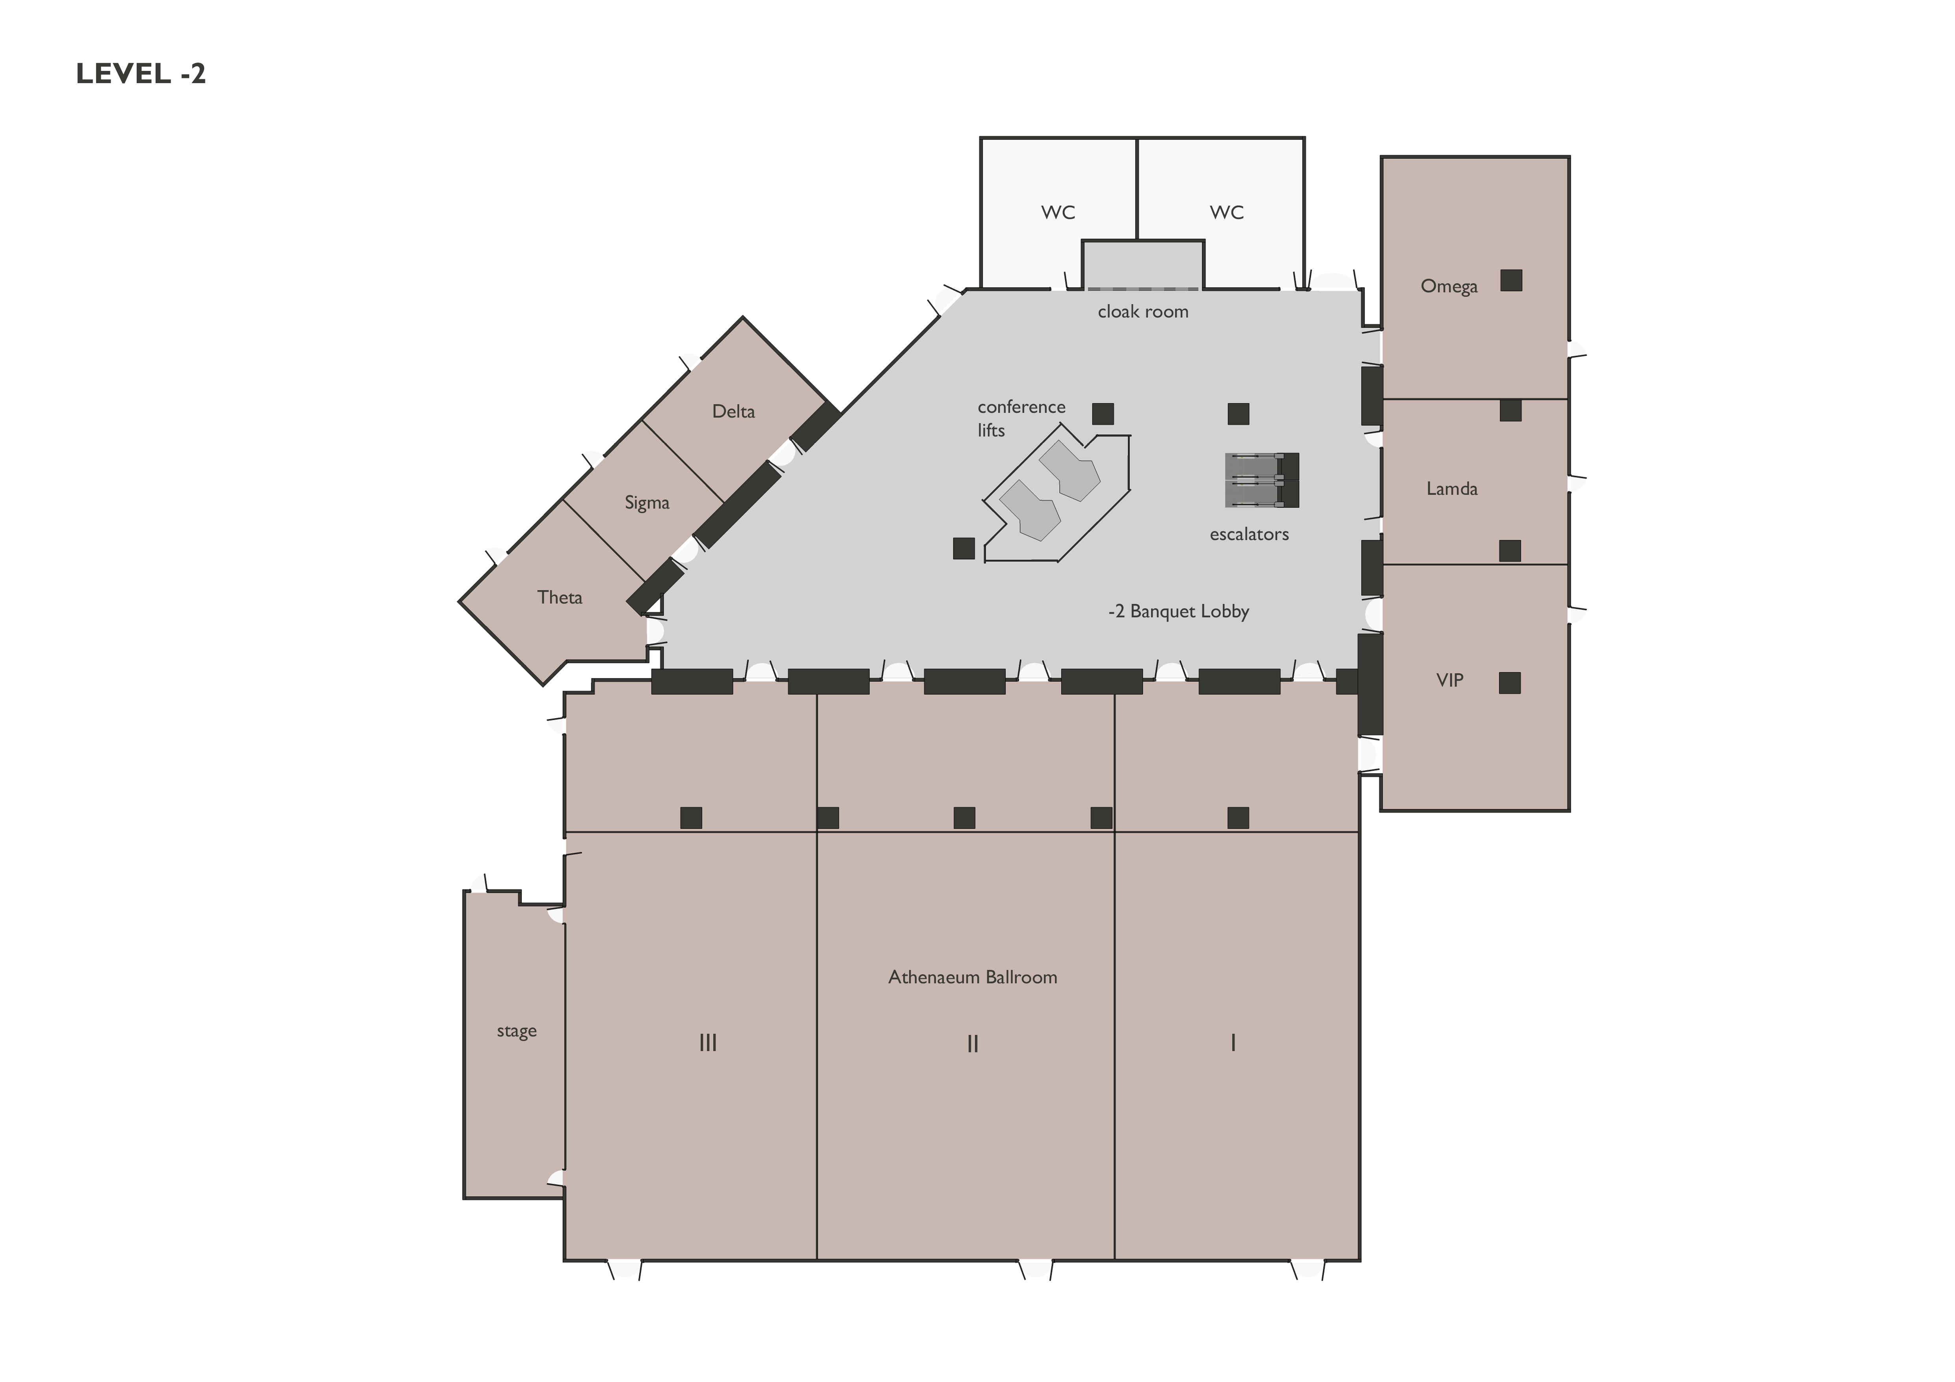
Omega
RAN1
Delta/Sigma
RAN2
Theta
RAN4
VIP/Lamda
RAN1
Ballroom I&II /
3GPP RAN1 Schoolroom 500
Ballroom III
RAN2
Ballroom II
RAN1
Ballroom I
RAN1

Slide 5
Meeting rooms capacity

Slide 6
RAN1: VIP/Lamda / Schoolroom 100
Omega / Schoolroom 50
Athenaeum Conference Center Schoolroom 100
Ballroom I&II / Schoolroom 500
RAN2: Ballroom III / Schoolroom 300
Aphrodite III&IV Schoolroom 120
Theta / Schoolroom 35
Omikron 2 Schoolroom 80
RAN3 Ypsilon 1,2,3 Schoolroom 110
RAN4: Aphrodite I&II Schoolroom 200
Arcade 1&2 Schoolroom 100
Aphrodite 5 Schoolroom 70
Delta/Sigma Schoolroom 20

Slide 7
RAN5: Omikron 1 Schoolroom 50
Ypsilon 4,5 Schoolroom 100

