Slide 1
Way Forward on BCS4 for general part
3GPP TSG-RAN WG4 Meeting # 100-e R4-21xxxxx
Electronic Meeting, Aug. 16-27, 2021
T-Mobile USA,

Slide 2
As a reminder, here are some guidelines from the WID
Guideline 1: To ease the concerns of vendors concerned that IoDT will increase with BCS4, RAN4 shall allow new BCSs to be created as requested for band combinations, but BCSs will not be required for new band combinations.
Guideline 2: Future band combinations may include BCSs, but they will not be required to have any other than BCS4.
Guideline 3: In order to ensure that MSD analysis is complete for BCS4 for SUL and NR CA band combinations that have already been requested but CRs have not yet been agreed by RAN4, the TPs and draft CRs and CRs with those band combinations shall include MSD analysis for all channel bandwidths for each band in the band combination.
Guideline 4: Until BCS4 CR(s) are agreed, TPs and Draft CRs should include the BCSs that were requested for already requested band combinations. After BCS4 CR(s) are agreed, it should be up to the proponents whether TPs and draft CRs include the BCS(s) that were requested and recorded in the WID, or if the TPs and draft CRs only include BCS4. If BCS4 is preferred, the exceptional case of inconsistent information between the basket WID and the TPs/draft CRs is acceptable until the WID is fixed accordingly.
Guideline 5: BCS4 CRs should be allowed to be introduced before all the MSD analysis is completed to avoid the situation where traditional BCSs are still required. All MSD analysis should be completed by the end of Rel-17. To facilitate the adoption of BCS4 prior to the completion of MSD analysis, MSD for missing channel BWs in existing band combinations shall be listed as infinity until the MSD analysis is complete. These infinite MSD’s are only placeholders which will be clarified in a note saying so in the initial CR.
Guideline 6: BCS4 doesn’t change anything with regard to mandatory or optional channel BWs.

Slide 3
1-1-1 the applicability of BCS4 and BCS5 to intra-band combinations
Proposal 1: Introduce BCS4/BCS5 for FR1 intra-band DL CA
Whether BCS4/BCS5 can be used for FR1 intra-band UL CA
Comment: BCSs are not defined or reported separately for UL and DL for traditional BCSs, so there should be no reason to differentiate between BCS4 and BCS5 for UL and DL
Proposal 2: BCS4 and BCS5 can be used for FR1 intra-band UL CA
Whether BCS4/BCS5 can be used for FR2 intra-band CA or current BCS0 is enough for FR2 intra-band CA
Proposal 3: Since all FR2 combinations only have BCS0 and new channel bandwidth have not been added, FR2 BCS4 is probably not needed for FR2, so for FR1+FR2 BCS4 and BCS5 combinations the configuration table shall state that BCS0 applies for the intra-band FR2 part (when applicable)

Slide 4
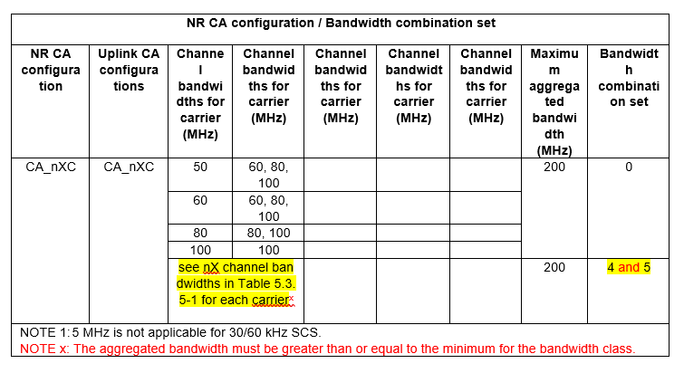
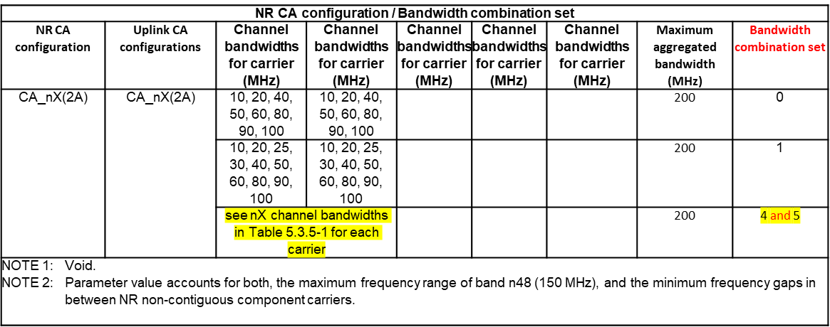
1-1-2 If RAN4 agrees to introduce BCS4/BCS5 for intra-band NR CA, how can BCS4 for intra-band NR CA be indicated?
For contiguous intra-band CA it is implied that the minimum aggregated bandwidth is greater than or equal to the minimum for the bandwidth class, but it shouldn’t hurt to add this note :
Note x: The aggregated bandwidth must be greater than or equal to the minimum for the bandwidth class.
Proposal 4: Accept the majority view for Option 1, with the tables modified as follows :
Table 2: NR CA configurations and bandwidth combination sets defined for intra-band contiguous CA
Table 3: NR CA configurations and bandwidth combination sets defined for intra-band non-contiguous CA
NOTE x: The aggregated bandwidth must be greater than or equal to the minimum for the bandwidth class defined in Table 5.3A.5-1, and smaller than or equal to the maximum aggregated bandwidth

Slide 5
Sub Topic 1-2
Issue 1-2-1: When can companies request BCS4/5?
Proposal 5: If comments are addressed in the second round RAN4 can agree to request BCS4/BCS5 from this meeting
Issue 1-2-2: Is it agreed that existing band combination that requested traditional BCSs can be changed to BCS5/BCS5 upon request?
Proposal 6: As suggested by the moderator, the contact person can request to change the not completed band combinations in basket WID once RAN4 agree to request BCS4/BCS5. And the revised WID can be approved in the upcoming RAN plenary meeting. RAN4 can do something based on the latest approved WID in next RAN4 meeting.
Issue 1-2-3: If BCS4 is requested for a band combination, does it mean that it is equivalent to get BCS5 requested, and vice versa.?
Comments: Even though BCS4 is release independent to Rel-15, BCS4 will only appear in the Rel-17 specs. The release independence for BCS4 and BCS5 will be documented in 38.307. The MSD analysis for BCS4 will apply to BCS5 since any BCS5 combination will be a subset of BCS4.
Proposal 7: BCS4 and BCS5 shall be requested together because there is no difference in the MSD analysis

Slide 6
Sub-Topic 1-3
Issue 1-3-1: Should BCS4 (and BCS5) for SUL band combinations reuse the same indication format with inter-band CA?
Proposal 8: BCS4 and BCS5 for SUL band combinations reuse the same indication format with inter-band CA
Issue 1-3-2: Clarify the scope
Proposal 9: RAN4 confirms that BCS4 and BCS5 apply to SUL, NR CA, NR DC and SUL and/or NR CA part of inter band MR-DC while it does not apply to intra band MR DC.

