Slide 1

Virtual Celebration
Completion of 3GPP Release 17
3GPP RAN3
- May 2022 -

Slide 2
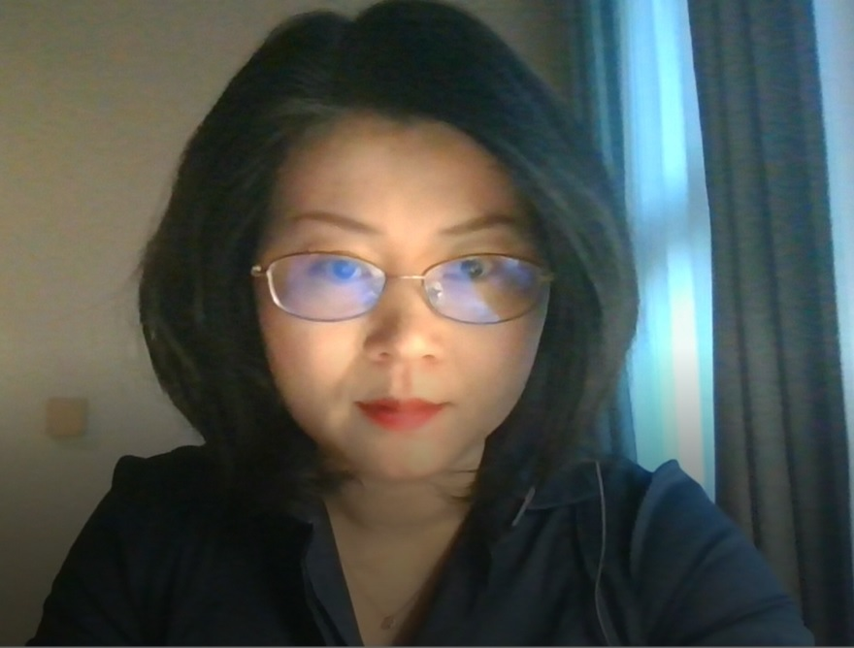
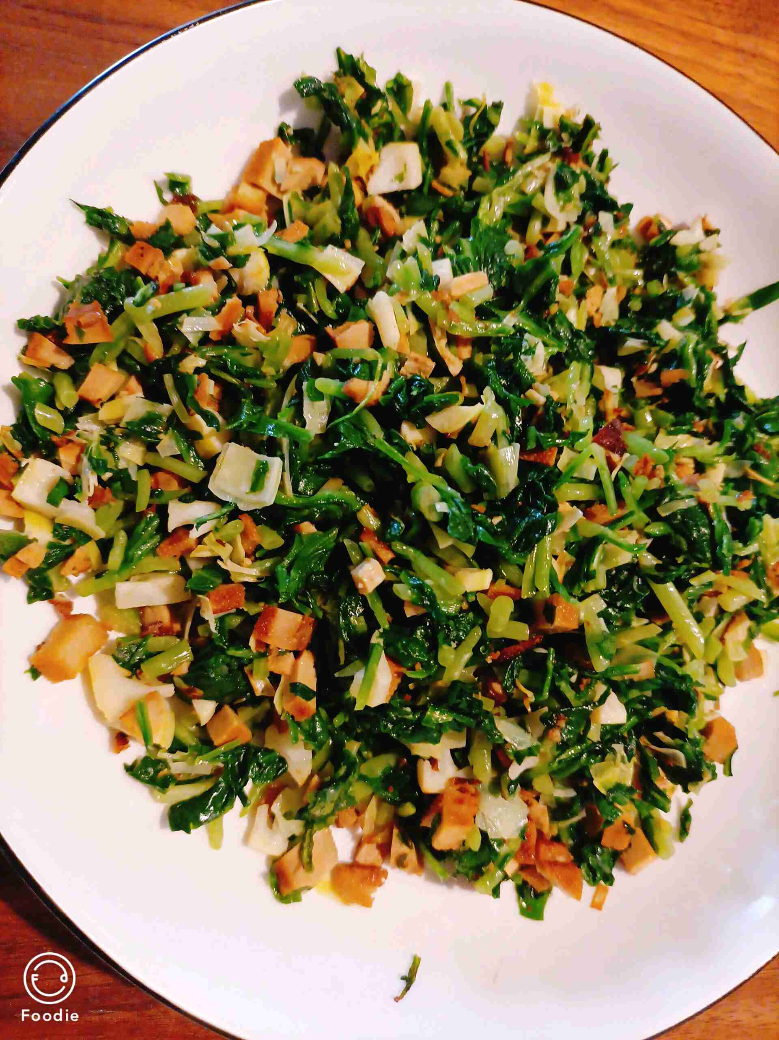
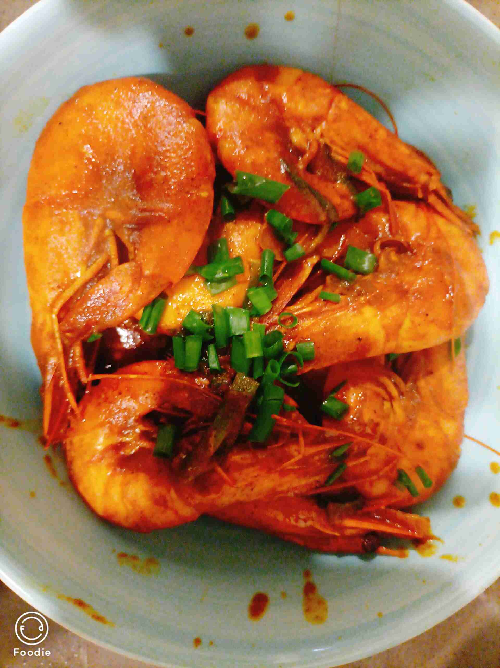
Thank You All for Great Effort to complete R17!
Yin Gao – RAN3 Chair
RAN3 started R17 work under the leadership of Gino since 2020, and the new leadership was elected in May last year. We also faced the challenge of Covid19, an efficient working model for RAN3 e-meetings was established which brought people to home office while still kept all talented and passionate people connected. You all deserve this celebration for the hard work that got you to this moment!
I enjoyed the team work with all of you, with home office, the achievements in last two years is not only our world-class R17 specifications, but also my cooking skills, as shown in the figure left :)
This celebration event is a sentimental time of looking back and looking forward. Cheers!
Home office

Slide 3
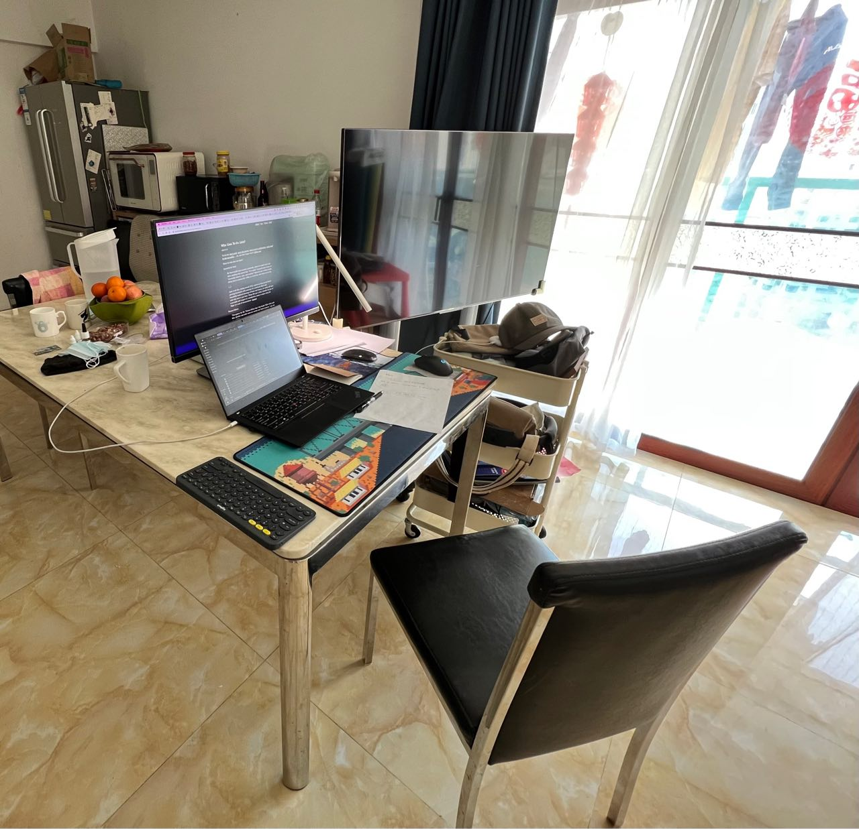
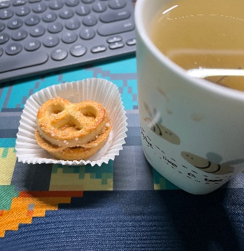
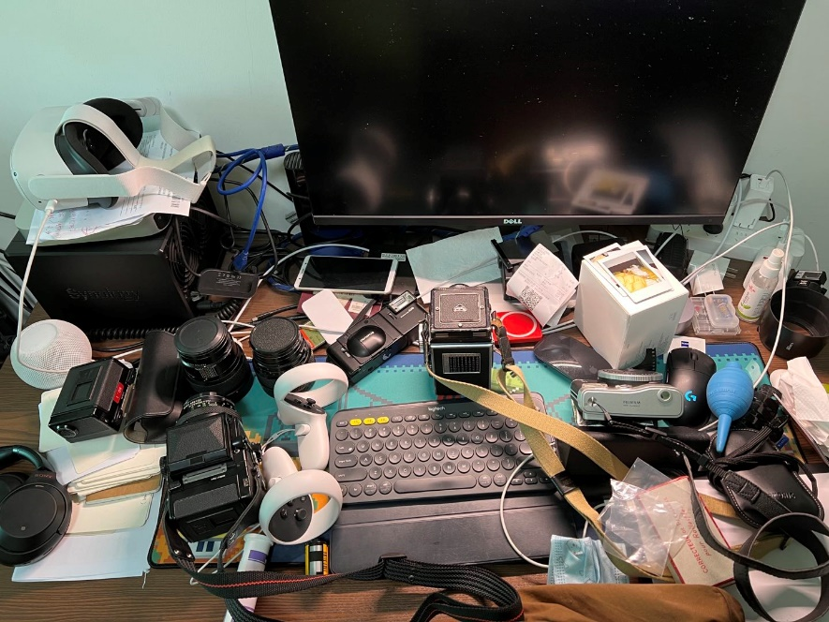
Unexpected journey to be purely online, and feeling grateful
tao – ZTE
1/ this is my first journey as 3GPP RAN3 delegate, did not expect it to be a purely on-line experience. I was felling reluctant to meet and argue with people, so good to start with online without not seeing each other?
2/ I have learnt a lot from you guys in the WI of NR MBS which is not an easy one (e.g., organize a CB, arguing in email, and other working procedures stuff..), great thanks to Yin, Gino, Xipeng, Aijuan, Philip, Yan, and Alex of course.
3/ it was challenging for me (and you too I am sure) to work from home, and sometimes midnight here in China in the bedroom with a totally mess on my desk. I have to move to the living room on the dining table for work.
4/ meanwhile it is also good to WFH, as you can always enjoy your fav cookie and tea anytime you want. And you can spend more time with your family too.
5/ never been so eager to go back to F2F to talk to people I have never met, but at the same time I am sure people will miss the days we spent online.

Slide 4

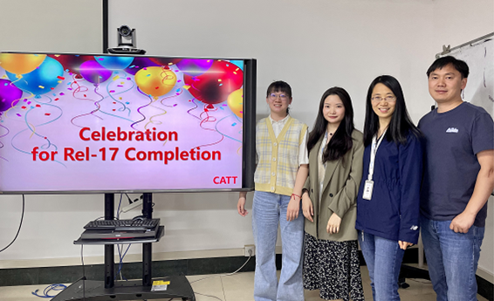
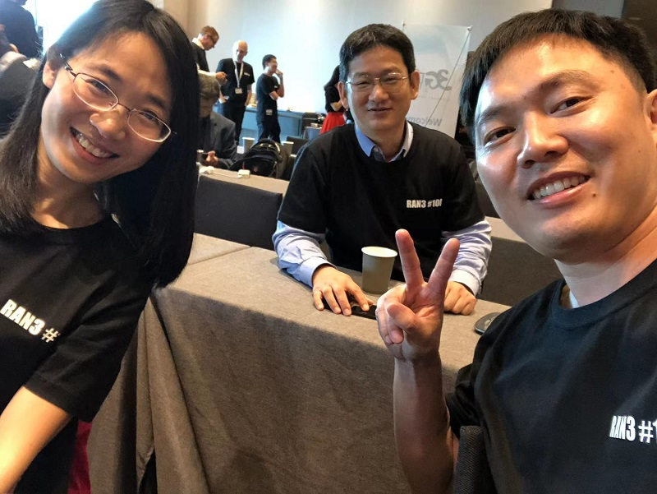
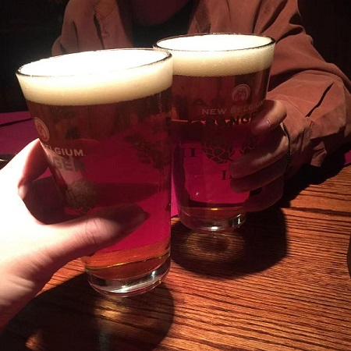
Add picture here
Add picture here
Our new faces: Ziqiao Liu, Jiaying Sun
CATT - Congratulations to RAN3, A Talent Team
We come from different countries, different nations, different companies, but we are a team, a talent team. It’s not easy for us to complete the Rel-17 work in time all by the online meetings, it’s a great success. Cheers 3GPP~ Cheers, RAN3~
Some of us often dreamed about our business trips all around the world, sight seeing, shopping, smiling and arguing, they’re really nice memories.
Expect to see you ASAP, our old friends and new friends.

Slide 5
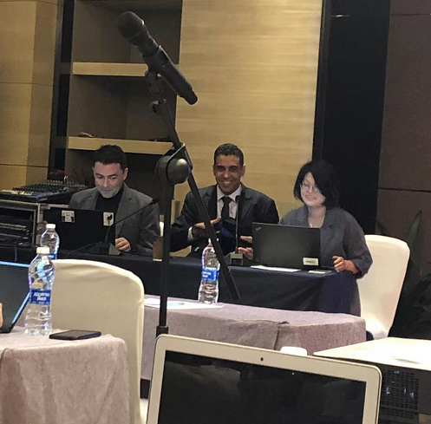
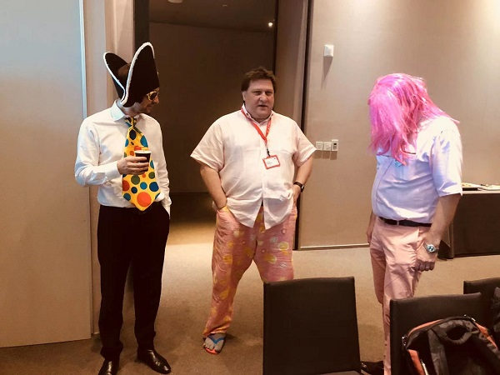
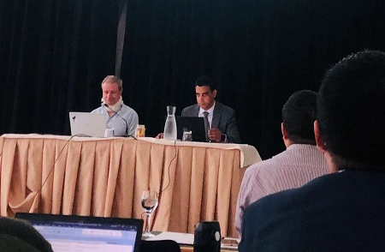
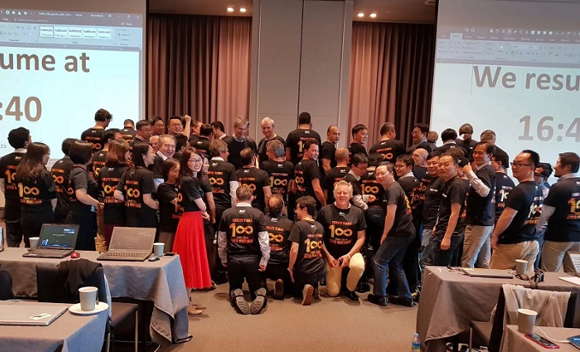
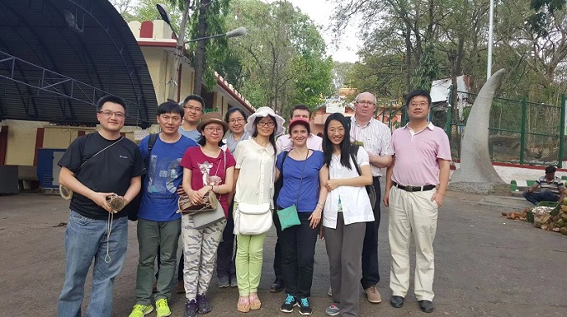

Slide 6
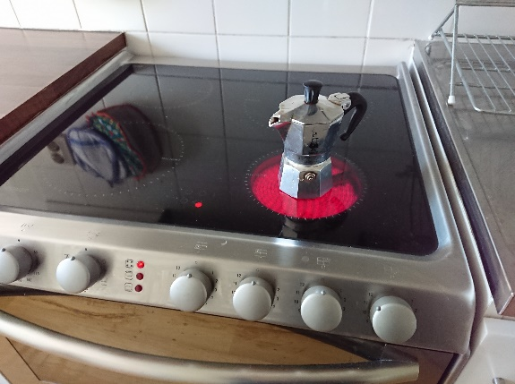
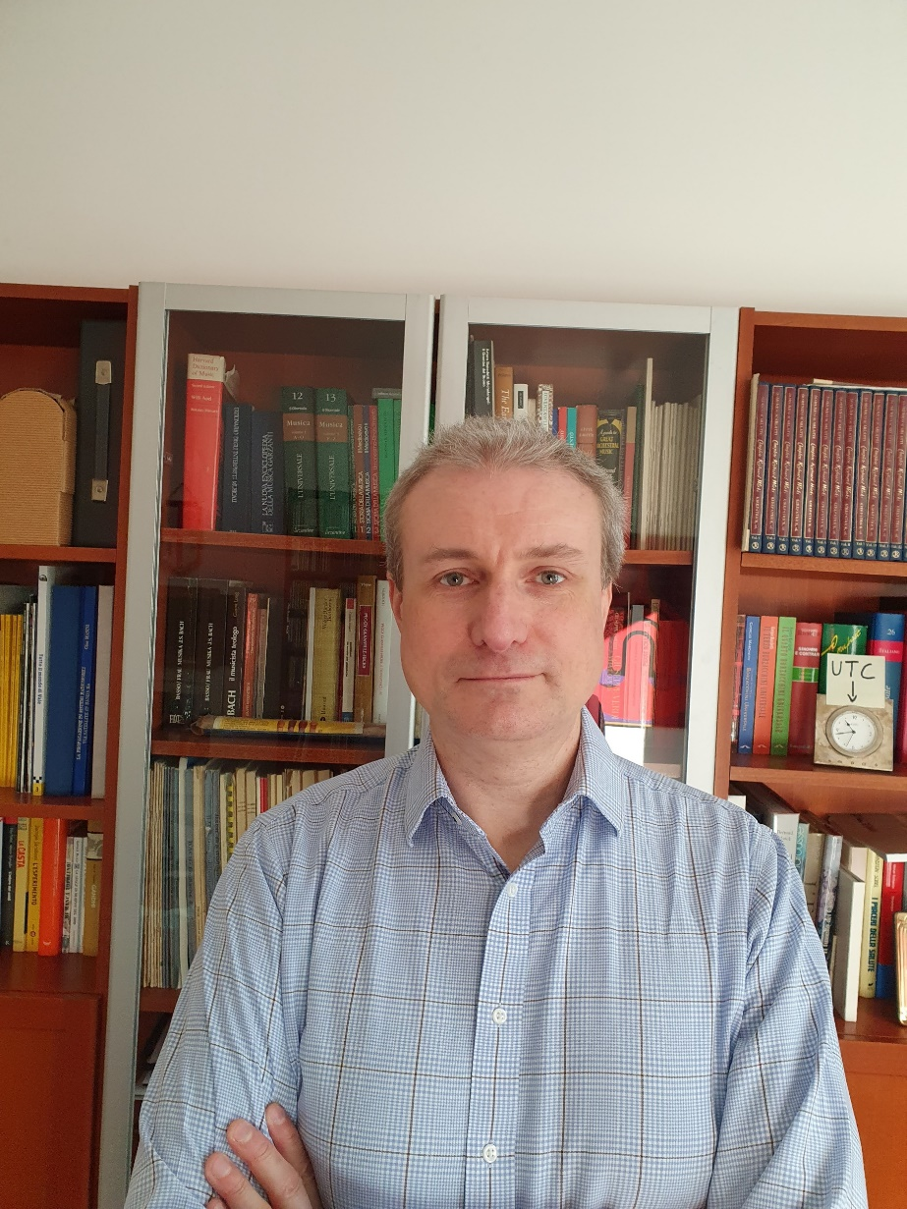
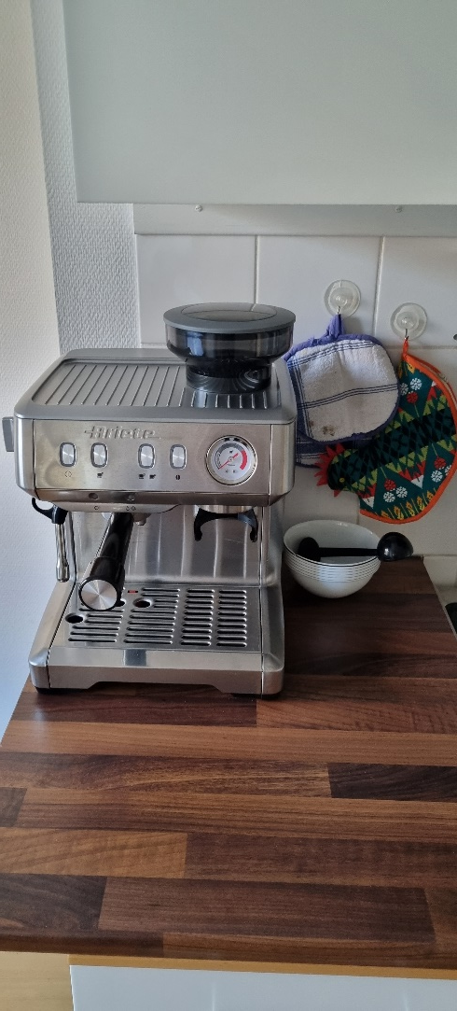
RAN3 Rel-17 from home
TEI17 espresso upgrade (NBC)
Gino Masini – Ericsson
My “RAN3 Rel-17 from home” experience:
Home espresso coffee breaks (upgraded during TEI17 – NBC change)
Always keeping a clock on UTC to avoid missing deadlines!
The jingle from the Swedish ice cream truck disrupting our GTW sessions! (https://www.youtube.com/watch?v=qpoi2BqbxkY)
All the RAN3 ties and scarves in my wardrobe, waiting to be handed over to the new Chair!
Looking forward to seeing you all once again!

Slide 7
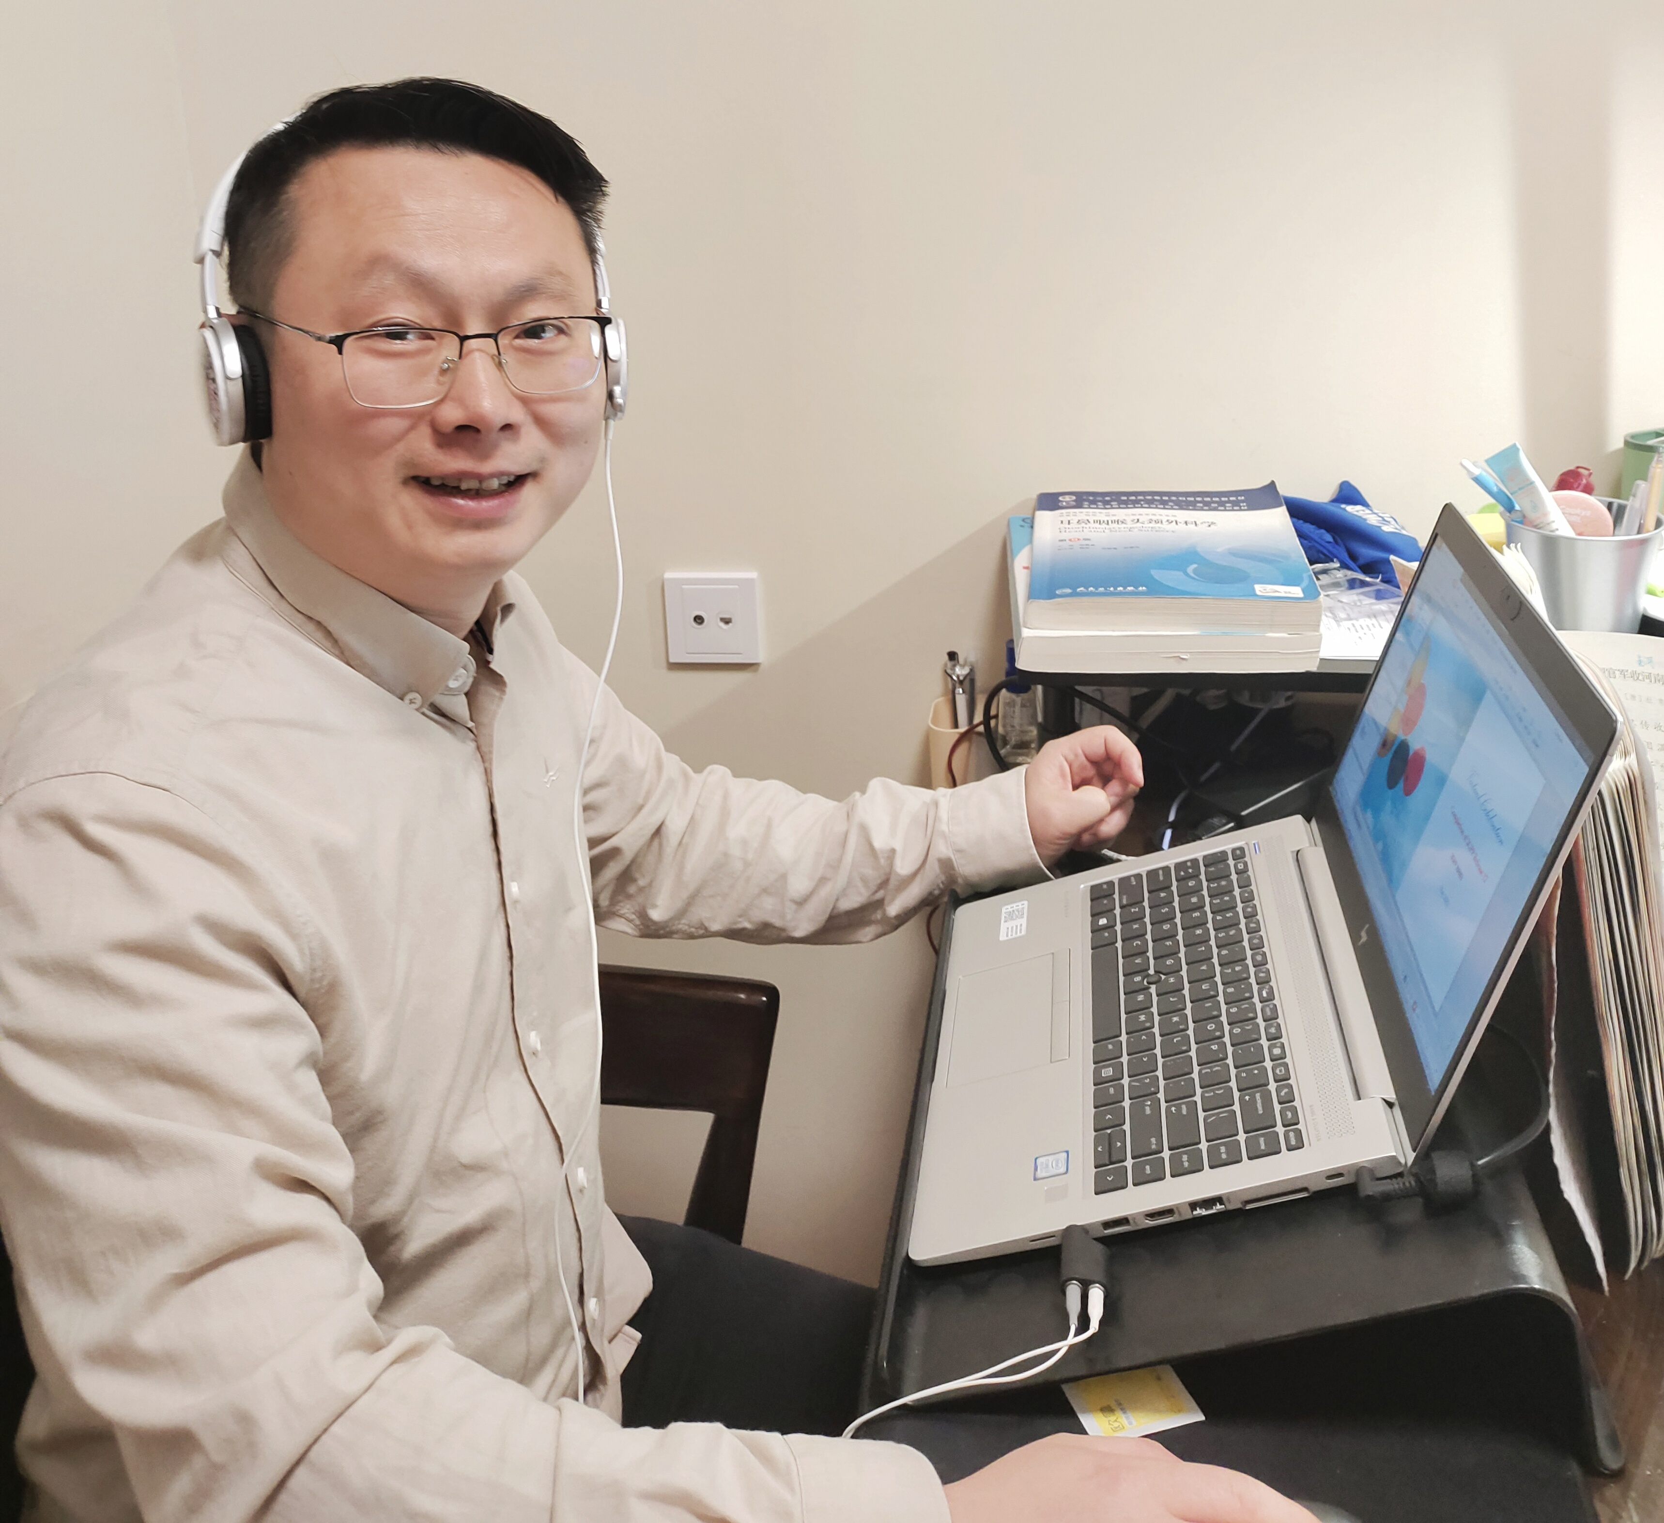
Send words from RAN3 delegates
Dapeng – ZTE
This is the first time that I have completed a release version in the form of e-meeting. Thanks to 3GPP for bringing all delegates to work in a safe environment and successfully complete the task of Rel-17. To be honest, during e-meeting, I learned how to stay up late and get overweighted. However, it doesn't seem like a bad thing to my daughter. She prefers her father to work at home :- )
I hope that the pandemic can be ended as soon as possible and then we can meet each other F2F in the safe mode.
Add picture here

Slide 8
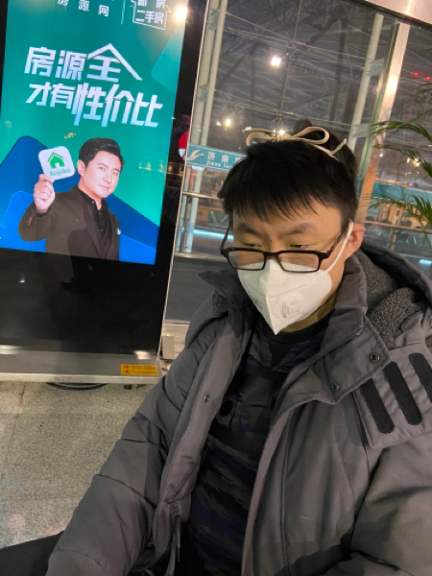
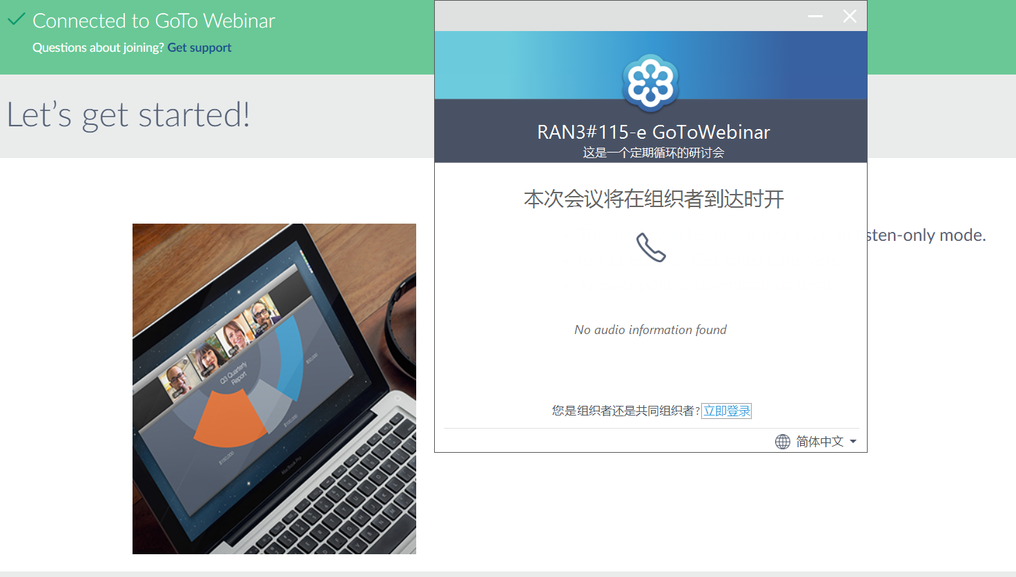
Jiren Han – ZTE
Since the beginning of 2020, the Covid19 has swept the world. People have to wear the tight face mask to keep safe when travelling. And the F2F 3GPP meeting was suspended to decrease the risk of virus transmission. The Covid19 has extended the distance between us.
Fortunately, we have the smart meeting tool-GoToWebinar, although there could be some latency and audio quality issue, it helps us a lot to improve the efficiency of online discussion as much as possible.
From August 2020 to May 2022, the whole Rel-17 RAN3 meetings have been held online. The benefit is that people do not need to spend a lot of time on the road, which saves our time to be with faimilies (^-^)
Hope the epidemic ends ASAP and everyone keeps healthy, see you face to face in Rel-18!

Slide 9
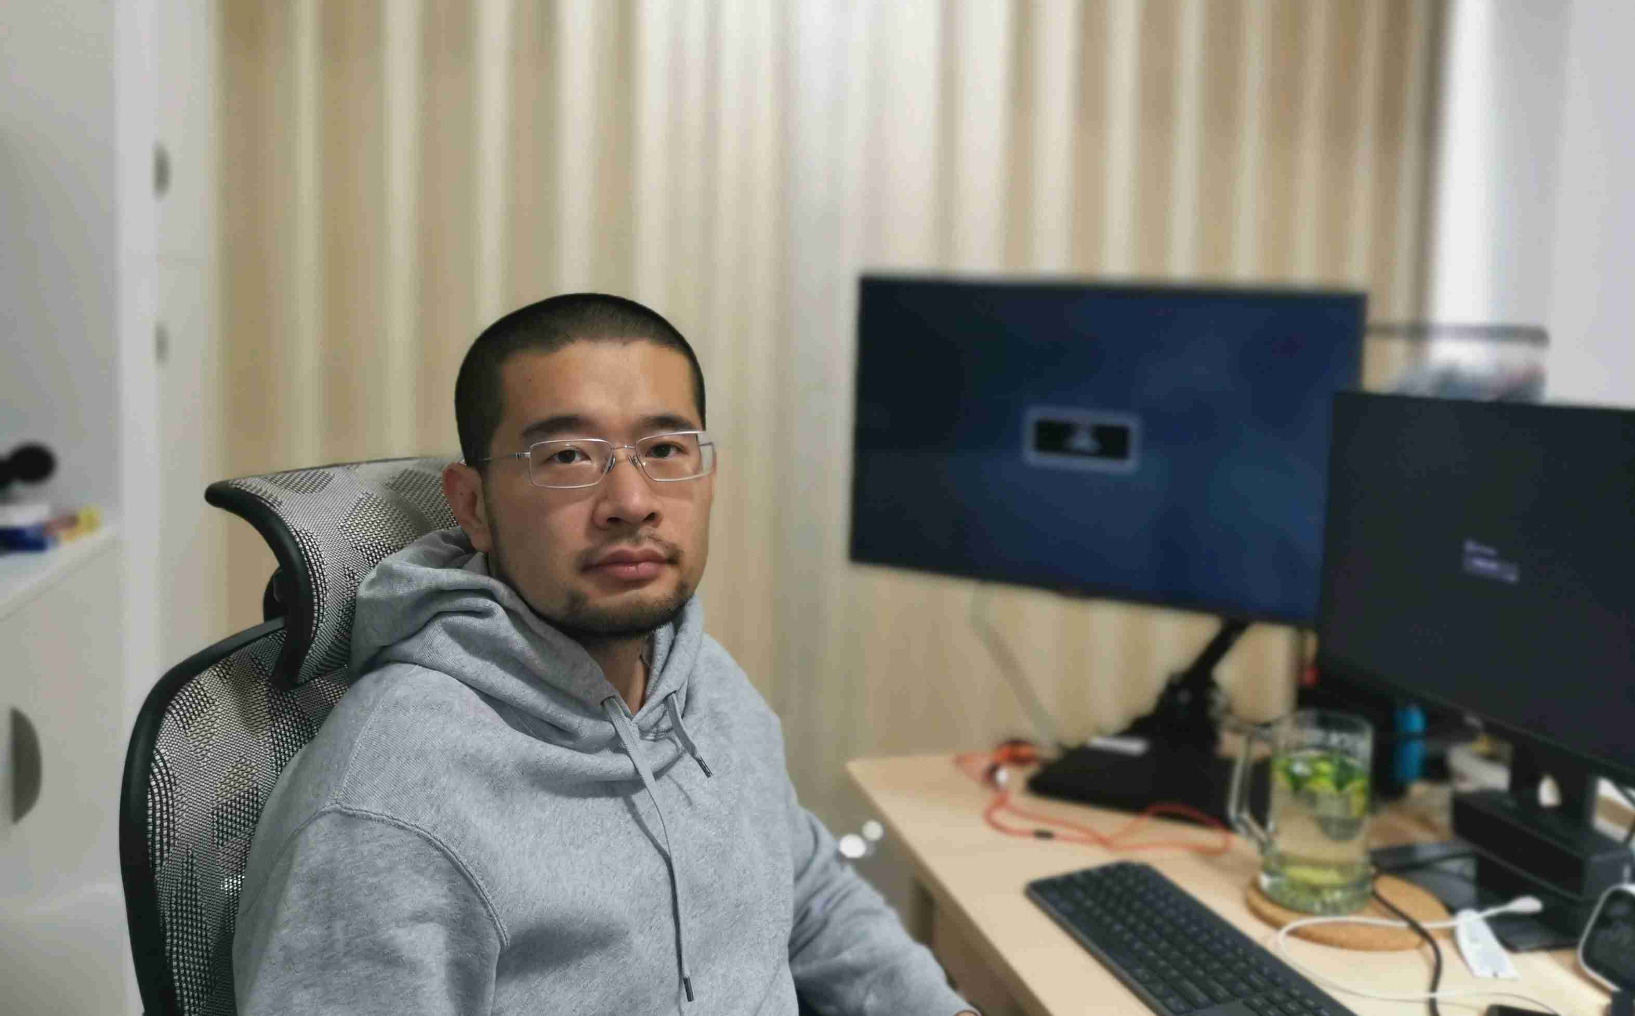
Send words from RAN3 delegates
Liu Yansheng – ZTE
Rel-17 is the first one I have followed completely in both RAN2 and RAN3. I have charted with a lot of nice delegates from other companies during the online and offline discussions. I hope to see you all in the upcoming face to face RAN3 meeting in Rel-18, and wish we can complete the Rel-18 specifications without covid impact.
Peace&Love~

Slide 10
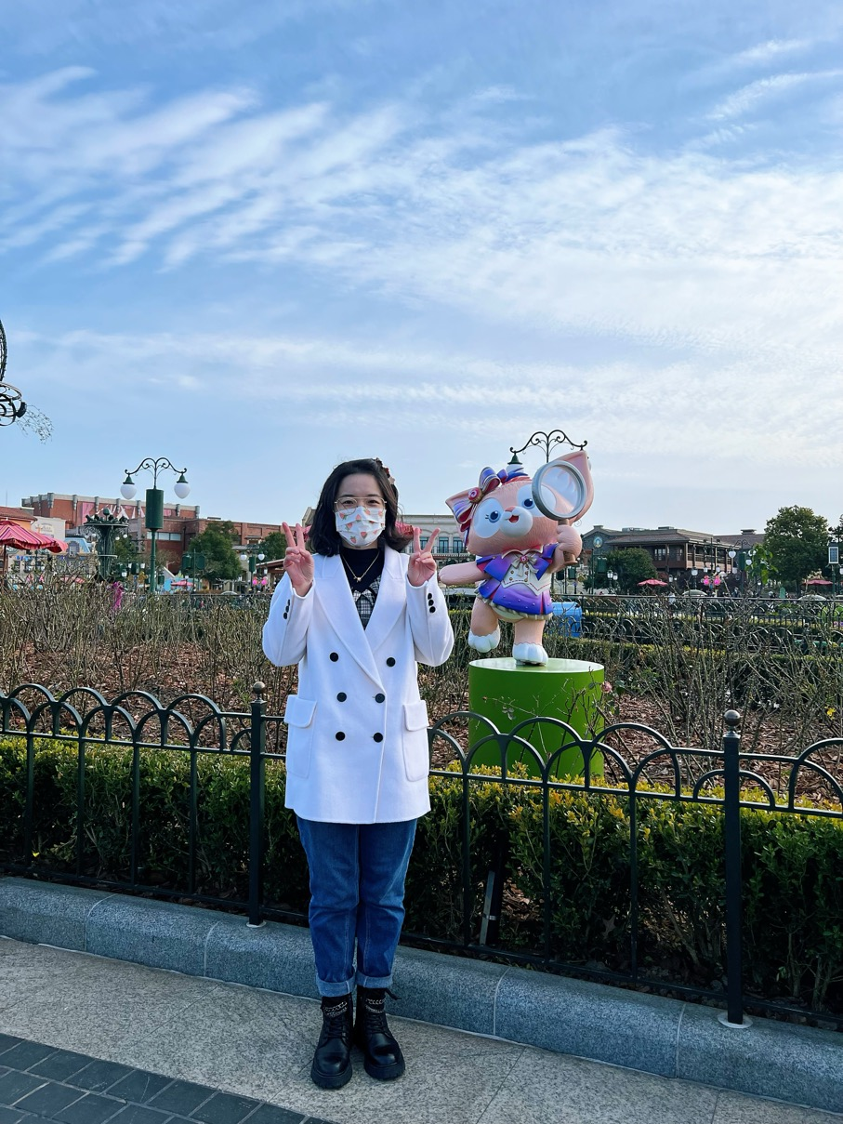
Yingjun Zhou – ZTE
I'm incredibly grateful for the opportunity to work with you to complete R17. This is the first release that I have pariticipated in as a new delegate, which is a really wonderful experience for me. I still remember the curiosity of attending my first online meeting, and the nervousness of my first public presentation. The expertise I have developed here over the past two years will be beneficial for me throughout my career. Thank you all for helping me grow tremendously. Can't wait to see you in the near future！
The pink fox in my photo is LinaBell introduced in 2021 at Shanghai Disneyland. She is really popular in China due to her cute look and character. Hope we have the opportunity to have a meeting in Shanghai in the future and go to see her together :)

Slide 11
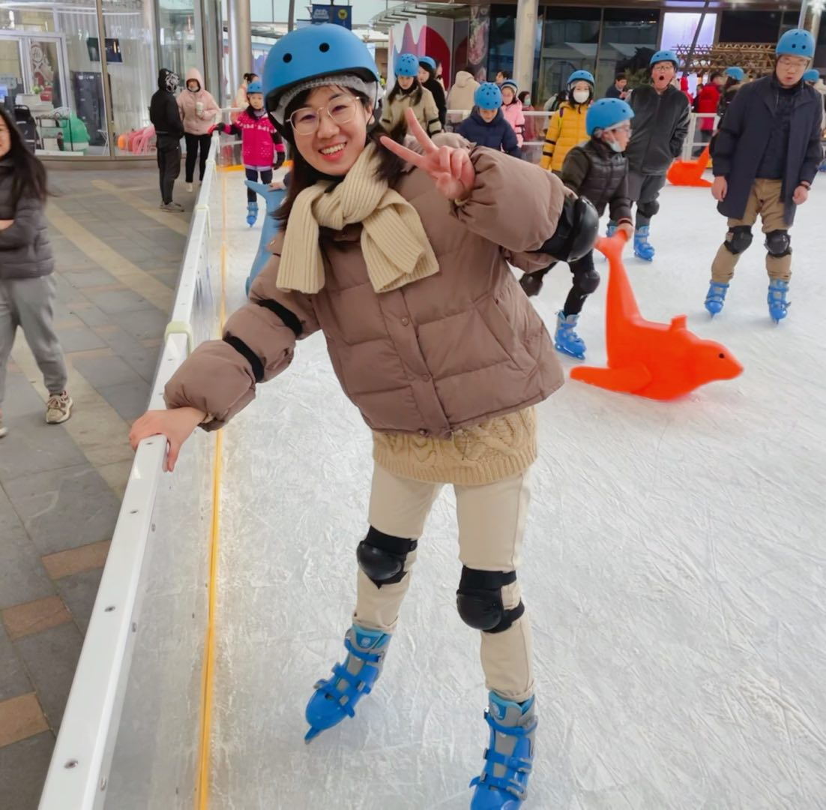

Thanks and Goodbye, Rel17 : )
Man Zhang - ZTE
To be honest, I am quite a freshman to 3GPP —— Rel 17 is the first whole release that I have put my efforts in. I still remeber the day that I first spoke out via my microphone, saying my name to every one, and received a kind greeting from Gino, “Welcome on board”. That was a really exciting time and good starting point for me. Now I have been on RAN3 board for more than one year ; )
I am grateful for all the delegates that I have ever worked with. Sometimes I am not familiar with the working procedures and make mistakes by accident (like forgetting to drop SoD into inbox...). It is all your paticence and great efforts that help me improve myself and feel much better each time working as a delegate.
Thanks and Goodbye R17. And look forward to our future work together!
Summer is coming
...
Last winter...
Editor's Note:
Let's enjoy the journey to Rel18!
>This is the flower of ailanthus altissima,
which indicates a close summer.
😉

Slide 12
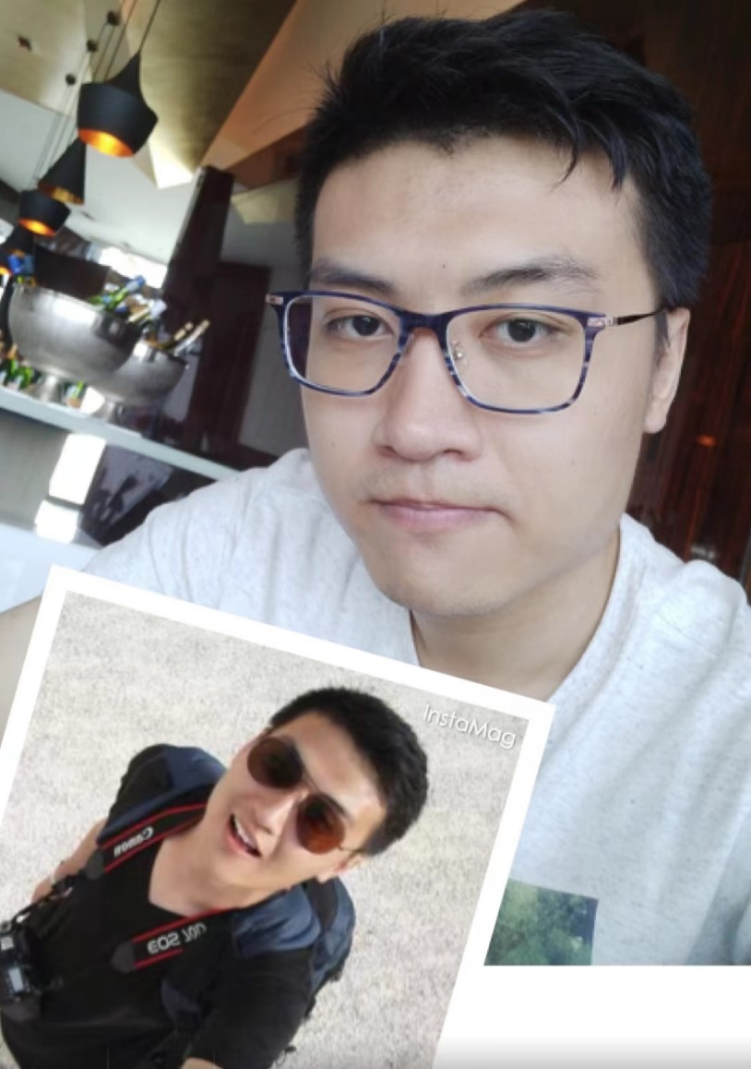
Jiajun Chen - ZTE
The release 17 is the first whole release that I experience. Unfortunately, because of the COVID-19, I have not seen you guys in the F2F meeting. But during these e-meeting, I saw all participants great efforts to the normative work, and I learned a lot from you all.
Hope we can see each other in the F2F meeting soon. And we can have a business trip all over the world, rather than business trip at home. ☺

Slide 13
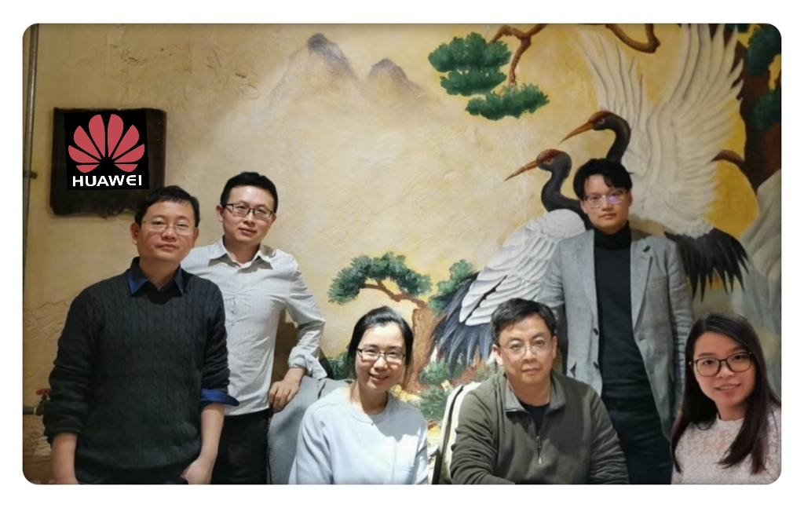
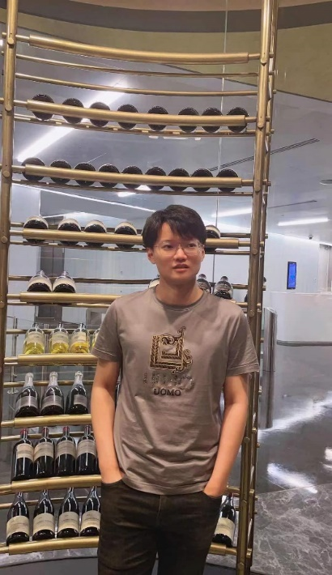
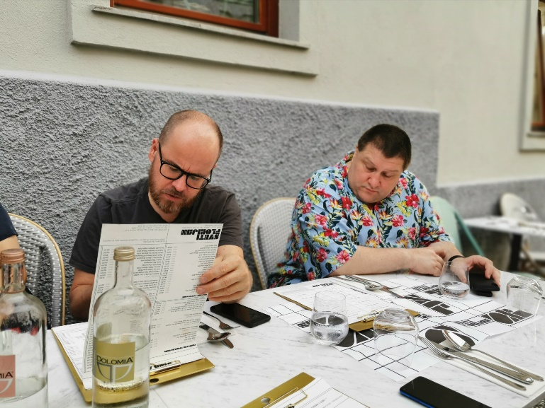
HHHHhHHHHHuawei - Congratulations to RAN3 R17 Completion!
Time flies fast, and the RAN3 R17 will come to an end in a blink of an eye. Considering the challenge of covid-19 and e-meeting, the successful completion of R17 in our RAN3 group was awesome!
Let’s keep up the good work and cheers for our success！
Our new face:
Jingcong Sun
“MMmy career as a RAN3 delegate starts in R17, so R17 definitely means a lot to me. Although I have actively attended 5 or 6 meetings already, I still haven’t got a chance to meet everyone…A pity for sure.. ☹
Working with you has been one of the most amazing experiences! ”

Slide 14
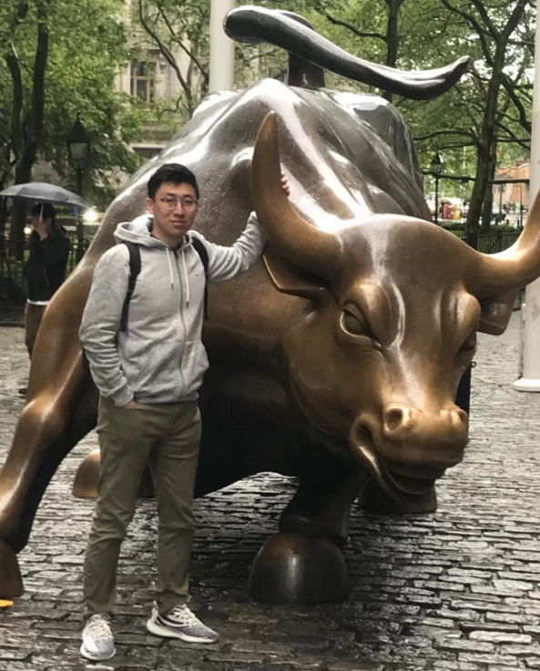
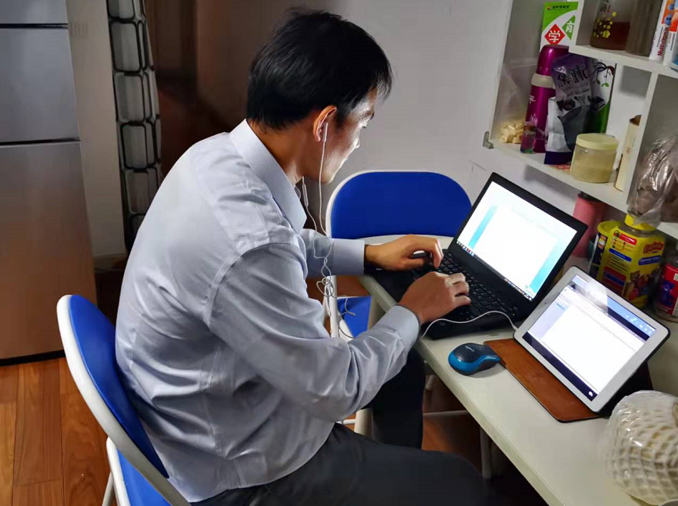

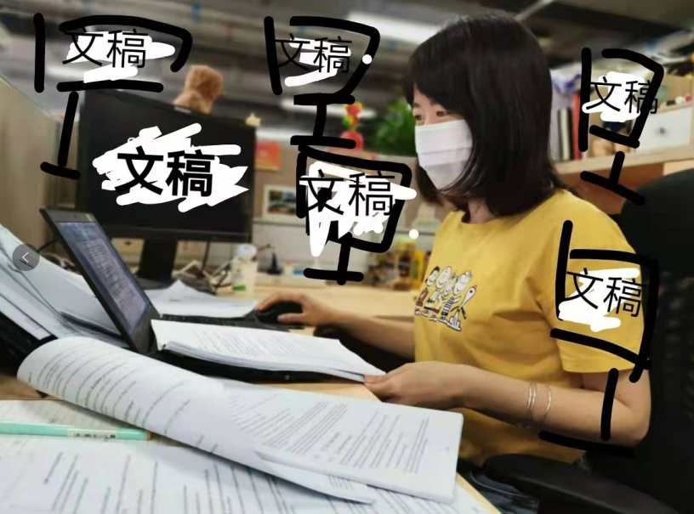
Miaoqi ZHANG
Liang LIU
Fang XIE
Xueyan HUANG
CMCC - Congratulations on Completion of 3GPP Release 17 !
Cheers to the incredible job we have done in RAN3 Rel-17! All of the delegates in RAN3 overcame the effect of covid-19 and time difference. During the online meeting, accompanied with rational discussions and creative collisions, we successfully completed the Rel-17 specifications of RAN3 part. Hope the covid-19 will end soon, cannot wait to see you guys in the future F2F meeting!

Slide 15
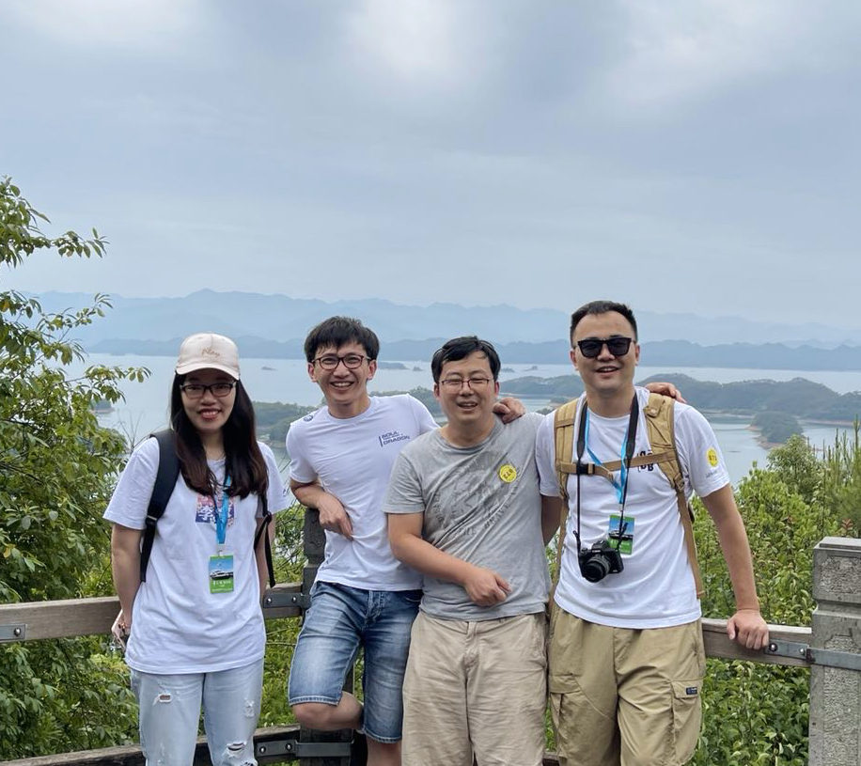
Congratulations!!!
from fresh new Lenovo RAN3 team!!!
Rel17 is the first release Lenovo RAN3 team has contributed to! It means a lot!
It’s a pity we didn’t have a chance to meet f2f, but for sure in Rel18! 😉
We appreciate the openness, professionalism, and spirit of collaboration in 3GPP RAN3 group!
This photo was taken the next day after RAN3 112e meeting in 2021 May. Look how happy we were after that 2 weeks of online meeting!
We are even happier now, because Rel17 is accomplished! Hello Rel18! 😁
- Lenovo RAN3 Team
Le
Mingzeng
Yibin
Congchi

Slide 16
Send words from RAN3 delegates
(You can change the title to make it match your words better)
Name – Company
Please share your words about Release 17 in this textbox, including but not limited to your feelings, some of your experience and your wishes to 3GPP. You can replace the picture in the left side with a photo of your own, for example, when your are working from home. More than one photo are also welcome. You can arrange the photos in the way you like.
Feel free to edit the page with the style you like ; )
Add picture here

Slide 17
Another template provided
Name – Company
Please share your words about Release 17 in this textbox, including but not limited to your feelings, your experience and your wishes to 3GPP. You can replace the picture in the left side with a photo of your own, for example, when your are working from home.
Add picture here
Title
Name – Company
The ‘Title’ and ‘Name – Company’ are not needed if it is the same person using the whole slide to share words and pics (of course it is completely welcome).
You can replace the picture in the right side with a photo of your own which you would like to share.
Add picture here

Slide 18
Another template provided
Name – Company
Please share your words about Release 17 in this textbox, including but not limited to your feelings, your experience and your wishes to 3GPP. You can replace the picture in the right side with a photo of your own, for example, when your are working from home. More than one photo are also welcome. You can arrange the photos in the way you like.
Add picture here

Slide 19
The last template provided
Add picture here
Add picture here
Name – Company
Please share your words about Release 17 in this textbox, including but not limited to your feelings, your experience and your wishes to 3GPP. You can replace the picture in the upside with photo(s) of your own, for example, when your are working from home.

Slide 20

The great ending and a fresh new start!

