Slide 1
First Snow 2022 — Forbidden City

Slide 2
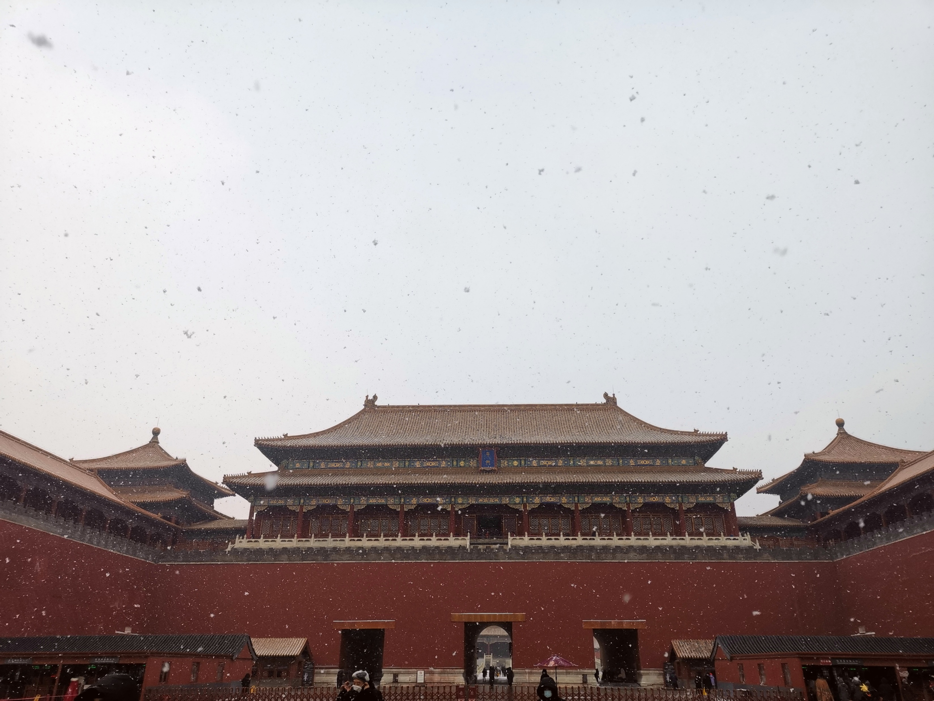

Slide 3
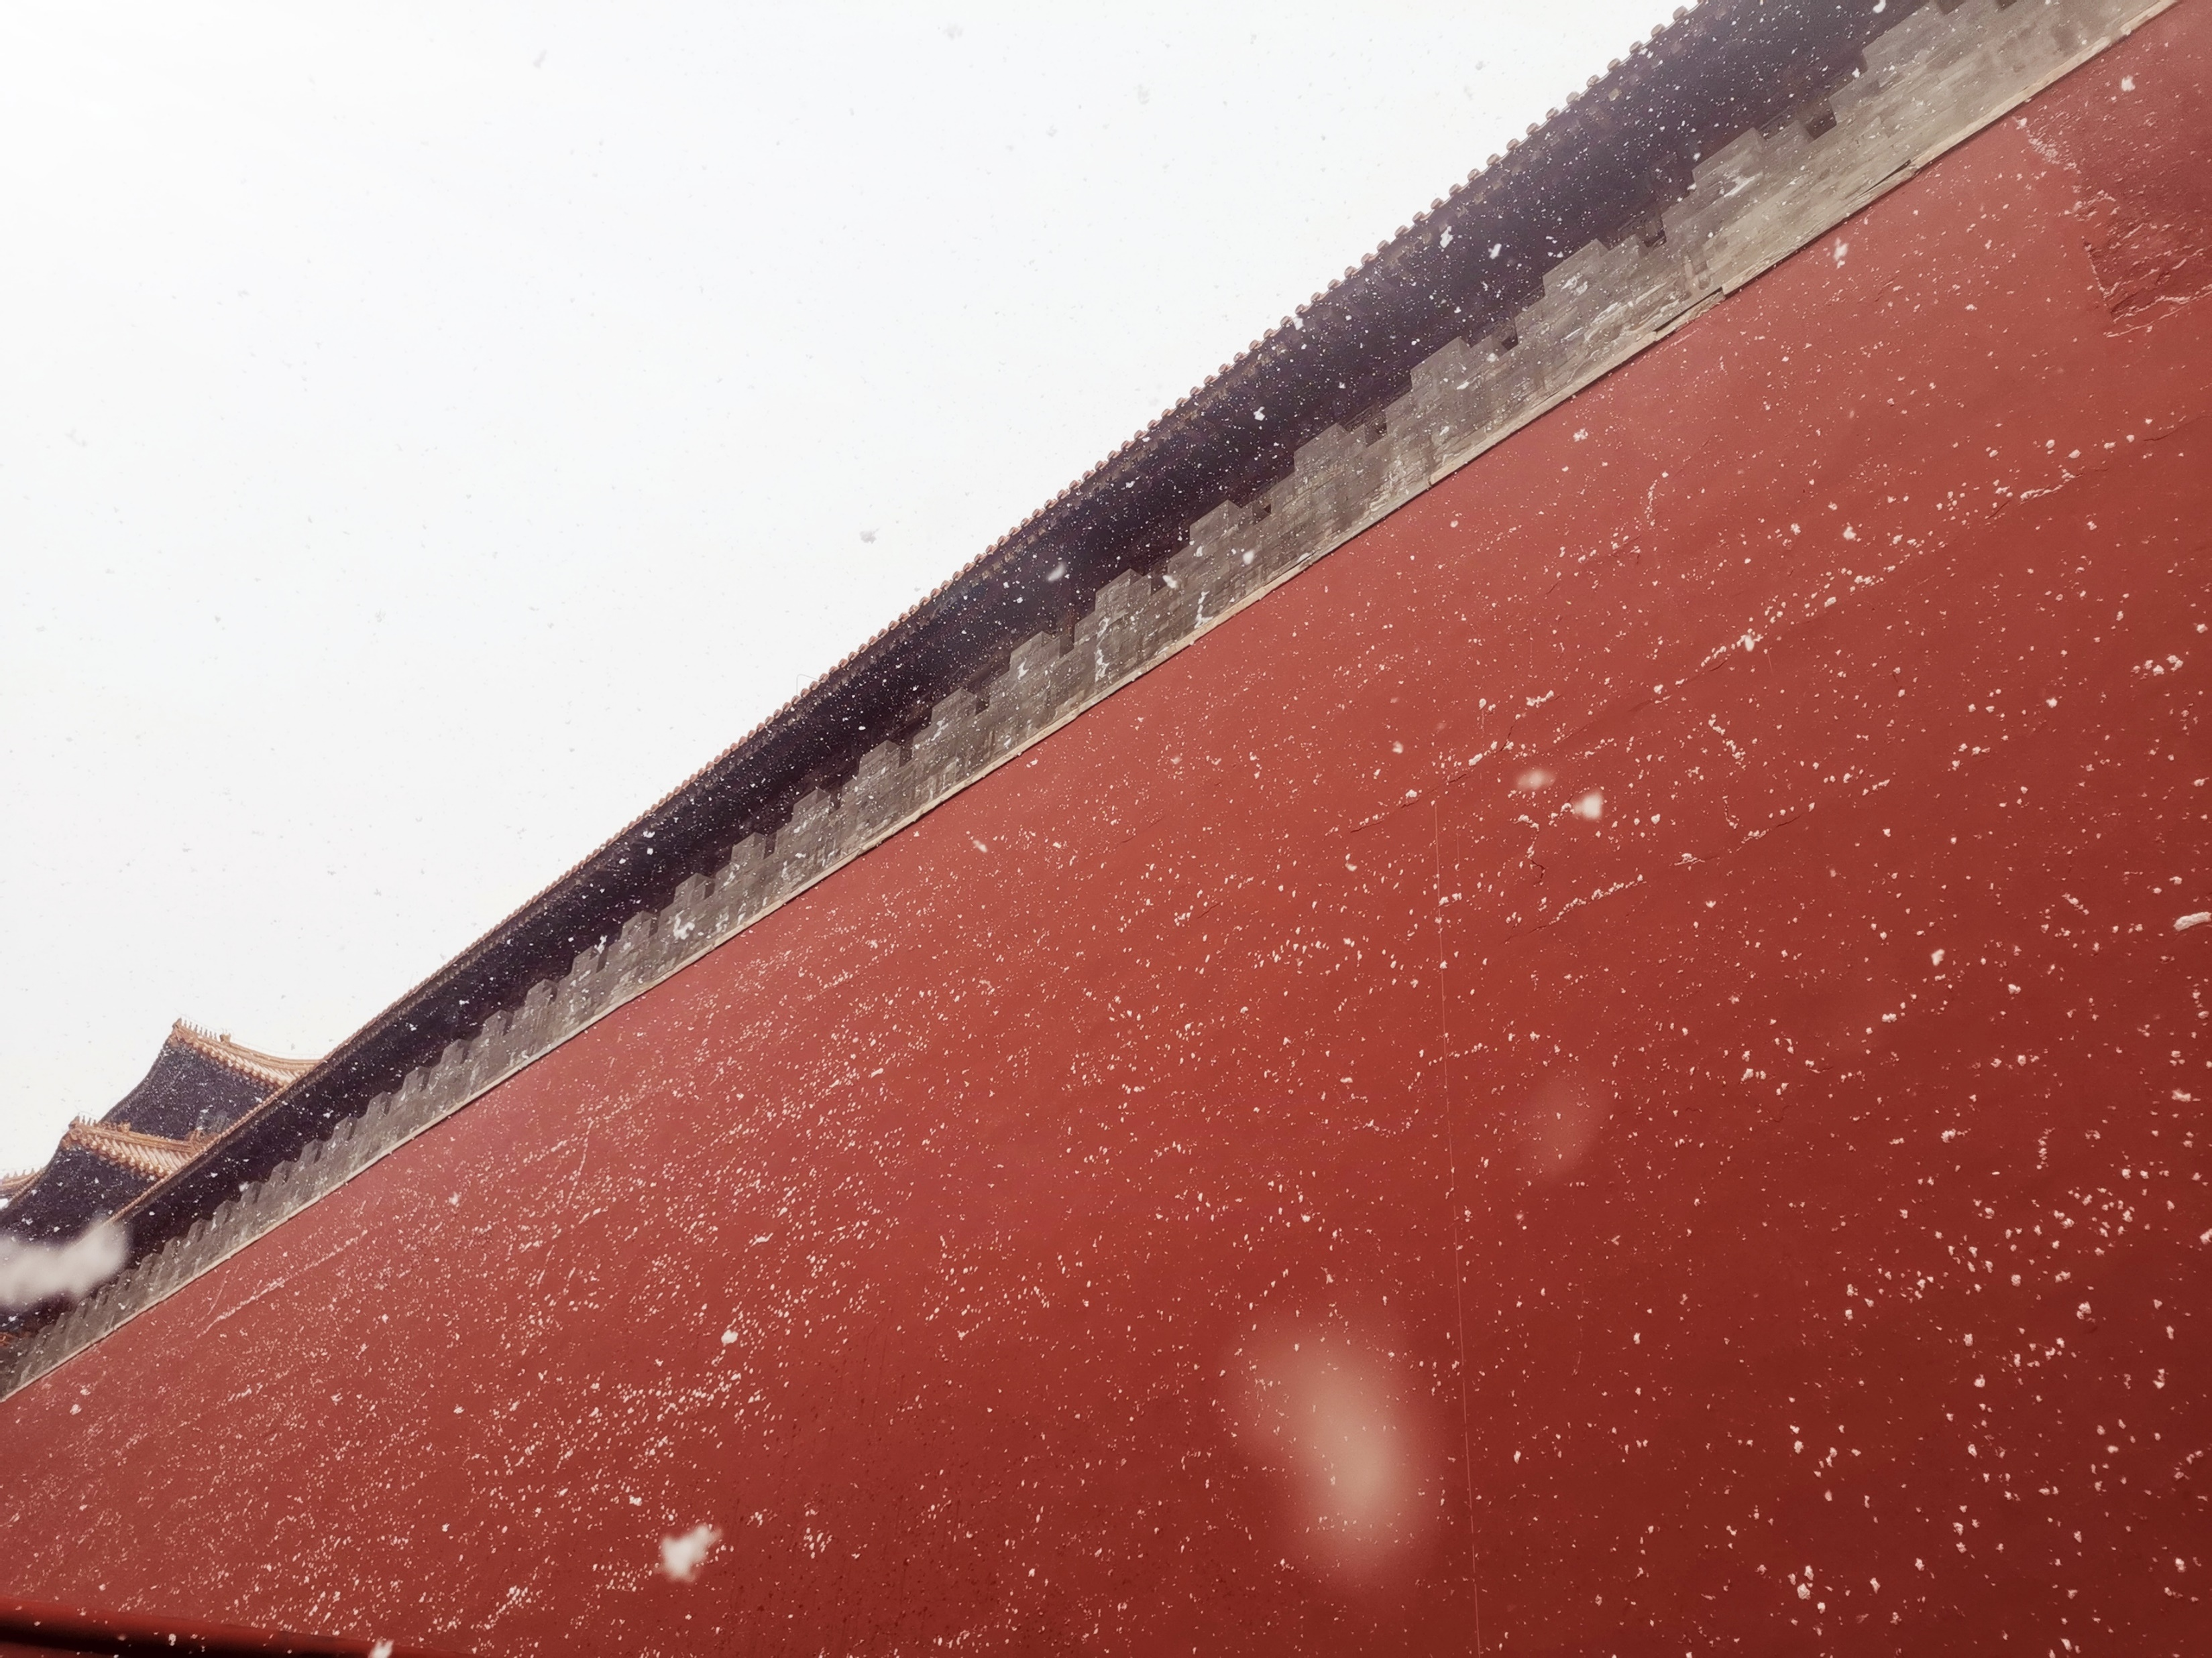

Slide 4
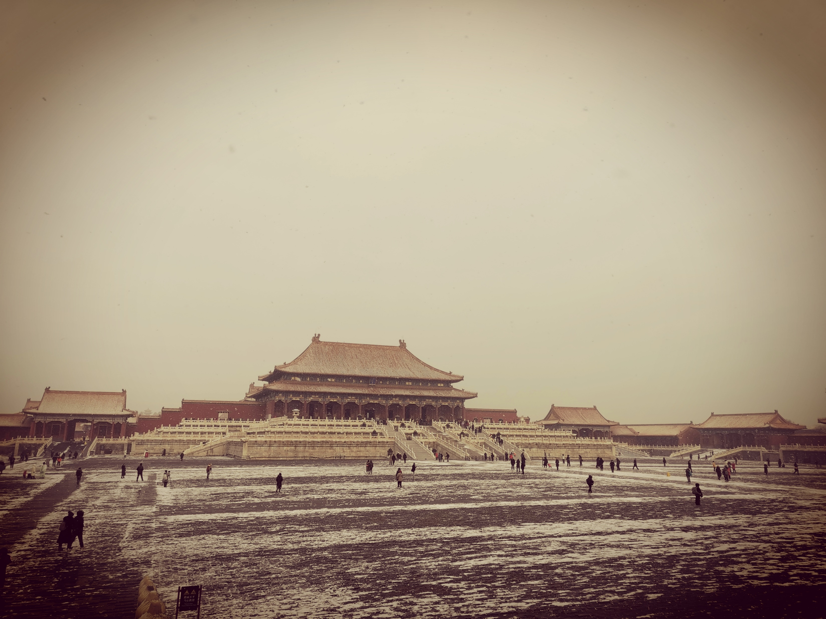

Slide 5
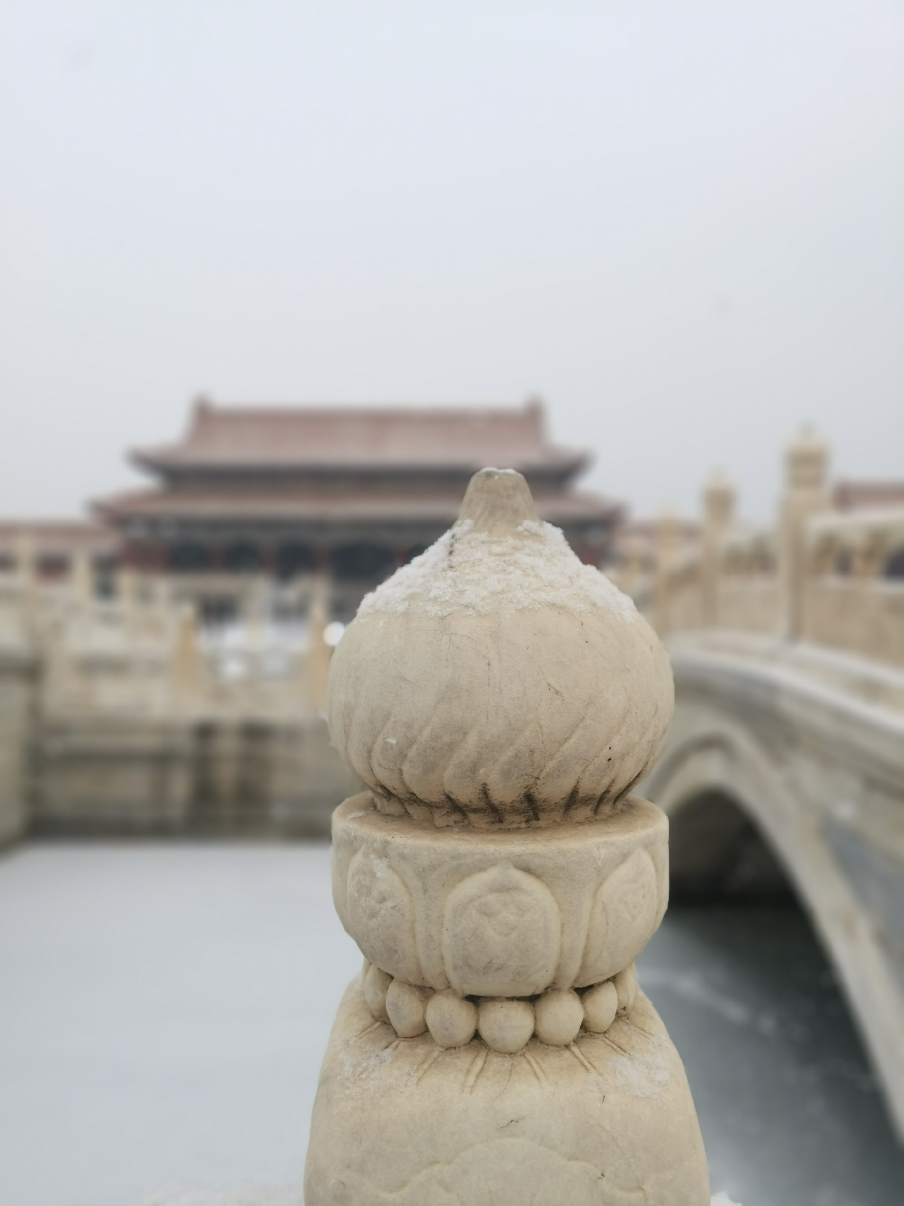

Slide 6
This is a video, move your mouse on the picture

Slide 7
This is a video, move your mouse on the picture

