Slide 1
CT WG1 Status Report to TSG CT#97
Peter Leis
CT1 Chair, Nokia

Slide 2
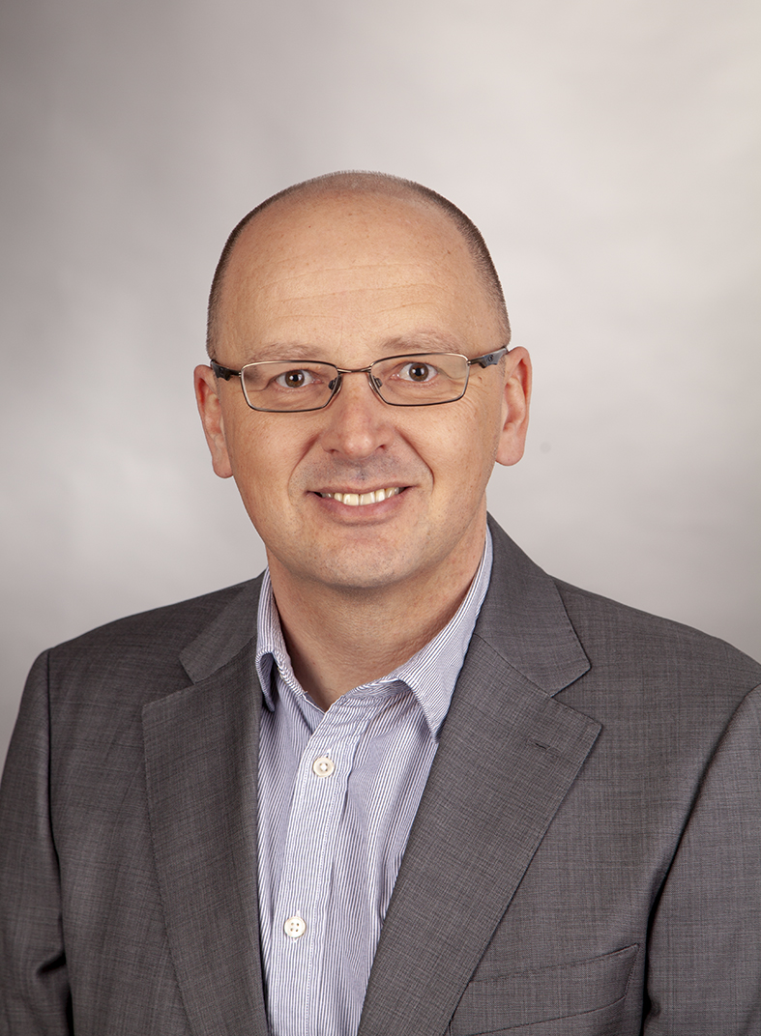

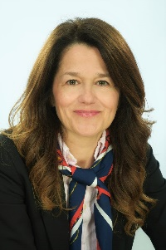
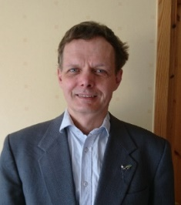

TSG CT WG1 Officials
Peter Leis
TSG CT WG1 Chair
ETSI
peter.leis@nokia.com
Lena Chaponniere
TSG CT WG1 ViceChair
ATIS
lguellec@QTI.QUALCOMM.COM
Andrijana Brekalo
Secretary
MCC
Andrijana.Brekalo@etsi.org
Jörgen Axell
TSG CT WG1 ViceChair
ETSI
jorgen.axell@ericsson.com

Slide 3
Meeting Calendar
Since the last CT plenary
  CT1#137-e (electronic)
Upcoming Meetings
  CT1#138-e
    Begin October 10th 2022
    End October 10th 2022
  CT1#139
    Begin November 14th 2022
    End November 14th 2022

Slide 4
TSG CT WG1 Statistics
Number of handled documents
  CT1#137-e: 926
Agreed CRs
  CT1#137-e: Cat B/C/F: 272
Agreed pCRs
  CT1#137-e: 0
Attendances
  CT1#137-e: 221 attended
Other information
  CT1#137-e had full scope

Slide 5
New agreed Study/Work Items led by CT1
TDoc # | Title | Source | Objectives
CP-222175 | CT aspects of Mission Critical Services over 5MBS | TD Tech | Define the stage-3 aspects for stage-2 defined in TS 23.289 developed by SA6 under Rel-18 WI MCOver5MBS, to support on-network multicast and broadcast transport capabilities for Mission Critical Services over 5GS
CP-222176 | CT aspects of Mission Critical Services over 5GProSe | Huawei | Define the stage 3 aspects for stage 2 defined in TS 23.289 developed by SA6 under Rel-18 WI MCOver5GProSe.
CP-222177 | IMS Stage-3 IETF Protocol Alignment | Nokia | Ensure protocol alignment between 3GPP Stage 3 IMS work and IETF and minor technical improvements and enhancements to IMS, not of sufficient significance to be normally covered by a work item

Slide 6
Revised Study/Work Items led by CT1
TDoc # | Title | Source | Objectives

Slide 7
Work Plan Rel-17
Name | Acronym | Start | End | % | WID
Protocol enhancements of Mission Critical Services | MCProtoc17 | June 2020 | Sept 2021 | 100% | CP-202193
Mission Critical system migration and interconnection | MCSMI_CT | Dec 2018 |  | 100% | CP-190143
Stage-3 of MuDe | MuDe | June 2020 | June 2021 | 100% | CP-211162
CT1 aspects of MPS2 | MPS2 | June 2020 | March 2021 | 100% | CP-201207
Stage 3 of eCPSOR_CON | eCPSOR_CON | June 2020 | March.2022 | 100% | CP-210148
Stage-3 5GS NAS protocol development 17 | 5GProtoc17 | June 2020 | March 2022 | 100% | CP-201163
Stage-3 SAE Protocol Development | SAES17 | June 2020 | Sept 2021 | 100% | CP-201165
Legend
Green row – Newly completed
Yellow row – on time for completion
Red row – at risk for completion on time, requires exception sheet
98 – no progress since the last plenary
98 - Updated

Slide 8
Work Plan Rel-17
Name | Acronym | Start | End | % | WID
IMS Stage-3 IETF Protocol Alignment | IMSProtoc17 | June 2020 | Sept 2021 | 100% | CP-201167
Study on enhanced IMS to 5GC Integration Phase 2 | FS_eIMS5G2 | June .020 | Sept 2021 | 100% | CP-201168
CT aspects of Enhancements to Mission Critical Data | eMCData3 | June 2020 | Sept 2021 | 100% | CP-201177
Enhancements to LMR interworking | eMCCI_CT | Sept 2020 | Sept 2021 | 100% | CP-202241
CT aspects of Enhanced Mission Critical Push-to-talk architecture | enh3MCPTT-CT | Sept 2020 | Sept 2021 | 100% | CP-202188
CT aspects of 5GC architecture for satellite networks | 5GSAT_ARCH-CT | Sept 2020 | Sept 2021 | 100% | CP-210149
Enhancements to Mobile Communication System for Railways (MONASTERY) Phase 2 | eMONASTERY2 | Sept 2020 | March 2022 | 100% 98% | CP-210145
Legend
Green row – Newly completed
Yellow row – on time for completion
Red row – at risk for completion on time, requires exception sheet 98 – no progress since the last plenary
98 - Updated

Slide 9
Work Plan Rel-17
Name | Acronym | Start | End | % | WID
CT1 aspects of PAP/CHAP protocols usage in 5GS | PAP_CHAP | June 2020 | Sept 2021 | 100% | CP-201167
CT1 aspects of AKMA | AKMA-CT | June 2020 | March 2021 | 100% | CP-201168
CT1 aspects of SMS_SBI | SMS_SBI | June 2020 | Sept 2021 | 100% | CP-201177
CT aspects for Enabling Edge Applications | EDGEAPP | Dec 2020 | Sept 2021 | 100% 99% | CP-203106
SID - Study on the CT aspects of Support for Minimization of service Interruption | FS_MINT-CT | Dec 2020 | June 2021 | 100% | CP-210144
Reliable Data Service Serialization Indication | RDSSI_CT | Dec 2020 | Sept 2021 | 100% | CP-203234
New WID on CT aspects of Access Traffic Steering, Switch and Splitting support in the 5G system architecture; Phase 2 | ATSSS_Ph2 | March 2021 | March 2022 | 100% | CP-210136
Legend
Green row – Newly completed
Yellow row – on time for completion
Red row – at risk for completion on time, requires exception sheet
98 – no progress since the last plenary
98 - Updated

Slide 10
Work Plan Rel-17
Name | Acronym | Start | End | % | WID
CT aspects of enhanced support of industrial IoT | IIoT | March 2021 | March 2022 | 100% | CP-210279
Enabling Multi-USIM devices | MUSIM | March 2021 | March 2022 | 100% | CP-210280
CT aspects of Enhanced support of Non-Public Networks | eNPN | March 2021 | March 2022 | 100% | CP-210139
CT aspects for Support of Unmanned Aerial Systems Connectivity, Identification, and Tracking | ID_UAS | March 2021 | March 2022 | 100% | CP-210287
CT aspects of Enhancement for Proximity based Services in 5GS | 5G_ProSe | March 2021 | March 2022 | 100% 85% | CP-210292
CT aspects of Enhanced application layer support for V2X services | eV2XAPP | March 2021 | March 2022 | 100% | CP-210273
CT aspects on support for Signed Attestation for Priority and Emergency Sessions | TEI17_SAPES | March 2021 | Sept 2021 | 100% | CP-210272
Legend
Green row – Newly completed
Yellow row – on time for completion
Red row – at risk for completion on time, requires exception sheet
98 – no progress since the last plenary
98 - Updated

Slide 11
Work Plan Rel-17
Name | Acronym | Start | End | % | WID
CT1 aspects of eNS_Ph2 | eNS_Ph2 | March 2021 | March 2022 | 100% | CP-211091
CT1 aspects of 5G_eLCS_ph2 | 5G_eLCS_ph2 | March 2021 | March 2022 | 100% | CP-210075
CT1 aspects of 5G eEDGE | eEDGE_5GC | March 2021 | March 2022 | 100% | CP-210284
CT1 Aspects of Application Layer Support for Uncrewed Aerial Systems (UAS) | UASAPP | June 2021 | March 2022 | 100% | CP-211111
CT1 aspects of eV2XARC_Ph2 | eV2XARC_Ph2 | June 2021 | March 2022 | 100% | CP-211116
CT1 aspects of the architectural enhancements for 5G multicast-broadcast services | 5MBS | June 2021 | March 2022 | 97% 97% | CP-211093
CT1 aspects of MCOver5GS | MCOver5GS | June 2021 | March 2022 | 100% | CP-211118
Legend
Green row – Newly completed
Yellow row – on time for completion
Red row – at risk for completion on time, requires exception sheet
98 – no progress since the last plenary
98 - Updated

Slide 12
Work Plan Rel-17
Name | Acronym | Start | End | % | WID
CT1 aspects of NBI17 | NBI17 | June 2021 | March 2022 | 100% | CP-211197
CT1 aspects of eSEAL | eSEAL | June 2021 | March 2022 | 100% 99% | CP-211117
CT1 aspects of Support of different slices over different Non 3GPP access | TEI17_N3SLICE | June 2021 | June 2021 | 100% | CP-211089
System enhancement for redundant PDU session | TEI17_SE_RPS | Sept 2021 | March 2022 | 100% | CP-212099
CT aspects of Support for Minimization of service Interruption | MINT | Sept 2021 | March 2022 | 100% | CP-212166
IMS voice service support and network usability guarantee for UE’s E-UTRA capability disabled scenario in SA 5GS | ING_5GS | Sept 2021 | March 2022 | 100% | CP-212231
CT aspects for enabling MSGin5G Service | 5GMARCH | Sept 2021 | March 2022 | 100% | CP-212106
Legend
Green row – Newly completed
Yellow row – on time for completion
Red row – at risk for completion on time, requires exception sheet
98 – no progress since the last plenary
98 - Updated

Slide 13
Work Plan Rel-17
Name | Acronym | Start | End | % | WID
CT1 aspects of NR_redcap | ARCH_NR_REDCAP | Dec 2021 | March 2022 | 100% | CP-213081
IoT NTN support for EPS | IOT_SAT_ARCH_EPS | Dec 2021 | March 2022 | 100% 95% | CP-213074
Stage 3 CT1 for eCryptPr | eCryptPr | Dec 2021 | March 2022 | 100% | CP-213083
Multi-device enhancements for device transfers | MuDTran | Dec 2021 | March 2022 | 100% | CP-213080
IMS Optimization for HSS Group ID in an SBA environment | TEI17_IMSGID | Dec 2021 | March 2022 | 100% | CP-213082
CT aspects for modifying PASSporT signing | SPECTRE_Ph3 | March 2022 | June 2022 | 100% | CP-220302
CT aspects of AKMA TLS protocol profiles | AKMA_TLS | March 2022 | June 2022 | 100% | CP-220307
Legend
Green row – Newly completed
Yellow row – on time for completion
Red row – at risk for completion on time, requires exception sheet
98 – no progress since the last plenary
98 - Updated

Slide 14
Work Plan Rel-17
Name | Acronym | Start | End | % | WID
CT1 aspects of enhancement of RAN Slicing for NR | NRslice | Mar 2022 | June 2022 | 100% | CP-221266
Legend
Green row – Newly completed
Yellow row – on time for completion
Red row – at risk for completion on time, requires exception sheet
98 – no progress since the last plenary
98 - Updated

Slide 15
Work Plan Rel-18
UID | Name | Acronym | Release | Group | End | Status old | Status new | Notes
960053 | CT1 aspects of NBI18 | NBI18 | Rel-18 | C1 | 12.12.2023 | 0% | 0%
960055 | Stage-3 5GS NAS protocol development 18 | 5GProtoc18 | Rel-18 | C1 | 12.12.2023 | 0% | 10%
960057 | Stage-3 SAE Protocol Development | SAES18 | Rel-18 | C1 | 12.12.2023 | 0% | 10%
960009 | Protocol enhancements for Mission Critical Services | MCProtoc18 | Rel-18 | C1 | 08.12.2023 | 0% | 10%
960010 | MPS for Supplementary Services | MPSSupServ | Rel-18 | C1 | 08.12.2022 | 0% | 20%
Legend
Green row – Newly completed
Yellow row – on time for completion
Red row – at risk for completion on time, requires exception sheet
98 – no progress since the last plenary
98 - Updated

Slide 16
TS/TR sent to CT plenary
TDoc # | Title | Version | Rapporteurs | Sent for

Slide 17
Work Item Exception Sheets
TDoc # | Title | Acronym | Source

Slide 18
Status of older releases
Rel-14: 1 CAT F CR for Mission Critical work items agreed
Rel-15: 3 CAT F CRs for Mission Critical work items agreed

Slide 19
Release 16 Status
1 CAT F CRs against Rel-16 agreed , fixing FASMO
See next slide for info on non backward compatible CRs

Slide 20
Backward Incompatible Changes
In “Frozen” specification, with impact on other TSG WGs
TDoc # | Title | Source | Impacted TS | Impacted TSG WG

Slide 21
Release 17 Status - Statistics
186 CRs were agreed for Release 17
0 pCRs were agreed for Release 17
0 new work items under CT1 lead was agreed

Slide 22
Release 17 Status
Significant progress since previous meeting. In last plenary, CT approved 6 work items exception for CT1. The work progressed as follows
  eMONASTERY 98% -> 100%
  IoT_SAT_ARCH_EPS 95% -> 100%
  5MBS 97% -> 97%
  EDGEAPP 99% -> 100%
  eSEAL 99% -> 100%
  5G_ProSe 96% ->100%
On 5MBS, CT1 did not receive an LS from SA2 in reply of CT plenary LS in CP-220398 on “LS on parameters preconfigured in the UE to receive MBS service”. More info on next slide
Alignment with stage-2 and across stage-3 specs is expected for all work ítems.

Slide 23
Status of 5MBS
The exception sheet for 5MBS lists the followoing open task
  „To complete the specification TS 24.575 to support UE pre-configuration for broadcast service”
pCRs against TS 24.575 on this open task, namely on a Management Object for pre-configuration of UEs were discussed, however, no consensus was found
it is to note that the related reply LS from SA2, answering questions in CP-220398 was not received by CT1
as consequence, TS 24.575 is currently available as version 0.1.0
CT plenary expected to decide on the way forward regarding the open task from the 5MBS exception sheet.

Slide 24
Status of 5G_ProSe
The exception sheet for 5G_ProSe MBS lists the followoing open tasks
  As part of support UE policy for proximity based services in 5GS, support of 5G ProSe policy request during registration procedure;
  As part of support UE-to-network relay for proximity based services in 5GS, how the UE determines whether to use UP based or CP based security procedure;
  Support UE usage reporting in 5GS.
Item 2 and 3 were addressed in the previous meetings.
For Item 1, several proposal were presented, however, CT1 did not find consensus on a CR (Please note that the capability would also impact V2X policy). Due to the time frame for Rel-17, CT1 will not pursue V2X/ProSe policy request during registration procedure in Rel-17
Common understanding in CT1 that the capability should be added in Rel-18
Related LS C1-225451 sent to SA2, Cc’ed to plenaries

Slide 25
Release 18 Status
3 new work items have been agreed for Rel-18
Work on Rel-18 CRs has started, mainly protocol enhancements

Slide 26
For Information to CT
For the work on V2X/ProSe policy request during registration procedure, CT1 had joint email discussion with CT3

Slide 27
For Action to CT
Decision needed on way forward for 5MBS support UE pre-configuration for broadcast service

Slide 28
Experience with e-meeting
High number of emails resulted in a very busy meeting:
  CT1#137-e roughly 4100 emails
Conference calls
  Used GoTo Meeting
  Useful to find way forward
Decision making over email not always easy
  sometimes slow (different timezones), no f2f offline discussion
  as a consequence, complex topics are more easily shifted out of the meeting

Slide 29
Some stats, agreed CRs/pCRs
January 2020 meeting not shown, February and April 2020 had limited scope
January/ April / October 2021 with limited scope
January / April 2022 with limited scope

Slide 30
Acknowledgement
The CT1 Chair wants to thank
Lena Chaponniere for chairing the breakout stream on “Services” topics
Jörgen Axell for chairing the breakout stream on “IMS and MC” topics
Andrijana Brekalo for excellent support before, during and after the meetings
Most important the CT1 delegates for their dedication and hard work during very busy and demanding electronic meetings

Slide 31
Annex

Slide 32
CRs for conditional approval (I)
TDoc # | Title | Spec | CR# | Dependancy

Slide 33
CRs for conditional approval (II)
TDoc # | Title | Spec | CR# | Dependancy

Slide 34
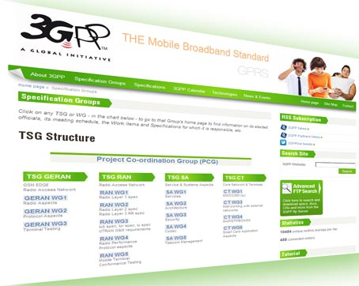
Thank You!
Peter Leis
3GPP TSG CT WG1 Chair
peter.leis@nokia.com

