Slide 1
SoH Questions for R19 FS_AIML_CN
vivo (Rapporteur) MediaTek Inc. (Rapporteur)

Slide 2
SoH for KI#1: Enhancements to LCS to support Direct AI/ML based Positioning (1/2): asked in TueQ4
Question 1: Which entity is to perform model training?
Option A: LMF is enhanced to perform model training (6 objections: Huawei, Nokia, Oppo, ZTE, CATT, Lenovo)
Yes: 7
No: 6
Option B: MTLF is enhanced to perform model training (2 objections: Ericsson, Qualcomm)
Yes: 14
No: 2
Option C: both LMF and MTLF are enhanced to perform model training (2 objections: Huawei, CATT)
Yes: 10
No: 4
Question 2: Which entity is to perform AIML-based UE positioning ?
Option A: enhanced LMF is to perform Location Calculation based on the ML model
Yes: 14
No: 1
Option B: enhanced AnLF is to perform Location Calculation based on the ML model
Yes: 6
No: 8
Option C: enhanced LMF and enhanced AnLF
Yes
No
Option A is selected as a basis to update the pCR

Slide 3
SoH for KI#1: Enhancements to LCS to support Direct AI/ML based Positioning (2/2)
New indication vs new analytics ID
Q8: When retrieving ML model from the MTLF, LMF uses a new indication (indicates requesting ML model for Direct AI/ML based positioning ) or a new analytics ID?
New indication
Yes
No
New analytics ID
Yes
No
AIML based LMF selection
Q7: Extend the LMF profile at the NRF to support the selection of an LMF that supports AI/ML based Positioning
Yes
No

Slide 4
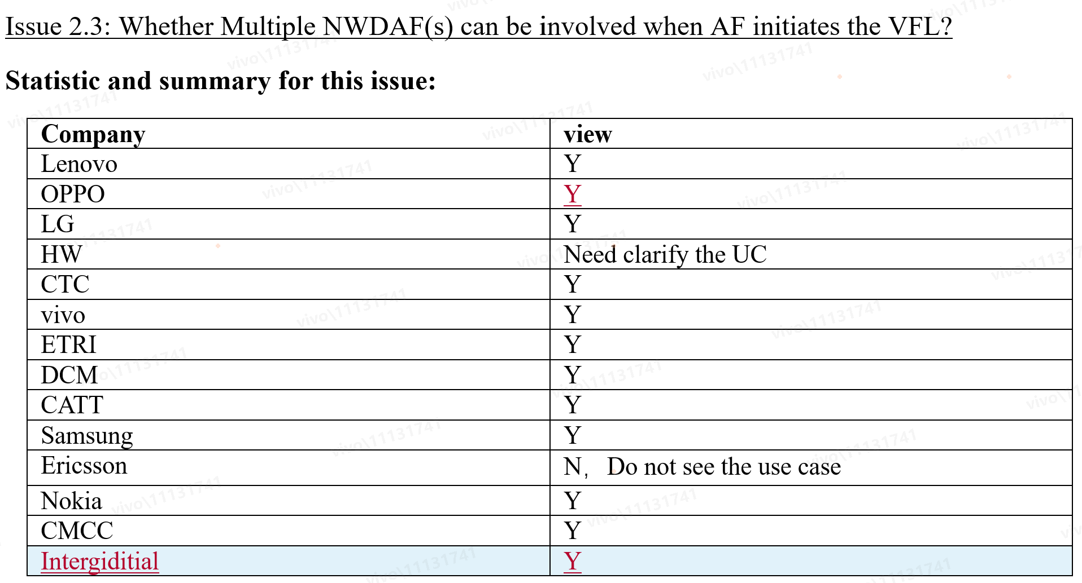
KI#2: 5GC Support for Vertical Federated Learning
Observation
Majority support multiple NWDAFs involved for AF initiated VFL and two companies need UC(s) clarification
Way forward
It is proposed to go with multiple NWDAFs involved for AF initiated VFL and further offline discussion

Slide 5
SoH for KI#3: NWDAF-assisted policy control and QoS enhancement: asked on TueQ4
Q1: Shall we support the following: NWDAF generates candidate QoS parameters with the expected QoE/service experience/performance information? (2 objection: Qualcomm, Nokia)
Yes: 10
No: 5
Q2: Shall we introduce a new logical function to recommend candidate QoS parameters to PCF? (4 objections: Qualcomm, MediaTek, Nokia, Ericsson)
Yes: 8
No: 10
Q3: Shall we define a new NWDAF service to recommend candidate QoS parameters to PCF? (3 objections: Nokia, Ericsson, Qualcomm)
Yes: 10
No: 6

Slide 6
BACKUP

Slide 7
KI#1: AI based positioning and existing analytics(1/2)
 | Existing Analytics | AI based positioning
Goals | To get thing’s statistical patterns or to predict future trends | To get UE location with high accuracy
Type of output | Statistics and prediction based on ML model | Location Calculation based on ML model
Applicable time | Either in past or in future | Current time
Inference/Location calculation entity | AnLF | enhanced LMF or LMF (collocated with enhanced AnLF)
Observation
AI based positioning is little bit different from the existing analytics which only comprise statistics and predictions.
Two alternative solutions for AI based positioning:
Alt a: enhanced LMF is to perform Location Calculation based on ML model
Alt b: LMF(collocated with enhanced AnLF) is to perform Location Calculation based on ML model
Way forward
LMF determines the location of UE directly using an ML model i.e. calculate location per the trained ML model
Further discussion about option selection e.g. only Alt a or Alt b or both

Slide 8
KI#1: Data collection/Model accuracy monitoring (1/2)
Option 1 (P#1.1): LMF calculating location + LMF model training(i.e. LMF have to support AI computing and big volume data storage)
Option 2 (P#1.2): LMF calculating location + MTLF model training
Option 3 (new): LMF calculating location + OAM model training
 | Option 1 | Option 2 | Option 3(SA5)
Training entity | LMF | MTLF | OAM
Data sources | UE, RAN and PRU | UE, RAN and PRU (via LMF) | UE, RAN and PRU
Data collection for Model training triggered by who | LMF | MTLF | OAM
granularity | Per area (any UE) | Per UE or per area (any UE) | Per area (any UE)
Model accuracy monitoring | LMF | Either LMF or MTLF | OAM
Note1: Additional optional data that may be collected is UE ID (from AMF), past UE location, positioning methods, LCS QoS (from GMLC), UE trajectory, GNSS info (from AF) and UE speed, UE orientation (from OAM).
Note2: Regarding S2-2405833 LS on data collection to RAN, RAN1 sent us LS response S2-2406872.zip
Observation
data collection is the common part for all the options
Way forward
Option 3 is SA5 scope and LS is proposed to send to SA5 in August and SA2 will align with SA5 and SA2 further discussion about option selection e.g. only option 1 or only option 2 or both
Data collection procedures for training model is the common part and need to be specified
The data for model training, inference and model performance monitoring will be decided by RAN WGs and SA2 will align with RAN WGs and standardize the potential SA2 impact
Model accuracy monitoring will be concluded in normative phase, taking into consideration related input of RAN WGs.

Slide 9
KI#2: VFL terminology (3/3)
Observation
Active/passive participant are only used in the VFL training phase.
VFL client has the same functionality with passive participant in the training phase.
Active participant is only used in VFL training phase while VFL server is used in both training and inference
Most solutions assume NWDAF/AF have role of VFL server and VFL Active Participant during VFL training
Way forward
Adopt VFL server and VFL client for both training and inference phase as baseline.
VFL server definition：.
discovering and selecting VFL clients
coordinating the VFL process
integrating all the local training and inference results
access to labels
overseeing loss value

Slide 10
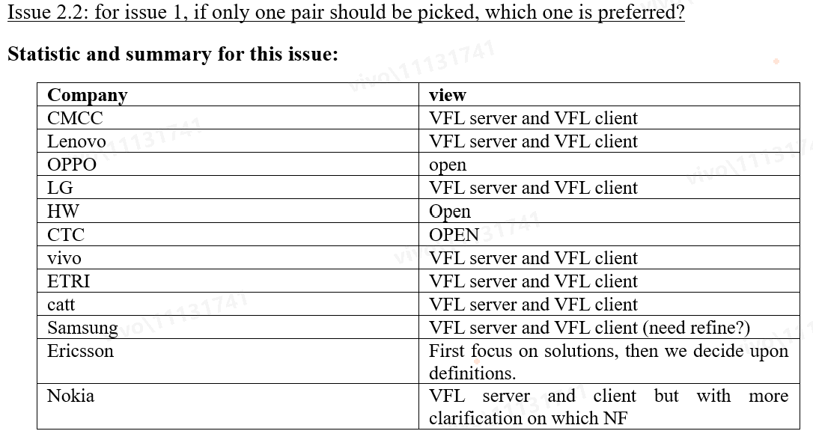
KI#2: VFL terminology (1/3)
Based on NWM discussion, majority prefer to have VFL Server/VFL client and however it need to further discuss the definition for VFL Server/VFL client.

Slide 11
KI#2: VFL terminology (2/3)
 | S2-2406316, China Mobile, ZTE, OPPO, CATT, vivo, Huawei, Sony | S2-2405948, Samsung | S2-2406203, Ericsson
VFL Server | discovering and selecting VFL clients coordinating the VFL process integrating all the local training and inference results access to labels | discovering and selecting VFL clients coordinating the VFL process | discovering and selecting VFL clients coordinateing the VFL process
VFL Client | performing local VFL training and inference without labels access to input data | performing local VFL training and inference | same as VFL Passive Participant
VFL Active Participant | N/A | access to labels may have related input data | may have related input data generating the output(i.e. analytics ID) access to labels (either available, calculated locally or may be retrieved from ) overseeing loss value (either locally or in another participant)
VFL Passive Participant | N/A | without labels access to input data | without labels access to input data

Slide 12
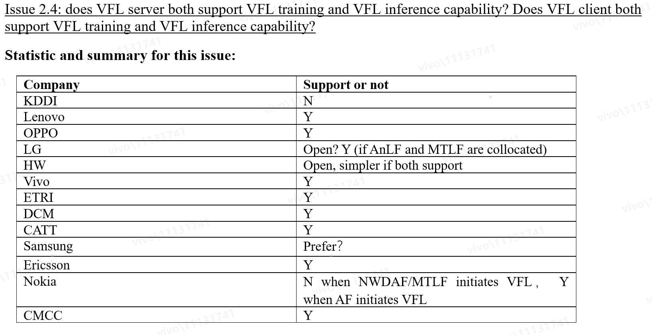
KI#2:VFL training and VFL inference capability
Observation
Both options are technically correct and majority prefer to have a simple solution in R19 due to limited time
Way forward
Due to limited time and for the sake of simplicity, NWDAF with VFL capability contains both MTLF and AnLF in this release, i.e. VFL server and VFL client supports both VFL training capability and VFL inference capability.
Regarding whether and how VFL server and VFL client support VFL training capability and VFL inference capability separately is FFS and deferred to normative phase.

Slide 13
KI#3: NWDAF-assisted policy control and QoS enhancement(1/3)
 | Alt a: Assistance information in NWDAF | Alt b: Recommendation in NWDAF | Alt c: Reinforcement Learning in PCF | Alt d: PDU set assistance via NWDAF
Goal | Assist PCF in QoS determination and modification of QoS parameters | recommend the action that could be taken by the PCF directly | Provide NW state and reward to PCF to learn appropriate actions | Assist PCF in determination of default PDU set QoS parameters
Output | One or multiple set(s) of candidate QoS parameters | Recommended QoS parameters combination(s) | NW state (e.g. slice load, NW performance, OSE) | (Enhanced) existing analytics (e.g. DN performance) to provide average/ maximum packet delay per PDU set or average packet loss per PDU set in form of statistics or predictions.
 | A combination of (enhanced) existing analytics (e.g. finer granularity QoS KPI, traffic characteristics)
 |  |  | Reward (the Reward of the action applied by the PCF)
 | Duration and number of usages of QoS Flow
Service | Enhance existing service or new service or new analytics IDs (FFS) | New service (new logical function) at NWDAF and new services / logic at PCF (FFS) | New service ? | Enhance existing service(s)
Entity | NWDAF (containing AnLF) | a new logical function (e.g. ReLF) at NWDAF / new services at PCF? | NWDAF or PCF? | NWDAF (FFS)
Observation:
NWDAF shall not be aware of PCF internal logic regardless which alternative(s) is selected
It looks more time needed for KI#3, especially Recommendation/Reinforcement Learning in PCF to help interested companies better understand the solutions

Slide 14
KI#3: NWDAF-assisted policy control and QoS enhancement(2/3)
4 alternative solutions on the table:
Alt a: enhance NWDAF existing service (or new service) to provide assistance information for PCF's determination of QoS policy.
Alt b: In addition to MTLF/AnLF, a new logical function(or new service) is introduced to recommend QoS parameters to PCF.
Alt c: NWDAF new service to provide NW state and reward to PCF to learn appropriate actions
Alt d: enhance NWDAF existing services to provide PDU set assistance information for PCF
Way forward:
NWDAF shall not be aware of PCF internal logic regardless which alternative(s) is selected
Regarding Alt a and and Alt d , it looks we may conclude the following:
A combination of (enhanced) existing analytics that are valid during the same validity period, including the Observed service experience, QoS sustainability, UE Communication, Network Performance analytics
Whether and how to provide PDU set assistance for XRM-service is FFS.
Alt b, Alt c need more time. However it seems the following part could have a chance to be concluded
The PCF may send request to NWDAF, including one or multiple sets of QoS parameters, target QoE/ service experience/performance information of a service, etc.
NWDAF may include one or multiple set(s) of candidate QoS parameters associated with the corresponding priorities and predicted target QoE/ service experience/performance information. How NWDAF derives the candidate QoS parameters (i.e. the input data used for this) is FFS.
It is FFS whether to introduce new service or reuse existing service for providing candidate QoS.

