Slide 1
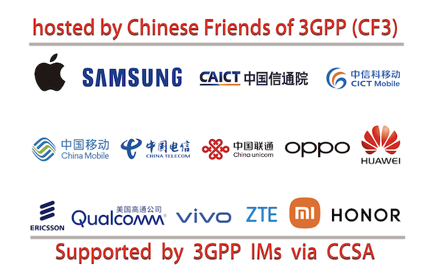
CCSA and CF3 has the pleasure of welcoming you to
3GPP RAN2#127-bis, CT1#151, CT3#137 and CT4#125
Hefei, China, 14-18 October, 2024

Slide 2
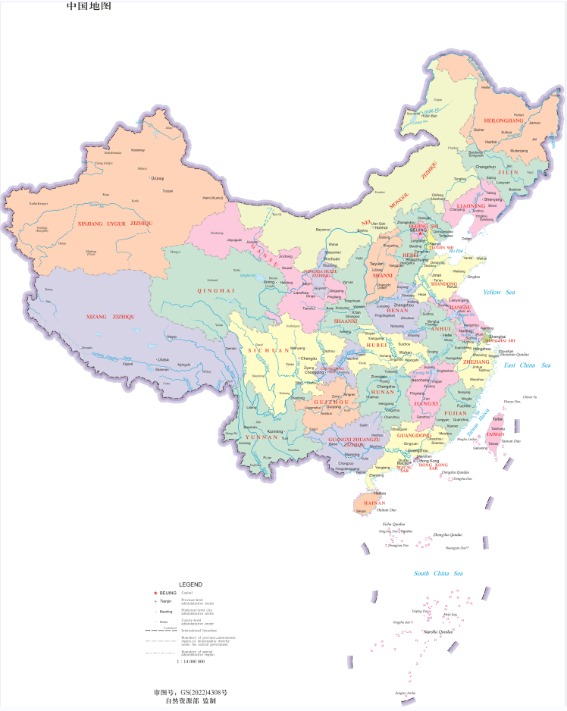
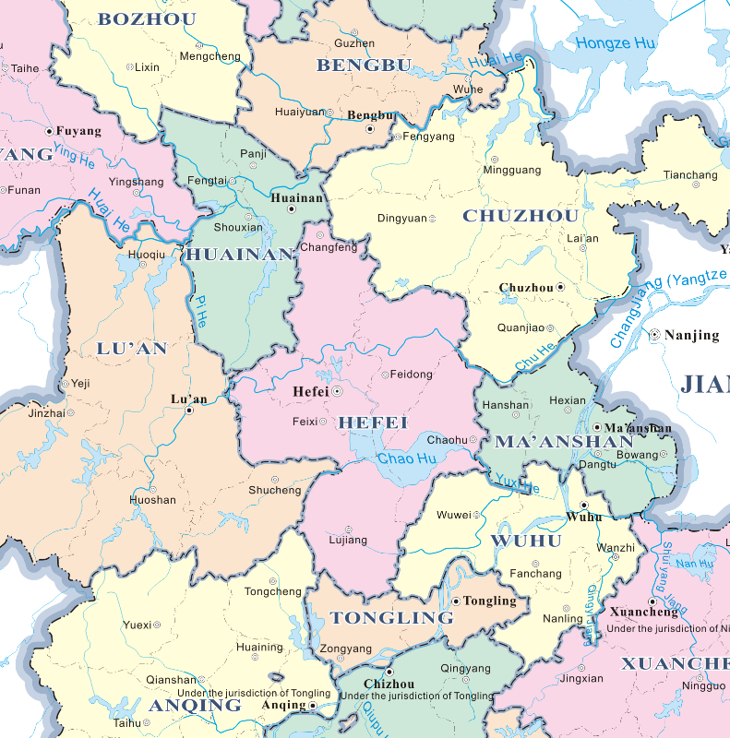
Hefei’s Location in China Map

Slide 3
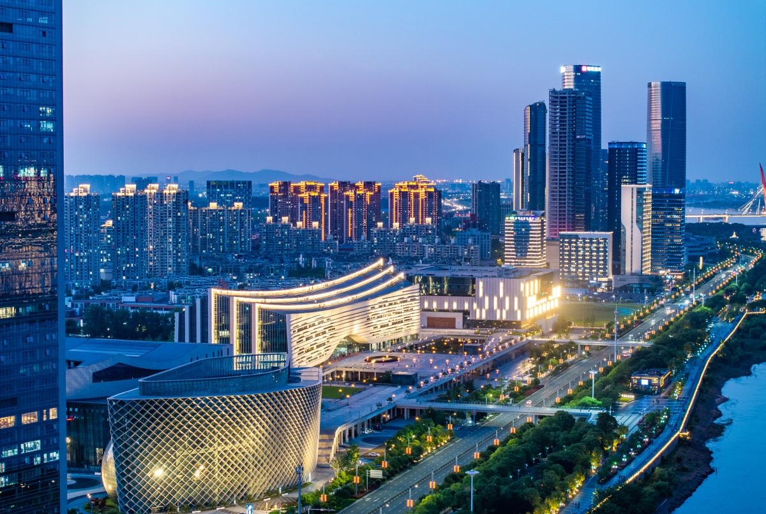
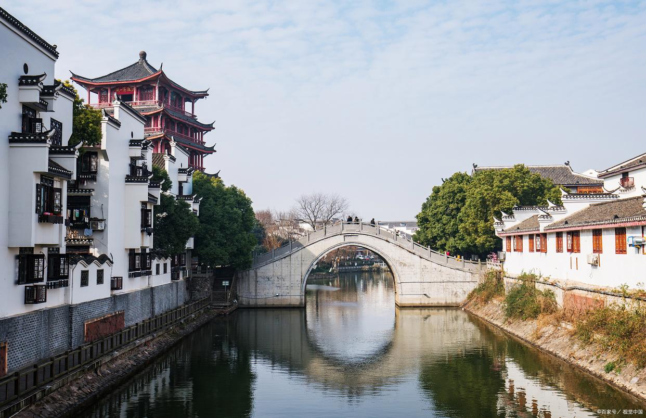
Brief Introduction of Hefei
Hefei, referred to as "Lu" or "He" in ancient times, known as Luzhou, Luyang, Hefei, is a prefecture-level city in Anhui Province. It is located in the central part of Anhui Province, in the west wing of the Yangtze River delta, surrounded by Chaohu Lake.
Hefei is one of the important cradles of Chinese civilization. The East Fei River and the South Fei River both originate here, hence the name. It is an important administrative center, commercial port and military town in the Jianghuai region, known as "the right throat of the Huai River, Jiangnan Lip Tooth," "the first county of the Jianghuai River, Wu Chu Yaochong," "the hometown of the Three Kingdoms, the hometown of Bao Zheng, and the cradle of the Huai Army." It is also the central city of the G60 Science and Technology Innovation Corridor, the strategic dual-node cities of the Belt and Road Initiative and the Yangtze River Economic Belt, the comprehensive national scientific centre, the member cities of the World Alliance of Science and Technology Cities, and the national pilot cities of science and technology innovation.

Slide 4
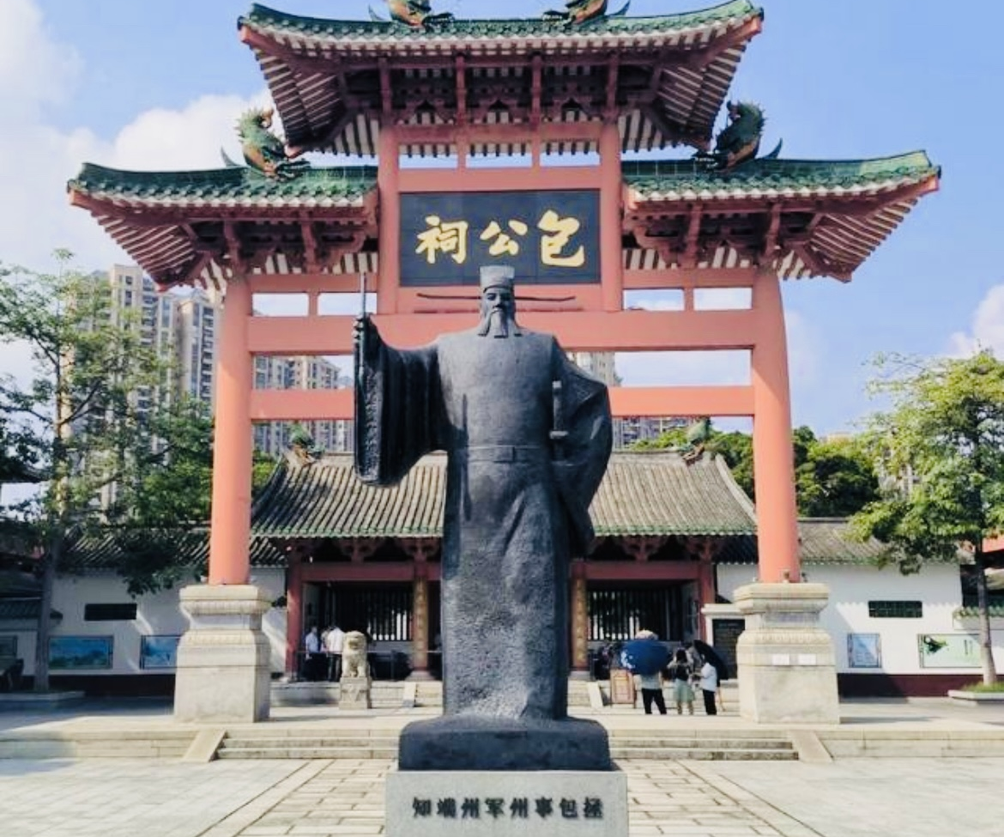
Hefei’s Attractions
Bao Ancestral Hall in Hefei
Bao Ancestral Hall, the full name of Bao Xiaosu Ancestral Hall, is located in Hefei, Anhui Province, on a mound in the eastern section of Huancheng South Road. It is a memorial hall for Bao Zheng, a minister of the Northern Song Dynasty. It was built in the Ming Dynasty and rebuilt in the Qing Dynasty. It covers an area of 10,000 square meters. Bao Gong Temple consists of a closed courtyard with white walls and green tiles. The main building is Bao Gong Ting Hall, sitting Bao Zheng tall statue, wall embedded black stone Bao Gong carved image, the majesty is not A, the performance of the "untouchable" black-faced Bao Gong's awe-inspiring righteousness. The west side of the pavilion is equipped with a corridor of curved pavilions; In the east there are 16 Longjing Pavilion stands, there are ancient wells, the number "Lian Quan." On September 8, 1981, Baogong Temple was announced by the Anhui Provincial People's Government as a provincial cultural relics protection unit in Anhui Province.

Slide 5
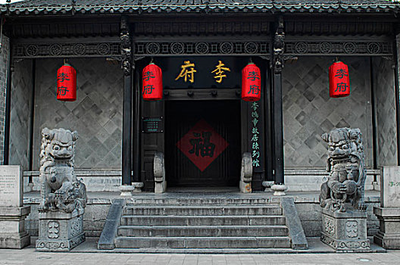
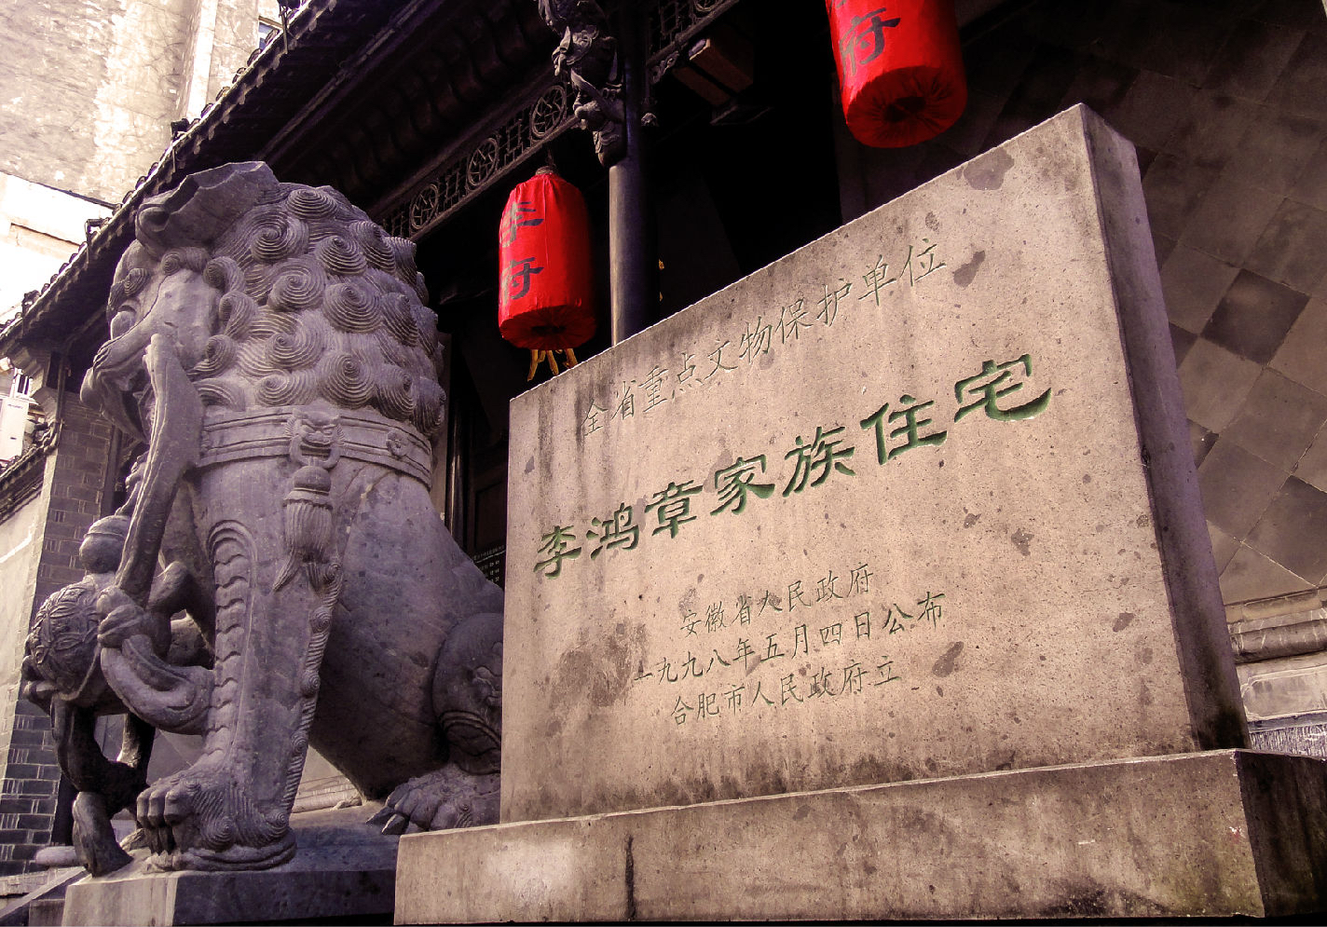
Hefei’s Attractions
Former Residence of Li Hongzhang
Hefei Li Hongzhang former residence, located in Hefei, Anhui Province, Luyang District, Huaihe Road, the middle section of the pedestrian street No. 208, is the late Qing Dynasty Li Hongzhang's home, typical of the late Qing Dynasty Jianghuai residential architecture. The former residence of Li Hongzhang covers an area of 3500 square meters and consists of the Li Mansion and the Huai Department Exhibition Hall.
The Li Mansion covers an area of 2000 square meters and the Huai Department Exhibition Hall covers an area of more than 1500 square meters. Li Fu is divided into five from south to north, followed by the foyer, lobby, the hall and Zouma Zhuan Xin Lou. The former residence is not only one of the "Top Ten Scenic Spots" of Hefei, but also the first choice of the public. It is listed as a national key cultural relics protection unit and a national AAAA tourist attraction.

Slide 6
Hefei’s Attractions
Sanhe Ancient Town
Sanhe Ancient Town, the ancient name of Que Zhu, Que Wei (Zhu), Que An, is China's historical and cultural town, the national AAAAA level tourist attractions, located in the southern tip of Feixi County, Hefei City, Anhui Province, is located at the junction of Feixi, Lujiang, Shucheng, the ancient town with a total area of 2.9 square kilometers. Three River town was originally Chaohu in the high Island, due to sedimentation, gradually become land. In the late Northern and Southern Dynasties, said the three rivers, Ming and Qing Sanhe Town. Three River town has Fengle River, Hang River port, small Nanhe convergence in the territory, the new river flows eastward about 15 kilometers into Chaohu. In the town, there are ancient city walls, ancient artillery, the old site of the Taiping Army Command, Ying Wang Palace, One Lane, Ten thousand thousand meters, Li Fu grain warehouse, He Lu, Liu Tong Xinglong Zhuang, and other historical relics. It is the birthplace of the Lu opera. The ancient town has special products such as rice dumplings, beef sugar, sweet sugar, malt sugar, dried tea, and rice wine.

Slide 7
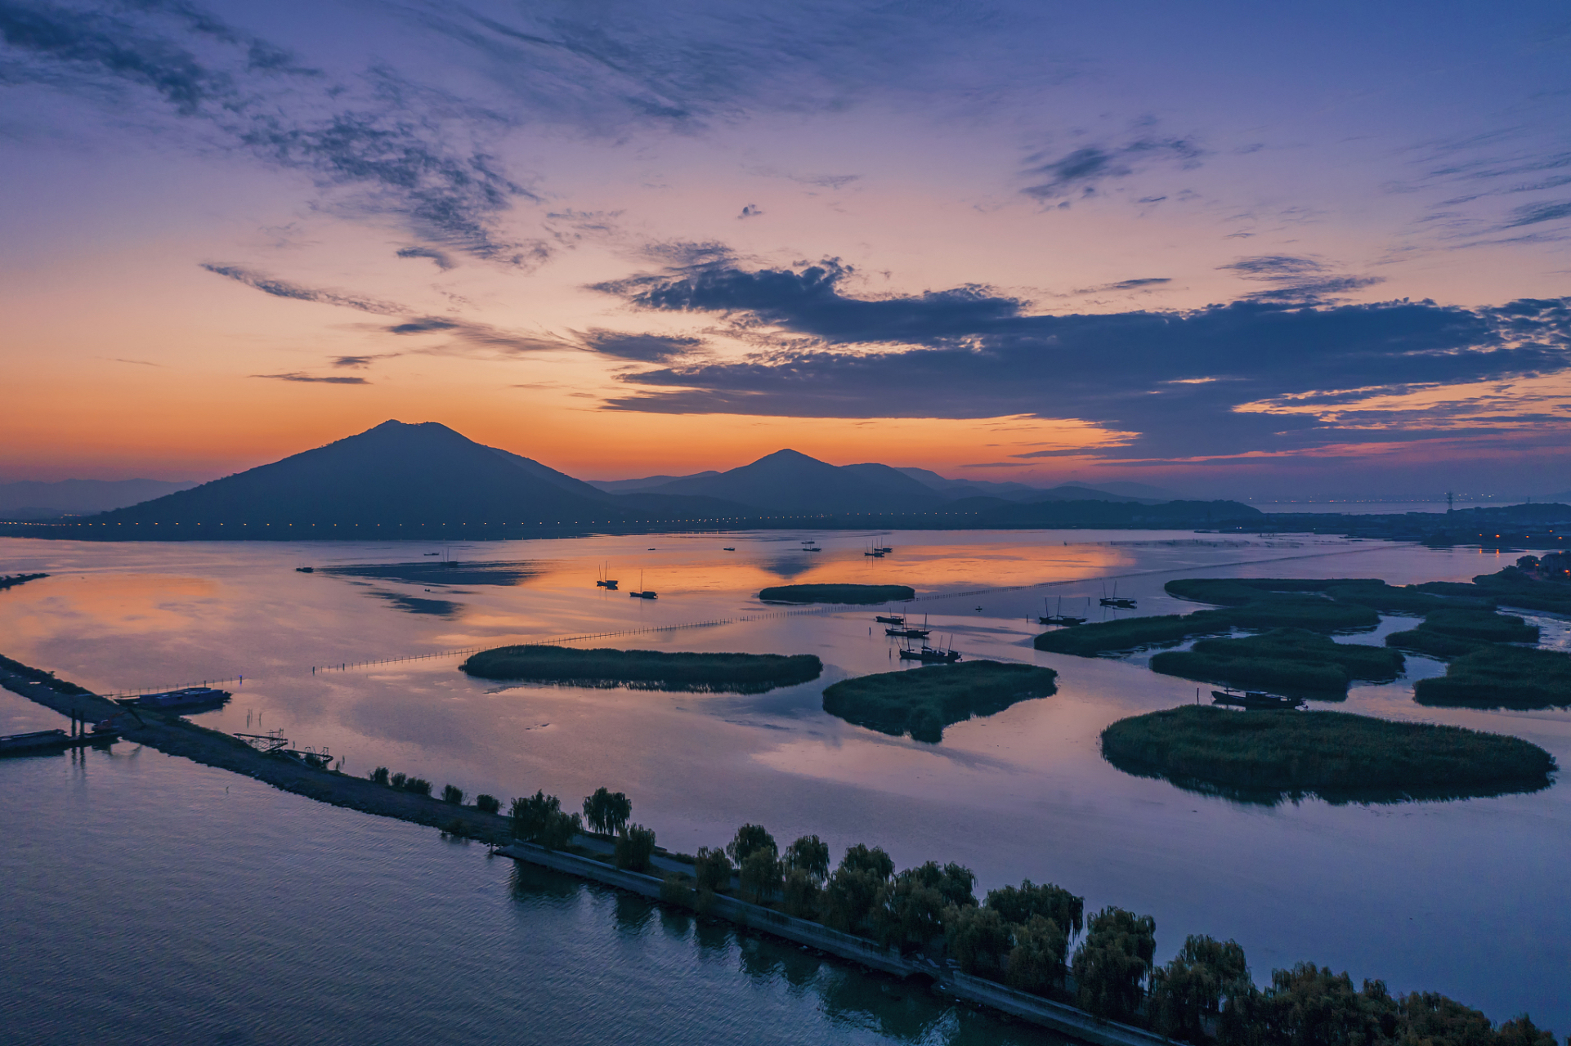
Hefei’s Attractions
Chaohu lake
Chaohu Lake, a large freshwater lake in central Anhui Province, belongs to the Yangtze River Basin and is one of the five largest freshwater lakes in China. It is not only geographically important, but also historically, culturally and ecologically significant. Chaohu has rich aquatic resources to whitebait, beautiful white shrimp and lake crab "three fresh" known, while the lake is rich in fish resources, such as lake coilia, red culter, "four big fish," carp, crucian carp and so on. In addition, Chaohu has good navigation conditions and a number of ports and docks along the lake, which have promoted the economic development of the local and surrounding areas. Chaohu Lake is not only an important natural resource, but also a tourist attraction. Laoshan Island scenic area, tulip highland scenic area and Chaohu wetland park are tourists favorite places. These scenic spots not only show the natural beauty of Chaohu Lake, but also provide a rich tourist experience.

Slide 8
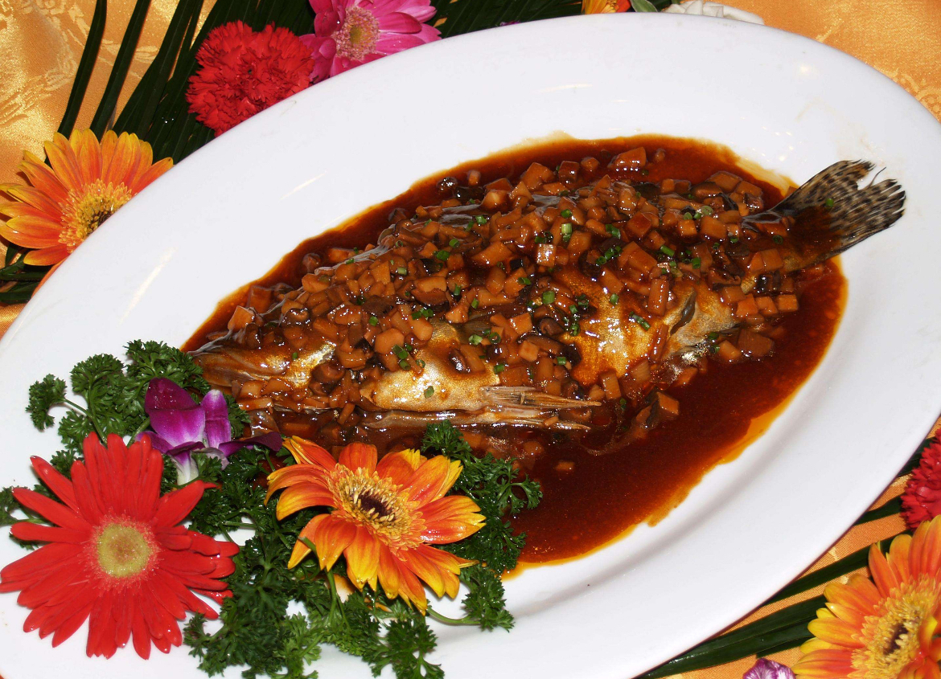
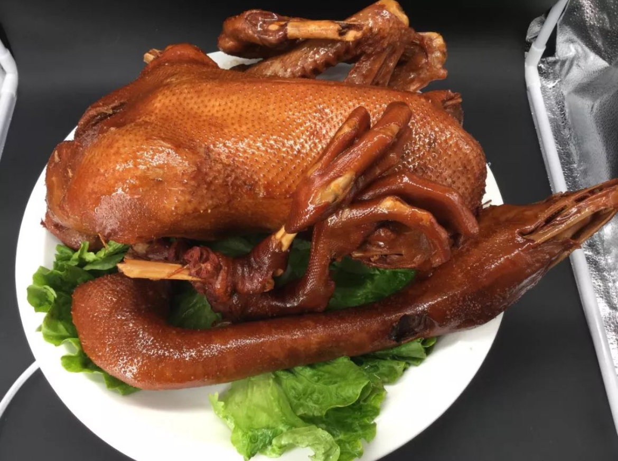
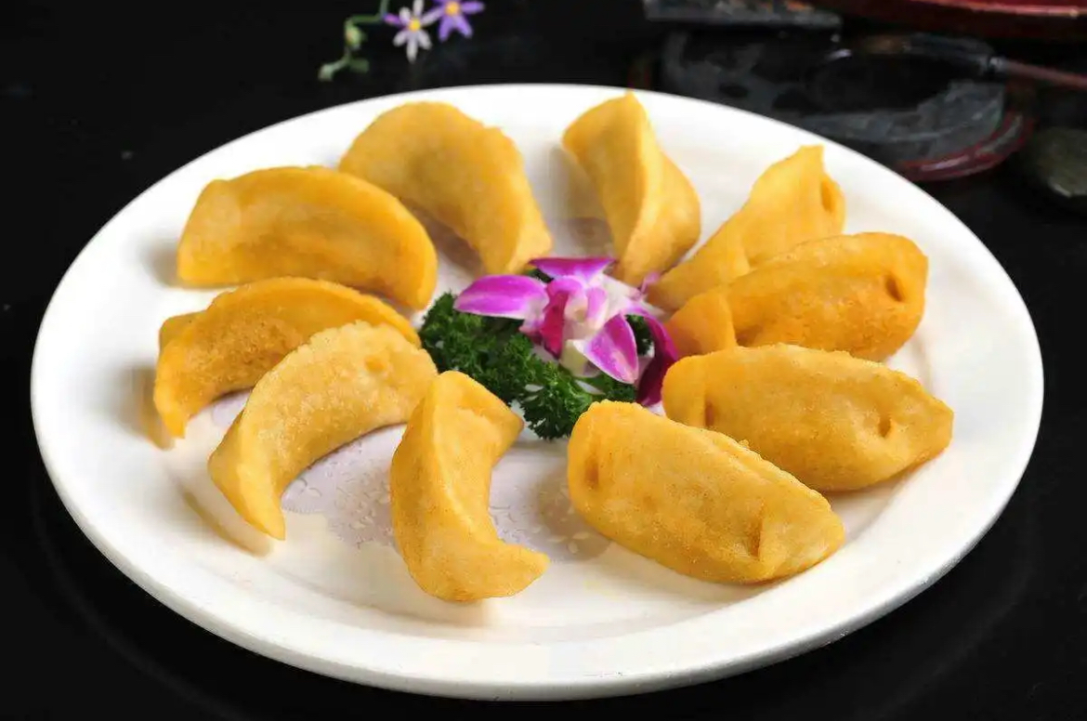
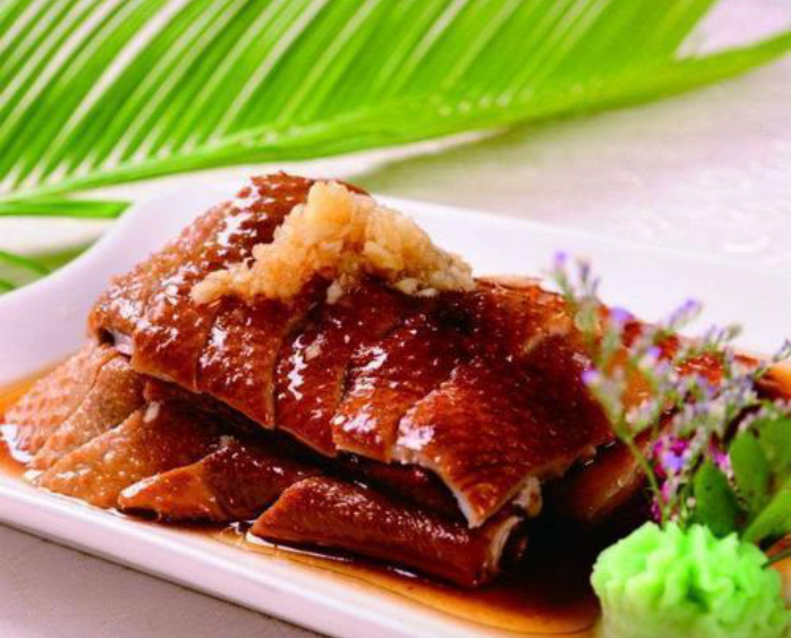
Local Food
Preserved mandarin fish（臭鳜鱼）
Wu Shan Gong Goose （吴山贡鹅）
Three Rivers Rice Dumplings （三河米饺）
Luzhou roast duck （庐州烤鸭）

Slide 9
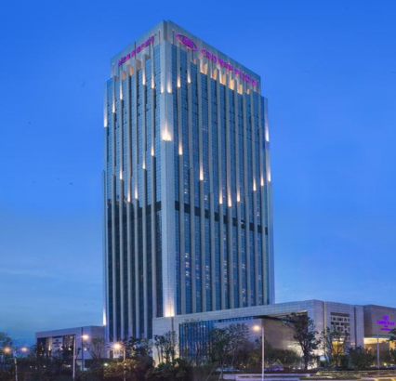
Hotel
Crowne Plaza Hefei
Crowne Plaza Hefei is an international luxury brand hotel located in Shushan District. It is conveniently located close to tourist attractions such as Dashu Mountain National Forests, Shu Peak Bay Wetland Park, Botanic Garden, Wildlife Park, Sea World
Theme Park and Banbian Street Mall. The hotel is 35 kational Airport(Airport shuttle stops at hotel entrance) and 12 kilometers away from Hefei South Railway Station.
Please take me to Crowne Plaza Hefei,
address:Building A, No.598, Huangshan Road, High-tech Zone, Hefei, Anhui 230088
Tel:86-551-62971888
请送我去合肥皇冠假日酒店
地址：合肥市蜀山区黄山路598号A座
电话：86-551-62971888

Slide 10
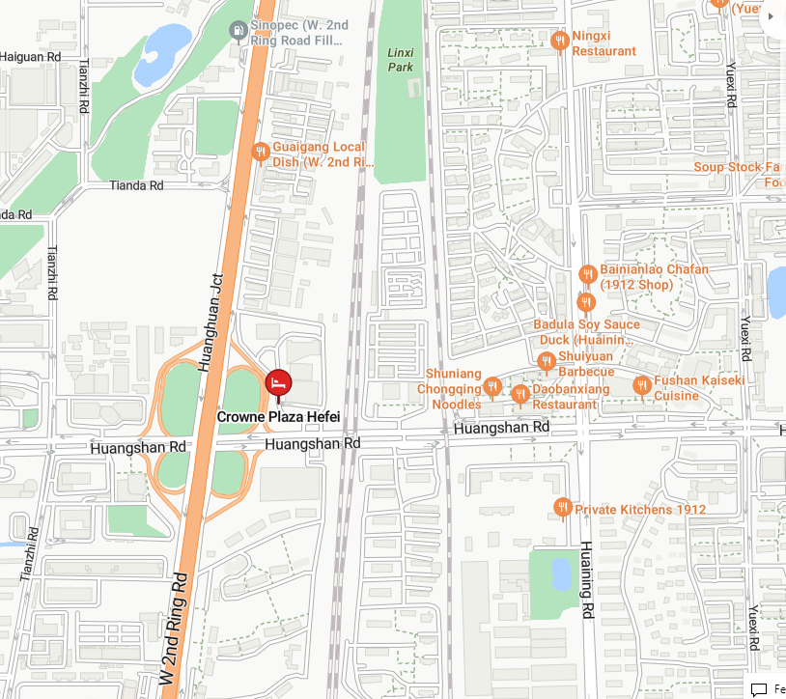
Hotel Location

Slide 11
Meeting Room Allocation-MON
Date | Time | Event | Function room/Capacity
14th Oct (MON) | 9:00-20:00 | CT1 - 1 | Theater Room(30F )/100
 | 9:00-20:00 | CT1 - 2 | Jiao Tai Room(29F)/30
 | 9:00-20:00 | CT3 - 1 | Acacia Room(3F)/60
 | 9:00-20:00 | CT3 - 2 | Sycamore Room(3F)/20
 | 9:00-20:00 | CT4-Main Session | Funtion Room(2F)/100
 | 9:00-20:00 | RAN2-Main | Fenghua Ballroom 1+2（3F）/350
 | 9:00-20:00 | RAN2-Breakout 1 | Fenghua Ballroom 3（3F）/150
 | 9:00-20:00 | RAN2-Breakout 2 | Maple Mahogany Willow Room(3F)/150
 | 9:00-20:00 | RAN2-Breakout 3 | Birch Room（3F）/40
 | 10:30-11:00/ 15:30-16:00(CT) 16:30-17:00(RAN2) | Coffee Break | Foyer

Slide 12
Meeting Room Allocation-TUE
Date | Time | Event | Function room/Capacity
15th Oct (TUE) | 8:00-20:00 | CT1 - 1 | Theater Room(30F )/100
 | 8:00-20:00 | CT1 - 2 | Jiao Tai Room(29F)/30
 | 8:00-20:00 | CT3 - 1 | Acacia Room(3F)/60
 | 8:00-20:00 | CT3 - 2 | Sycamore Room(3F)/20
 | 8:00-19:00 | CT4-Main Session | Funtion Room(2F)100
 | 8:00-19:00 | CT4-Breakout | Oak Room（3F）/40
 | 8:30-20:00 | RAN2-Main | Fenghua Ballroom 1+2（3F）/350
 | 8:30-20:00 | RAN2-Breakout 1 | Fenghua Ballroom 3（3F）/150
 | 8:30-20:00 | RAN2-Breakout 2 | Maple Mahogany Willow Room(3F)/150
 | 8:30-20:00 | RAN2-Breakout 3 | Birch Room（3F）/40
 | 10:30-11:00/ 15:30-16:00(CT) 16:30-17:00(RAN2) | Coffee Break | Foyer

Slide 13
Meeting Room Allocation-WED
Date | Time | Event | Function room/Capacity
16th Oct (WED) | 8:00-20:00 | CT1 - 1 | Theater Room(30F )/100
 | 8:00-20:00 | CT1 - 2 | Jiao Tai Room(29F)/30
 | 8:00-20:00 | CT3 - 1 | Acacia Room(3F)/60
 | 8:00-20:00 | CT3 - 2 | Sycamore Room(3F)/20
 | 8:00-19:00 | CT4-Main Session | Funtion Room(2F)100
 | 8:00-19:00 | CT4-Breakout | Oak Room（3F）/40
 | 8:30-20:00 | RAN2-Main | Fenghua Ballroom 1+2（3F）/350
 | 8:30-20:00 | RAN2-Breakout 1 | Fenghua Ballroom 3（3F）/150
 | 8:30-20:00 | RAN2-Breakout 2 | Maple Mahogany Willow Room(3F)/150
 | 8:30-20:00 | RAN2-Breakout 3 | Birch Room（3F）/40
 | 10:30-11:00/ 15:30-16:00(CT) 16:30-17:00(RAN2) | Coffee Break | Foyer

Slide 14
Meeting Room Allocation-THU
Date | Time | Event | Function room/Capacity
17th Oct (THU) | 8:00-20:00 | CT1 - 1 | Theater Room(30F )/100
 | 8:00-20:00 | CT1 - 2 | Jiao Tai Room(29F)/30
 | 8:00-20:00 | CT3 - 1 | Acacia Room(3F)/60
 | 8:00-20:00 | CT3 - 2 | Sycamore Room(3F)/20
 | 8:00-19:00 | CT4-Main Session | Funtion Room(2F)100
 | 8:00-19:00 | CT4-Breakout | Oak Room（3F）/40
 | 8:30-20:00 | RAN2-Main | Fenghua Ballroom 1+2（3F）/350
 | 8:30-20:00 | RAN2-Breakout 1 | Fenghua Ballroom 3（3F）/150
 | 8:30-20:00 | RAN2-Breakout 2 | Maple Mahogany Willow Room(3F)/150
 | 8:30-20:00 | RAN2-Breakout 3 | Birch Room（3F）/40
 | 10:30-11:00/ 15:30-16:00(CT) 16:30-17:00(RAN2) | Coffee Break | Foyer

Slide 15
Meeting Room Allocation-FRI
Date | Time | Event | Function room/Capacity
18th Oct (FRI) | 8:00-20:00 | CT1 | Theater Room(30F )/100
 | 8:00-20:00 | CT3 | Acacia Room(3F)/60
 | 8:00-20:00 | CT4-Main Session | Funtion Room(2F)/100
 | 8:30-17:00 | RAN2-Main | Fenghua Ballroom 1+2（3F）/350
 | 8:30-14:00 | RAN2-Breakout 1 | Fenghua Ballroom 3（3F）/150
 | 8:30-14:00 | RAN2-Breakout 2 | Maple Mahogany Willow Room(3F)/150
 | 10:30-11:00 | Coffee Break | Foyer

Slide 16
Time: 19:10 - 20:30 Date: 15 October, 2024 (Tuesday） Venue：Fiesta Café（菲亚斯特咖啡厅）, 2F, Crowne Plaza Sponsored by:
Welcome Social Event

Slide 17
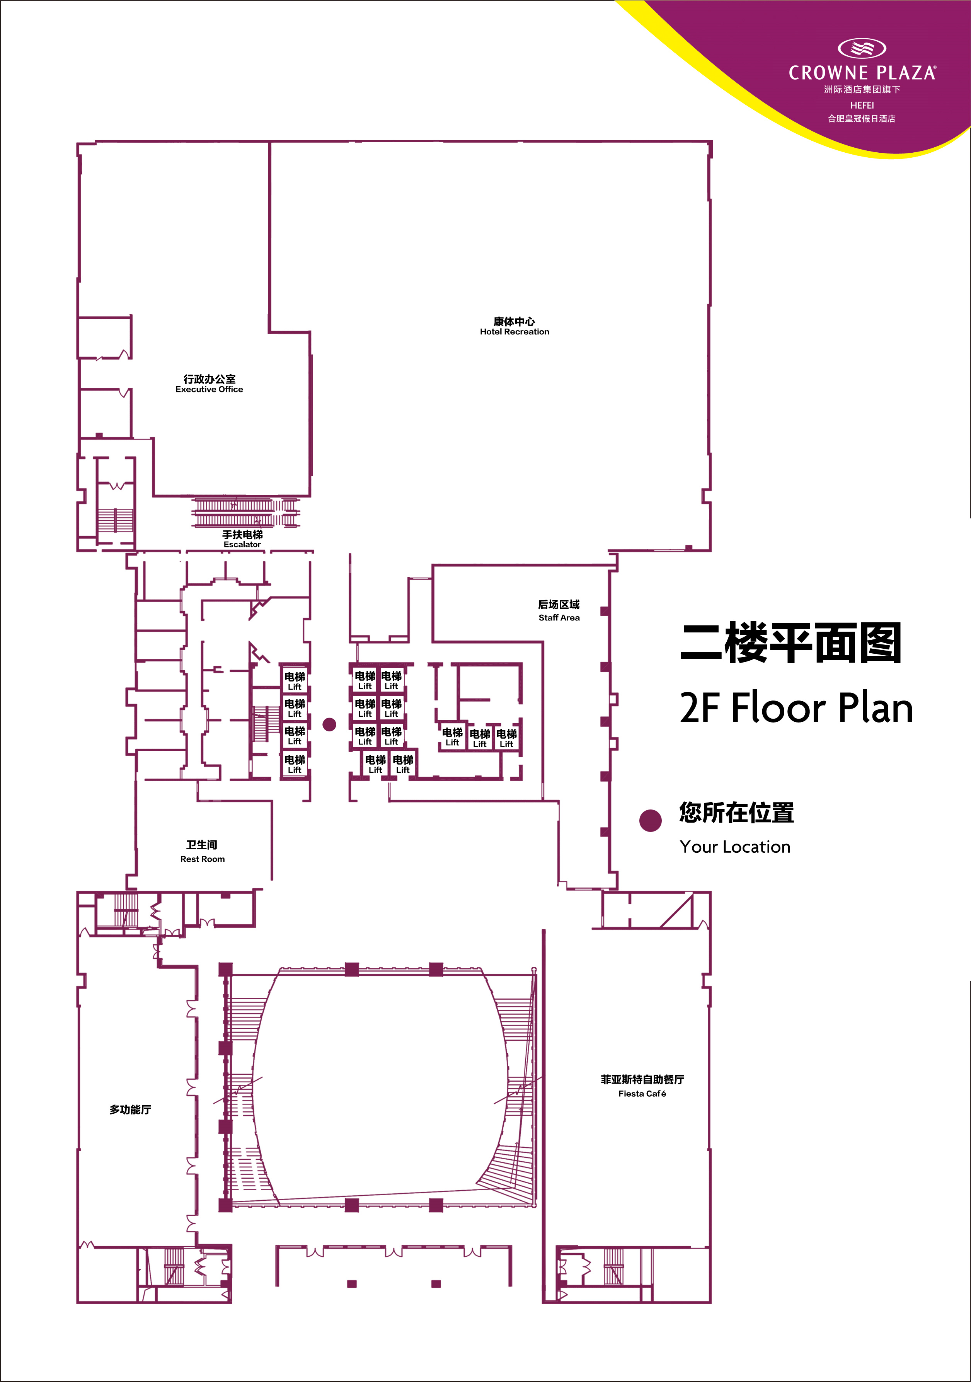
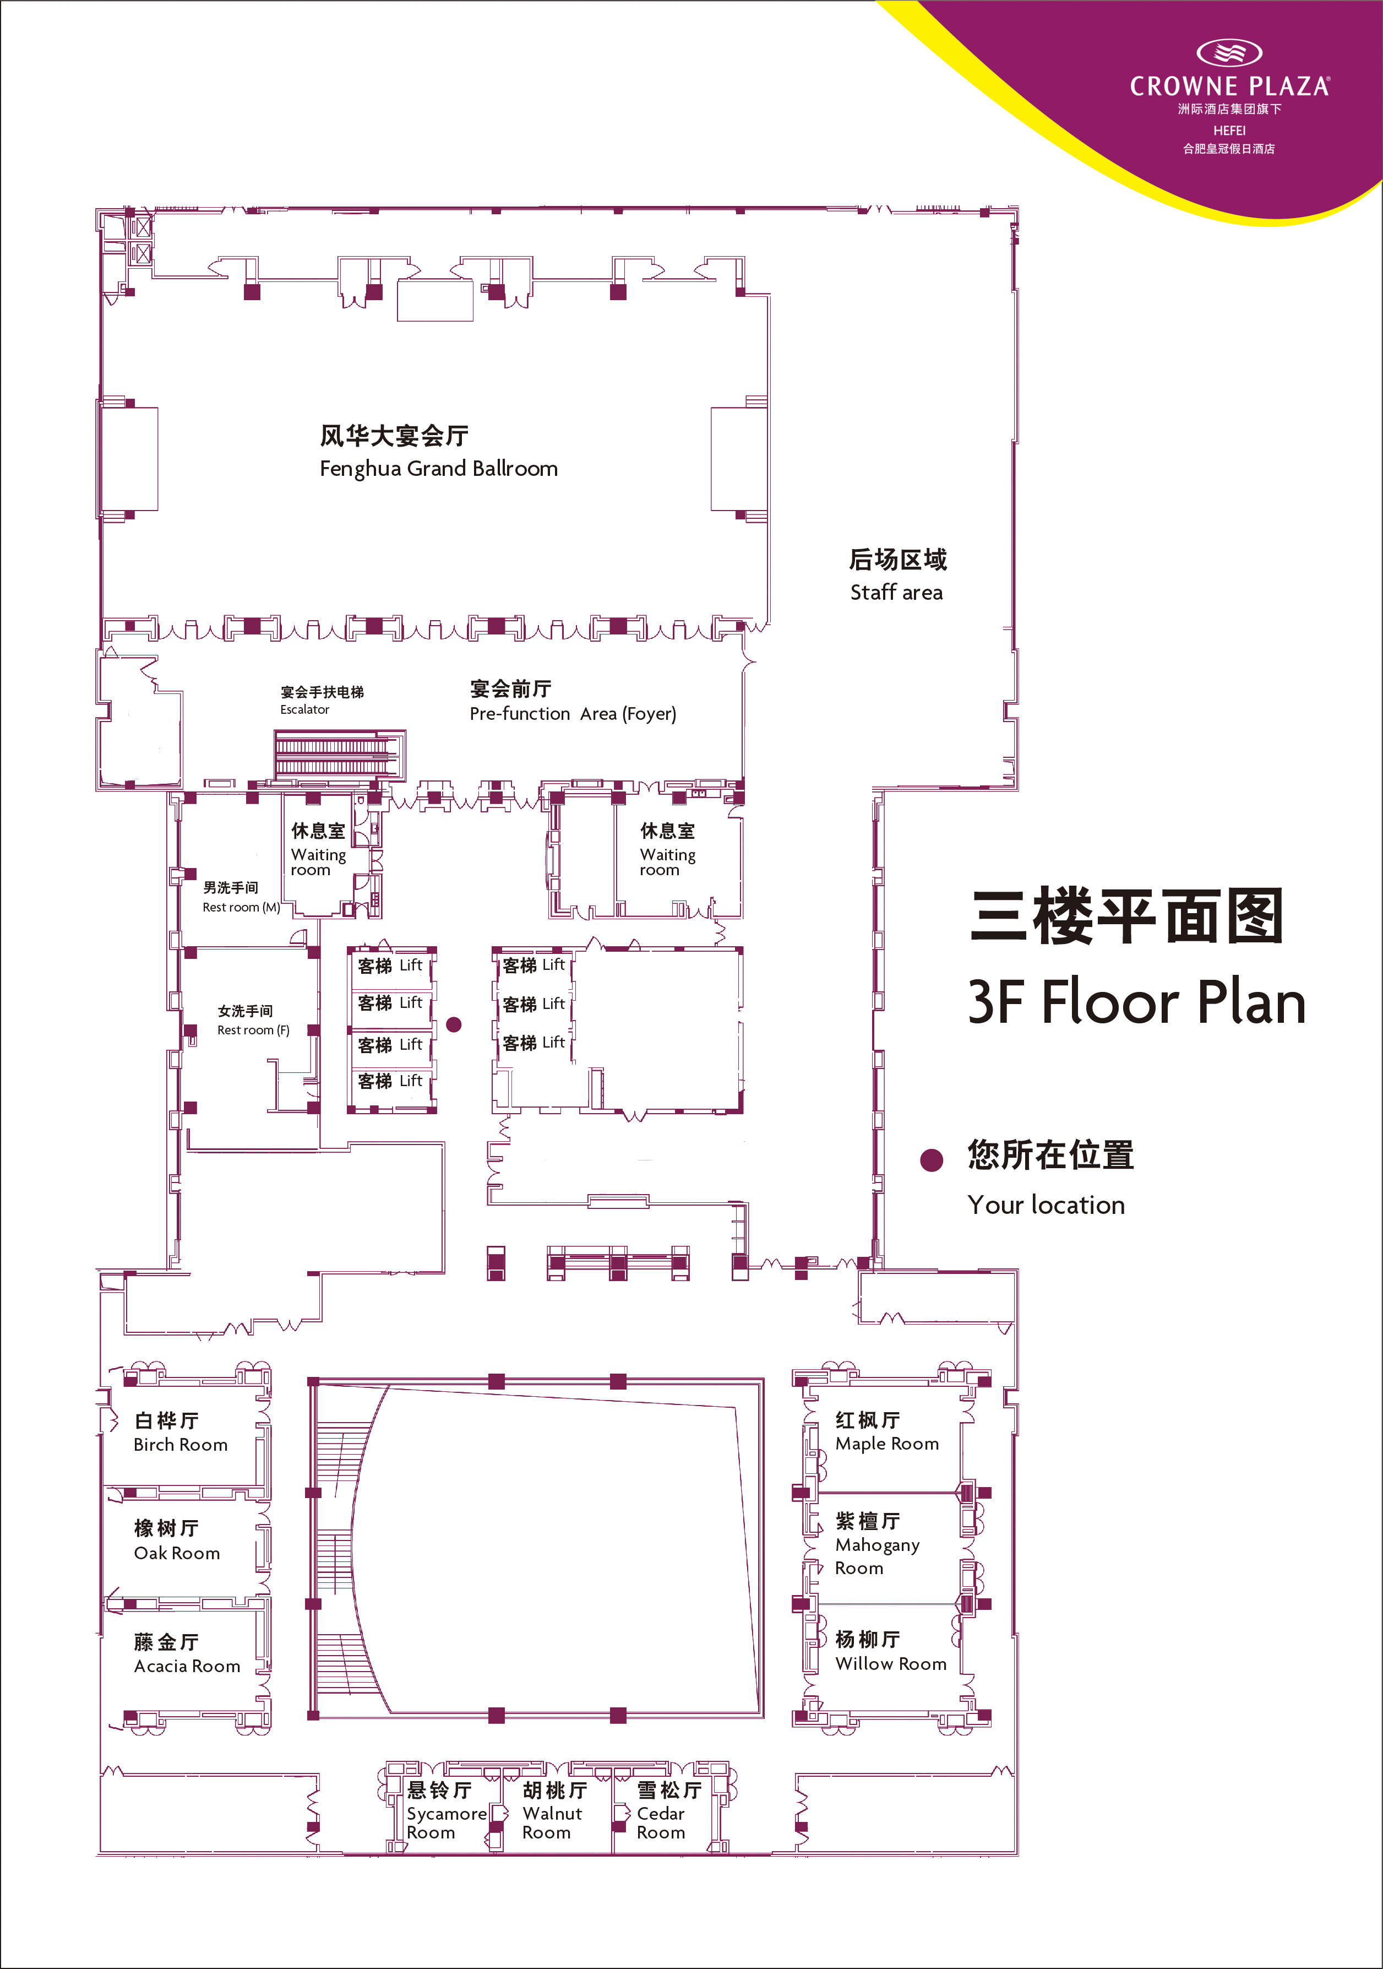
Meeting Room Map
2nd floor
3rd floor

Slide 18
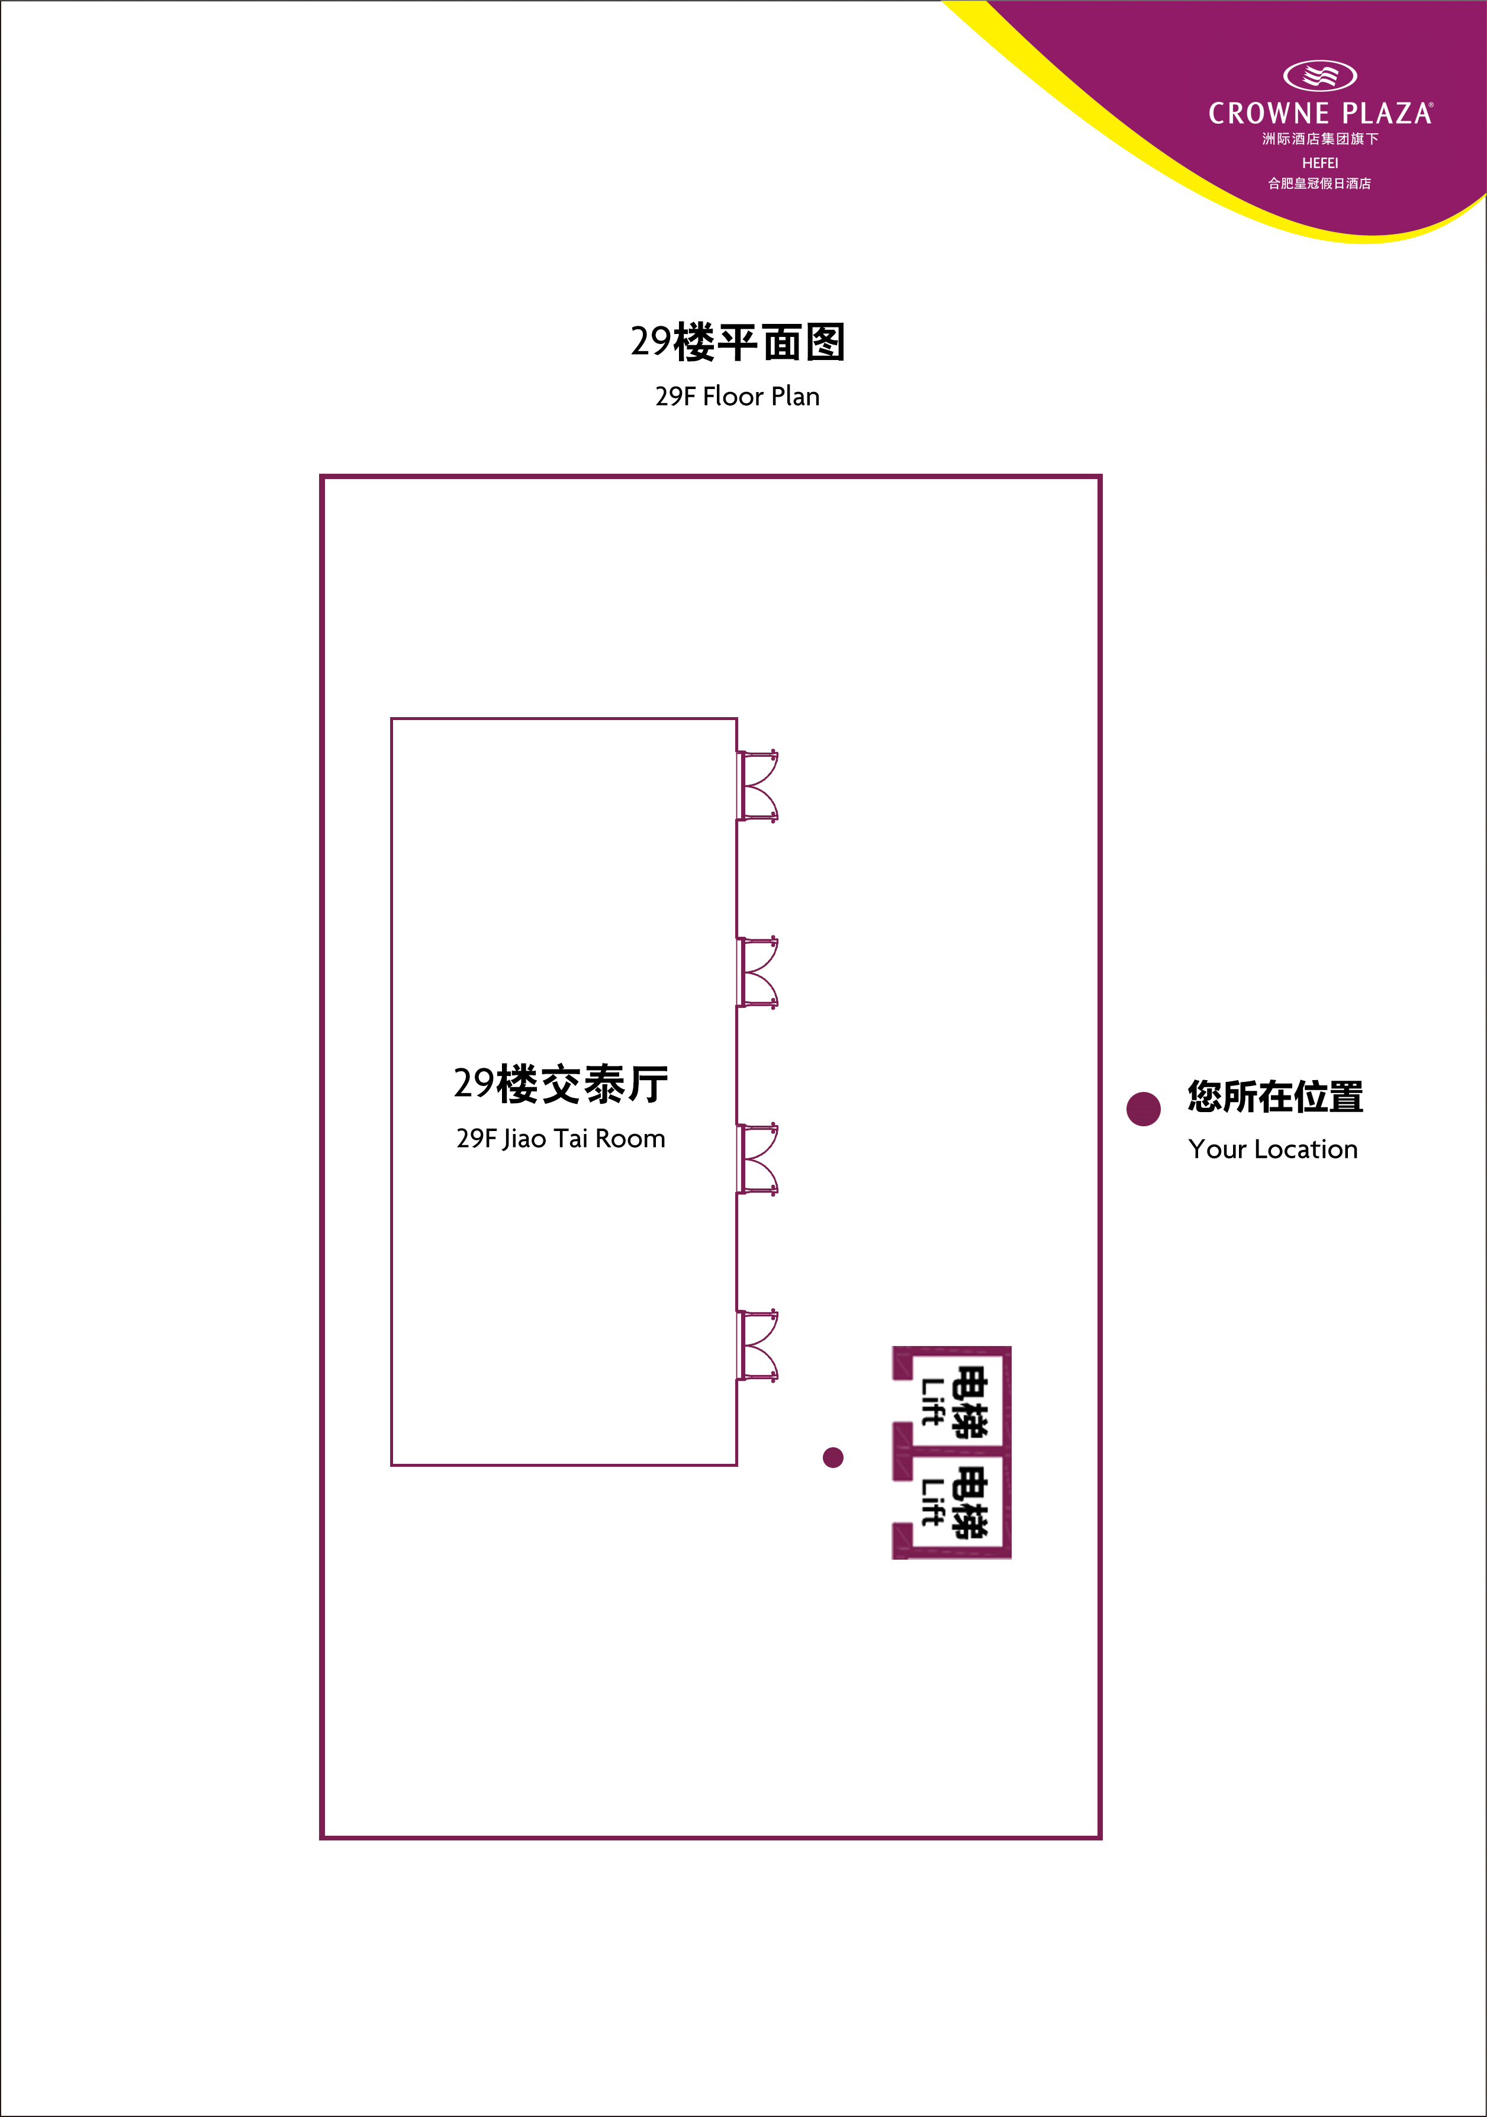
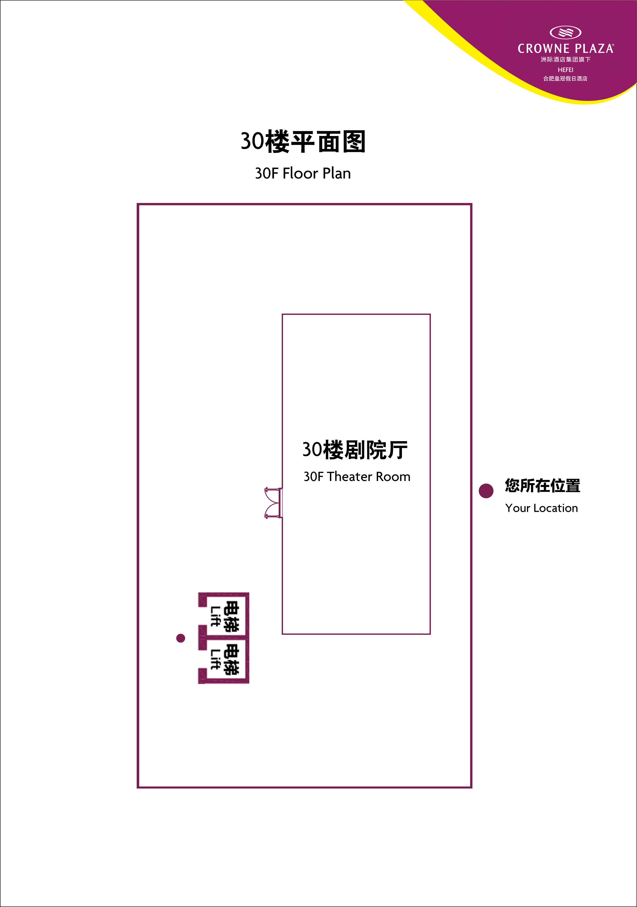
Meeting Room Map
29th floor
30th floor

Slide 19
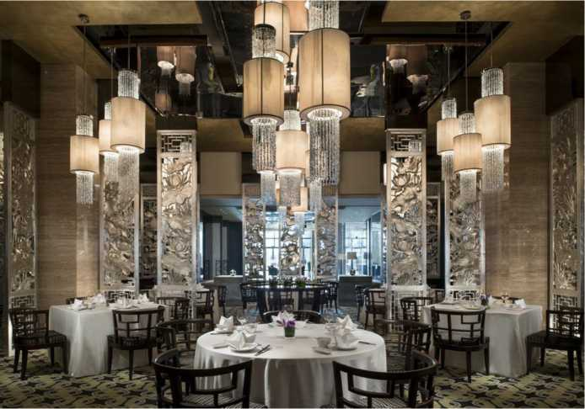
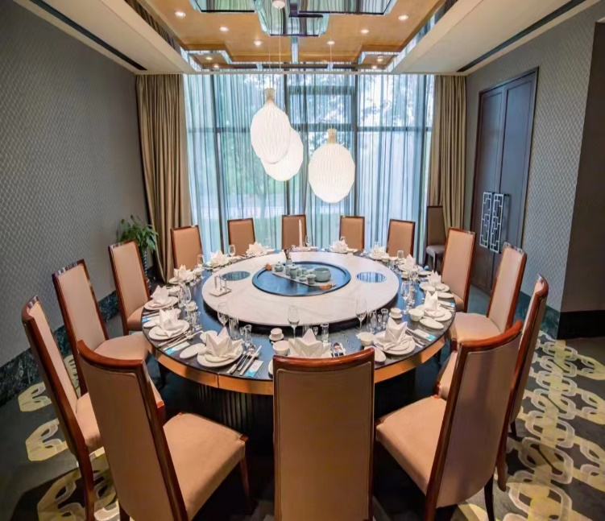
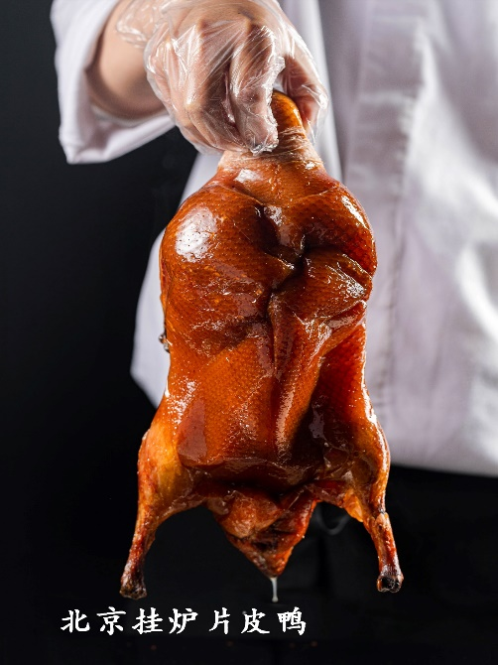
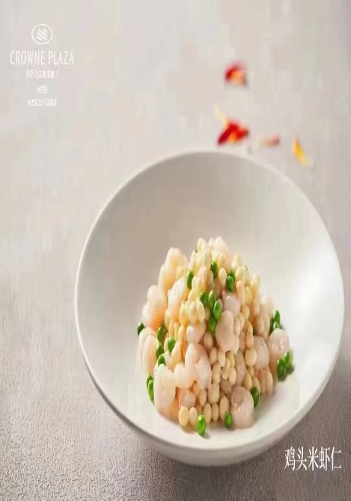
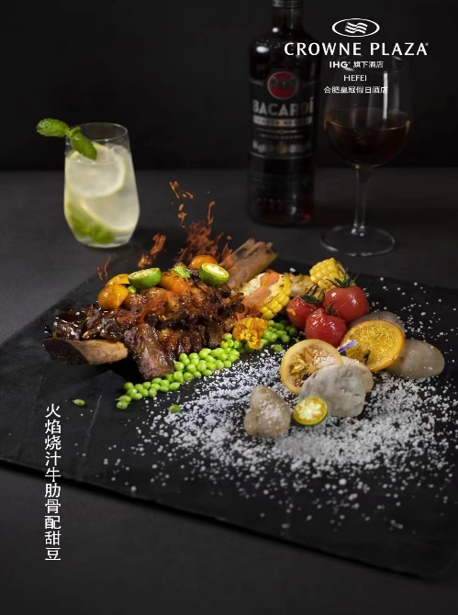
Hotel Gourmet Restaurant
Chinese Restaurant located at Level 1Private Dining Room:12
Operation Hours：Lunch 11:00 - 14:00 Dinner 17:00 - 22:00
An elegant and luxury Jade Chinese restaurant, serves authentic Cantonese cuisine and regional dishes.
Provide Chinese set menu (advance ordering 24 hours)

Slide 20
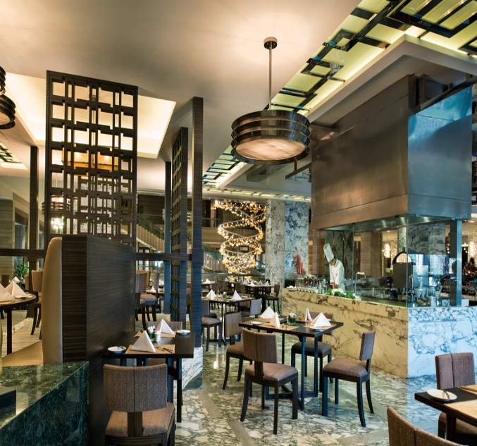
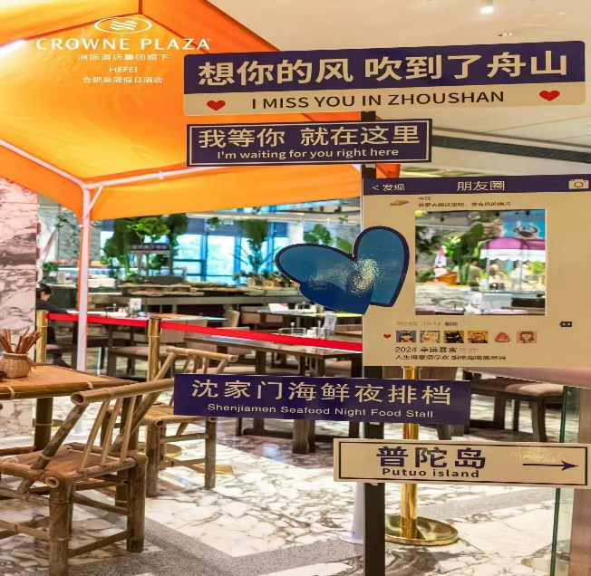
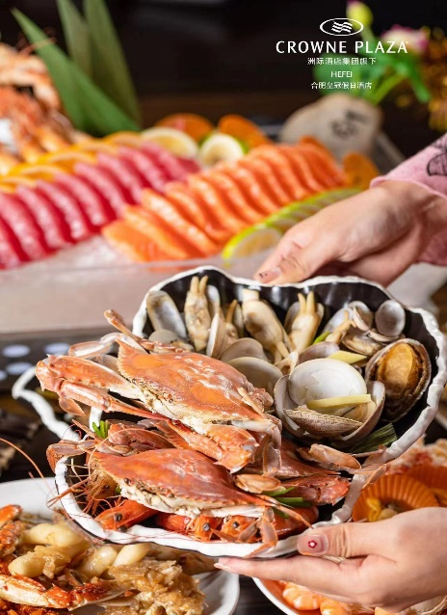
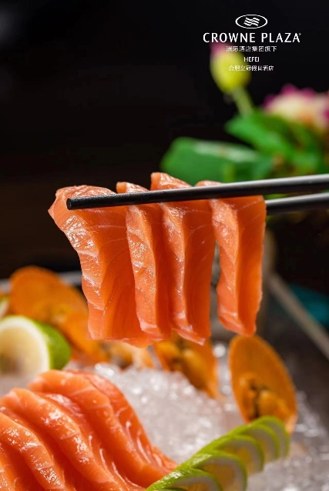
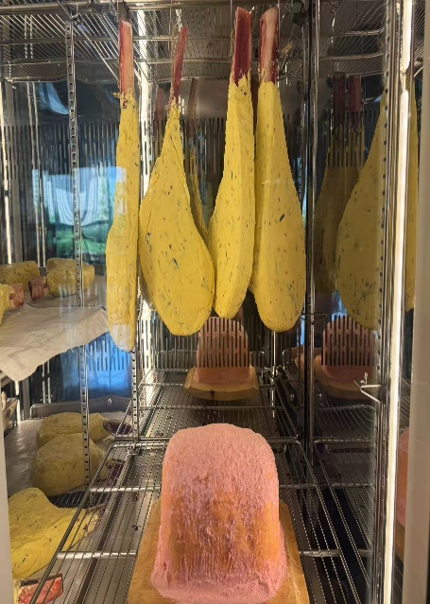
Hotel Gourmet Restaurant
Fiesta Café Located at Level 2
Breakfast Buffet
Monday to Friday 06:00 - 10:00
Saturday to Sunday 06:00 - 10:30
Dinner Buffet
17:30 - 21:00
Room Service
6:00-01:00
Fiesta Cafe is set in a relaxed and comfortable atmosphere, offering a variety of authentic cuisines.
Provide Hamburger/Sandwich/Pasta set menu (advance ordering 24 hours)

Slide 21
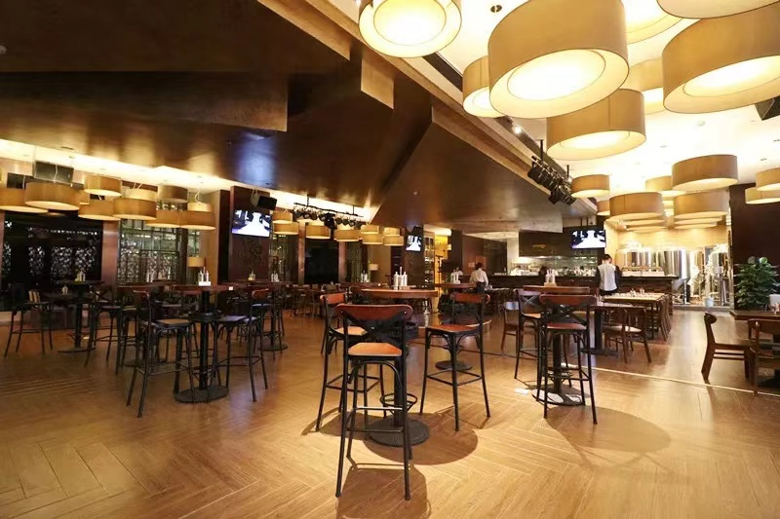
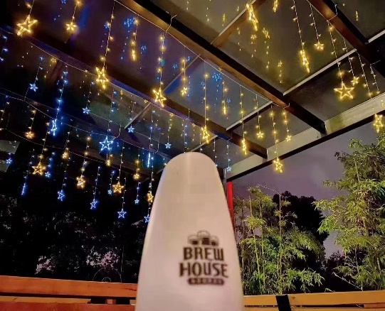
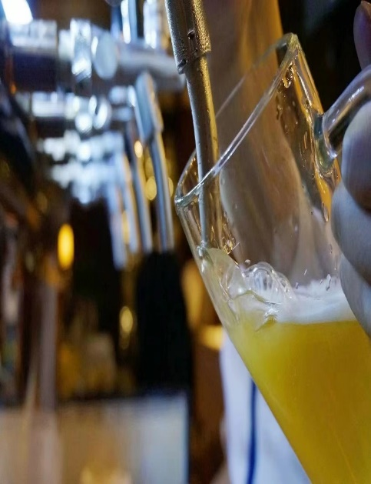
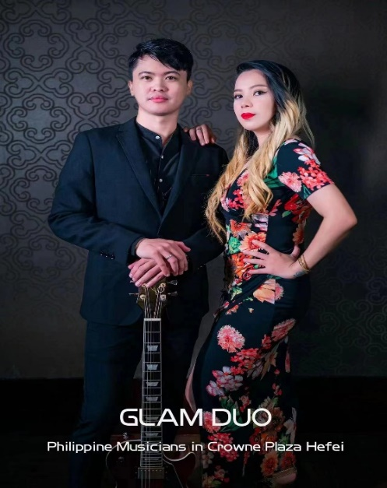
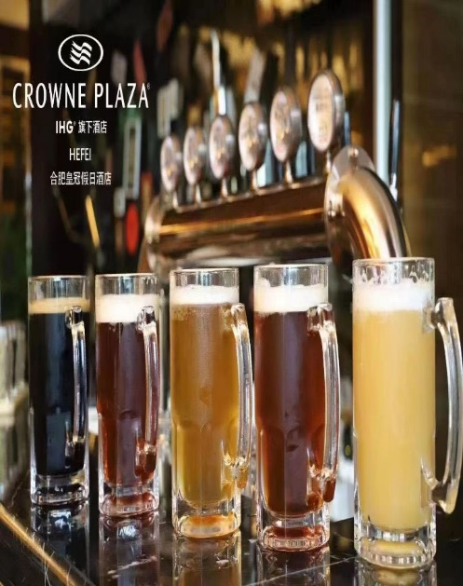
Hotel Gourmet Restaurant
Brew House adopts the large-scale self-brewing equipment, traditional European brewing technology, classic Belgian wheat and American Cascade hops ,which will provide you imported high-grade steaks, German sausage platter, roasted pork knuckle in German style and a lot of classic western dishes, it's a perfect place to have a pleasant time.
Located at Level 1
Operation Hours 10:00 – 14:00
17:00-01:00

Slide 22
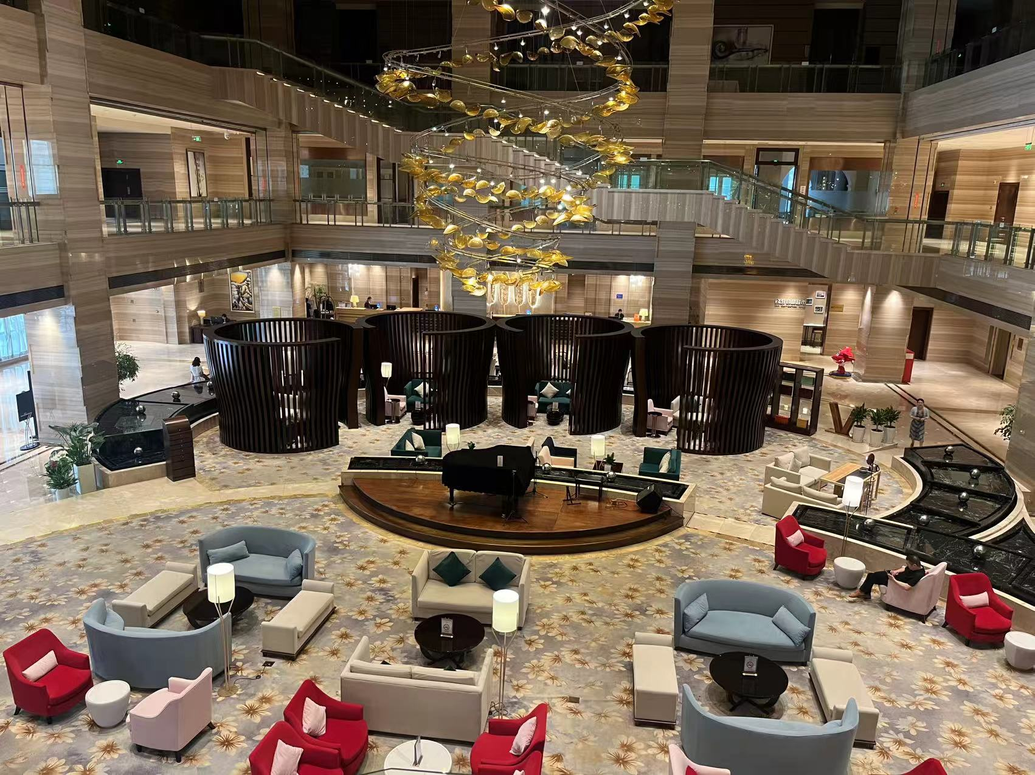
Hotel Lobby Bar
Illusions Lounge is located in the lobby, you can enjoy a lot of delicious desserts and drinks,it is an elegant and chic lounge.
Located at Level 1
Operation Hours 08:00 - 23:00

Slide 23
How to Use Alipay and WeChat Pay
Alipay and WeChat Pay are two important payment methods in China. Learning how to use them will make your travel to China much easier. Click on the PDF link below to learn more.

Slide 24
Meeting Staff
If you need any assistance during your stay, you may go to staff at the Information desk outside the meeting room.For any emergency please contact us at:
CCSA Mr. Qi Xu (+86-13466724696)

Slide 25
Have a successful meeting and
enjoy your stay in Hefei!

