Slide 1
Network slice performance and analytics data collection Discussion
György Réthy (Ericsson)

Slide 2
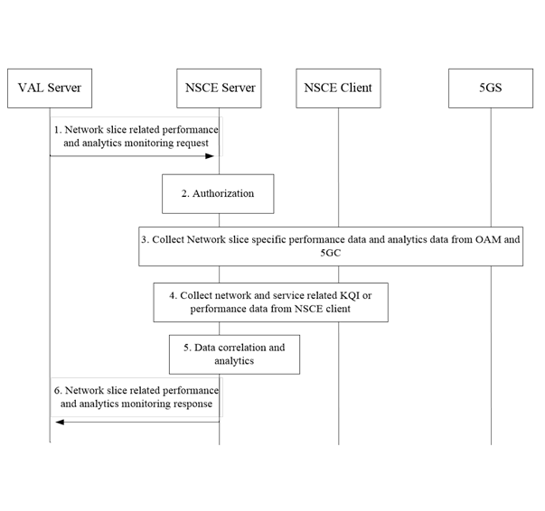
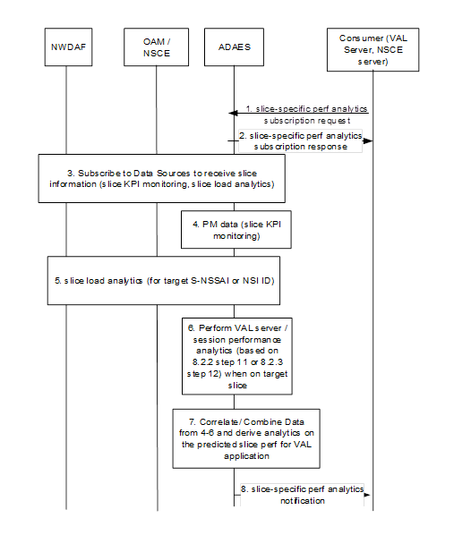
Slice performance and analytics data retrieval from 5GS Procedures defined
23.435 NSCALE, clause 9.7
23.436 ADAES, clause 8.3
Request/response procedure
Purpose: NSCE server providing a combined slice status info
Information sources: OAM threshold crossing & perf. meas. data, NWDAF slice analytics info, VAL UEs
Subscribe/notify procedure
Purpose: Provide slice-spec. analytics data to VAL server
Information sources: OAM perf. meas. data (directly or via NSCE server), NWDAF slice analytics info

Slide 3
Observations
The procedures are partly overlapping
Slice data collection from 5GS (OAM and NWDAF)
In current draft TS 23.436 v0.2.0
ADAE server either collects network data from 5GS directly or uses NSCE services
In the latter case ADAE server should behave like a VAL server, as no interface is defined between them
However, NSCE server doesn’t provide a network data collection service to VAL, this task is embedded into a more complex service
SEAL enabler responding in a timely manner is critical for some applications
In both procedures interactions with several 5G APIs occur
Retrieving some 5G data may take significant time
e.g. if measurement is needed or data is provided on a subscription/notify API
TS 22.261 sets a req. for 5G exposure APIs to respond to requests within 100 ms (note)
But, for example, 5G-ACIA requires 100 ms response time on 5G exposure APIs (Gap G.2)
Notes:
Note: Based on MNO policy, see clause 6.10.2 paragraph 23

Slide 4
Conclusions
Regarding procedures and architecture
To avoid duplication, it is proposed to define a single generalized network slice data collection service
It is suggested that this service is provided by a common enabler to make it easy reuse-able by both other enablers and verticals
Verticals already have interfaces to both SEAL and enablers (new SEAL-Xn or inter-enabler reference point(s) to be added)
To meet response time requirements
The procedure should be subscription/notify-based, with immediate acknowledge of subscription on checking its capability to collect the requested information

Slide 5
Thank You!

