Slide 1
Discussion about 5G enabled Transport Layer Optimization of SEALDD
Yaxin (wangyaxin11@huawei.com)
Huawei, Hisilicon

Slide 2
Outline
5G enabled Transport Layer Optimization
Information Collection and Examples
Left APs from Last CC
Summary
Annex: Transport layer connection startup

Slide 3
5G enabled Transport Layer Optimization
This discussion is in the scope of KI #2 and KI #3
5G system is already capable to expose network information to Application for service improvement.
QoS status (GFBR(guaranteed flow bit rate), MFBR(maximum flow bit rate), ) via SM notification (PCF, 23.501)
Delay in 5GS via QoS monitoring notification (PCF, 23.501)
Predicted UP path performance, QoE (NWDAF, 23.501)
Transport layer usage with bitrate control (e.g. TCP, QUIC) can have better performance if configured with the transport layer parameters for application session/traffic based on network status info, compared to configuring the transport layer parameters with default values. It will be beneficial for some VAL applications with strict QoS requirements.
5G system exposed network information can be used to optimize the transport layer parameter configuration:
Congestion window calculation based on GFBR, MFBR info
RTT detection and calculation based on Delay in 5GS
Other optimization (congestion prediction) based on Predicted UP path performance.
Enhancement in SEALDD:
Subscribe and receive QoS parameters and network status information from 5GS
Generate optimal transport layer parameters like startup parameters (for EAS relocation or connection initiating scenario) to be applied/configured for the application session.

Slide 4
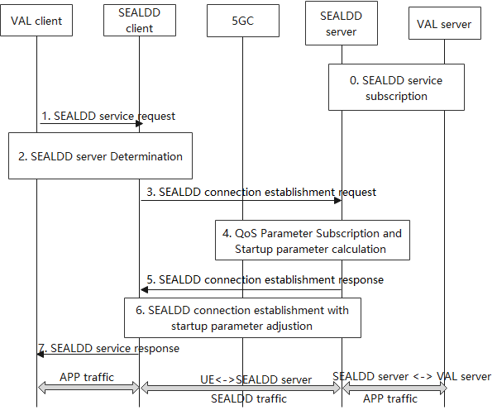
Information Collection and Examples
QoS parameters collection of the new data transmission path from 5GS before application data transmission:
GFBR/MFBR not changed for the same QoS flow
New path already determined before SEALDD connection establishment(4.3.6.3 of 23.502)
Dummy packets can be generated for QoS monitoring (5.33.3.2 of 23.501)
Predicted UP path performance before UP path establishment (23.288)
Transport layer optimization procedure
Shown as the figure
Mapping table (TCP as example):
QoS parameter | Source | Transport layer parameter
GFBR/MFBR | SEALDD server/PCF | Congestion window size/ssthresh, window scaling factor
RAN delay and N3 delay | PCF | RTT/RTO
N6 delay (SA6’s scope) | SEALDD server | RTT/RTO
Predicted UP path performance | NWDAF | Window size and ssthresh, window scaling factor.

Slide 5
Left APs from Last CC
AP1: Whether Transport layer protocol stacks (e.g. TCP) provides interfaces to application layer for startup parameter adjustion?
AP2: Whether the SEALDD client needs to be notified about the startup parameters by the SEALDD server?
AP3: Whether the startup parameters calculated by the Source SEALDD server are useful for the Target SEALDD server with new UP path?

Slide 6
AP1:
RFC 1323 defines TCP extensions for window scaling, timestamps, and protection against wrapped sequence numbers, for efficient and safe operation over paths with large bandwidth-delay products. [ref: RFC 4614, RFC 1323]
These extensions are commonly found in currently used systems; however, they may require manual tuning and configuration. [ref: RFC 4614]
Operating system now provides interfaces to adjust the parameters defined in RFC 1323.
[ref: wiki: https://en.wikipedia.org/wiki/TCP_window_scale_option ]
Operating system now provides interfaces to adjust the parameters defined in RFC 1323.
RFC 3390 permits a larger initial TCP window during the slow-start phase, depending on the segment size. [ref: RFC 4614, RFC 3390]
RFC 3390 can be implemented by web browser to open larger initial windows. [ref: RFC3390]
Larger initial windows have better performance in some scenario while worse performance in other scenarios.[ref: RFC3390]
Conclusion:
Current IETF RFCs support operating systems (e.g. Linux, and the system can provide interface to applications for parameter adjustion) and applications (e.g. Web Browser) to adjust the initial windows manually.
The performance of different startup parameters depends on the scenario (network status)
If the application can have acknowledge of the network status and adjust the startup parameters manually, transport layer will have better performance.

Slide 7
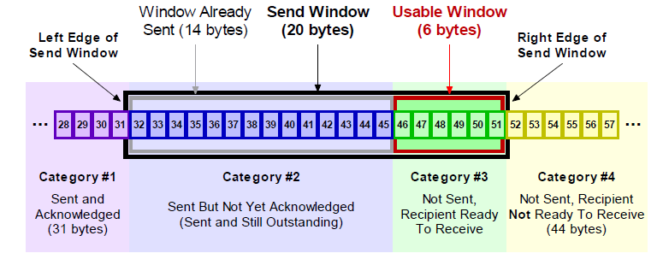
AP2:
Network information acknowlege:
Currently only the AF (SEALDD server) can get the network status information from 5GC via Exposure services.
The UE only has radio interface info and now it is not exposed to application layer.
The Startup parameters can only be calculated by the SEALDD server currently.
Window size notification:
Two directions have their own window parameter sets.
CWND is set by the sender and can be adjusted according to the receiver’s response.
RWND is set by the receiver and notified to the sender.
Conclusion:
The window size of the two directions are different.
Not all the window size related startup parameters can be negotiated by TCP interaction. Some of the parameters (e.g. CWND) should be decided by the sender itself.
If the SEALDD server calculates the startup parameters, it should notify the SEALDD client via application layer.

Slide 8
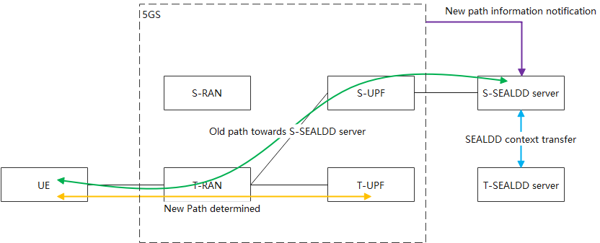
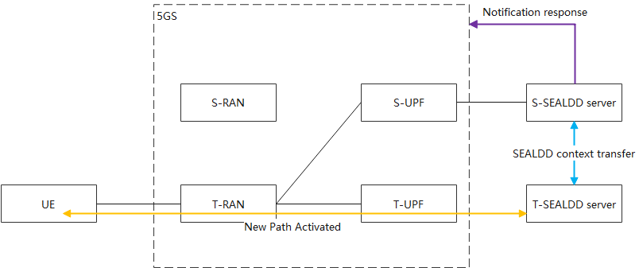
AP3:
Network information notification:
Currently the AF (SEALDD server) can get the network status information from 5GC via Exposure services about the new UP path before SEALDD server change.
The RAN has already changed before this notification.
New UPF has been selected before this notification, new UP path from UE to new UPF has been decided and this notification is sent to the source SEALDD server. (Clause 4.3.6.3 of TS 23.502)
SEALDD server change and new UP path activation:
Target SEALDD server determination and SEALDD context transfer. (Startup Parameter Transfer)
Source SEALDD server responds to the 5GC
New UP path towards Target SEALDD server is activated.
New SEALDD connection establishment. (with Startup parameter execution)
QoS and network information of the new path for the UE
Key message:
1. Network path changes before SEAL DD relocation S-SEALDD server could get QoS information relevent with new path.
2. QoS information should be per UE, rather than per Node. So the information T-SEALDD got for other UE can not be used for the relocated UE.
Conclusion:
the startup parameters calculated by the Source SEALDD server are useful for the Target SEALDD server with new UP path.

Slide 9
Summary
SEALDD can collect enough information for Transport layer optimization.
SEALDD can provide Transport layer optimization for better traffic transmission (see Annex 2,3, AP1).
Startup parameter should be notified to the SEALDD client for client side startup parameter setting. (see Annex 1, AP2).
Source SEALDD server can calculate the startup parameters for the Target SEALDD server in EAS relocation scenario. (AP3)

Slide 10
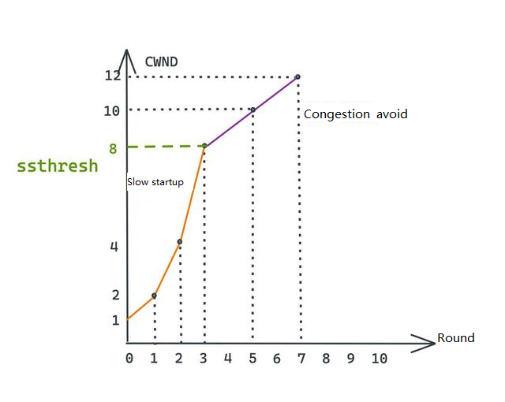
Annex 1: Transport Layer Connection Startup
Transport protocols with bitrate control (e.g. TCP, QUIC) has slow startup mechanism
Window size scaling:
CWND(congestion window):
Slow startup
Congestion control
RWND(receiver window):
Buffer notification
Window size notification:
Two directions have their own window parameter sets.
CWND is set by the sender and can be adjusted according to the receiver’s response.
RWND is set by the receiver and notified to the sender.

Slide 11
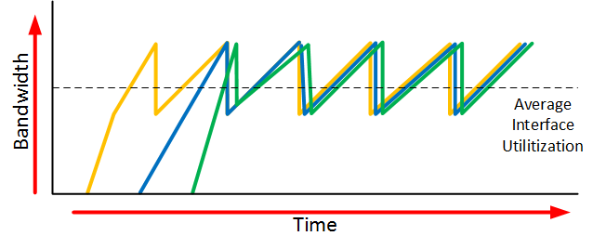
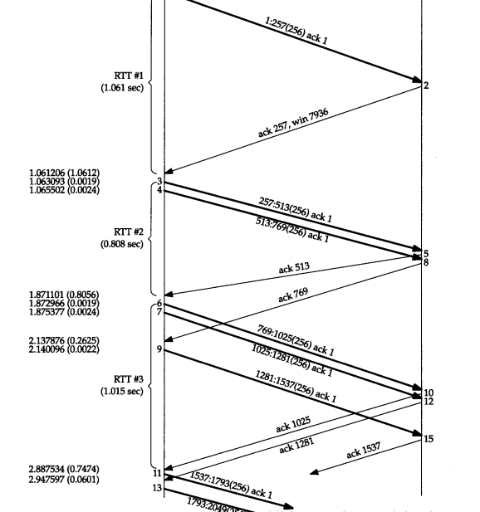
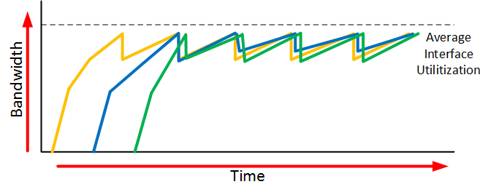
Annex 2: Transport Layer Connection Startup
Transport protocols with bitrate control (e.g. TCP, QUIC) has slow startup mechanism
RTO(retransmission timeout):
Affects the final average bitrate:
ACK notification interval
Retransmission and window size reduction trigger
Recovery trigger
For EAS relocation scenario:
RTO should be re-calculated according to several rounds of RTT detection

Slide 12
Annex 3: TCP startup Parameter Decision
RFC 1323 defines TCP extensions for window scaling, timestamps, and protection against wrapped sequence numbers, for efficient and safe operation over paths with large bandwidth-delay products. [ref: RFC 4614, RFC 1323]
These extensions are commonly found in currently used systems; however, they may require manual tuning and configuration. [ref: RFC 4614]
Operating system now provides interfaces to adjust the parameters defined in RFC 1323.
[ref: wiki: https://en.wikipedia.org/wiki/TCP_window_scale_option ]
Operating system now provides interfaces to adjust the parameters defined in RFC 1323.
RFC 3390 permits a larger initial TCP window during the slow-start phase, depending on the segment size. [ref: RFC 4614, RFC 3390]
RFC 3390 can be implemented by web browser to open larger initial windows. [ref: RFC3390]
Larger initial windows have better performance in some scenario while worse performance in other scenarios.[ref: RFC3390]
Conclusion:
Current IETF RFCs support operating systems (e.g. Linux, and the system can provide interface to applications for parameter adjustion) and applications (e.g. Web Browser) to adjust the initial windows manually.
The performance of different startup parameters depends on the scenario (network status)
If the application can have acknowledge of the network status and adjust the startup parameters manually, transport layer will have better performance.

