Slide 1
Discussion about 5G enabled Transport Layer Optimization of SEALDD
Yaxin (wangyaxin11@huawei.com)
Huawei, Hisilicon

Slide 2
Outline
5G enabled Transport Layer Optimization
Information Collection and Examples
Summary
Annex: Transport layer connection startup

Slide 3
5G enabled Transport Layer Optimization
This discussion is in the scope of KI #2 and KI #3
5G system is already capable to expose network information to Application for service improvement.
QoS status (GFBR(guaranteed flow bit rate), MFBR(maximum flow bit rate), ) via SM notification (PCF, 23.501)
Delay in 5GS via QoS monitoring notification (PCF, 23.501)
Predicted UP path performance, QoE (NWDAF, 23.501)
Transport layer usage with bitrate control (e.g. TCP, QUIC) can have better performance if configured with the transport layer parameters for application session/traffic based on network status info, compared to configuring the transport layer parameters with default values. It will be beneficial for some VAL applications with strict QoS requirements.
5G system exposed network information can be used to optimize the transport layer parameter configuration:
Congestion window calculation based on GFBR, MFBR info
RTT detection and calculation based on Delay in 5GS
Other optimization (congestion prediction) based on Predicted UP path performance.
Enhancement in SEALDD:
Subscribe and receive QoS parameters and network status information from 5GS
Generate optimal transport layer parameters like startup parameters (for EAS relocation or connection initiating scenario) to be applied/configured for the application session.

Slide 4
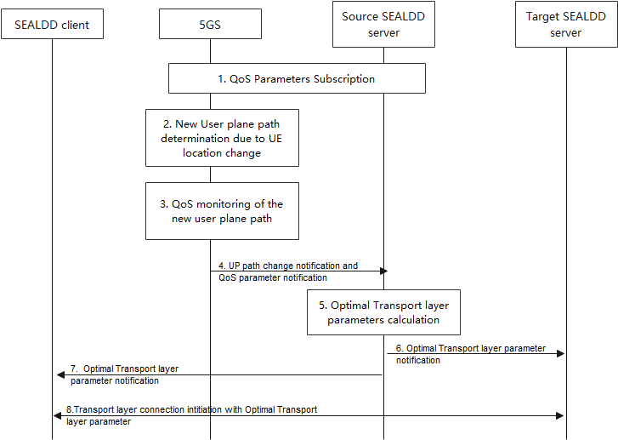
Information Collection and Examples
QoS parameters collection of the new data transmission path from 5GS before application data transmission:
GFBR/MFBR not changed for the same QoS flow
New path already determined before notifying SEALDD server for SEALDD server relocation (4.3.6.3 of 23.502)
Dummy packets can be generated for QoS monitoring (5.33.3.2 of 23.501)
Predicted UP path performance before UP path establishment (23.288)
Transport layer optimization procedure
Shown as the figure
Mapping table (TCP as example):
QoS parameter | Source | Transport layer parameter
GFBR/MFBR | SEALDD server/PCF | Congestion window size/ssthresh
RAN delay and N3 delay | PCF | RTT/RTO
N6 delay (SA6’s scope) | SEALDD server | RTT/RTO
Packets in the buffer | SEALDD server | Receiver window size
Predicted UP path performance | NWDAF | Window size and ssthresh

Slide 5
Summary
SEALDD can collect enough information for Transport layer optimization.
SEALDD can provide Transport layer optimization for better traffic transmission.

Slide 6
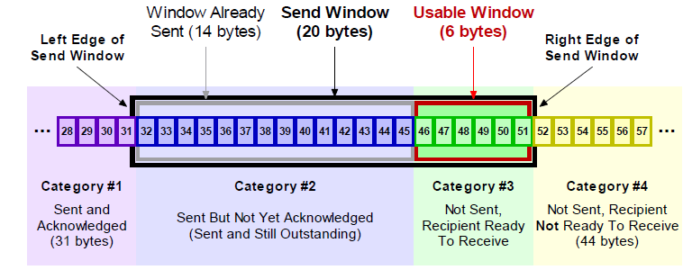
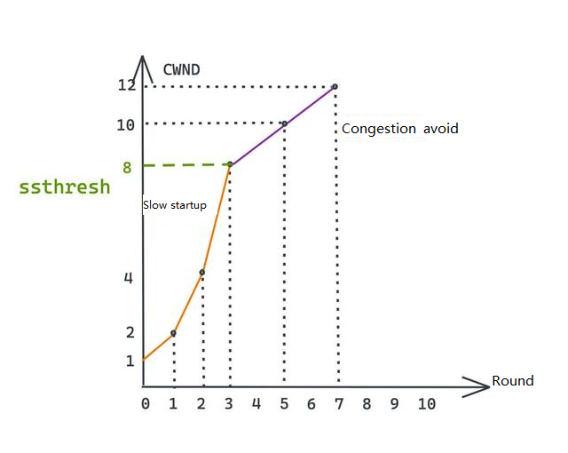
Annex: Transport Layer Connection Startup
Transport protocols with bitrate control (e.g. TCP, QUIC) has slow startup mechanism
Window size scaling:
CWND(congestion window):
Slow startup
Congestion control
RWND(receiver window):
Buffer notification
For EAS relocation scenario:
CWND should be reset suitable to new path.
Buffer status should be synchronized.

Slide 7
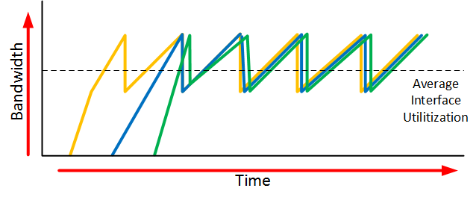
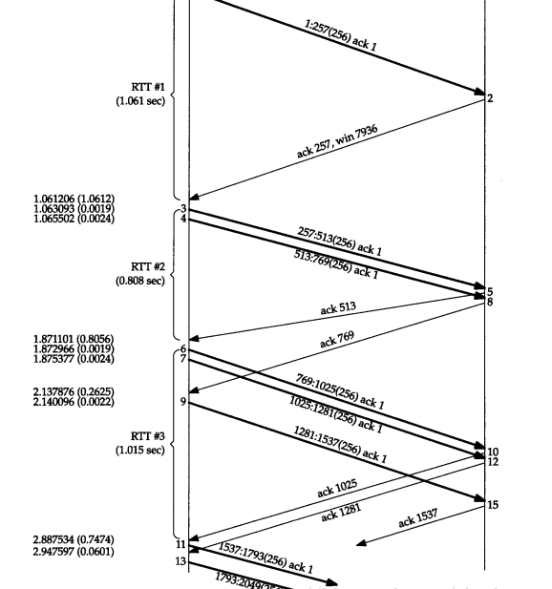
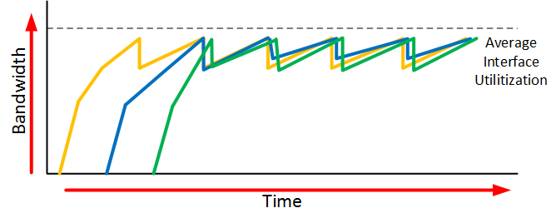
Annex: Transport Layer Connection Startup
Transport protocols with bitrate control (e.g. TCP, QUIC) has slow startup mechanism
RTO(retransmission timeout):
Affects the final average bitrate:
ACK notification interval
Retransmission and window size reduction trigger
Recovery trigger
For EAS relocation scenario:
RTO should be re-calculated according to several rounds of RTT detection

