Slide 1
AIMLAPP – Status and discussion on way forward
S6-24xxxx
Manos Pateromichelakis
Lenovo

Slide 2
Contents
AIMLAPP status
Discussion on ML-related Definitions
Discussion on Architecture
Discussion on relation to SA4

Slide 3
AIMLAPP Status and TUs
Meeting | TUs Planned |  | Work Planned | % Completion | Work Expected
 | SID | WID
SA6#56 (Aug-23) | - | - | SID Approval
SA6#57 (Oct-09) | 2.0 TU |  | Skeleton, Scope, Key Issues, Solutions | 15%
SA6#58 (Nov-13) | 1.0 TU |  | Key Issues, Architecture Requirements, Solutions, Background Analysis | 35%
SA6#59 (Feb-24) | 1.0 TU |  | Key Issues (Freeze), Solutions and solution updates | 55%
SA6#60 (Apr-24) | 1.0 TU |  | Stable Architecture, Solutions (Freeze), Solution Updates and Evaluations, Deployment/ Business Models | 80%
SA6#61 (May-24) | 1.0 TU |  | Overall Evaluation and Conclusions. SID send for Approval. WID Approval | 95%
SA6#62-Adhoc-e (Jul-24) (TBC) | - | 1.0 TU | Architecture, Deployments and Features (procedures and flows) | SID: 100 % WID: 5% | Skeleton, Scope and Intro
SA6#62 (Aug-24) | - | 1.0 TU + 1.0 TU? | Features (procedures and flows) and APIs | 25-30%? | Architecture, deployment/business scenarios, and initial features
SA6#63 (Oct-24) | - | 1.0 TU + 1.0 TU? | Features (procedures and flows) and APIs | 50-60%?
SA6#64 (Nov24) | - | 1.0 TU + 1.0 TU? | Complete unfinished work, Send for Approval. | 80-90%?
Total | 6 TUs | 4 Tus + 4.0 Tus?

Slide 4
AIMLAPP impacted specifications
Expected contributions to below specifications:
TS 23.482: Functional architecture, Features based on the TR solutions related to AIMLE (procedures / flows and APIs), Business and Deployment scenarios
TS 23.434: High level architecture (inclusion of SEAL AIMLE as part of SEAL services).
TS 23.436: Features based on the TR solutions related to ADAES enhancements (procedures / flows and APIs)
TS 23.558: Potential Enhancements for EES/CES services by supporting or consuming AIMLE services

Slide 5
Discussion on Definitions(1)
Proper and consistent definition of AI/ML terms is needed. In TR we have defined
AI/ML Operations: AIML operations can consist of data collection, data preparation, exploratory data analysis (EDA), AIML training, and AIML inference. AIML operations can also consist of participation in split AIML or transfer learning operations.
AI/ML service operation: undefined
AIML service: undefined
AI/ML service lifecycle: defined as example → AIML service creation, service status, service operation
ML model lifecycle: The lifecycle of an ML model includes data collection, data processing, model training, model verification, model instantiation and deployment, model monitoring and termination of ML model components.
Split operation pipeline: is defined to represent distributed compute nodes configured sequentially. Data can be provided at the entry point of the pipeline, and sequentially processed through each node of the pipeline
Considering the effort from SA to align terminologies we need to have some clear definition and relation among terms related to ML operations, ML model Lifecycle / workflow, ML service vs ML support service…

Slide 6
Discussion on Definitions (2)
Definitions in other groups:
3GPP SA1:
AI/ML Operations: Three types of AIML operations have been defined in SA1 (TS 22.261); however the ML operation is usually the ML training / inference operation:
AI/ML operation splitting between AI/ML endpoints;
AI/ML model/data distribution and sharing over 5G system;
Distributed/Federated Learning over 5G system.
3GPP SA5 (TS 28.105):
ML model lifecycle (or operational workflow) includes AI/ML operations like:
ML model training
ML model testing
ML inference emulation
ML model deployment
ML inference
There are multiple definitions of the “model lifecycle” or “ ML model workflow” consisting numerous operations (depending also on the type of ML methods etc). However, the minimum aspects which can be defined as AIML operations are:
Data Management operations (collection, preparation)
Model training (selection, config, training)
Model testing / evaluation
Model deployment
Model monitoring and inference / retraining

Slide 7
Discussion on Definitions (3)
The study provided multiple ML operations and terminologies which can be related. Here we try to provide some basic definitions to avoid confusion at the normative phase:
Definition 1: An ML model lifecycle consists of a sequence of AIML operations for a given ML task / job (such job can be an analytics task or a VAL automation task)
Definition 2: The AIML operations depend on the required ML task/job and can be: an ML training operation, ML inference operation, data management-related operation, ML testing/evaluation operation, ML distribution operation, Split ML operation, FL-related operations (e.g., member selection)
Definition 3: An AIML service (as defined in TR) is equivalent to an AIMLE service, and assists in performing or enabling one or more AIML operations
Definition 4: An AIML service may be performed directly by the AIMLE based on the AIMLE capabilities, whereas the remaining AIML operations are performed by the VAL layer (and out of scope).
Definition 5: AIMLE may also provide assisting AIML services for enabling an AIML operation (e.g. assistance in discovery/registration of the model and members etc)
Definition 6: An AIML service lifecycle as discussed in Sol#11 includes deployment, instantiation and termination of the AIMLE service and is not related to the ML model lifecycle.

Slide 8
Discussion on Architecture
Architecture discussions / open points
ML repository was introduced at the TR acting as registry for both ML models and ML members.
Such ML repository is accessible only via AIMLE server (as global registry).
Different deployments and access rights to VAL and other enablers are not investigated, but we could re-visit in normative phase if there is a valid use case.
AIMLE client services and the impact on AIML-C / AIML-PC5 interfaces are not discussed much in the TR phase even if some solutions may involve UE-to-UE interactions.
We need to discuss further (given the time limitations) the UE impacts.
Interaction with EDGEAPP is discussed in some solutions (e.g. Sol#23); however the enhancements in EES/CES and how EDGEAPP will utilize AIMLE services is not investigated.
Further discussion is needed to capture what enhancements are needed in EDGEAPP

Slide 9
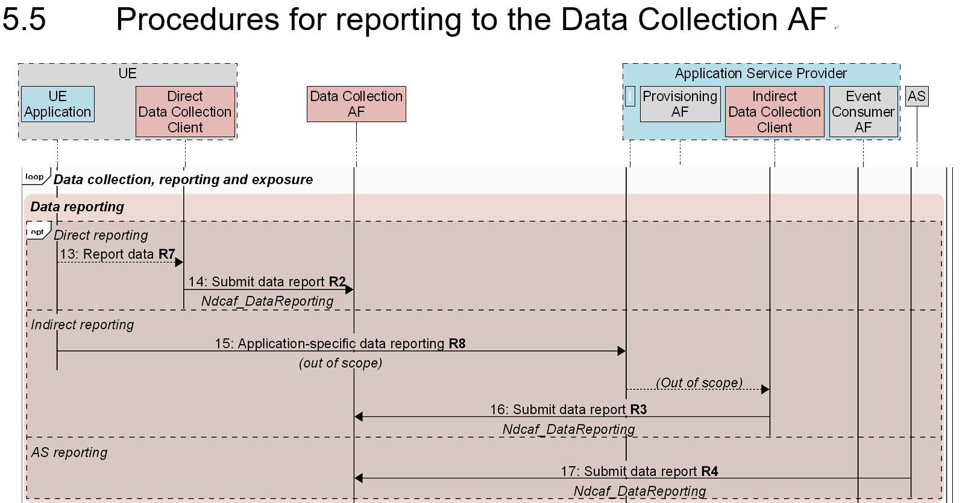
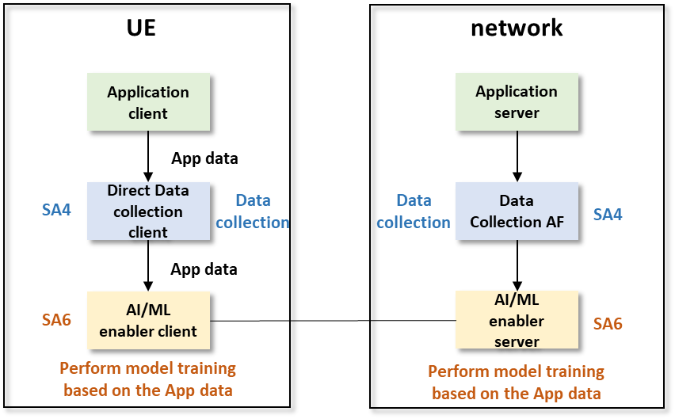
Discussion on relation to SA4
SA6a240087 provided a DP on the potential relation to EVEX/SA4 for the data collection aspects
EVEX is a framework which provides a generic mechanism for for data collection from the UE side (directly or indirectly ) via DCAF.
Currently used in SA2 for supporting data collection at the network side for NWDAF analytics via AF
Data Collection from the VAL UE has been discussed in SA6 in ADAES as part of the analytics services defined, and possible re-use of EVEX was well captured.
In AIMLAPP, only a small part of the study discussed the data collection aspects (a solution on data management) as part of the ML model lifecycle (can relate to one of the AIML operations).
Open discussion: Do we need to discuss more on the possible relation to SA4 in normative phase?
If yes, what exact solutions are impacted?
Is EVEX functionality sufficient to meet the AIMLAPP requirements or we need enhancements?
Would it be a good opportunity for SA6 to undertake EVEX from R19 onwards, based on AIMLAPP new requirements?
SA6a240087

