Slide 1
Spatial Mapping and Localization
Sapan Shah
Samsung

Slide 2
Contents
Definitions from SA1
How to expose Spatial map?
What is spatial localization service?
What can be augmented/overlaid?
Spatial map and Spatial anchors
Do we need to define each team based on augmentation?

Slide 3
Definitions from SA1
spatial map: A collection of information that corresponds to space, including information gathered from sensors concerning characteristics of the forms in that space, especially appearance information.
spatial mapping service: A service offered by a mobile network operator that gathers sensor data in order to create and maintain a Spatial Map that can be used to offer customers Spatial Localization Service.
spatial localization service: A service offered by a mobile network operator that can provide customers with Localization.
localization: A known location in 3 dimensional space, including an orientation, e.g., defined as pitch, yaw and roll.

Slide 4
How to expose Spatial map?
3GPP TR 22.856. Clause 5.5.1, Quote:
“the service provider or operator needs to provide and use spatial map information, i.e. a 3D map of indoor or outdoor environment”
Observation: To expose spatial map, the enabler should provide 3D map of the area of interest.
As shown in Figure (C).
How to provide 3D map? Using which format?
MAP file?
SA4 scope?
Table 7.8.4.3-2: Get spatial map response
Information element | Status | Description
Result | M | Result of the producing spatial map (e.g., success or fail), including cause of failure if needed
List of discovered spatial maps | O | List of discovered spatial anchor(s). Each element includes the information described below
> Spatial map ID | M | ID of a spatial map discovered
> Spatial map information | M | A collection of information that corresponds to the discovered spatial map including dimensional information, stationary or moving objects with attributes, e.g., object type, appearance, position, direction and speed of them
This is actually Spatial localization information, not the Spatial map. (See next slide)

Slide 5
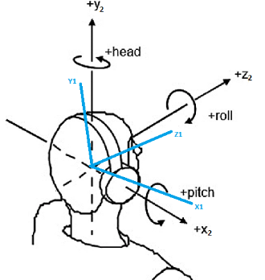
What is spatial localization service?
3GPP TS 23.156.
“localization: A known location in 3 dimensional space, including an orientation, e.g., defined as pitch, yaw and roll.”
3GPP TR 22.856. Clause 5.5.1, Quote:
“Spatial mapping will classify objects into modelling and tracking of stationary and moving objects. For stationary object, spatial mapping has to estimate the number of objects, type of object and position. Whereas for moving objects, spatial mapping has to determine the position, type of object, direction, speed. Once the spatial mapping service has sufficient information, it has to map all the stationary and moving objects related to UE’s environment. This information can be provided to the UE, service providers and surrounding subscribed users as well [17,19,24]”
Observation 1: To provide spatial localization service, the enabler should provide
Static objects details:
Number of objects, and for each objects: type of object and 3D position (including pitch, yaw and roll)
Moving objects
For each object: type of object, direction, speed and 3D position (including pitch, yaw and roll)
Observation 2: Spatial map may not be ready for the localization service immediately after creation.

Slide 6
What can be augmented? Spatial map and Spatial anchors
3GPP TS 22.156, Clause 5.2.1.1: Quote:
“The spatial map is created using processed sensor data. The 5G system supports a spatial mapping service to customers that, for example, want to offer mobile metaverse services associated with spatial anchors on their premises. Creation of a spatial map for a location makes localization there possible, as well as assignment of spatial anchors in that location.”
5G System
Customer of 5G system (Metaverse Service Provider)
End User
Supports a spatial mapping service to customers
Offers mobile metaverse services associated with spatial anchors
Observation:
The base spatial map can be overlaid with other spatial information like Spatial anchors, floor details, UE details, etc.
As we can augment/overlaid many spatial information, we do not need to define each term.

