Slide 1
Discussion on support for the permission control of digital asset
Jingwen Liu
China Mobile

Slide 2
Outline
Defination of digital asset
Requirement
Usecase
Summary

Slide 3
Defination
Defination of digital asset in 3GPP TS 22.156：
digitally stored information that is uniquely identifiable and can be used to realize value according to their licensing conditions and applicable regulations. Examples of digital assets include digital representation (avatar), software licenses, gift certificates, tokens and files (e.g. music files) that have been purchased. This is not an exhaustive list of examples.

Slide 4
Requirement
The requirements of digital asset management in 3GPP TS 23.156 are as follows:
Subject to operator policy, regulatory requirements and user consent, the 5G system shall be able to provide functionality to store digital assets associated with a user, and to remove such digital assets associated with a user.
Subject to operator policy, regulatory requirements and user consent, the 5G system shall provide a means to allow a user to securely access and update their digital assets.
Subject to operator policy and user consent, the 5G system shall be able to allow an authorized third party to retrieve the digital asset(s) associated with a user, e.g. when the user accesses a specific application.

Slide 5
Previous work
The support for digital asset storage has been completed in SA6#60
The entity is defined: Application - Digital Asset Container Management(A-DACM)
the architecture and solution is shown in 6.2 and 7.7
A-DACM architecture to support Metaverse services
Next work for the digital asset focuses on providing enablement service to support access/retrieve by an authorized third party

Slide 6
Usecase(1/2)
The use case can be considered for study as follows:
-When users share their own digital assets with others, and the service enabler layer supports access/download/modify/delete to digital assets by other authorized users.
owner
consumer
1.upload a picture
3.ask for the permission
2.apply for access the picture
4.the picture share to the consumer
SEAL

Slide 7
Usecase(2/2)
login
login
Virtical Application 1
Virtical Application 2
Another usecase:
-When a user's digital asset transitions between multiple metaverse applications, and the service enabler layer supports access/download/modify/delete to digital assets by authorized metaverse applications to ensure the consistency of the digital assets.
1.upload a avatar
3.ask for the permission
2.apply for download avatar
4.send avatar
SEAL

Slide 8
Summary
SA6 can provide service to support for permission control of digital asset operation by the consumers (i.e. application clients and servers) or across verticals.
Note: operation may includes access, download, modification, delete, etc

Slide 9
Thanks

Slide 10
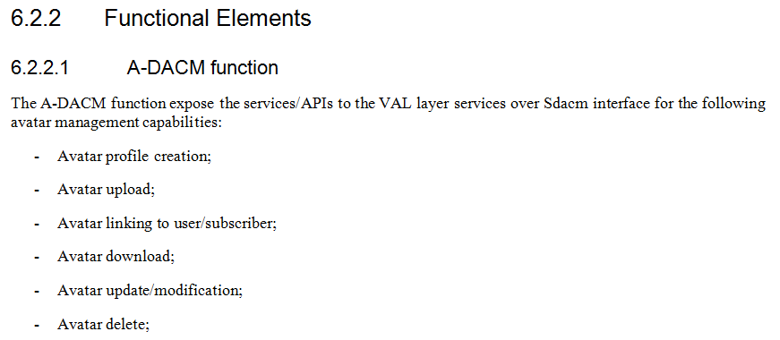
Annex 1

