Slide 1
SA5 presentation for SA Rel-18 workshop SA5#138e, 23 – 31 August, 2021
Zou Lan, SA5 Vice-Chair, HUAWEI
Thomas Tovinger, 3GPP SA5 Chair, ERICSSON
Maryse Gardella, 3GPP SA5 Vice-Chair, NOKIA

Slide 2
Content
3GPP SA5 Rel-18 time plan
3GPP SA5 working relation with other groups
List of Rel-18 topics

Slide 3
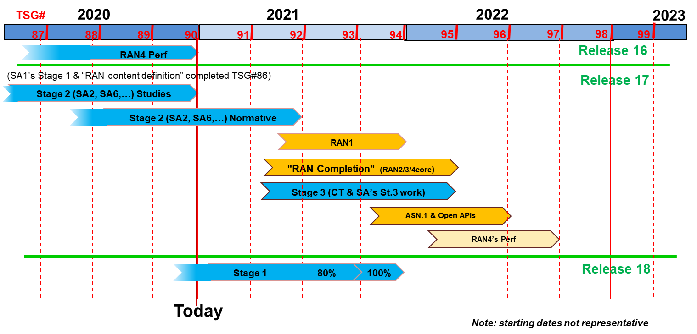
SA5 Release planning in accordance with 3GPP releases timelines
SA5 Release 17 Freezes and other milestones :
Closure of WI/SI proposal for OAM: No new Rel-17 WID/SID proposals to be submitted after SA5 #136e, except for new WIDs which have a corresponding (existing) Rel-17 study item.
Sep.2021 (SA5# 138e/TSG#93): OAM Stage 1 freeze except requirements which supporting other groups
Dec.2021 (SA5# 140e/TSG#94): Stage 2 freeze
Mar.2022 (SA5# 141/TSG#95): Stage 3 freeze
SA5 Release 18 planning：
Aug.2021 (SA5# 138e): first meeting to discuss new Rel-18 WID/SID proposals and ideas for OAM.
Jan. 2022 (SA5#141): first meeting to start new Rel-18 WID/SID for CH.
Jun.2022 (SA5# 143/TSG#96): OAM Rel-18 Stage 1 freeze (may adjust according to SA overall time plan)
Rel-18 stage 2/stage 3 OAM/CH: TBD, will follow SA overall time plan.
#91e
#92e
#93e
#94
#95
#96
SA5 time plan
#135e
#136e
#137e
#138e
#139e
#140e
#141
#142
#143
No new R17 WI/SI
Rel-17
Schedule
R17 OAM stage 1
R17 OAM stage 2
R17 OAM stage 3
Rel-17 SA5 Charging
Rel-18
Schedule
(preliminary)
Start new
R18 WI/SI
R18 OAM stage 1
Rel-18 SA5 Charging

Slide 4
Detailed view of SA5 relation with other groups
1. SA1 Management requirements refer to SA5 management specifications. SA1 charging requirements as input to SA5 CH
2. Take GSMA requirements as SA5 OAM and CH input.
3. Align the MnS with ZSM if needed
4. ONAP reuses SA5 management MnS
5. Collaboration with SA2 on architecture and CN management
6. Collaboration with SA4 on QoE management
7. Provide OAM inputs to CT, collaborate stage 3 with CT.
8. Collaboration with RAN on RAN management
9. SA2 input to SA5 CH
10. SA6 input to SA5 CH
11. OAM input to SA5 CH
12. Part of SA5 CH stage 3 aligned with CT stage 3 framework
SA1
Requirements
GSMA
time
2
Stage 1
1
SA5 OAM
Stage 1
ETSI ZSM
RAN
Radio Access
3
5
11
10
Stage 2
SA2
Architecture
SA3
Security
SA4
Media
SA5 OAM
Stage 2
SA5 CH
Stage 1&2
SA6
Apps/MC
6
9
8
7
Stage 3
CT – Protocols & Coding
SA5 OAM
Stage 3
SA5 CH
Stage 3
12
4
Update of S5-212330
ONAP

Slide 5
SA5 Charging Rel-18
Will not start before January 2022
A set of ongoing CH Rel-17 Studies resulting in Rel-18 normative work:
Enhancement of Nchf charging services
5G roaming charging architecture for wholesale and retail scenarios
Rel-18 SA2 & SA6 studies considering charging aspects should also be investigated
Rel-18 SA2 & SA6 normative work which need to be covered by charging aspects (based on preliminary available SA2/SA6 architectures and functionalities).

Slide 6
List of OAM topics under discussion (1/5)
1. Enhancement of autonomous network levels, with the following example areas :
Autonomous network levels classification for additional management use cases
Methodology for quantitative evaluation
Key effectiveness indicators for evaluating the application effects of each level
Collaboration with TMF, ETSI ZSM
2. Enhanced intent driven management services for mobile network, with the following example areas:
New management scenarios for intent driven management and corresponding intent model enhancement (incl. radio network capacity intent expectation).
New capabilities for intent driven management (incl. Intent confliction detection and resolution)
New business use case and classifications of use cases of IDM related to 5GC scenarios.
Collaboration with TMF, ETSI ZSM
3. Study on AI/ML management, with the following example areas:
To study the AI/ML management capabilities to support AI/ML in 3GPP management system, 5GC and NG-RAN, including ML model creation, testing, deployments, etc.
Investigation of which Management Service (e.g., MDA MnS) the AI/ML can be used for, and the data to support the ML model management for each management service.
Relation between AI/ML management and other Management Services (MnSs) and network functions/entities.
Investigate whether there are available AI/ML management mechanisms developed outside of 3GPP that can be considered.
Collaboration with RAN and SA WGs on Rel-18 AI/ML work, collaboration with ETSI ZSM and possibly others.
4. Self-Configuration of RAN Nes, with the following example areas:
Concepts, use cases and requirements for Self-configuration and ARCF data handling of RAN NEs
Procedure of self-configuration and ARCF data handling management of RAN NEs
Solution Set (SS) for Self-configuration and ARCF data handling management based on SBMA
Collaboration with RAN on Rel-18 SON work

Slide 7
List of OAM topics under discussion (2/5)
5. Enhancement of service-based management architecture, with the following example areas:
Architectural support to autonomous networks
Collaboration with TMF, ETSI ZSM
6. Digital Twin for Network Management, with the following example areas:
Use cases and requirements of digital twin for management
Solutions for network management based on digital twin
Interaction between digital twin network and network management system
7. Federated Learning for Mobile Network Management, with the following example areas :
Scenarios, requirements and solutions for FL
Management aspects of federated nodes, e.g. authentication, registration, resource management
8. Further enhancements into Management Data Analytics (MDA), with the following example areas :
Address solutions of the rest of use cases from TR28.809 that have not been included in Rel-17 normative work due to time constraint.
New use cases and corresponding solutions leading to further enhanced capabilities of the MDA.
9. Enhancement of the management aspects related to NWDAF, with the following example areas:
the enhancement NRM of NWDAF supporting the logical decomposition of NWDAF
the performance management of NWDAF
the management service supporting multiple-NWDAF deployment

Slide 8
List of OAM topics under discussion (3/5)
10. Study on enhancement management of non-public networks, with the following example areas:
how the mobile network operator and vertical customer cooperate to realize management and orchestration of network in management mode 1b and 2b in TS 28.557.
management of vertical tenant as an authorized NPN service consumer and the privilege of vertical tenant.
management capability exposure to NPN based on the privilege of vertical tenant.
NPN in RAN sharing scenarios.
energy efficiency in NPN scenarios.
convergence between NPN for an enterprise and the legacy operational technology (OT) network of the enterprise.
11. Study on Deterministic Service Assurance Management, with the following example areas:
Scenarios, general process, and related managed services for deterministic service assurance;
Cross-domain and domain management collaborations to support E2E deterministic assurance;
Potential requirements, conditions, constraints and solutions for deterministic service assurance for specific services (e.g. video monitoring, remote control etc.):
In Network provisioning phase, network planning, verification and prediction based on deterministic service modelling and SLS requirements;
In Operation phase, network optimization, verification and prediction solutions;
Potential PM and FM enhancements to support deterministic services;
12. Key Quality Indicators(KQIs)for 5G service experience, with the following example areas:
The definition, scope and scenarios of the KQIs for 5G service experience. The KQIs of the typical services, e.g. services of Video Uploading, Remote Controlling and Cloud VR will be specified;
The influencing factors for 5G service experience according to the example services;
The mapping from KQI to network KPI if possible;
The evaluation method and formula definition of related KQIs for the example services;
The evaluation criterion of the KQIs for the example services;
The relation with the SLS requirements.
Collaboration with RAN on Rel-18 KPI/Performance measurements work

Slide 9
List of OAM topics under discussion (4/5)
13. Energy Efficiency of 5G, with the following example areas:
Refine the estimates of 5G NF energy consumption in virtualized environment
Extend existing VM-based EE KPI definitions to Containers
New use cases and solutions for Energy Saving (incl. AI/ML assisted ES)
Management aspects of TSG RAN energy saving functionalities
Collaboration with RAN on Rel-18 Network Energy Saving work
14. Management aspects of traffic scheduling in terrestrial and satellite converged network, with the following example areas:
Optimal connectivity topology and management between heterogeneous satellite constellation (including GEO, MEO and/or LEO).
Traffic scheduling from terrestrial network to satellite network/from satellite network to terrestrial network
Management functions/ deployments considerations on traffic scheduling in terrestrial and satellite converged network.
Collaboration with RAN on Rel-18 NTN work??
15. Edge Computing Enhancement
Specify solutions to fulfil GSMA OPG NBI requirements
Study the relevance of ETSI MEC with ECM

Slide 10
List of OAM topics under discussion (5/5)
16. Incident Management (Fault Management Evolution), with the following example areas:
Concepts and characteristics of incident and incident management, relation with existing fault and performance management concepts;
Scenarios and use cases of incidents, e.g. 5G SLA deterioration incidents, 5GC service risk incidents, and large-scale radio access network decommissioning incidents etc;
Awareness, RCA, demarcation and close loop solutions for different types of incidents;
Relation with eMDAS and eCOSLA;
17. Network Slice Provisioning Enhancement, with the following example areas:
Network slice reservation and feasibility check.
Network slice capacity planning.
Network slice capability change subscription and notification.
Network slice subnet capabilities support.
Network slice subnet deallocation/termination.
Network slice subnet activation and de-activation.
Collaboration with SA2/SA6 on Rel-18 network slicing work??
18. Management support for Rel-18 items in other WGs, with the following example areas:
Concrete items depend on the work progress in other WGs.

Slide 11
List of Agreed OAM topics (1/)
XXX

Slide 12
List of agreed areas (1/)
XXX

Slide 13
General principles for Rel-18 work in SA5
Align the SA5 Rel-18 stage 2/ stage 3 time plan according to 3GPP SA overall time plan (when finalized).
Work on concrete WI/SI proposals before SA#94e and try to finalize majority of Rel-18 work area before SA#94e (especially for the areas which has close relation with other SWGs).
Joint efforts and close coordination are needed on the following topics related to management and orchestration (to be updated with work progress) in Rel-18:
RAN groups:
AI/ML
Network energy savings
Network slicing enhancements
SON/MDT
SA2/CT4:
NWDAF related analytics topics
NRF/NEF related network configuration related topics
Network slicing
SA6:
MEC configuration related topics
Network slicing exposure
Joint efforts and close coordination are needed on the following topics related to Charging (to be updated with work progress):

Slide 14
Thank you!

