Slide 1
3GPP SA5 Forge repository structure proposal SA5#132e, 17 Aug – 28 Aug,2020 e-meeting
Zou Lan, SA5 Vice Chair (Huawei)

Slide 2
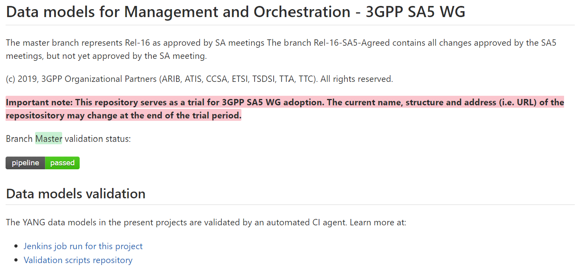
Current layout of 3GPP Forge for SA5
SA5 - Management and Orchestration
https://forge.3gpp.org/rep/sa5
Trial – SA5 Data models
https://forge.3gpp.org/rep/sa5/data-models
Issues:
“Trial-SA5 data model” needs to be renamed.
Website link “data-models” also needs to be updated.
There is no differentiation of Rel-16 and Rel-17

Slide 3
Proposal layout of 3GPP Forge for SA5
SA5 - Management and Orchestration and charging
https://forge.3gpp.org/rep/sa5
Management and Orchestration APIs
https://forge.3gpp.org/rep/sa5/MnS
https://forge.3gpp.org/rep/sa5/MnS/tree/Rel-16
Rel-16
Rel-17
https://forge.3gpp.org/rep/sa5/MnS/tree/Rel-17

Slide 4
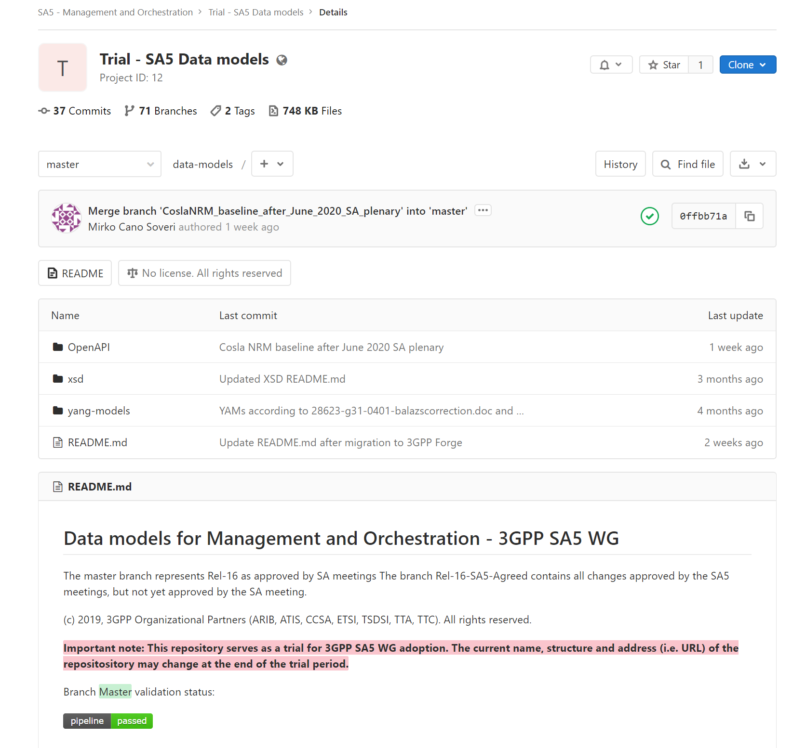
Modification proposal of 3GPP Forge for SA5
3. Rename to “MnS”
1. Rename to “Management and Orchestration APIs”
2. create Rel-16 branch now (spawn off master) and
spawn Rel-17 once we publish something with v.17.x.x.
4. Revise “Data models for Management and Orchestration-3GPP SA5 WG” to “Management and Orchestration - 3GPP SA5 WG”
5. Replace the description text to the following text:
The Rel-16 branch represents the latest Rel-16 content approved and published after each TSG SA plenary. The Rel-17 branch represents the latest Rel-17 content approved and published after each TSG SA plenary. Master branch represents the current working in progress release status.
(c) 2019, 3GPP Organizational Partners (ARIB, ATIS, CCSA, ETSI, TSDSI, TTA, TTC).All rights reserved.

Slide 5
Summary of use 3GPP forge for SA5
“master” branch
dynamic and represents the current “work in progress” release (whatever SA5 works on today)
“Rel-16” branch
is semi-dynamic and represents the latest (updated after each SA plenary) status of the release 16 published code (e.g. content extracted from 16.x.x MS Word documents)
“Rel-17” branch
is semi-dynamic and represents the latest (updated after each SA plenary) status of the release 17 published code (e.g. content extracted from 17.x.x MS Word documents)
“tag” branch:
“SA88-Rel16” (Anatoly created this one) is a “tag” branch – it’s static (does not change) and represents read-only snapshot of the Rel-16 content approved/published after SA88 plenary
We will need “SA88-Rel16”, “SA89-Rel16”, “SA89-Rel17”, “SA90-Rel16”, “SA90-Rel17” later… to be created/published after each SA plenary
Rel-15 or other branch:
Whether we need to touch/create any Rel-15 or SAxx-Rel15 branches depends on SA5 decision to publish (or not) Rel-15 content…

Slide 6
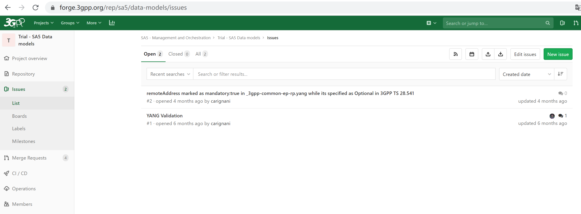
Proposal handling of Non-3GPP member request to 3GPP Forge
How non-3GPP member report 3GPP Forge issue？
https://forge.3gpp.org/rep/sa5/data-models/issues
Proposal:
Non-3GPP members could provide issue in 3GPP forge. (Whether reporting issue in 3GPP forge is allowed by non-3GPP members?)
Need a 3GPP SA5 contact regularly check the new issues and coordinate in 3GPP SA5 for feedback solutions/recommendations.
3GPP members are volunteered to provide related contributions for the update of 3GPP specifications.

Slide 7
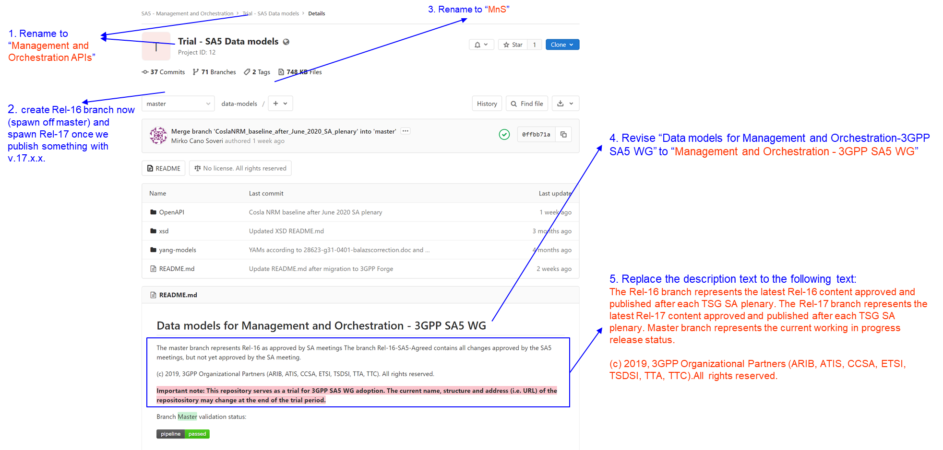
For discussion and endorsement(1)
We propose to update the following SA5 related information in https://forge.3gpp.org/
Replace “Trial-SA5 data model” to “Management and Orchestration APIs”
Keep “master” branch, “Rel-16” branch, “SA88-Rel16”,”SAxx-Rel16”,”Saxx-17”(xx needs to be replaced by each SA meeting information) branch only, cleanup other branch information in the dropdownlist after every SA meeting. Whether keep the other branches needs further check with Michele.
Update the link name from https://forge.3gpp.org/rep/sa5/data-models to https://forge.3gpp.org/rep/sa5/MnS
Revise “Data models for Management and Orchestration-3GPP SA5 WG” to “Management and Orchestration - 3GPP SA5 WG”
Update the description to “The Rel-16 branch represents the latest Rel-16 content approved and published after each TSG SA plenary. The Rel-17 branch represents the latest Rel-17 content approved and published after each TSG SA plenary. Master branch represents the current working in progress release status.(c) 2019, 3GPP Organizational Partners (ARIB, ATIS, CCSA, ETSI, TSDSI, TTA, TTC).All rights reserved.

Slide 8
For discussion and endorsement(2)
Add the following action items in OAM action list:
MCC check with Michele on the process for maintaining branches in 3GPP forge.
MCC check the potential mechanisms to support non-3GPP member report 3GPP Forge issue？(e.g. how to provide feedback and keep track of the handling information in 3GPP Forge website?)

