Slide 1
WF on [312] NTN_Solutions_Part1 (NTN general part)
Moderator, THALES

Slide 2
Outline
Proposed way forward based on the outcomes of “Email discussion summary for [99-e][312] NTN_Solutions_Part1”
See R4-2108699 (revision of R4-2108437)

Slide 3
Content
Topic #1: NTN Architecture Aspects
Topic #2: NTN Generic Parameters
Topic #3: FR1 Generalities
Topic #4: FR2 Generalities

Slide 4
Summary
List of proposals for each topics discussed
In “agreements” part
Proposals with “green” comments are agreeable.
In “open issues” part
Proposals with “purple” comments not agreeable.
Proposals with “orange” comments not agreeable:
If there is a GTW session and we could agree on some of them, this WF will be revised anyway;
Please also note that the “orange” proposals were the results of “agreed with changes” comments.
Proposals without any comment were not discussed.

Slide 5
Agreeable Proposals
(after the 1st and 2nd round of discussions in RAN4#99-e, please also note that NTN GTW slot on 25/05/2021 could not be used)

Slide 6
Topic #1
Proposal 1-1-2-1: RAN4 shall consider for NTN framework similar testing procedures as in TS 38.141-like. Based on different combinations and following similar testing procedures as in e.g. TS 38.141-like, the throughput measurement point at the Non-NTN infrastructure gNB can be used to determine the 5% throughput loss.
Note1: For the Non-NTN infrastructure gNB, please refer to RAN3 NTN architecture.
Proposal 1-3-2-1: Satellite companies and some other companies expressed strong concerns if (Satellite+Feederlink+GW) is considered as a Repeater, because it would reduce NTN capacity and in general would not align with real satellite payload design.

Slide 7
Topic #1 – NTN REFSENS Test
Proposal 1-1-4-1: Additional evidence should be provided before concluding that OTA based REFSENS test is feasible for (Satellite + feeder link + NTN-Gateway + Non-NTN infrastructure gNB) as a single entity.
Note1: For the Non-NTN infrastructure gNB, please refer to RAN3 NTN architecture.
Note2: RAN4 to identify any additional evidence to be provided.

Slide 8
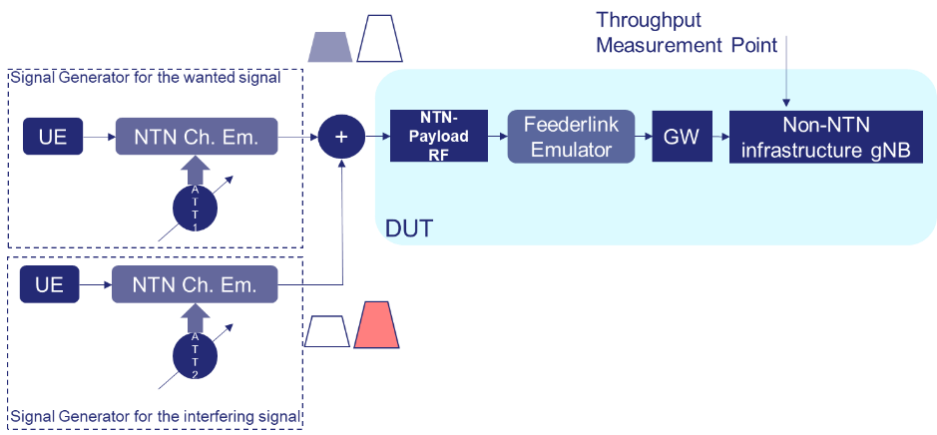
Topic #1 – NTN Blocking Test
Proposal 1-1-5-1: Additional evidence should be provided before concluding that OTA based Blocking test is feasible for (Satellite + feeder link + NTN-Gateway + Non-NTN infrastructure gNB) as a single entity.
Note1: For the Non-NTN infrastructure gNB, please refer to RAN3 NTN architecture.
Note2: RAN4 to identify any additional evidence to be provided.

Slide 9
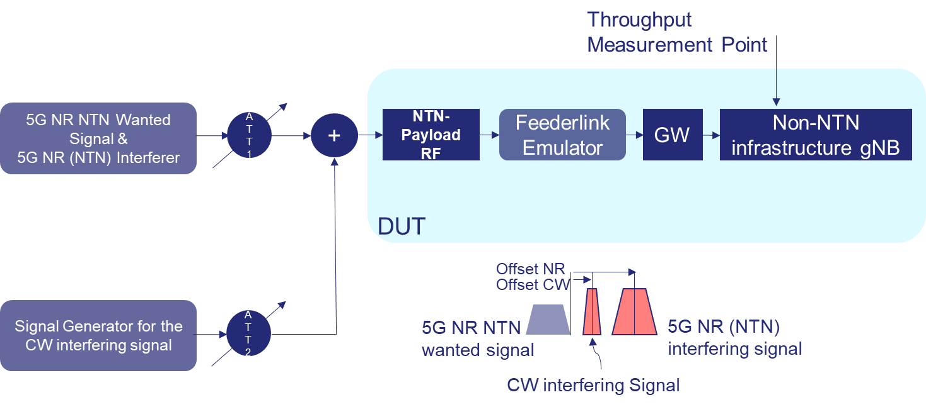
Topic #1 – NTN Intermodulation Test
Proposal 1-1-6-1: Additional evidence should be provided before concluding that OTA based Intermodulation test is feasible for (Satellite + feeder link + NTN-Gateway + Non-NTN infrastructure gNB) as a single entity.
Note1: For the Non-NTN infrastructure gNB, please refer to RAN3 NTN architecture.
Note2: RAN4 to identify any additional evidence to be provided.

Slide 10
Topic #1
Proposal 1-1-1-2: RAN4 should reconsider/adapt the reference measurement channels for NTN use case.
Note: Details are FFS.
Proposal 1-3-1-1: It can be assumed that the linkage between NTN-Gateway and Non-NTN Infrastructure gNB functions is expected to be typically implemented with a non-RF connection.

Slide 11
Topic #2
Proposal 2-1-2-1: The common definition for channel bandwidth, transmission bandwidth configuration, minimum guard band, and RB alignment in 38.104 and 38.101-1 can be reused for NTN system.
Proposal 2-1-3-1: The supported channel bandwidth per operating band should be defined based on NTN operator input.
Proposal 2-1-4-1: The channel spacing in 38.104 can be reused for NTN. Exact definition pending channel raster decision.
Proposal 2-2-1-1: UE NTN FR1 may use similar specification as TS 38.101-1 (with different clauses for NTN).

Slide 12
Topic #2
Proposal 2-1-1-1: The first NTN band will have the following frequency range definition: 1980-2010 MHz in UL and 2170-2200 MHz in DL. Its band number is FFS.
Note: Companies are encouraged to provide a NTN band numbering scheme for next RAN4 meeting.
Proposal 2-3-1-1: RAN4 to study and agree on the reference assumption to be used for the on-board satellite amplification process.
Note: Clarifications required on what “reference assumption” means, and typical implementations for on-board satellite amplification processes.
Proposal 2-3-1-2: RAN4 to consider Constant Equivalent Isotropic Radiated Power (EIRP) and/or Constant Power at Receiver options for on-board satellite amplification process.

Slide 13
Topic #3
Proposal 3-1-2-1: RAN4 shall consider the following bandwidth size configuration for MSS S-Band with SCS 15 kHz: 5, 10, 15, 20 MHz.
Proposal 3-1-3-1: RAN4 shall consider the following bandwidth size configuration for MSS S-Band with SCS 30 kHz and SCS 60 kHz: 10, 15, 20 MHz.
Proposal 3-1-3-2: The supported channel bandwidth per operating band should be defined based on NTN operator input.

Slide 14
Topic #3
Proposal 3-1-5-1: RAN4 shall consider a 100 kHz MSS S-Band Channel Raster.
Proposal 3-1-6-1: With respect to MSS S-Band Synchronization Raster, one solution is to reuse current NR work frame for NTN system, but for applicable SS raster entries per operating band RAN4 may need to further study it.
Proposal 3-2-2-1: RAN4 shall consider a 100 kHz MSS L-Band Channel Raster.
Proposal 3-3-3-1: 3GPP should take the relevant FCC and ETSI regulation into account when defining Tx and Rx NTN requirements for the pairing of 1610 - 1618.725 MHz UL and 2483.5 – 2500 MHz DL.

Slide 15
Topic #3
Proposal 3-1-1-1: RAN4 shall use S-Band Reference Operational Deployment Scenario using 1980-2010 MHz for UL and 2170-2200 MHz for DL.

Slide 16
Topic #3
Proposal 3-1-8-1: RAN4 may consider S-band extension in a new WI on operator’s request, as it’s common practice for any TN band in RAN4.
Proposal 3-3-1-1: RAN4 may consider mixed pairing of (L-band) and (S-band) in a separate dedicated WI, as it’s common practice for any TN band in RAN4. The core functionality should be forward compatible with mixed pairing.
Proposal 3-3-2-1: RAN4 may consider pairing of 1610 - 1618.725 MHz UL (L-band) and 2483.5 – 2500 MHz DL (S-band) in a separate dedicated WI, as it’s common practice for any TN band in RAN4. The core functionality should be forward compatible with mixed pairing.

Slide 17
Proposals requiring more discussion
(during GTW session on 27/05/2021 or in next RAN4 meeting)

Slide 18
Topic #1
Proposal 1-1-1-1: RAN4 should first consider conducted mode testing (e.g. 1-H) for NTN gNB. 1-O can be considered in a later stage. FFS for 1-C.
Note1: (from satellite company) in AIT phase (i.e. during Assembly, Integration and Test), the NTN-Payload is usually tested in conducted mode, meaning that the (radiant) antenna elements are disconnected before connecting the test equipment. RAN4 could therefore start with 1-C and/or 1-H, but there should (probably) not be any restriction for 1-O.
Note2: For NTN gNB please refer to RAN3 NTN architecture.
Note3: (suggested by 1 company) Further alignment would be needed to verify if the same definition of “conducted” (connectivity type, port type, etc.).
Note4: (suggested by 1 company) 1-C

Slide 19
Topic #1
Proposal 1-1-3-1: The NTN DUT device for testing Rx NTN gNB parameters shall be composed of the NTN-Payload RF, (potentially) Feederlink Emulator, GW, Non-NTN infrastructure gNB and the required signal generators for 5G NR NTN wanted signal, 5G NR (NTN) interfering signal and CW interfering signal.
Note1: For the Non-NTN infrastructure gNB, please refer to RAN3 NTN architecture.
RAN4 confirm the baseline assumption that from RF Tx, RX requirements (for conductive RF requirements) perspective, NTN-Payload RF, feederlink, GW, Non-NTN infrastructure gNB shall be considered as single entity.
The detailed test set-up can be further discussed. Further confirmation still required for OTA based RF requirements if introduced
Or alternatively:
Proposal 1-1-3-1: The NTN DUT device for testing Rx NTN gNB parameters shall be composed of the NTN-Payload RF, GW, Non-NTN infrastructure gNB and the required signal generators for 5G NR NTN wanted signal, 5G NR (NTN) interfering signal and CW interfering signal.
Note1: For the Non-NTN infrastructure gNB, please refer to RAN3 NTN architecture.

Slide 20
Topic #1
Proposal 1-1-4-2: REFSENS test can be performed in conducted mode, by considering BS type 1-C and/or 1-H. 1-O can be considered FFS for the time being.
Proposal 1-1-5-2: Blocking test can be performed in conducted mode, by considering BS type 1-C and/or 1-H. 1-O can be considered FFS for the time being.
Proposal 1-1-6-2: Intermodulation test can be performed in conducted mode, by considering BS type 1-C and/or 1-H. 1-O can be considered FFS for the time being.
Proposal 1-1-7-3: In a first step, RAN4 can assume BS type 1-C or BS type 1-H for NTN gNB tests. BS type 1-O type can be consider later on for OTA NTN tests.
For all previous proposals:
Note1: confirmation received that antenna ports corresponding to a single transmitter/receiver are accessible for testing NTN-Payload during AIT phase.
Note2: For the NTN gNB, please refer to RAN3 NTN architecture.

Slide 21
Topic #2
Proposal 2-3-1-3: RAN4 to consider reference assumption for the amplification process as implementation issue, not in the scope of RAN4.

Slide 22
Topic #3
Proposal 3-1-4-1: Is up to NTN operator network design which FRF value shall be further used for a real deployment situation, independently of the coexistence analysis.
Proposal 3-1-7-1: RAN4 should consider 190 MHz for default TX channel (carrier centre frequency) to RX channel (carrier centre frequency) separation for NTN S-band;
Note: Maximum BW sizes of 20 MHz may apply.

Slide 23
Topic #4
Proposal 4-1-1-1: Should there be any NTN FR2 study (coexistence) phase before the introduction to specification/normative phase?
Proposal 4-2-1-1: If yes, NTN FR2 coexistence studies in Rel-17 should consider:
RAN4 will use UL (27-30 GHz) frequency range of Ka band to do co-existence study in Rel-17 NR-NTN WI;
Ka band (UL)/FR2 co-existence analysis can be started once the S band/FR1 co-existence analysis principles are stable enough; The actual started time need to be checked at August meeting.
Other bands such as Ku & Q/V band will leverage the FR2 co-existence study approach in the future.
Note: Huawei, Ericsson still have concern on above proposals.

Slide 24
Topic #4
Proposal 4-2-2-1: Consider the uplink part of satellite “Ka band”, corresponding with the 27.0 – 30.0 GHz range, which includes both “FSS” and “MSS” denomination, since the provision of VSAT and ESIM services from GSO and NGSO is allowed in FSS as well as MSS denominated spectrum within said range, with different denomination depending on regional regulations, as regulated by ITU-R regulations and recently harmonized on a global basis by WRC Resolutions 156 [8], 169 [9] and 173 [10].
Proposal 4-3-1-1: It has been clarified throughout the SI and WI definition that NTN covers both VSAT and ESIMs/ESOMPs (which are a type of mobile VSATs operating in FSS spectrum). VSAT and ESIM operates in the entire Ka-band, hence, the frequency bands considered for 3GPP NTN RAN4 work should include spectrum relevant to VSAT and ESIM/ESOMP operation. RAN4 to consider defining the entire “Ka Band” as an NTN-NR band in FR2 range for GEO and NGSO based satellite access as proposed in RP-200638 [2].

Slide 25
Backup Slides

Slide 26
Agreements from previous RAN4 meeting RAN4#98-bis-e (1/2)
Baseline assumption: The linkage between NTN Gateway and non-NTN gNB is up to implementation and without 3GPP standardized solution
Pending on further check on the test feasibility of Rx requirements on gNB side of service link (refer to the figure in the next slide)
RAN4 to decide if there are any testing concerns for Satellite + feeder link + NTN-Gateway + gNB as a single entity, and why.
RAN4 shall take into account the inputs from companies to decide if the typical satellite implementation considers wired or non-wired connection with the GW.

Slide 27
Agreements from previous RAN4 meeting RAN4#98-bis-e (2/2)
RAN4 shall consider the architecture defined by RAN3 as baseline and shall allow further potential modifications if required pending further check on test feasibility.
RAN4 shall consider the architecture defined by RAN3 as baseline for test setup pending on further check on test feasibility.

Slide 28
Feedback received at the end of previous RAN4 meeting (see R4-2106147 from RAN4#98-bis-e)
Company | Rx parameter on the service link for (Satellite + feeder link + NTN-Gateway + gNB) as a single entity | Expressed Testing Concern (or other comment)
Ericsson | REFSENS being the basis for many other Rx requirements, we would like to understand how the following 3 requirements would be tested (test set up + test procedure) : REFSENS Blocking Rx intermodulation
Nokia | Similar comment as Ericsson on Rx parameters. Also, even if this is seen as a single entity, requirements will need to be defined to ensure aspects as timings. We should emphasize that this design, illustrated in issue 1-3, is targeted RAN1/2 and has a note explicit highlighting this limitation in the RAN3 CR.
Company | Comment
Inmarsat | No concern expressed. We need more details from the concerned companies regarding the specific issues. REFSENS for example in our view does not present any specific issues if the whole (Satellite + feeder + NTNGW + gNB) is considered as a black box. Assuming the feeder link is left to implementation, the collective losses remaining can be calculated and subsumed into a single IL value, while the rest can follow same principles as for terrestrial gNB. It’s also unclear how timing concerns apply, since the satellite + feeder + NTNGW are transparent elements in the RF link path. Please provide further details on the issues, if any.
THALES | Only a comment: As already explained in the GTW session, we have to be careful when describing the architecture (and this is the reason for which RAN3 architecture comes back many times) since there might be a capacity issue if NTN architecture considers (Satellite+Feederlink+GateWay) as a single entity (Repeater). At least for the satellite case, the number of beams may be very high, and this would complicate a lot the connectivity at the GW side with the Non-NTN infrastructure.

Slide 29
Comments from the moderator prior to the GTW session on 25th May 2021
The initial question was if (Satellite + feeder link + NTN-Gateway + Non-NTN Infrastructure gNB) can be tested as a single entity.
It was decided that the decision is pending on further check on test feasibility
Then, clarification was asked with respect to the how to test following RX Parameters: REFSENS, Blocking, Rx intermodulation
However in RAN4#98-bis-e it was no explicit testing concern, and no request for the exact (detailed) test procedure description
Some information was provided in R4-2111460, indicating most of the possible alternatives to perform testing (e.g. with and without channel model, with or without cable connection), and therefore indicating evidence (at least) for the (NTN) Rx tests feasibility.
Follow-up questions (after received questions during 1st Round):
Should we describe the full test setup and procedure before deciding that (Satellite + feeder link + NTN-Gateway + Non-NTN Infrastructure gNB) can be tested as a single entity?
Should we enter into all these details? Or should we conclude only if Tests are (in principle) Feasible?
In any case, it is obvious that some adaptation is still required for NTN, for example the reference measurement channels (which may not correspond 100% to the required NTN MCS).

Slide 30
RAN-P decisions from RP-210791
Agreed Proposal NTN-1.1: “For frequencies above 10 GHz, any work can be limited to VSAT, ESIM service and terminals.”
Agreed Proposal NTN-1.2: “The Satellite Ka band refers to [17.3 – 20.2 GHz] on the downlink and [27.0 – 30.0 GHz] on the uplink as allocated by ITU-R to satellite services. Some of this range is designated as FSS and some as MSS.”

