Slide 1
WF for FR2 UL MIMO EVM
RAN4#99-e R4-2108651
e-Meeting, May 2021
Qualcomm Incorporated

Slide 2
Background -1
Motivation:
It is agreed that a TE with dual polarization coherent receivers would be an ‘enhancement which addresses the UE demodulation part of the polarization mismatch objective’ (see WF R4-2017594)
There is however no standardized procedure yet to evaluate UE UL signal quality with enhanced TE – LTE and FR1 SISO have such a documented procedure in RAN5
TE must be able to resolve UL signals measured OTA into their constituent layers (‘diagonalization’), prior to EVM calculation
Two schemes to diagonalize the channel have been proposed. Both diagonalize by equalizing with inverse of channel estimate:
Method 1: channel estimate based on DMRS symbols alone
Method 2: channel estimate based on LSE channel estimate
This WF focuses on defining evaluation criteria to help down-select between the EVM calculation methods

Slide 3
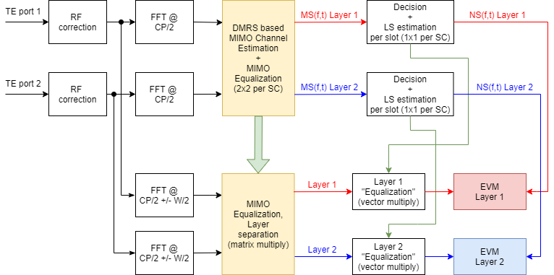
Background – 2 : Method 1
Equalizer is derived from DMRS symbols alone
See R4-2109915

Slide 4
Background – 3 : Method 2
Equalizer is derived by inversion of LSE estimate of channel
Extension of legacy SISO method to rank 2
See R4-2108811

Slide 5
WF – Simulation assumptions
Method other than method 1 and 2 is not precluded
Test waveforms constructed with:
Flat signal PSD
Injected AWGN
Signal configuration:
[50] contiguous RBs
CP-OFDM (QPSK – 64 QAM) PUSCH, rank 2
UL RMC as defined in appendix of 38.101-2
AWGN noise sweep for SNR range of 10 dB to 30 dB over allocated RBs
Polarization basis mismatch:
Evaluate for following matrices that relate TE receiver signal to UE individual chain outputs ->
$\left[\begin{matrix}1 & 0 \\ 0 & 1\end{matrix}\right]$
$\left[\begin{matrix}1 & −1 \\ 1 & 1\end{matrix}\right].\frac{1}{\sqrt{2}}$
Others unitary matrices not precluded

Slide 6
WF – Criteria for comparison of methods
Calculated EVM accuracy for different SNR cases due to AWGN
Calculated EVM repeatability for above cases over 10 sub-frames average per standard for PUSCH
Sensitivity of calculated EVM to DMRS configuration
Sensitivity of calculated EVM to frequency domain smoothing
Sensitivity of calculated EVM to scheduled number of PUSCH symbols
Handling of non-invertible matrix cases
The allowable EVM measurement error
Implementation challenges
Other criteria not precluded

