Slide 1
[Draft] Way Forward for [313]NTN_Soltions_Part2
JIN Yiran
Moderator, Samsung

Slide 2
Outline
This document provides proposed way forward based on the outcomes of “Email discussion summary for [99e][313] NTN_Solutions_Part2”
See R4-2108700
Proposals/Recommended WF in “orange” are those not agreed yet but worth a try.

Slide 3
Way Forward - Scenarios
Agree to remove NR/NB-IoT Indoor scenarios.
FR1: 2GHz |  |  | Set 1 |  |  | Set 2² |  |  | HAPS
 |  |  | GEO | LEO 600km | LEO 1200km | GEO | LEO 600km | LEO 1200km
NR / NB-IoT | Rural |  | X | X | X | X | X | X | FFS
 | Urban macro |  | X | X | X | X | X | X | FFS
 | Dense Urban |  | X | X | X | X | X | X | FFS
NTN¹ | GEO³ | Set 1 | X | X | X | N/A | N/A | N/A | FFS
 | LEO 1200km |  | X | X | X | N/A | N/A | N/A | FFS
 | LEO 600km |  | X | X | X | N/A | N/A | N/A | FFS
 | GEO | Set 2² | N/A | N/A | N/A | X | X | X | FFS
 | LEO 1200km |  | N/A | N/A | N/A | X | X | X | FFS
 | LEO 600km |  | N/A | N/A | N/A | X | X | X | FFS
Note 1: Start with Earth Fixed beam first, Earth Moving Beams could be further discussed Note 2: Use Set 1 satellite antenna as the starting point for co-existence study. Set 2 might be used if any worst case in associate with Set 2 is found. Note 3: GEO and LEO only operate at adjacent channel. Note 4: Use GEO and LEO@600km when TN is victim.

Slide 4
Way Forward - Interference Table
RAN4 adopts a phase-by-phase approach to conduct co-existence study based on the table below.
The table has been updated based on last RAN4 meeting agreement.
No. | Combination | Aggressor | Victim | Notes | Study Phase
1 | TN with NTN | TN DL | NTN DL |  | Phase 1
2 | TN with NTN | TN UL | NTN UL |  | Phase 1
3 | TN with NTN | NTN DL | TN DL |  | Phase 1
4 | TN with NTN | NTN UL | TN UL |  | Phase 1
5 | TN with NTN | NTN UL | TN DL | Applicable for satellite operating in S band, e.g. coexistence with n34 TDD. | Phase 1
6 | TN with NTN | TN DL | NTN UL | Applicable for satellite operating in S band, e.g. coexistence with n34 TDD. | Phase 1
7 | TN with NTN | TN UL | NTN DL | Applicable for satellite operating in S band, e.g. coexistence with n41 TDD. | Phase 2
8 | TN with NTN | NTN DL | TN UL | Applicable for satellite operating in S band, e.g. coexistence with n41 TDD. | Phase 1
9 | NTN with NTN | NTN DL | NTN DL | LEO-LEO | Phase 2
 |  |  |  | GEO-GEO | Phase 2
 |  |  |  | GEO-LEO@600 or HAPS-HAPS | Phase 2
 |  | NTN UL | NTN UL | LEO-LEO | Phase 2
 |  |  |  | GEO-GEO | Phase 2
 |  |  |  | GEO-LEO@600 or HAPS-HAPS | Phase 2

Slide 5
Way Forward - Interference Table
Open issues:
Whether NTN with NTN scenarios can be removed.
Whether to capture the Figure 1, 2 &3 as informative Annex.
Details are all captured in R4-2108645.
Remaining open issue are with [] and will be further discussed.

Slide 6
Way Forward - NW layout models
Coordinate system: FFS
Option 1: RAN4 to consider the used assumptions in TR 38.811 for 3D global coordinate system as well the curvature of earth formula to calculate the slant distance between the UE and satellite. (Option 1 of R4-2106105)
Option 2: There is no need to consider the curvature of earth for layout, assuming one satellite beam for the simulation. The distances for LEO-600, LEO-1200 and GEO can be assumed as 600km, 1200km and 35786km separately for any point under the 3dB satellite beam. (Option 2 of R4-2106105)
➔ Recommended WF: Do not consider curvature of earth for calibration and adopt Option 1 for co-existence study.

Slide 7
Way Forward - NW layout models
Method to generate TN sites for NTN-TN co-existence studies:
Agreements:
It should not be assumed that all TN networks are transmitting simultaneously in simulation.
Low elevation angle cases should be further considered based on the table below.
Open issues: 4 options are captured in R4-2108645 with [] and will be further discussed.

Slide 8
Way Forward - NW layout models
Co-existence between NTN and NTN
Recommended WF:
NTN-NTN layouts in R4-2106105 has been agreed as a starting point and square brackets have been removed.
Other new options are not precluded.
Details are all captured in R4-2108645.
Remaining open issue are with [] and will be further discussed.

Slide 9
Way Forward - Simulation Assumptions
Detailed assumptions have been captured in R4-2108645.
Consensus have been achieved on following items
Item | Agreements
NTN FRF | Follow RAN4#98bis-e agreement as following, 2 phases will be considered for FRF: FRF=1 in phase 1 for simplification; FRF=3 in phase 2 or it is found FRF=1 is too stringent.
Satellite channel bandwidth (BW) | 20MHz (associated with FRF=1)
Satellite max TX power | Update Set-1 Satellite parameter table with max TX power in dBm. Update TX power for 20MHz BW if it is agreed.
NTN Performance metric | The average throughput loss and 5%-ile throughput loss should be less than 5%.
Propagation model in TR 38.811 | Companies who contributed to TR 38.811 section 6.6.2 are invited and strongly encouraged to provide information w.r.t. this matter.

Slide 10
Way Forward - Simulation Assumptions
Satellite max TX power: Agreements as following
The satellite max Tx power can be calculated by the equation as below:
$$\max{Tx power\left[dBm\right]=}EIRP density\left[\frac{dBW}{MHz}\right]+30+10 \log_{10}\left(N_{RB}∗SCS\left[MHz\right]∗12\right)−Max Gain\left[dBi\right]$$
N_{RB} configuration per BandWidth size and SCS:
Configuration FR1 S-band | N_{RB} (5MHz BW) | N_{RB} (10MHz BW) | N_{RB} (15MHz BW) | N_{RB} (20MHz BW)
SCS 15 kHz | 25 | 52 | 79 | TBA
SCS 30 kHz | 11 | 24 | 38 | TBA
Following information is to be updated in Set-1 satellite parameters table.
Satellite orbit |  | GEO |  |  |  | LEO-1200 |  |  |  | LEO-600
Payload characteristics for DL transmissions
Satellite max TX power in dBm | BW | 5MHz | 10MHz | 15MHz | 20MHz | 5MHz | 10MHz | 15MHz | 20MHz | 5MHz | 10MHz | 15MHz | 20MHz
 | SCS 15kHz | 44.53 | 47.71 | 49.53 | TBA | 46.53 | 49.71 | 51.53 | TBA | 40.53 | 43.71 | 45.53 | TBA
 | SCS 30kHz | 43.98 | 47.37 | 49.36 | TBA | 45.98 | 49.37 | 51.36 | TBA | 39.98 | 43.37 | 45.36 | TBA

Slide 11
Way Forward - Simulation Assumptions
Satellite channel bandwidth (BW): 20MHz (associated with FRF=1)
NTN system noise figure in dB: Further discuss values in the table below.
Satellite | GEO | LEO 600 | LEO 1200
G/T (dB K⁻¹) | 19 | 1.1 | 1.1
G_Rx (dBi) | 51 | 30 | 30
NF (dB) | 7.4 | 4.3 | 4.3
TN Parameters: FFS as attached.

Slide 12
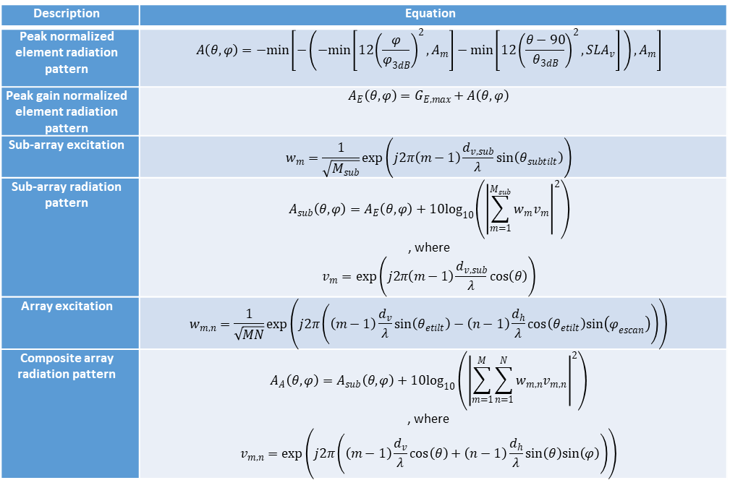
Way Forward - Simulation Assumptions
TN BS AAS Antenna: FFS
Option 1: For AAS antennas, refer to the ITU LS reply in R4-2008924.
Option 2: Adopt the extended BS AAS antenna model for TN in the scope of NTN simulations.
Option 2
Description | Equation
Peak normalized element radiation pattern | $$A\left(θ,φ\right)=−min\left[−\left(−min\left[12{\left(\frac{φ}{φ_{3dB}}\right)}^{2},A_{m}\right]−min\left[12{\left(\frac{θ−90}{θ_{3dB}}\right)}^{2},{SLA}_{v}\right] \right),A_{m}\right]$$
Peak gain normalized element radiation pattern | $$A_{E}\left(θ,φ\right)=G_{E,max}+A\left(θ,φ\right)$$
Sub-array excitation | $$w_{m}=\frac{1}{\sqrt{M_{sub}}}exp\left(j2π\left(m−1\right)\frac{d_{v,sub}}{λ}sin\left(θ_{subtilt}\right)\right)$$
Sub-array radiation pattern | $$A_{sub}\left(θ,φ\right)=A_{E}\left(θ,φ\right)+10\log_{10}\left({\left|\sum_{m=1}^{M_{sub}}{w_{m}v_{m}}\right|}^{2}\right)$$ , where $$v_{m}=exp\left(j2π\left(m−1\right)\frac{d_{v,sub}}{λ}cos\left(θ\right)\right)$$
Array excitation | $$w_{m,n}=\frac{1}{\sqrt{MN}}exp\left(j2π\left(\left(m−1\right)\frac{d_{v}}{λ}sin\left(θ_{etilt}\right)−\left(n−1\right)\frac{d_{h}}{λ}cos\left(θ_{etilt}\right)sin\left(φ_{escan}\right)\right)\right)$$
Composite array radiation pattern | $$A_{A}\left(θ,φ\right)=A_{sub}\left(θ,φ\right)+10\log_{10}\left({\left|\sum_{m=1}^{M}{\sum_{n=1}^{N}{w_{m,n}v_{m,n}}}\right|}^{2}\right)$$ , where $$v_{m,n}=exp\left(j2π\left(\left(m−1\right)\frac{d_{v}}{λ}cos\left(θ\right)+\left(n−1\right)\frac{d_{h}}{λ}sin\left(θ\right)sin\left(φ\right)\right)\right)$$
Moderator:
It should be noted that,
Option 1 AAS antenna pattern refers to that in ITU-R M.2101 and input parameters follow Table 2.3-6 (Antenna row could be updated to ITU-R M.2101).
TR 38.921 pattern is the same with ITU-R M.2101 pattern.
For Option 2, relative discussion is ongoing in [337].

Slide 13
Way Forward - Simulation Assumptions
TN BS non-AAS Antenna: FFS
Option 1: For non-AAS antennas, refer to the ITU LS reply in R4-2008924 but its vertical coverage should be ~10deg. (and not 30) and the gain should be around 17-18 dBi (not 12).
Option 2: RAN4 to refer to TR 36.942 for the BS non-AAS antenna pattern.
Option 3: Table 2.4.3-1 of R4-2106105
Note that Table 2.4.3-1 of R4-2106105 defined the antenna element pattern for non-AAS antennas.RAN4 needs to define the antenna pattern for non-AAS BS for simulation.

Slide 14
Way Forward - Simulation Assumptions
Deployment of NTN UE: FFS
Option 1: NTN UE should be randomly generated within the NTN area. And when co-locate with TN network, co-ex study only consider those NTN UE dropped within the TN network. The simulation should follow similar Monte-Carlo approach as for TN simulation assumptions. And further discuss following factors
Depending on who is the aggressor, and who is the victim, the simulation approach may be different. For generating interference, RAN4 simulations may consider multiple sources, but for measuring interference, RAN4 simulation may use one single destination in different locations.
The simulation assumptions should consider UEs connecting with higher priority to the network providing higher QoS.
The simulation assumptions could be further simplified with NTN UEs at the edge of TN network or outside TN network.
Option 2: Distribute the NTN UEs within the TN network boundaries or centers randomly corresponding to simulation cases.

Slide 15
Way Forward - Simulation Assumptions
Principles to consider UE numbers: FFS
RAN4 should consider the number of TN UEs or their respective densities as a function of interference type.
RAN4 should consider the number of NTN UEs or their respective densities as a function of interference type.
If TN simulation assumptions are using one single TN UE scheduled approach, NTN simulation assumptions should also use one single NTN UE scheduled approach.
If TN simulation assumptions are using a density of TN UEs, NTN simulation assumptions should also use a density of NTN UEs.

Slide 16
Way Forward - Simulation Assumptions
Number of active NTN UE: FFS
Option 1: 3 in UL and 1 in DL (same with TN)
Option 2: Set-1 satellite parameters should be update with following NTN UE density assumptions.
Satellite orbit |  | GEO | LEO-1200 | LEO-600
Satellite altitude |  | 35786 km | 1200 km | 600 km
NTN UE Assumptions (Distribution, Density/km²) for 15 MHz and 30 MHz configurations (FRF1)
Satellite Beam Diameter | 2GHz | 250 km | 90 km | 50 km
Mean Throughput Rate per (Active) NTN UE |  | 250 kbps | 250 kbps | 250 kbps
Satellite Spectrum Efficiency Assumption |  | 1.35bit/sec/Hz | 1.35bit/sec/Hz | 1.35bit/sec/Hz
Channel Bandwidth Assumption per Beam |  | 5; 10; 15; 30 MHz | 5; 10; 15; 30 MHz | 5; 10; 15; 30 MHz
Maximum Throughput per Beam |  | 6.75; 13.5; 20.25; 40.5 Mbps | 6.75; 13.5; 20.25; 40.5 Mbps | 6.75; 13.5; 20.25; 40.5 Mbps
Number of NTN (Active) UEs per Beam |  | 30 MHz assumption: 162 NTN UEs/beam 15 MHz assumption: 81 NTN UEs/beam | 30 MHz assumption: 162 NTN UEs/beam 15 MHz assumption: 81 NTN UEs/beam | 30 MHz assumption: 162 NTN UEs/beam 15 MHz assumption: 81 NTN UEs/beam
NTN UE Density per Given Service Type (for Simulation Purpose) |  | 30 MHz assumption: 0.0033 NTN UEs/km² 15 MHz assumption: 0.0016 NTN UEs/km² | 30 MHz assumption: 0.0255 NTN UEs/km² 15 MHz assumption: 0.0127 NTN UEs/km² | 30 MHz assumption: 0.0825 NTN UEs/km² 15 MHz assumption: 0.0412 NTN UEs/km²

Slide 17
Way Forward - Simulation Assumptions
Indoor/outdoor TN UE: FFS
Option 1: Assume 80% of TN UEs are outdoor and 20% indoor for TN macro urban and suburban.
Option 2: 100% Outdoor
➔ Recommended WF: Adopt Option 2
NTN UL TPC: FFS
Option 1: Whether to use NTN UL power control or set 23 dBm may depend on the relation between CLx-ile, Path loss and Satellite Rx max Gain.
Option 2: The CLx-ile value should be adapted for rural, dense urban and indoor scenarios.
Option 3: RAN4 to reuse the same TN TPC for NTN with SNR target 15dB.
➔Recommended WF: Adopt Option 3 for calibration

Slide 18
Way Forward - Simulation Assumptions
Throughput ~ SNR mapping: FFS
Option 1: the parameters in tale 5-1 can be reused for the following parameters α , SNIRMIN, and SNIRMAX, but other options are not precluded.
➔ Recommended WF: Option 1 can be a starting point.
Parameter | DL | UL | Notes
α, attenuation | 0.6 | 0.4 | Represents implementation losses
SNIR_{MIN}, dB | -10 | -10 | Based on QPSK, 1/8 rate (DL) & 1/5 rate (UL)
SNIR_{MAX}, dB | 30 | 22 | Based on 256QAM 0.93(DL) & 64QAM 0.93 (UL)
It’s infeasible to achieve 30dB/22dB DL/UL maximum SNIR for NR NTN, so the following parameters need to be further studied and RAN4 need to check them with RAN1.
α Attenuation factor, representing implementation losses SNIR_{MIN} Minimum SNIR of the code set, dB SNIR_{MAX} Maximum SNIR of the code set, dB

Slide 19
Way Forward - Simulation Assumptions
Interference impact analysis when TN UL is victim: FFS
Option 1: Only consider the TN cells hosting NTN UEs (i.e. impact should be checked only for TN UEs inside those TN cells).
Option 2: Consider all TN cells.
Option 3 (new): Consider the impact to the whole TN network (19-Cell, 57 Sectors), if NTN UE is dropped within this TN network (19-cell, 57 sectors), we consider the impact.
Details are all captured in R4-2108645.
Remaining open issue are with [] and will be further discussed.

Slide 20
Way Forward - HAPS
Agreed on HAPS UE NF=9dB.
Layout between HAPS and TN: FFS
HAPS UE UL TPC: FFS
Use the following parameters to set the UE’s UL transmit power in the agreed UL power control model:
UL power control parameter | TN | HAPS
P_{max} (dBm) | 23 | 23
R_{min} (dB) | -54 | -54
γ | 1 | 1
X, transmission bandwidth (MHz) | 2.88 | 0.36
Y, BS noise figure (dB) | 5 | 5

Slide 21
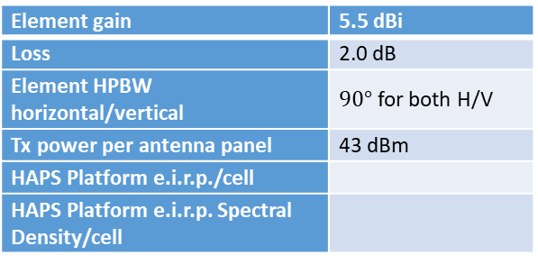
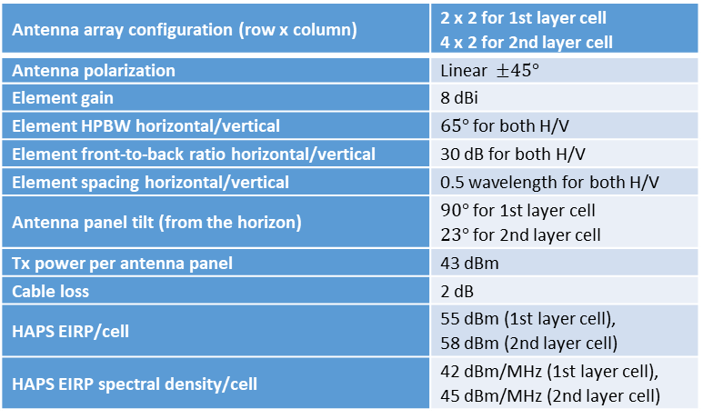
Way Forward - HAPS
Antenna parameters: FFS
Option 2
Option 1
Antenna array configuration (row x column) | 2 x 2 for 1st layer cell 4 x 2 for 2nd layer cell
Antenna polarization | Linear $±45°$
Element gain | 8 dBi
Element HPBW horizontal/vertical | $65°$ for both H/V
Element front-to-back ratio horizontal/vertical | 30 dB for both H/V
Element spacing horizontal/vertical | 0.5 wavelength for both H/V
Antenna panel tilt (from the horizon) | $90°$ for 1st layer cell $23°$ for 2nd layer cell
Tx power per antenna panel | 43 dBm
Cable loss | 2 dB
HAPS EIRP/cell | 55 dBm (1st layer cell), 58 dBm (2nd layer cell)
HAPS EIRP spectral density/cell | 42 dBm/MHz (1st layer cell), 45 dBm/MHz (2nd layer cell)
Element gain | 5.5 dBi
Loss | 2.0 dB
Element HPBW horizontal/vertical | $90°$ for both H/V
Tx power per antenna panel | 43 dBm
HAPS Platform e.i.r.p./cell
HAPS Platform e.i.r.p. Spectral Density/cell

Slide 22
Way Forward - HAPS
Uplink scheduled bandwidth: FFS
Option 1:
For the HAPS network, UL scheduled bandwidth is 2 RBs per UE and 10 UEs are scheduled per cell. Scheduled UE resources are randomly distributed across the bandwidth.
For the TN network, UL scheduled bandwidth is 16 RBs per UE and 6 UEs are scheduled per cell. Scheduled UE resources are randomly distributed across the bandwidth.
Option 2:
For the HAPS network, 3 or 10
For the TN network, 3UEs are usually assumed for simultaneous transmission
Details are all captured in R4-2108646.
Remaining open issue are with [] and will be further discussed.

Slide 23
Way Forward - Calibration
Agreement:
Develop tables (R4-2108721) to calibrate following values for TN, NTN and HAPS respectively.
TN: DL SINR cdf , the UE Tx cdf and the UL SINR cdf
NTN: DL SINR cdf , the UE Tx cdf and the UL SINR cdf
HAPS: DL SINR cdf , the UE Tx cdf and the UL SINR cdf
Conduct the calibration during and after this meeting.
Finalize the calibration by RAN4#100e.

Slide 24
Way Forward - Calibration
Micro work plan for calibration and co-existence
~ August, 2021: conduct offline discussion and finalize calibration before the RAN4 meeting in August.
2021 Q3：collect results for phase 1 scenarios, and draw conclusion for phase 1 scenarios with ACIR as output.
2021 Q4: collect results for phase 2 scenarios, draw conclusion for NTN co-existence study with ACIR as output.

Slide 25
Appendix

Slide 26
Reference
[1] R4-2108700, “Email discussion summary for [99-e][313] NTN_Solutions_Part2”, Samsung
[2] R4-2108645, “Simulation assumptions for NTN co-existence study ”, Samsung, CATT
[3] R4-2108646, “Simulation assumptions for HAPS co-existence study ”, Nokia
[4] R4-2108721 , “Template for NTN co-existence calibration results collection ”, Samsung

Slide 27
Contribution list in RAN4 #99s-e
TDoc Number | Title | Company
R4-2109118 | Updated simulation assumptions for NTN co-existence | CATT
R4-2109119 | Comparison of co-existence performance w/w.o. consideration on earthe curvature | CATT
R4-2109544 | Proposed simulation assumptions for NTN co-existence study | Samsung
R4-2109645 | On simplification of TN UL --> NTN UL simulation | CATT
R4-2110119 | NTN Simulations assumptions | Ericsson
R4-2110121 | NTN - simulation results for alignment | Ericsson
R4-2110193 | Preminary simulation result for coexistence study on NR to support non-terrestrial networks | Xiaomi
R4-2110412 | Further discussion on NTN simulation assumptions | Huawei, HiSilicon
R4-2110689 | HAPS simulation assumptions for coexistence study | Nokia, Nokia Shanghai Bell
R4-2110690 | HAPS adjacent channel coexistence simulation results | Nokia, Nokia Shanghai Bell
R4-2110799 | Simulation scenarios and assumptions for NTN co-existence | Qualcomm Incorporated
R4-2110800 | HAPS coexistence simulation assumptions | Qualcomm Incorporated
R4-2111423 | Reference Deployment Scenario for NTN MSS S-Band | THALES
R4-2111462 | On the S-band NTN Scenarios and Parameters for Coexistence Study | THALES
R4-2108463* | Preliminary simulation result for discussion and calibration | Samsung
*Late document, not treated

