Slide 1
3GPP TSG-RAN WG4 Meeting #99-e
Electronic Meeting, 19-27 May, 2021
R4-21xxxxx
WF on NR Positioning Performance Requirements
Intel

Slide 2
Agreements in the 1st round/GTW
open for 2nd round discussion
Still open after 1st round discussion
Agreements in the 2nd round

Slide 3
Measurement Accuracy Requirements for RSTD(1)
PRS-RSTD and UE Rx-Tx measurement accuracy requirements
  Define an additional set of accuracy requirements for AWGN
  Capture in the specification the propagation channel models based on which the accuracy requirements are derived
When UE measures RSTD on PRS resources belonging to different PFLs, then the RSTD accuracy is defined as the accuracy corresponding to the largest accuracy value among different PFLs.
  Note: margins for measurements on different PFLs shall be considered in the group delay margin
RAN4 will add a non-zero group delay calibration margin to the RSTD accuracy requirements in FR1 and FR2.
  FFS the exact values of the margins for FR1 and FR2 in the maintenance stageFFS on frequency drift margin

Slide 4
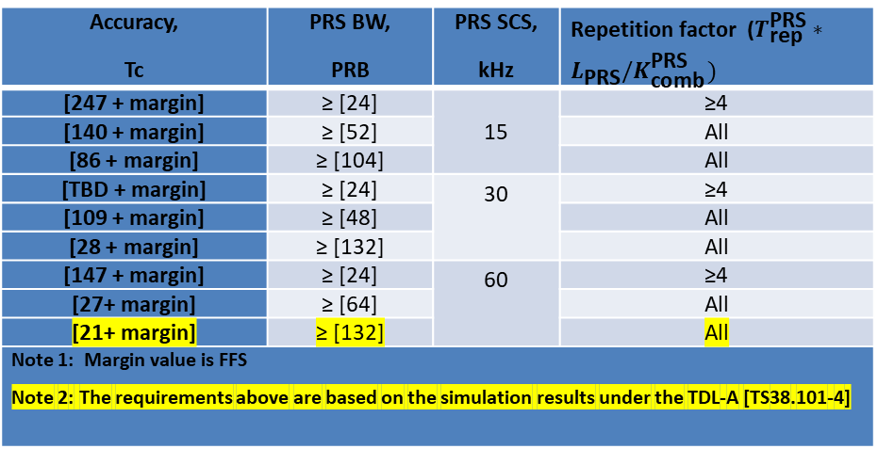
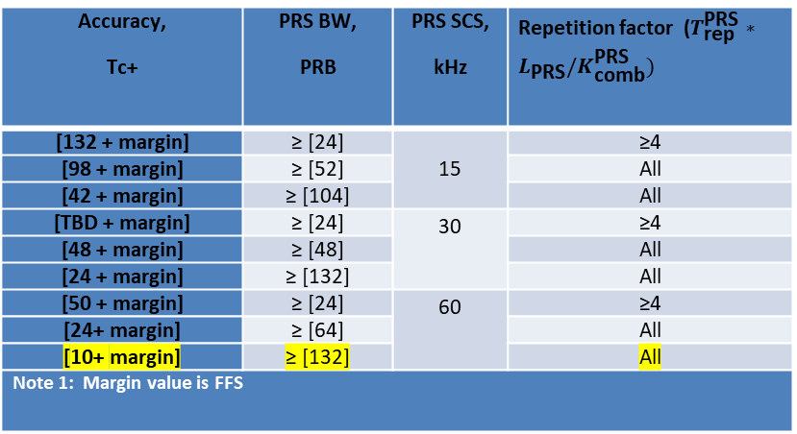
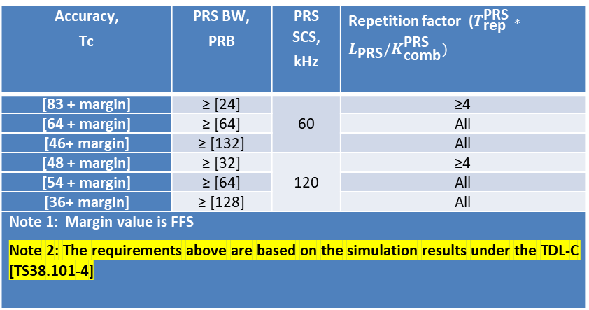
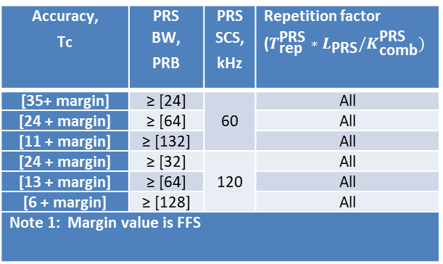
Measurement Accuracy Requirements for RSTD(2)
Reference point of ideal RX time for RSTD accuracy requirements is the absolute arrival time of the first path of the receive signal
Table 2-1: RSTD accuracy for fading channels in FR1
Table 1-1: RSTD accuracy for AWGN in FR1
Accuracy, Tc | PRS BW, PRB | PRS SCS, kHz | Repetition factor ($T_{\text{rep}}^{\text{PRS}}∗L_{\text{PRS}}/K_{\text{comb}}^{\text{PRS}})$
[247 + margin] | ≥ [24] | 15 | ≥4
[140 + margin] | ≥ [52] |  | All
[86 + margin] | ≥ [104] |  | All
[TBD + margin] | ≥ [24] | 30 | ≥4
[109 + margin] | ≥ [48] |  | All
[28 + margin] | ≥ [132] |  | All
[147 + margin] | ≥ [24] | 60 | ≥4
[27+ margin] | ≥ [64] |  | All
[21+ margin] | ≥ [132] |  | All
Note 1: Margin value is FFS Note 2: The requirements above are based on the simulation results under the TDL-A [TS38.101-4]
Accuracy, Tc+ | PRS BW, PRB | PRS SCS, kHz | Repetition factor ($T_{\text{rep}}^{\text{PRS}}∗L_{\text{PRS}}/K_{\text{comb}}^{\text{PRS}})$
[132 + margin] | ≥ [24] | 15 | ≥4
[98 + margin] | ≥ [52] |  | All
[42 + margin] | ≥ [104] |  | All
[TBD + margin] | ≥ [24] | 30 | ≥4
[48 + margin] | ≥ [48] |  | All
[24 + margin] | ≥ [132] |  | All
[50 + margin] | ≥ [24] | 60 | ≥4
[24+ margin] | ≥ [64] |  | All
[10+ margin] | ≥ [132] |  | All
Note 1: Margin value is FFS
Table 1-2: RSTD accuracy for AWGN in FR2
Table 2-2 RSTD accuracy for fading channels in FR2
Accuracy, Tc | PRS BW, PRB | PRS SCS, kHz | Repetition factor ($T_{\text{rep}}^{\text{PRS}}∗L_{\text{PRS}}/K_{\text{comb}}^{\text{PRS}})$
[83 + margin] | ≥ [24] | 60 | ≥4
[64 + margin] | ≥ [64] |  | All
[46+ margin] | ≥ [132] |  | All
[48 + margin] | ≥ [32] | 120 | ≥4
[54 + margin] | ≥ [64] |  | All
[36+ margin] | ≥ [128] |  | All
Note 1: Margin value is FFS Note 2: The requirements above are based on the simulation results under the TDL-C [TS38.101-4]
Accuracy, Tc | PRS BW, PRB | PRS SCS, kHz | Repetition factor ($T_{\text{rep}}^{\text{PRS}}∗L_{\text{PRS}}/K_{\text{comb}}^{\text{PRS}})$
[35+ margin] | ≥ [24] | 60 | All
[24 + margin] | ≥ [64] |  | All
[11 + margin] | ≥ [132] |  | All
[24 + margin] | ≥ [32] | 120 | All
[13 + margin] | ≥ [64] |  | All
[6 + margin] | ≥ [128] |  | All
Note 1: Margin value is FFS

Slide 5
Measurement Accuracy Requirements for PRS RSRP(1)
The relative RSRP accuracy should be (RSRP95 – RSRP05), which was agreed in R4#98bis-e
The PRS RSRP measurement requirements in extreme condition are X dB larger than that in normal condition, and X is:
  3dB for absolute accuracy for FR1.
  3dB for absolute accuracy for FR2.
  1dB for relative accuracy for FR1.
  3dB for relative accuracy for FR2
Relative PRS-RSRP accuracy requirements apply for the cases when PRS-RSRP is measured from resources in the same resource set, and PRS-RSRP is measured with same Rx beam in case of FR2.
  FFS on the exact value of RF calibration margin
    For FR2:
      Option 1: [2dB] for FR1
      Option 2: [0dB] for FR1
    For FR2: [4dB]

Slide 6
Measurement Accuracy Requirements for PRS RSRP(2)
PRS-RSRP accuracy requirements agreed in the last meeting can be taken as the baseline, which can be updated up to updated simulation results and agreed margin.

Slide 7
Measurement Accuracy Requirements for UE Rx-Tx time difference(1)
Applicability of accuracy requirements in the case of NTA_offset change :
  Clarify in section 10.1.25.2 in TS 38.133: “UE Rx-Tx time difference accuracy requirements shall not apply if N_{TA_offset} defined in Table 7.1.2-2 in 38.133 changes during the UE Rx-Tx measurement period.”
Applicability of accuracy requirements under TA adjustment :
  UE Rx-Tx measurement accuracy requirements shall not apply if the uplink transmission timing changes during the UE Rx-Tx measurement period due to network-configured TA command.
  UE Rx-Tx measurement accuracy requirements shall apply if the uplink transmission timing changes during the UE Rx-Tx measurement period due to autonomous adjustment

Slide 8
Measurement Accuracy Requirements for UE Rx-Tx time difference(2)
Applicable accuracy requirement in case of other (non-HO) serving cell changes:
    The UE shall continue and complete a UE Rx-Tx measurement while meeting UE Rx-Tx measurement accuracy requirements in clause 10.1.23, when a non-HO serving cell change occurs during the measurement, provided the cell change does not impact the configuration of the SRS used for the measurement.
The group delay calibration margin can be taken count into UE Rx-Tx difference accuracy requirement.
  The exact value can be FFS.

Slide 9
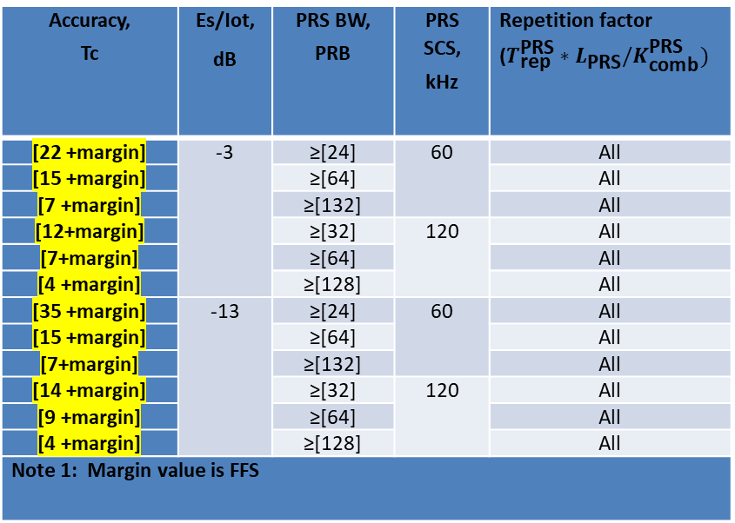
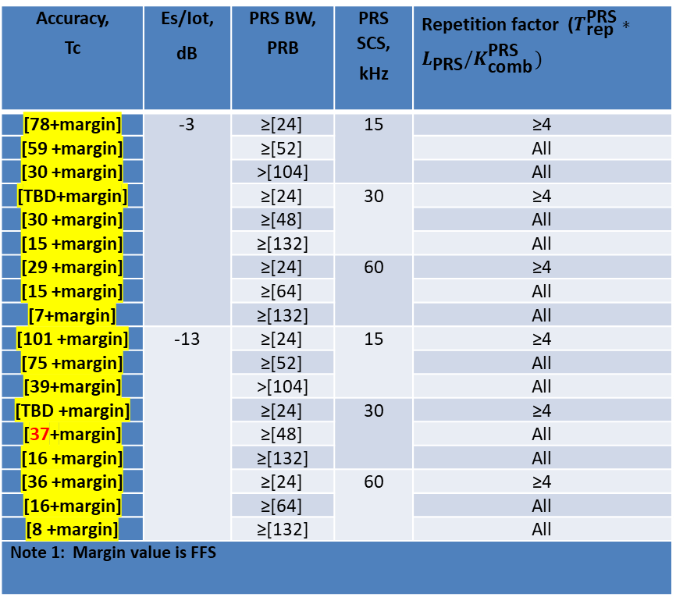
Measurement Accuracy Requirements for UE Rx-Tx time difference(3)
UE Rx-Tx time difference measurement accuracy requirements for AWGN
Table 1-1: UE Rx-Tx accuracy for AWGN in FR1
Accuracy, Tc | Es/Iot, dB | PRS BW, PRB | PRS SCS, kHz | Repetition factor ($T_{\text{rep}}^{\text{PRS}}∗L_{\text{PRS}}/K_{\text{comb}}^{\text{PRS}})$
[78+margin] | -3 | ≥[24] | 15 | ≥4
[59 +margin] |  | ≥[52] |  | All
[30 +margin] |  | >[104] |  | All
[TBD+margin] |  | ≥[24] | 30 | ≥4
[30 +margin] |  | ≥[48] |  | All
[15 +margin] |  | ≥[132] |  | All
[29 +margin] |  | ≥[24] | 60 | ≥4
[15 +margin] |  | ≥[64] |  | All
[7+margin] |  | ≥[132] |  | All
[101 +margin] | -13 | ≥[24] | 15 | ≥4
[75 +margin] |  | ≥[52] |  | All
[39+margin] |  | >[104] |  | All
[TBD +margin] |  | ≥[24] | 30 | ≥4
[37+margin] |  | ≥[48] |  | All
[16 +margin] |  | ≥[132] |  | All
[36 +margin] |  | ≥[24] | 60 | ≥4
[16+margin] |  | ≥[64] |  | All
[8 +margin] |  | ≥[132] |  | All
Note 1: Margin value is FFS
Table 1-2: UE Rx-Tx accuracy for AWGN in FR2
Accuracy, Tc | Es/Iot, dB | PRS BW, PRB | PRS SCS, kHz | Repetition factor ($T_{\text{rep}}^{\text{PRS}}∗L_{\text{PRS}}/K_{\text{comb}}^{\text{PRS}})$
[22 +margin] | -3 | ≥[24] | 60 | All
[15 +margin] |  | ≥[64] |  | All
[7 +margin] |  | ≥[132] |  | All
[12+margin] |  | ≥[32] | 120 | All
[7+margin] |  | ≥[64] |  | All
[4 +margin] |  | ≥[128] |  | All
[35 +margin] | -13 | ≥[24] | 60 | All
[15 +margin] |  | ≥[64] |  | All
[7+margin] |  | ≥[132] |  | All
[14 +margin] |  | ≥[32] | 120 | All
[9 +margin] |  | ≥[64] |  | All
[4 +margin] |  | ≥[128] |  | All
Note 1: Margin value is FFS

Slide 10
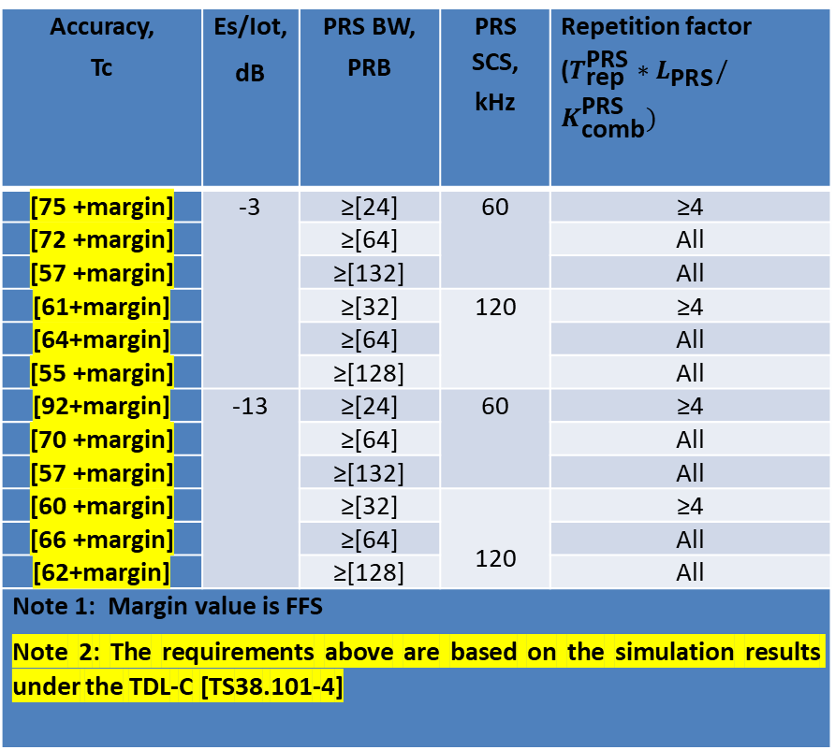
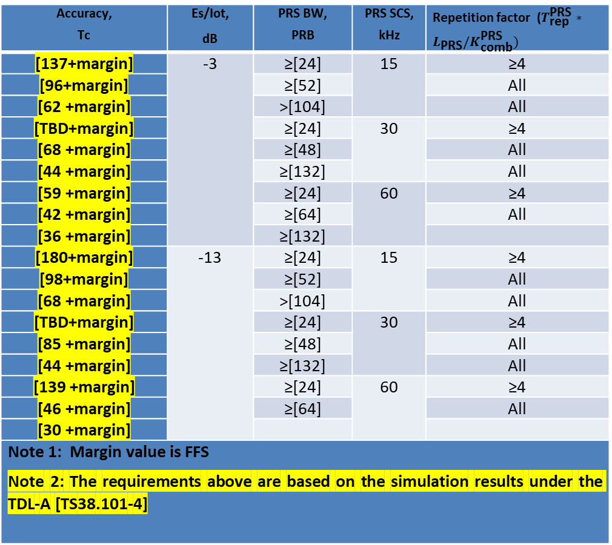
Measurement Accuracy Requirements for UE Rx-Tx time difference(4)
UE Rx-Tx time difference measurement accuracy requirements for fading channel
Table 2-1: UE Rx-Tx accuracy for fading channel in FR1
Accuracy, Tc | Es/Iot, dB | PRS BW, PRB | PRS SCS, kHz | Repetition factor ($T_{\text{rep}}^{\text{PRS}}∗L_{\text{PRS}}/K_{\text{comb}}^{\text{PRS}})$
[137+margin] | -3 | ≥[24] | 15 | ≥4
[96+margin] |  | ≥[52] |  | All
[62 +margin] |  | >[104] |  | All
[TBD+margin] |  | ≥[24] | 30 | ≥4
[68 +margin] |  | ≥[48] |  | All
[44 +margin] |  | ≥[132] |  | All
[59 +margin] |  | ≥[24] | 60 | ≥4
[42 +margin] |  | ≥[64] |  | All
[36 +margin] |  | ≥[132]
[180+margin] | -13 | ≥[24] | 15 | ≥4
[98+margin] |  | ≥[52] |  | All
[68 +margin] |  | >[104] |  | All
[TBD+margin] |  | ≥[24] | 30 | ≥4
[85 +margin] |  | ≥[48] |  | All
[44 +margin] |  | ≥[132] |  | All
[139 +margin] |  | ≥[24] | 60 | ≥4
[46 +margin] |  | ≥[64] |  | All
[30 +margin]
Note 1: Margin value is FFS Note 2: The requirements above are based on the simulation results under the TDL-A [TS38.101-4]
Table 2-2: UE Rx-Tx accuracy for fading channel FR2
Accuracy, Tc | Es/Iot, dB | PRS BW, PRB | PRS SCS, kHz | Repetition factor ($T_{\text{rep}}^{\text{PRS}}∗L_{\text{PRS}}/K_{\text{comb}}^{\text{PRS}})$
[75 +margin] | -3 | ≥[24] | 60 | ≥4
[72 +margin] |  | ≥[64] |  | All
[57 +margin] |  | ≥[132] |  | All
[61+margin] |  | ≥[32] | 120 | ≥4
[64+margin] |  | ≥[64] |  | All
[55 +margin] |  | ≥[128] |  | All
[92+margin] | -13 | ≥[24] | 60 | ≥4
[70 +margin] |  | ≥[64] |  | All
[57 +margin] |  | ≥[132] |  | All
[60 +margin] |  | ≥[32] | 120 | ≥4
[66 +margin] |  | ≥[64] |  | All
[62+margin] |  | ≥[128] |  | All
Note 1: Margin value is FFS Note 2: The requirements above are based on the simulation results under the TDL-C [TS38.101-4]

Slide 11
Test case design principles(1)
Test cases for PRS-RSTD, PRS-RSRP and UE Rx-Tx accuracy requirements
  Test cases are defined for AWGN conditions
  AWGN accuracy requirements are used for the accuracy test cases for PRS-RSTD and UE Rx-Tx.
Test cases for measurement delay requirements
  FFS if fading conditions can be used for FR1 measurement delay tests cases.
  AWGN conditions will be used for FR2 measurement delay test cases.
In the test one cell is serving and other cell(s) as non-serving cell
For PRS-RSRP measurement accuracy testing, define test cases with two PRS resources per TRP (in the same DL-PRS Resource Set) and configure the UE to report two measurements per TRP so that differential reporting is used to report one of the measurements

Slide 12
Test case design principles(2)
General PRS configuration for NR Positioning test case (e.g. PRS periodicity, combsize ,e.t.c)
  The basic PRS configuration patterns shall include two sub patterns for each SCS:
    PRSx.1: PRS BW = lowest PRS BW defined in the accuracy requirements (e.g. 24 PRBs for SCS 15kHz), repetition = 4 (e.g. symb =4, comb=2, rep=2 , which can avoid the cross-slot combination issue)
    PRSx.2: PRS BW = highest PRS BW defined in the accuracy requirements (e.g. 104 PRBs for SCS 15kHz), repetition = 1 (e.g. symb =4, comb=4, rep=1)
SRS configuration can be define based on the principle below.
  BW: to define the SRS BW corresponding to the channel BW, i.e. 10MHz for 15kHz SCS, 40MHz for 30kHz SCS and 100MHz for 120kHz SCS.
  comb size 4 with 4 OFDM symbols.
  160ms, and the offset is 20ms (the separation between PRS and SRS is 10ms)
  frequency hopping: no
  group or sequence hopping: no
  Number of antenna ports: 1
  Resource type: periodic
  SCS: same as for SSB
  Match SRS periodicity to PRS periodicity, i.e. 160 ms
General SRS configuration can be define as the table right
SRS-Resource | SRS-ResourceId | 0
 | nrofSRS-Ports | Port1
 | transmissionComb | n4
 | combOffset-n4 | 0
 | cyclicShift-n4 | 0
 | resourceMapping startPosition | 0
 | resourceMapping nrofSymbols | n4
 | resourceMapping repetitionFactor | n1
 | freqDomainPosition | 0
 | freqDomainShift | 0
 | freqHopping c-SRS | Matches N_{RB,c}
 | groupOrSequenceHopping | Neither
 | resourceType | Periodic
 | periodicityAndOffset-p | 160*2^u, 20*2^u
 | sequenceId | 0

Slide 13
Test case design principles(3)
Number of positioning frequency layers :
  single PFL tests and dual PFL tests in separate test cases (sections).
The synchronous cells will be tested for the measurement delay requirements test
Muting pattern :
    Cell 1: ‘10’
    Cell 2: ‘01’
    Cell 3: ‘10’
    Cell 1 and Cell 3 will be configured with different Comb patterns or resource offsets
Reporting configuration :No need limit the reporting granularity
Gap pattern: use MGP #24 if supported by UE otherwise #0 can be used.
Testing procedure:
  The testing procedure for LTE OTDoA can be taken as the baseline for NR RSTD and UE Rx-Tx time difference measurement tests.
  The further simplified procedure can be FFS
The setup of AoA for RSTD testing in FR2 can be based on AoA setup 1 for all cells/TRPs.

Slide 14
Test case design principles(4)
Supported test configurations in FR1 and FR2
  Support the proposed reference test configurations below under the assumption that they correspond to the Pcell configuration and do not constrain the PRS bandwidth and SCS to be tested in each test case.
Configuration | Description
1 | 15 kHz SSB SCS, 10 MHz bandwidth, FDD duplex mode
2 | 15 kHz SSB SCS, 10 MHz bandwidth, TDD duplex mode
3 | 30 kHz SSB SCS, 40 MHz bandwidth, TDD duplex mode
NOTE: The UE is only required to be tested in one of the supported test configurations.
Configuration | Description
1 | 120 kHz SSB SCS, 100 MHz bandwidth, TDD duplex mode

