Slide 1
WF on CBM UE architecture
RAN4#99-e R4-210xxxx
e-Meeting, May 2021
Qualcomm Incorporated

Slide 2
Background -1
Moderator summary from 1st round of discussion as captured in R4-2107663 ->
This WF accordingly focuses on ‘define CBM requirements in such manner that both single chain and multi chain architectures are possible’ for UEs supporting DL inter-band CA based on CBM
Sub-topic #1-3 CBM UE architecture | Most (11) of the companies prefer to define requirements so that both single chain and multi chain architectures are possible while three companies consider that requirements should be based on only single chain architecture. Tentative agreements: RAN4 agrees to define CBM requirements in such manner that both single chain and multi chain architectures are possible. Recommendations for 2nd round: WF assigned to Qualcomm.

Slide 3
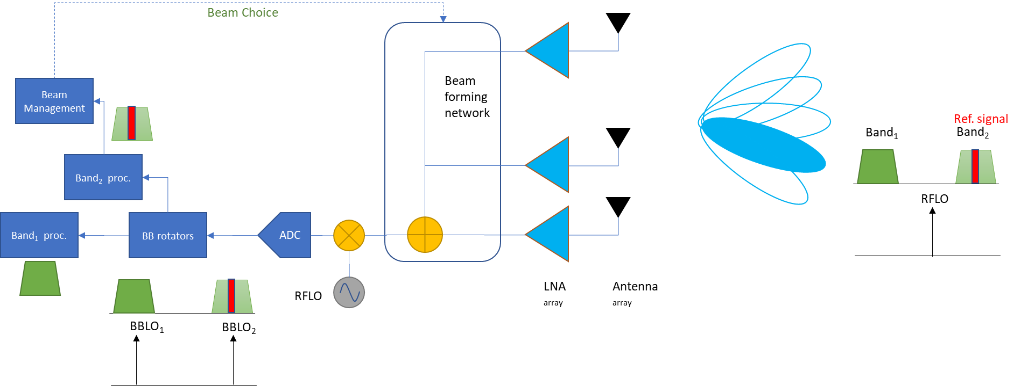
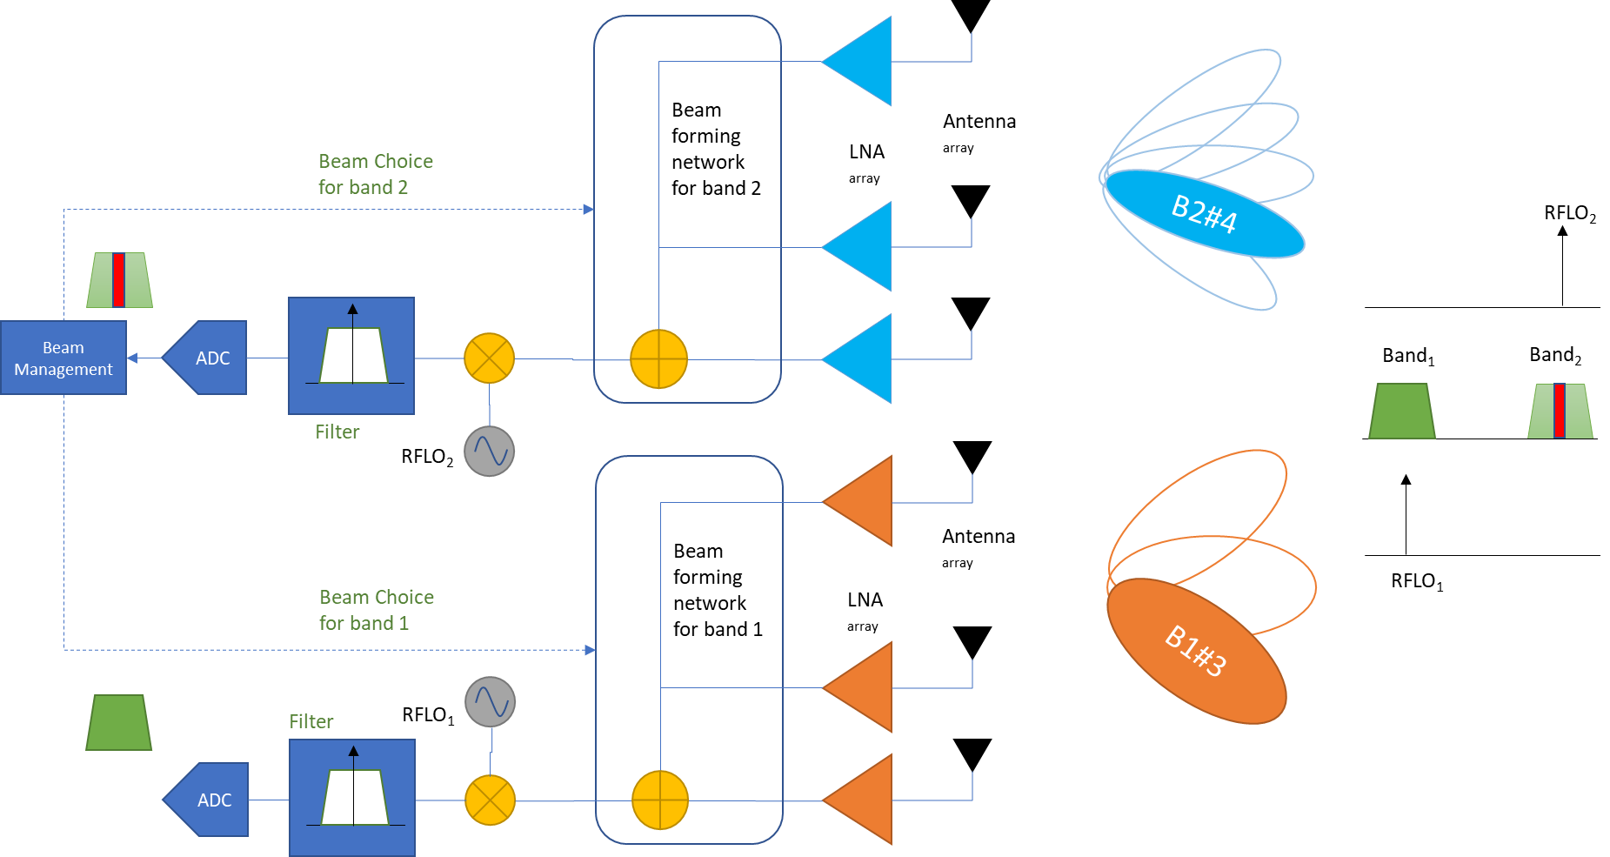
Background - 2
‘Single-chain architecture’: single beam forming network shared by both bands top figure
‘Multi-chain architecture’: multiple beam forming networks, each dedicated to one band bottom figure

Slide 4
WF – General
CBM requirements applicability for a UE supporting Band A + Band B CA based on CBM |  | [BMRS] Location
 |  | In band ‘A’ | in band ‘B’
Tested Band | ‘A’ | Yes
 | ‘A’ |  | Yes
 | ‘B’ | Yes
 | ‘B’ |  | Yes
Note: BMRS is provided in the CC with a configured UL BWP
RAN4 agrees to define CBM requirements in such manner that both single chain and multi chain architectures are possible.
For UEs supporting inter-band DL CA between band A and band B based on CBM, requirements apply per table ->
Verification testing reduction is FFS
Notes:
Mediatek:
Apple: beam management reference signal, in which case, where is BMRS located.
Samsung: we should explicitly describe the applicable condition.
Mediatek: if we may have multiple tests based on the conception of a) and b).

Slide 5
WF – CBM Tx/Rx requirement framework
The requirement framework and PSD condition of each below requirement shall be FFS for each one, respectively.
REFSENS requirement
EIS spherical coverage requirement
ACS and IBB requirement
Max. input power requirement
Others
Potential requirement framework as starting point
Option 1: Intra-band NC framework including relaxations
Option 2: Inter-band CA framework including relaxations (∆RIB)
Other framework is not precluded

