Slide 1
Way forward for PDSCH requirements with Single-DCI based multi-TRP/Panel transmission schemes (URLLC)
3GPP TSG-RAN WG4 Meeting #95e
Electronic, 25th May – 5th June, 2020 Agenda Item: 6.11.3
R4-2008814
Intel Corporation, …

Slide 2
Background
Agreed WFs for demodulation requirements for NR eMIMO WI in previous meetings
R4-2002419 WF on demodulation and CSI requirement for NR eMIMO, RAN4 #94-e
R4-2002420 WF on PDSCH demodulation requirements based on multi-TRP transmission for NR eMIMO, RAN4 #94-e
R4-2005529 WF on PDSCH demodulation requirement and general aspects for NR eMIMO, RAN4 #94e-Bis

Slide 3
Candidate Schemes
URLLC single-DCI based multi-TRP/panel transmission schemes (see Annex)
SDM scheme (1a)
Repetition schemes:
FDM scheme A (2a)
FDM scheme B (2b)
TDM scheme A (3)
Inter-slot TDM scheme (4)

Slide 4
Necessity of PDSCH requirements (Summary of the views from the first round discussion)
Whether already agreed requirements for multi-DCI based and single-DCI based multi-TRP transmission scheme and URLLC single-TRP requirements can cover single DCI based URLLC multi-TRP transmission schemes
Option 1: Yes. FDM schemes can be verified by multi-DCI based and single-DCI based SDM multi-TRP transmission schemes. TDM schemes can be verified by single-DCI based SDM multi-TRP transmission scheme and URLLC single-TRP slot aggregation (Qualcomm, Huawei, Apple).
Option 2: No. Each scheme is a separate UE feature. Different resource allocation approach comparing to single-DCI based SDM multi-TRP transmission scheme. Different CDM group and TBS calculation assumptions comparing to multi-DCI based and single-DCI based SDM multi-TRP transmission schemes. Non-synchronized (with TO/FO) transmission comparing to single TRP URLLC slot aggregation scenario. Specific sub-features for some schemes as: CW combining, number of repetitions. (Intel, Samsung)
Option 3: Cannot cover at least FDM scheme A (Ericsson)

Slide 5
PDSCH requirements introduction
Whether to define requirements for single DCI-based multi-TRP/Panel URLLC schemes
Candidate options from the first round discussion
Option 1: Not need to define (Qualcomm, Huawei)
Option 2a: Yes, only for scheme 2a (Ericsson)
Option 2b: Yes, for schemes 1a, 2a, 2b, 3 and 4 (Intel)
Option 2c: Yes, selection of transmission schemes for requirements definition need further discussion among schemes 2a, 2b, 3 and 4 (Samsung)
Option 3: Deprioritize discussion and come back after finalization of other requirements (Apple)
Proposed WF
Yes, only for one scheme from FDM schemes and one from TDM schemes (Intel)
FFS on the test applicable rules

Slide 6
Test metric
Test metric for requirements definition
Option 1: 1 % BLER which is more suitable for URLLC service (Intel)
Option 2: 70 % @ max throughput (Ericsson)

Slide 7
Applicability rule (if corresponding requirements will be introduced)
FFS on applicability rule between URLLC transmission schemes
FFS on applicability rule between eMBB and URLLC transmission schemes

Slide 8
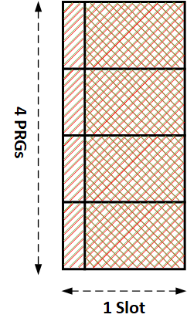
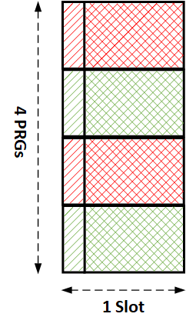
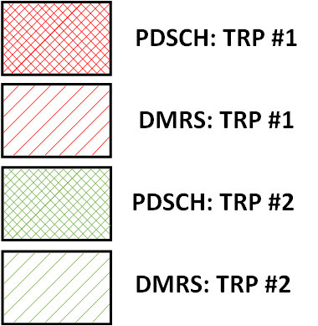
Annex
URLLC transmission schemes
Single-DCI based SDM scheme
Single RV in a slot, common FDRA, common TDRA, two CDM groups
Single-DCI based FDM repetition scheme A
Single RV in a slot, ~equally divided PRGs across TRPs, common TDRA, single CDM group, single PTRS port
Single-DCI based FDM repetition scheme B
RV pair in a slot, ~equally divided PRGs across TRPs, common TDRA, single CDM group, single PTRS port
SDM
FDM A
FDM B

Slide 9
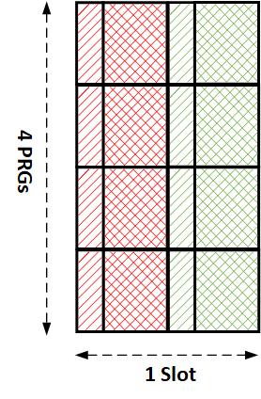
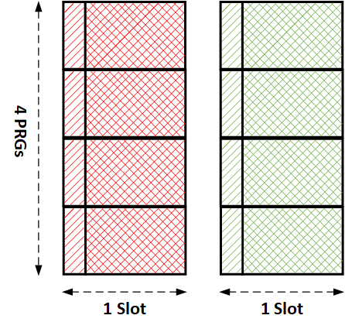
Annex (cont’d)
URLLC transmission schemes
Single-DCI based TDM repetition scheme A
RV pair in a slot, same FDRA, same symbol length of each Tx occasion, single CDM group, limited TBS
Single-DCI based inter-slot TDM repetition scheme
Single RV in a slot, common SLIV, common FDRA, number of Tx occasions 2-16, single CDM group, limited TBS
TDM A
Inter-slot TDM (2 Tx occasions)

