Slide 1
Way forward for PDSCH requirements with Single-DCI based multi-TRP/Panel transmission schemes (URLLC)
3GPP TSG-RAN WG4 Meeting #95e
Electronic, 25th May – 5th June, 2020 Agenda Item: 6.11.3
R4-2008814
Intel Corporation, …

Slide 2
Background
Agreed WFs for demodulation requirements for NR eMIMO WI in previous meetings
R4-2002419 WF on demodulation and CSI requirement for NR eMIMO, RAN4 #94-e
R4-2002420 WF on PDSCH demodulation requirements based on multi-TRP transmission for NR eMIMO, RAN4 #94-e
R4-2005529 WF on PDSCH demodulation requirement and general aspects for NR eMIMO, RAN4 #94e-Bis

Slide 3
Candidate Schemes
URLLC single-DCI based multi-TRP/panel transmission schemes (see Annex)
SDM scheme 1a
Repetition schemes:
FDM scheme A
FDM scheme B
TDM scheme A
Inter-slot TDM scheme

Slide 4
Necessity of PDSCH requirements (Summary of the views from the first round discussion)
Whether already agreed requirements for multi-DCI based and single-DCI based multi-TRP transmission scheme and URLLC single-TRP requirements can cover single DCI based URLLC multi-TRP transmission schemes
Option 1: Yes. FDM schemes can be verified by multi-DCI based and single-DCI based SDM multi-TRP transmission schemes. TDM schemes can be verified by single-DCI based SDM multi-TRP transmission scheme and URLLC single-TRP slot aggregation (Qualcomm, Huawei, Apple).
Option 2: No. Each scheme is a separate UE feature. Different resource allocation approach comparing to single-DCI based SDM multi-TRP transmission scheme. Different CDM group and TBS calculation assumptions comparing to multi-DCI based and single-DCI based SDM multi-TRP transmission schemes. Non-synchronized (with TO/FO) transmission comparing to single TRP URLLC slot aggregation scenario. Specific sub-features for some schemes as: CW combining, number of repetitions. (Intel, Samsung)
Option 3: Cannot cover at least FDM scheme A (Ericsson)

Slide 5
PDSCH requirements introduction
Whether to define requirements for single DCI-based multi-TRP/Panel URLLC schemes
Candidate options from the first round discussion
Option 1: Not need to define (Qualcomm, Huawei)
Option 2a: Yes, only for scheme 2a (Ericsson)
Option 2b: Yes, for schemes 1a, 2a, 2b, 3 and 4 (Intel)
Option 2c: Yes, selection of transmission schemes for requirements definition need further discussion (Samsung)
Option 3: Deprioritize discussion and come back after finalization of other requirements (Apple)
Proposed WF
Yes, only for one scheme from FDM schemes and one from TDM schemes (Intel)

Slide 6
Test metric
Test metric for requirements definition
Option 1: 1 % BLER which is more suitable for URLLC service (Intel)
Option 2: 70 % @ max throughput (Ericsson)

Slide 7
Applicability rule (if corresponding requirements will be introduced)
FFS on applicability rule between URLLC transmission schemes
FFS on applicability rule between eMBB and URLLC transmission schemes

Slide 8
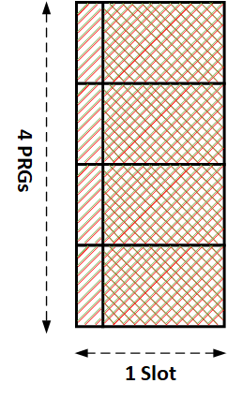
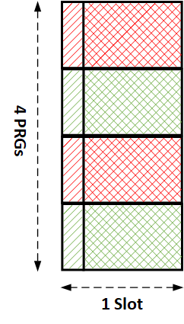
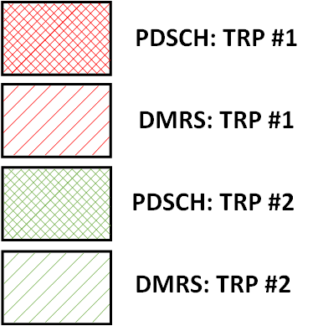
Annex
URLLC transmission schemes
Single-DCI based SDM scheme
Single RV in a slot, common FDRA, common TDRA, two CDM groups
Single-DCI based FDM repetition scheme A
Single RV in a slot, ~equally divided PRGs across TRPs, common TDRA, single CDM group, single PTRS port
Single-DCI based FDM repetition scheme B
RV pair in a slot, ~equally divided PRGs across TRPs, common TDRA, single CDM group, single PTRS port
SDM
FDM A
FDM B

Slide 9
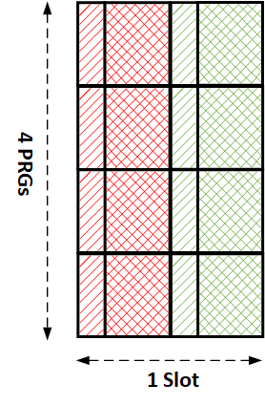
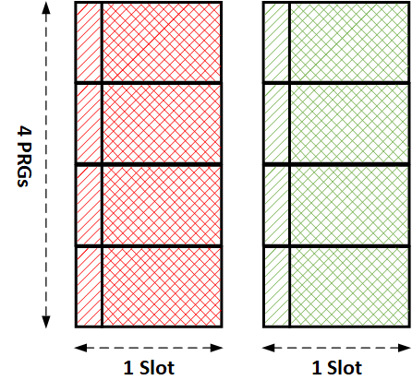
Annex (cont’d)
URLLC transmission schemes
Single-DCI based TDM repetition scheme A
RV pair in a slot, same FDRA, same symbol length of each Tx occasion, single CDM group, limited TBS
Single-DCI based inter-slot TDM repetition scheme
Single RV in a slot, common SLIV, common FDRA, number of Tx occasions 2-16, single CDM group, limited TBS
TDM A
Inter-slot TDM (2 Tx occasions)

