Slide 1
WF on NR RRM enhancements - BWP switching on multiple CCs
3GPP TSG-RAN WG4 Meeting #95-e R4-2008675
Electronic Meeting, 25 May – 5 June, 2020
Intel Corporation

Slide 2
Background
In RAN4#94e-bis WF on BWP switching on multiple CCs was approved - R4-2005339

Slide 3
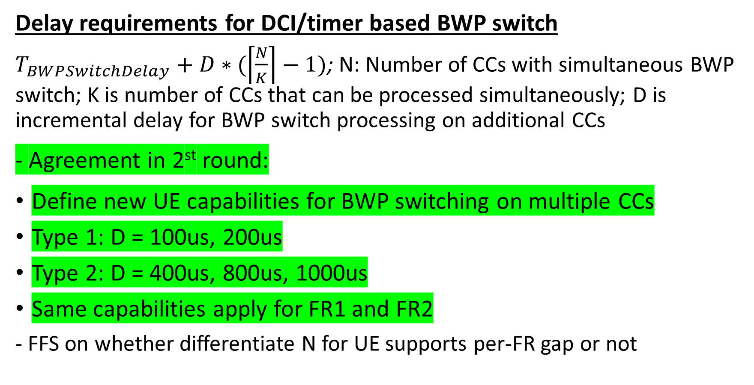
Simultaneous BWP switching on multiple CCs (1)
Delay requirements for DCI/timer based BWP switch
$T_{BWPSwitchDelay}+D∗(\left\lceil \frac{N}{K}\right\rceil −1)$; N: Number of CCs with simultaneous BWP switch; K is number of CCs that can be processed simultaneously; D is incremental delay for BWP switch processing on additional CCs
- Agreement in 2st round:
Define new UE capabilities for BWP switching on multiple CCs
Type 1: D = 100us, 200us
Type 2: D = 400us, 800us, 1000us
Same capabilities apply for FR1 and FR2
- FFS on whether differentiate N for UE supports per-FR gap or not

Slide 4
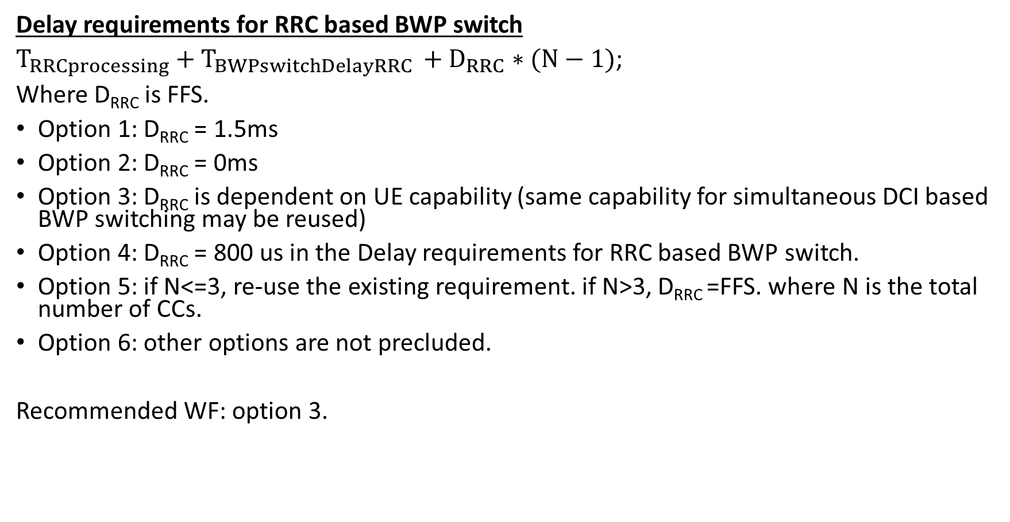
Simultaneous BWP switching on multiple CCs (2)
Delay requirements for RRC based BWP switch
$T_{RRCprocessing}+T_{BWPswitchDelayRRC }+D_{RRC}∗(N−1)$;
Where D_{RRC} is FFS.
Option 1: D_{RRC} = 1.5ms
Option 2: D_{RRC} = 0ms
Option 3: D_{RRC} is dependent on UE capability (same capability for simultaneous DCI based BWP switching may be reused)
Option 4: D_{RRC} = 800 us in the Delay requirements for RRC based BWP switch.
Option 5: if N<=3, re-use the existing requirement. if N>3, D_{RRC} =FFS. where N is the total number of CCs.
Option 6: other options are not precluded.
Recommended WF: option 3.

Slide 5

Simultaneous BWP switching on multiple CCs (3)
$T_{BWPswitchDelay}$when SCS changes
Agreement in 1st round: the simultaneous BWP switch on multiple CCs case, if the BWP switch on multiple CCs results in the change of the SCS on any CC among involved CCs, T_{BWPswitchDelay} should be based on the smallest SCS among all SCS values of all involved CCs.

Slide 6
Partial Overlap BWP switching on multiple CCs (1)
Conditions when requirements for partial overlap BWP switch are defined
DCI and RRC based BWP switch with partial overlap are defined for FR1+FR2 in NR-DC operation, when BWP switch doesn’t involve SCS change and UE supports per-FR gap.
- No requirement is defined for RRC based BWP switch with partial overlap within a cell group

Slide 7
Partial Overlap BWP switching on multiple CCs (2)
Timer based BWP switch
Delay requirement for timer-based BWP switch:
For UE not support per-FR gap:
  UE shall conduct the BWP switch for different request sequentially in a first-come-first-serve manner for non-simultaneous Timer-based BWP switch in NR-DC.
For UE support per-FR gap:
  Option 1: same as for UE not support per-FR gap
  Option 2: UE shall conduct the BWP switch for different request in the same FR sequentially in a first-come-first-serve manner for non-simultaneous Timer-based BWP switch in NR-DC.

Slide 8
Partial Overlap BWP switching on multiple CCs (3)
RRC based BWP switch
Sub1: whether RRC processing time is equal to BWP switch time in RAN2
Option 1: Yes
Option 2: No
Sub2:delay requirement for RRC based BWP switch
Option 1:upper bounded by the multiple BWP switch time in CG1.
Option 2:upper bounded by the RRC processing time in the 1st CG.
Option 3:RAN4 does not define any additional requirement to handle partially overlapped RRC based BWP switching.
Option 4:No need to introduce the waiting time for RRC based partial overlap BWP switching on multiple CCs, and the delay requirements for simultaneous BWP switch on multiple CCs shall be reused
Option 5: other options are not precluded.

