Slide 1
WF on NR RRM enhancements - BWP switching on multiple CCs
3GPP TSG-RAN WG4 Meeting #95-e R4-2008675
Electronic Meeting, 25 May – 5 June, 2020
Intel Corporation

Slide 2
Background
In RAN4#94e-bis WF on BWP switching on multiple CCs was approved - R4-2005339

Slide 3
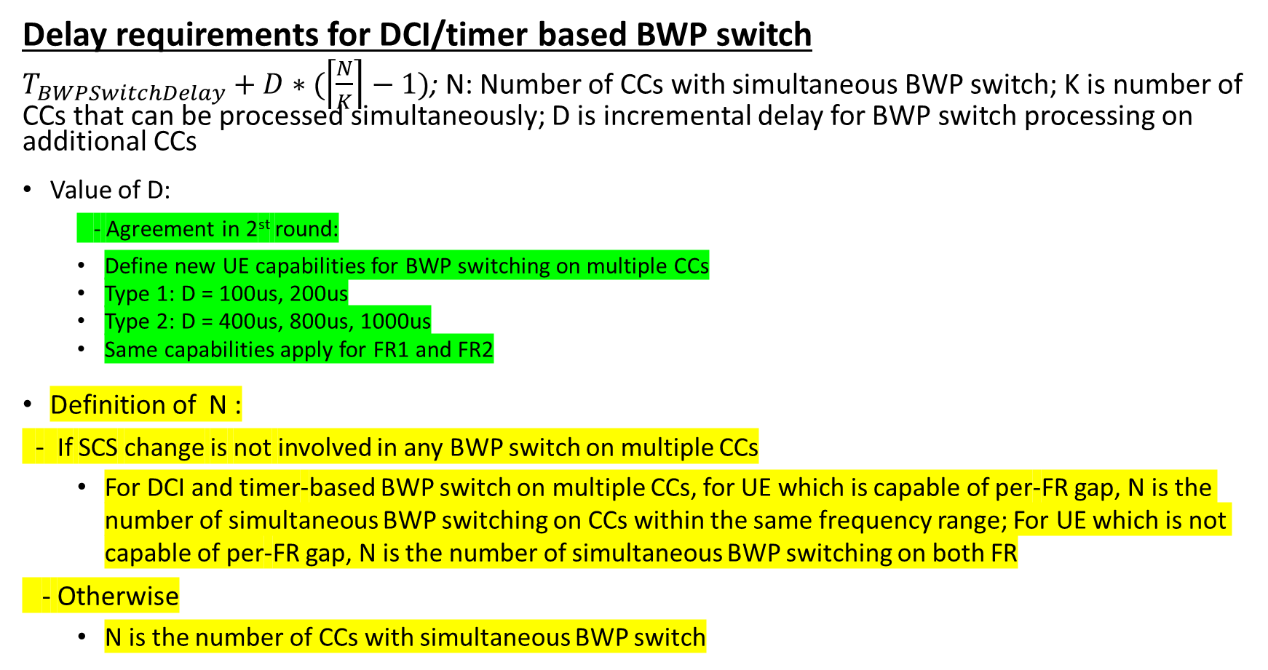
Simultaneous BWP switching on multiple CCs (1)
Delay requirements for DCI/timer based BWP switch
$T_{BWPSwitchDelay}+D∗(\left\lceil \frac{N}{K}\right\rceil −1)$; N: Number of CCs with simultaneous BWP switch; K is number of CCs that can be processed simultaneously; D is incremental delay for BWP switch processing on additional CCs
Value of D:
  - Agreement in 2st round:
  Define new UE capabilities for BWP switching on multiple CCs
  Type 1: D = 100us, 200us
  Type 2: D = 400us, 800us, 1000us
  Same capabilities apply for FR1 and FR2
Definition of N :
- If SCS change is not involved in any BWP switch on multiple CCs
  For DCI and timer-based BWP switch on multiple CCs, for UE which is capable of per-FR gap, N is the number of simultaneous BWP switching on CCs within the same frequency range; For UE which is not capable of per-FR gap, N is the number of simultaneous BWP switching on both FR
- Otherwise
  N is the number of CCs with simultaneous BWP switch

Slide 4
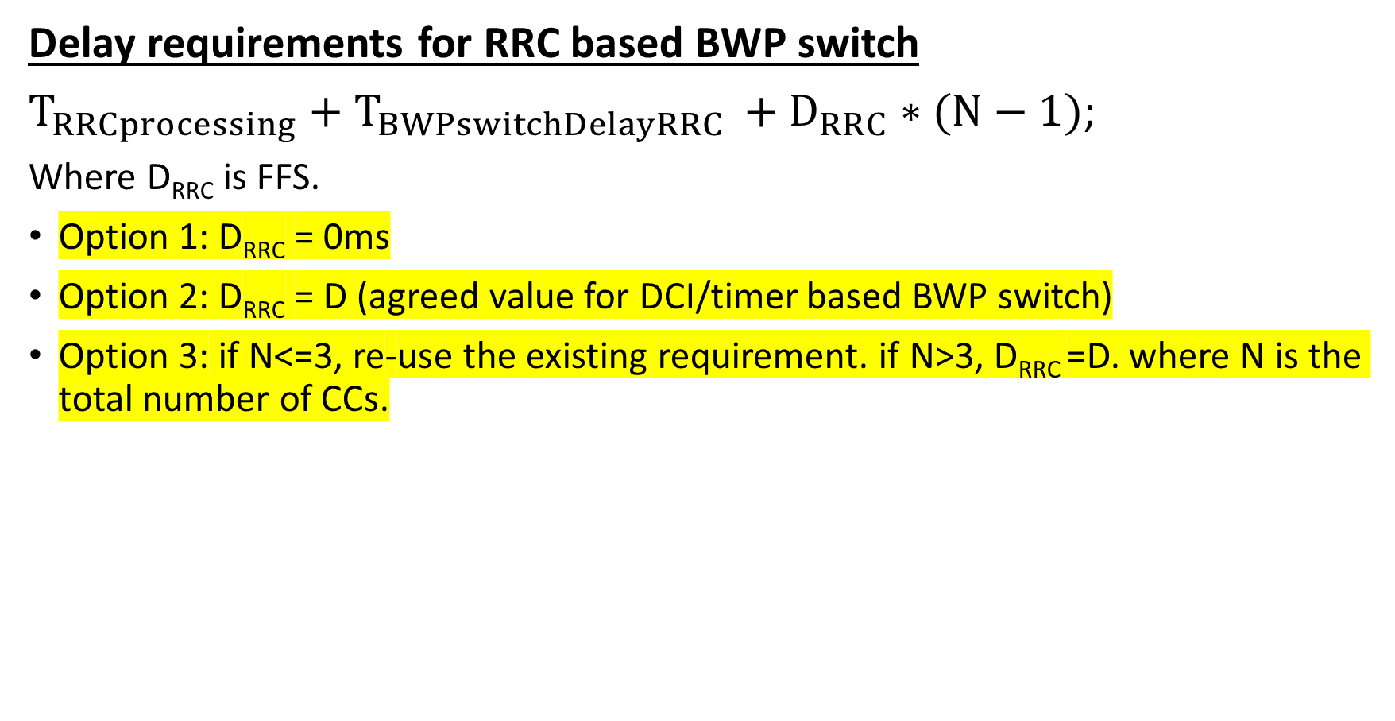
Simultaneous BWP switching on multiple CCs (2)
Delay requirements for RRC based BWP switch
$T_{RRCprocessing}+T_{BWPswitchDelayRRC }+D_{RRC}∗(N−1)$;
Where D_{RRC} is FFS.
Option 1: D_{RRC} = 0ms
Option 2: D_{RRC} = D (agreed value for DCI/timer based BWP switch)
Option 3: if N<=3, re-use the existing requirement. if N>3, D_{RRC} =D. where N is the total number of CCs.

Slide 5

Simultaneous BWP switching on multiple CCs (3)
$T_{BWPswitchDelay}$when SCS changes
Agreement in 1st round: the simultaneous BWP switch on multiple CCs case, if the BWP switch on multiple CCs results in the change of the SCS on any CC among involved CCs, T_{BWPswitchDelay} should be based on the smallest SCS among all SCS values of all involved CCs.

Slide 6
Partial Overlap BWP switching on multiple CCs (1)
Conditions when requirements for partial overlap BWP switch are defined
DCI and RRC based BWP switch with partial overlap are defined for FR1+FR2 in NR-DC operation, when BWP switch doesn’t involve SCS change and UE supports per-FR gap.
- No requirement is defined for RRC based BWP switch with partial overlap within a cell group

Slide 7
Partial Overlap BWP switching on multiple CCs (2)
Timer based BWP switch
Sub1: if UE is capable of per-FR gap and the timer based BWP switch happens in two frequency range, whether UE handled timer-based BWP switch in parallel or sequentially
Option 1: in parallel
Option 2: sequentially

Slide 8
Partial Overlap BWP switching on multiple CCs (2)
Timer based BWP switch
Sub2: Delay requirement for timer based BWP switch
Option 1: Don’t differentiate UE capability of per-FR gap
  TBWPSwitchDelayPartialOverlapTimer = T_{Delay} + T_{BWPSwitchDelayTimer} , where T_{Delay} is the time delayed by ongoing BWP switching on other single or simultaneously triggered multiple CCs. T_{BWPSwitchDelayTimer} is the timer-based BWP switch delay on current single CC or simultaneously triggered multiple CCs.
  Note: more clarification can be added for T_{delay} and T_{BWPSwitchDelayTimer} if identified necessary
Option 2: Dependent on the UE capability of per-FR gap
  For UE capable of per-FR gap:
  TBWPSwitchDelayPartialOverlapTimer = T_{Delay} + T_{BWPSwitchDelayTimer} , where T_{Delay} is the time delayed by ongoing BWP switching on other single or simultaneously triggered multiple CCs within the same frequency range. T_{BWPSwitchDelayTimer} is the timer-based BWP switch delay on current single CC or simultaneously triggered multiple CCs.
  For UE not capable of per-FR gap:
  T_{Delay}+T_{MultipleBWPSwitchDelay}, where T_{Delay} is the time delayed by ongoing timer-based BWP switching with in the same frequency range; T_{MultipleBWPSwitchDelay} is T_{BWPSwitchDelay}+ D(N-1), N is the number of timer-based BWP switch on CCs in the other FR of which the time periods of BWP switching delay are overlapped with T_{NonSimultaneousTimer}, and D is the incremental delay, which is same as that of simultaneous BWP switch on multiple CCs
  Note: more clarification can be added for T_{delay} and T_{BWPSwitchDelayTimer} if identified necessary

Slide 9
Partial Overlap BWP switching on multiple CCs (3)
RRC based BWP switch
Sub1: Whether RRC processing time is equal to BWP switch time in RAN2 (In case the RRC procedure triggers BWP switching, the RRC procedure delay is the value defined in the following table (Table 12.1-1 in TS 38.331) plus the BWP switching delay defined in TS 38.133 [14], clause 8.6.3.)
Option 1: Yes
Option 2: No
Sub2: Delay requirement for RRC based BWP switch
Option 1:upper bounded by the multiple BWP switch time in CG1.
Option 2:upper bounded by the RRC processing time in the 1st CG.
Option 3:No need to introduce the waiting time for RRC based partial overlap BWP switching on multiple CCs, and the delay requirements for simultaneous BWP switch on multiple CCs shall be reused

