Slide 1
3GPP TSG-RAN WG4 Meeting #94-e-Bis
Electronic Meeting, 20 – 30 Apr., 2020
draft R4-2005477
WF on IAB EMC
ZTE, …

Slide 2
Background
The IAB EMC has been extensively discussed and the first round discussion summary is in [1]
It is quite converged in [1] that IAB immunity requirement except Radiated immunity will reuse base station requirement.
For IAB radiated emission requirement, it has been agreed in [2] that:
“We will not define 2 sets of EMC requirement for DU and MT, but to define requirements per each enclosure and each port”.

Slide 3
Wayforward (General)
  Agreements in this WF do not imply that requirement will be defined for all the discussed cases of the enclosure considerations, e.g.
  One enclosure case, TDM IAB
  One enclosure case, FDM/SDM IAB
  Different enclosure case, TDM IAB
  Different enclosure case, FDM/SDM IAB
  All above example cases are for analysis purposes only and to find proper methodology to fully discuss the IAB EMC requirements.
  Final EMC requirements shape is to be discussed once technical issues are solved, and final requirements may be merged for the above listed cases, if seen feasible.

Slide 4
Wayforward (Radiated emission)
The IAB EMC radiated emission requirements will be discussed as four cases listed below
  One enclosure case, TDM IAB
  One enclosure case, FDM/SDM IAB
  Different enclosure case, TDM IAB
  Different enclosure caes, FDM/SDM IAB
  This doesn't imply that requirement will be different in the above 4 cases. It is just to find a method to fully discuss the requirement. Final emission requirement after discussion can be merged.

Slide 5
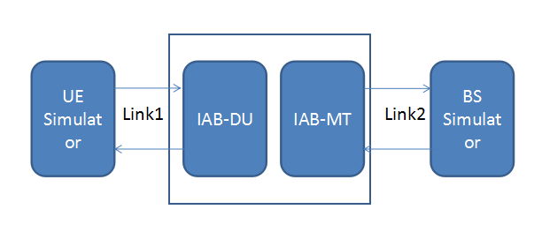
Wayforward (Radiated immunity)
This requirement will be discussed in two cases:
  Different enclosure:
    Option 1: BS and UE requirement apply to IAB-DU and IAB-MT enclosure separately
    Option 2: Apply BS requirement to each enclosure
  One enclosure:
  Some conformance issue has been listed in [2] but not fully discussed:
    Option 1: To test both links
    Option 2: To test each link at a time
  For core requirement:
  Test level:
    Option 1: To use base station requirement
    Option 2: To ues UE requirement
  Exclusion band:
    Option 1: A combined exclusion band to be discussed
    Option 2: To ues the exlusion band of BS and UE whichever is smaller
    Option 3: To ues the exlusion band of BS and UE whichever is larger

Slide 6
Wayforward (Capture the requirement)
How to capture the requirement:
  Option 1: A new TS is needed (ZTE, Huawei)
  Option 2: To capture in the BS spec TS 38.113 (Ericsson)

Slide 7
Reference
[1] R4-2005433 summary of RAN4#[94e Bis] [203] NR_EMC, ZTE
[2] R4-2002348 WF on IAB EMC core requirement, ZTE

