Slide 1
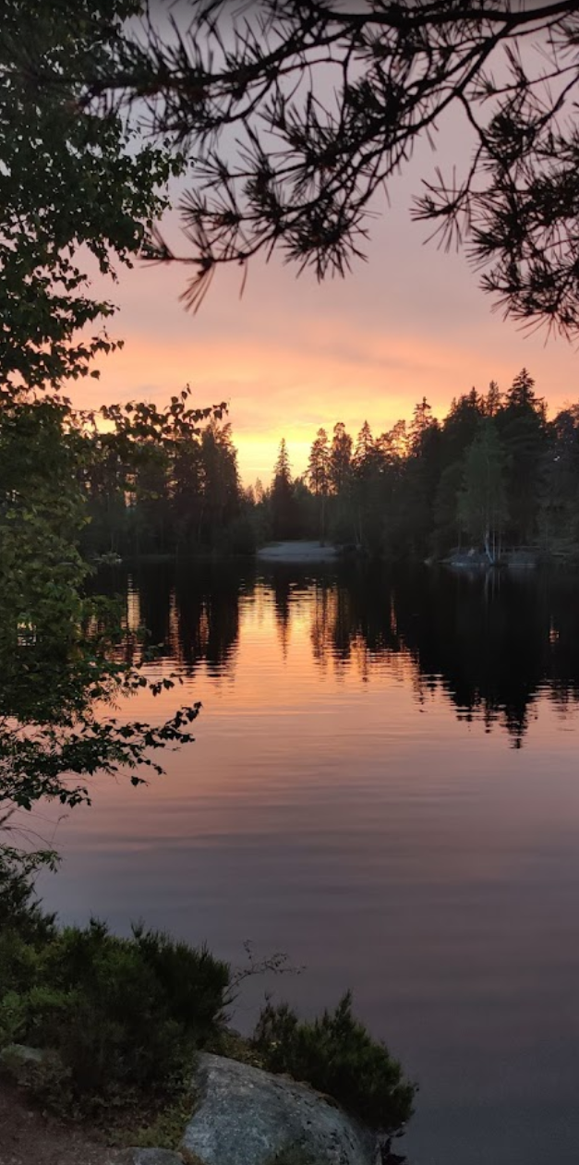
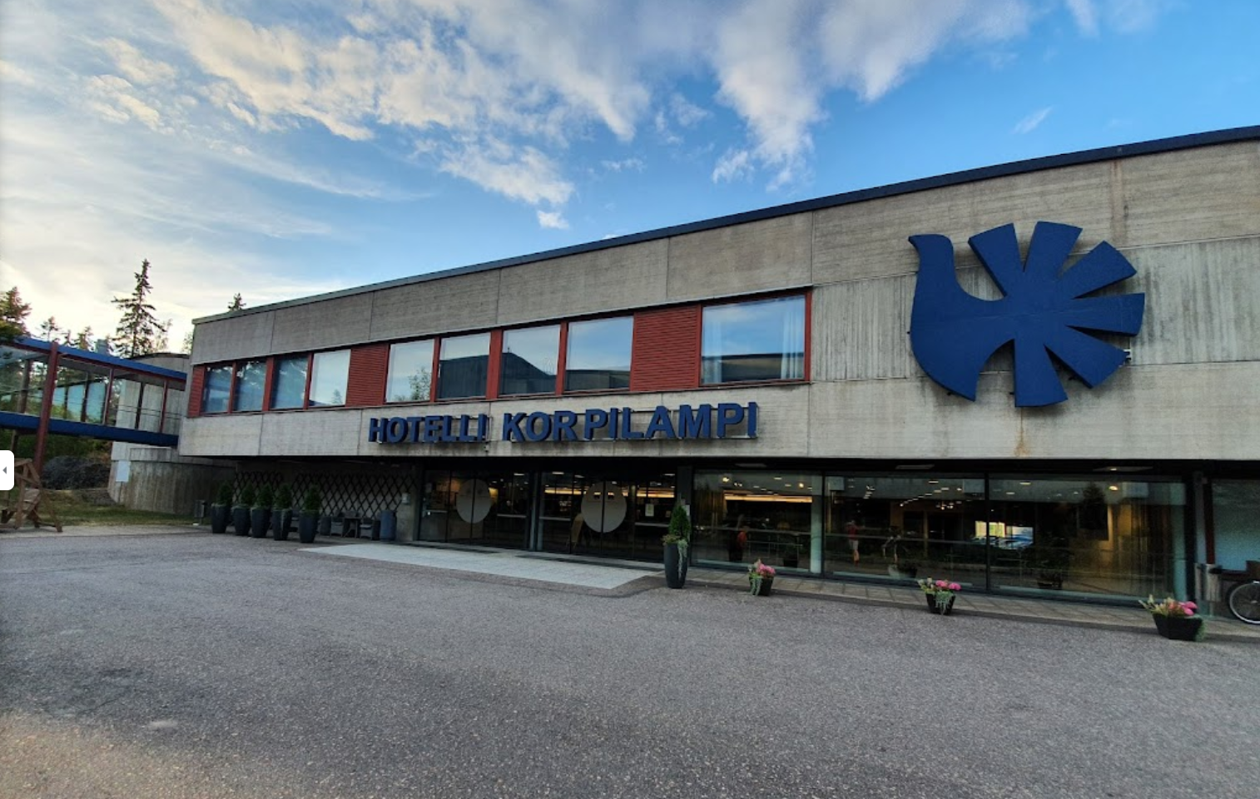
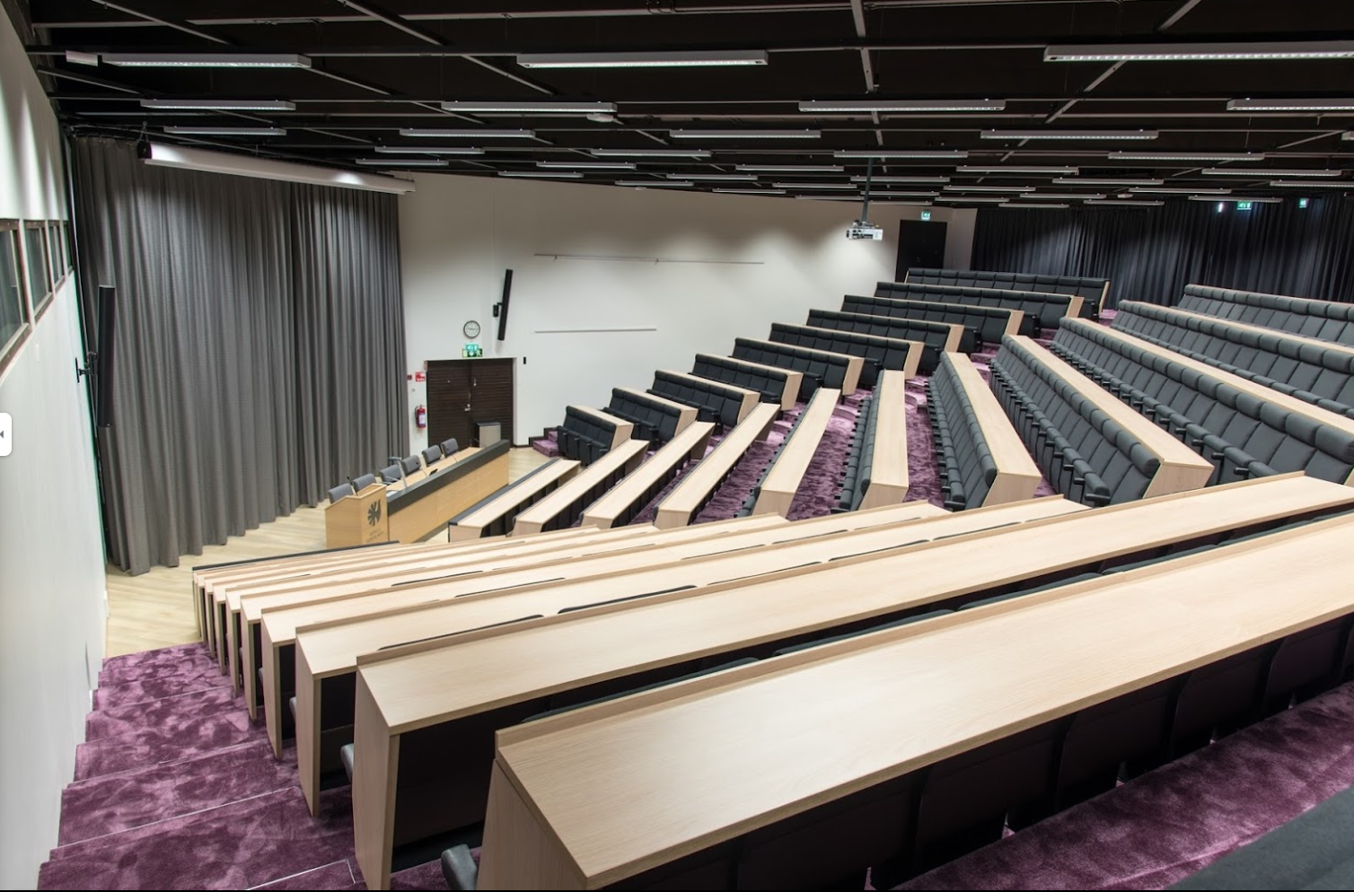
RAN4 #1, Espoo, Finland 21-22 January 1999 Hotel Serena Korpilampi

Slide 2
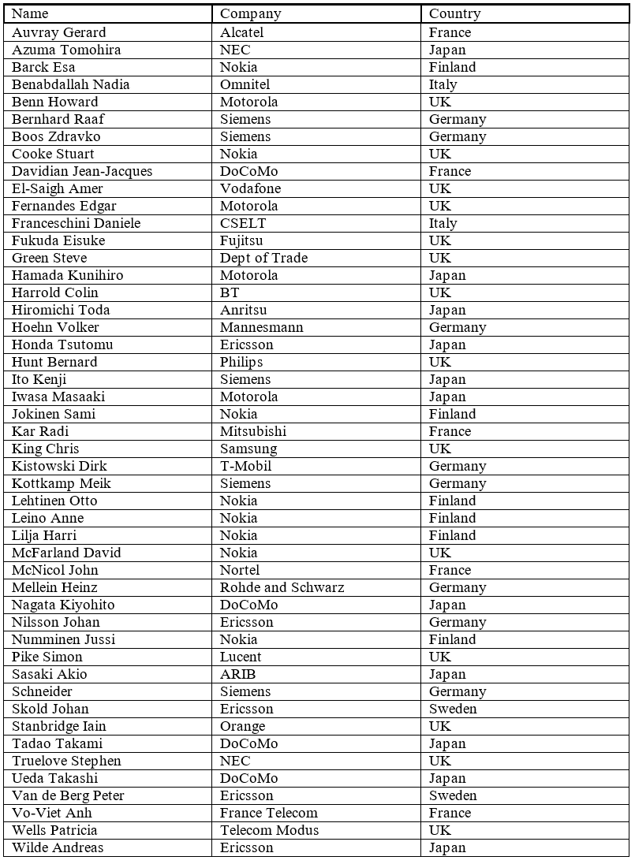
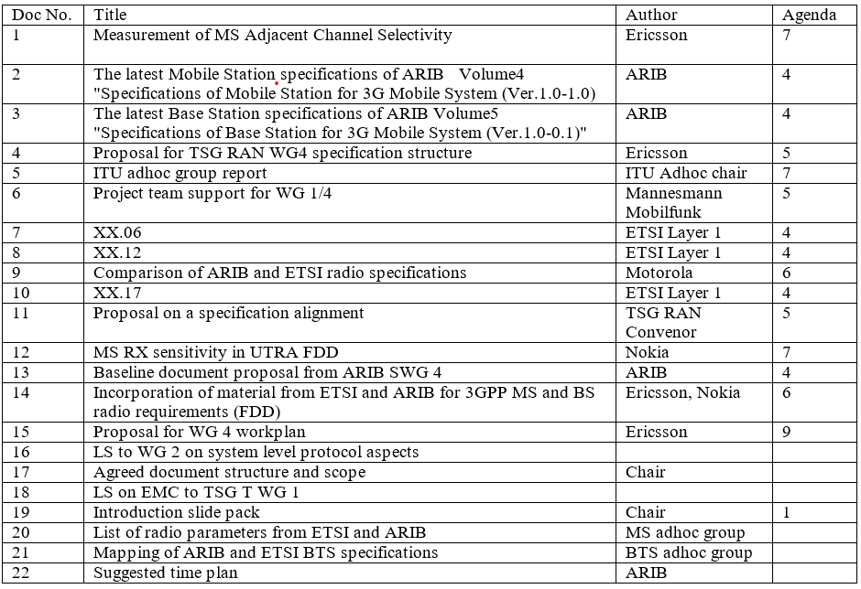
RAN4 #1 statistics
Convenor: Howard Benn, Motorola
Secretary: David Cooper, Telecom Modus
2 days, 48 delegates, Total of 22 (!) Tdocs.

Slide 3
How were meetings conducted back in 1999?
Tdoc distribution was
On paper! Printers used for revisions…
Later developments:
CD-ROM
USB sticks
Wired LAN (not-a-wireless-mtg)
WiFi with local server
WiFi with 3GPP servers

Slide 4
Specification and TSG RAN structure
First TSG RAN structure
RAN1 Radio physical layer
RAN2 Radio Layer 2 and 3 RRC
RAN3 RAN Architecture and interfaces
RAN4 Radio performance and protocol aspects
First RAN4 specification structure
R4.00 Introduction → Abandoned
S4.01 Radio transmission and reception (FDD) → 25.101/104
S4.02 Radio transmission and reception (TDD) → 25.102/105
S4.03 System level protocol aspects → … → 25.133
S4.11 BS conformance testing (FDD) → 25.141
S4.12 BS conformance testing (TDD) → 25.142
R4.01 System scenarios → 25.942
Specs vs. group numbering
Radio performance, protocols 25.1xx RAN1
Radio physical layer 1 25.2xx RAN2
Radio Layer 2 and 3 RRC 25.3xx RAN3
RAN Architecture, Interfaces 25.4xx RAN4
First considered to be part of RAN1!
Added last, that is why it is WG #4.

Slide 5
First year in RAN4
Activities in 1999:
Nine RAN4 meetings: Espoo, Turin, Tokyo, Kista, Miami, South Queensferry, Makuhari, Sophia-Antipolis, Bath
Two Ad hoc meetings: Amsterdam, Helsinki
Total of 1022 Tdocs in one year Numbered R4-99001 to R4-99a22
RAN4 specs raised to v3.0.0 TSG RAN#5, October 1999, Kyoungju
Release 99 “completed” TSG RAN#6, December 1999, Nice

Slide 6
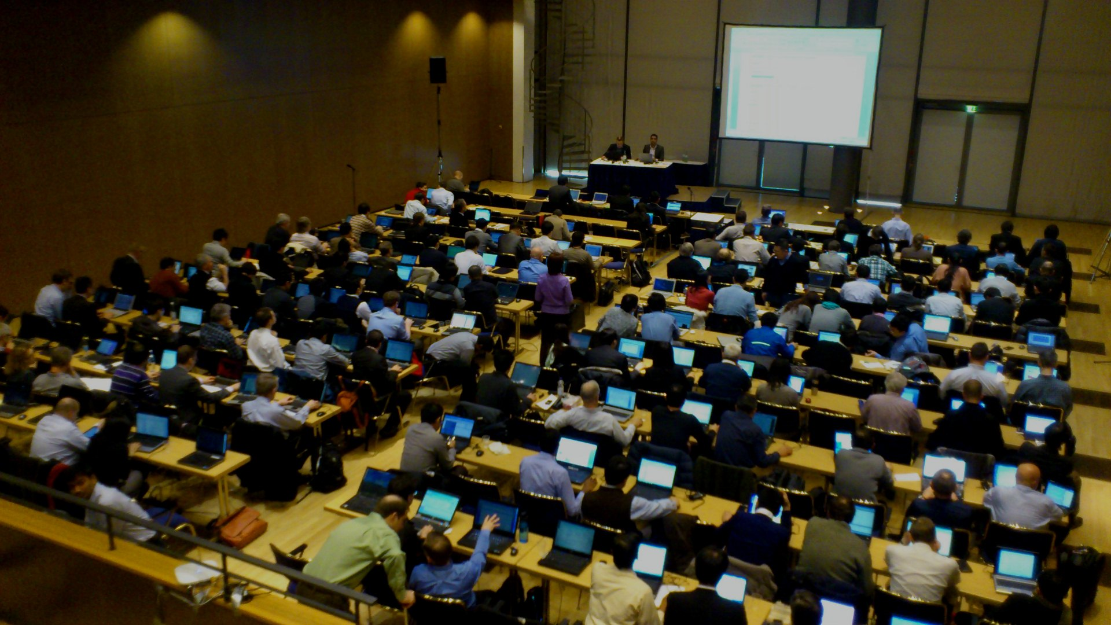
This is not the 100th meeting…!
From 1999 to 2021, RAN4 held
100 “regular” meetings
30 bis-meetings
3 RAN4 AH meetings
44 “topics” AH meetings
Total: 177 meetings
RAN4 chairmen
Howard Benn, Motorola
Takaharu Nakamura, Fujitsu
Dawei Zhang, CMCC
Tuomo Saynajakangas, Nokia
Xutao Zhou, Samsung
Steven Chen, Futurewei
Xizeng Dai, Huawei

Slide 7
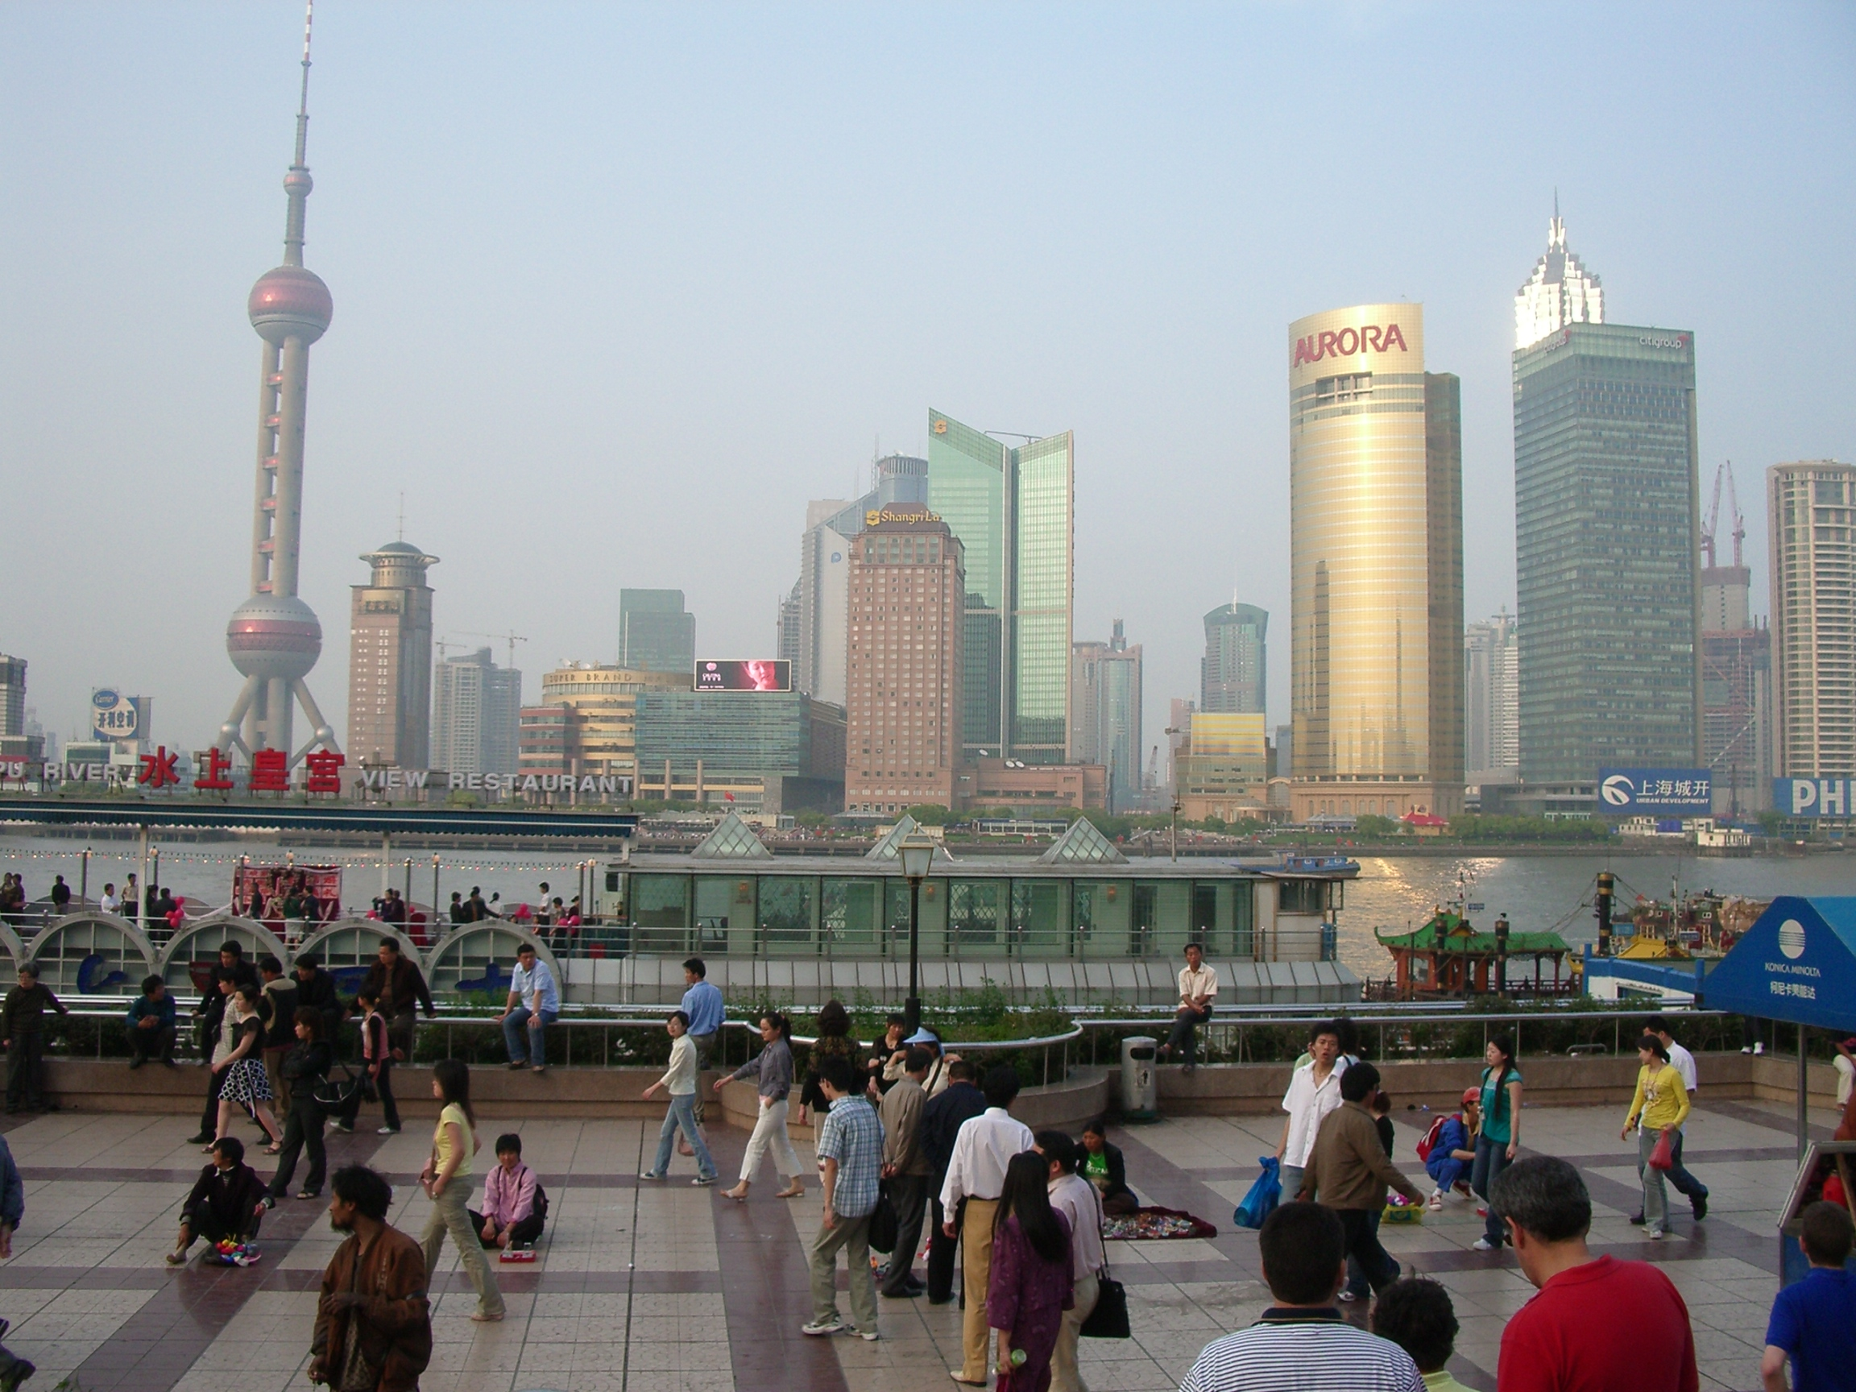
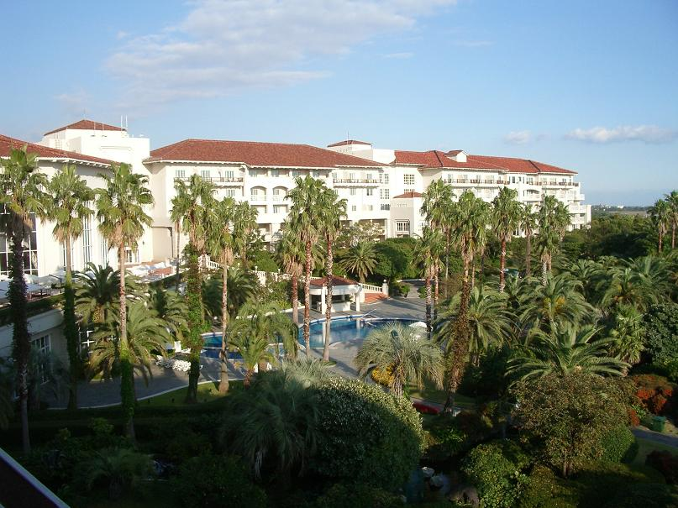
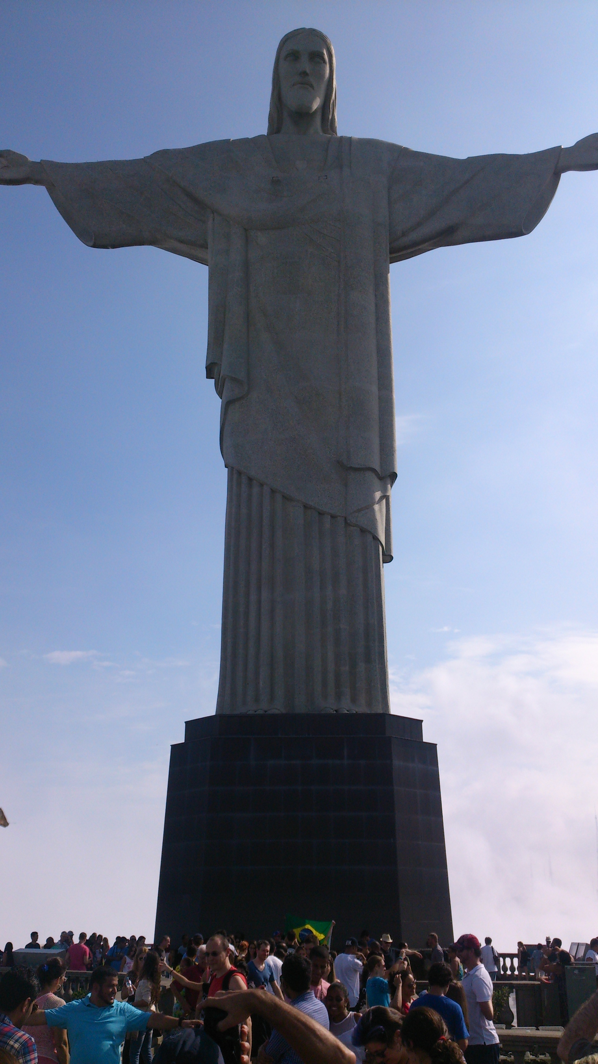
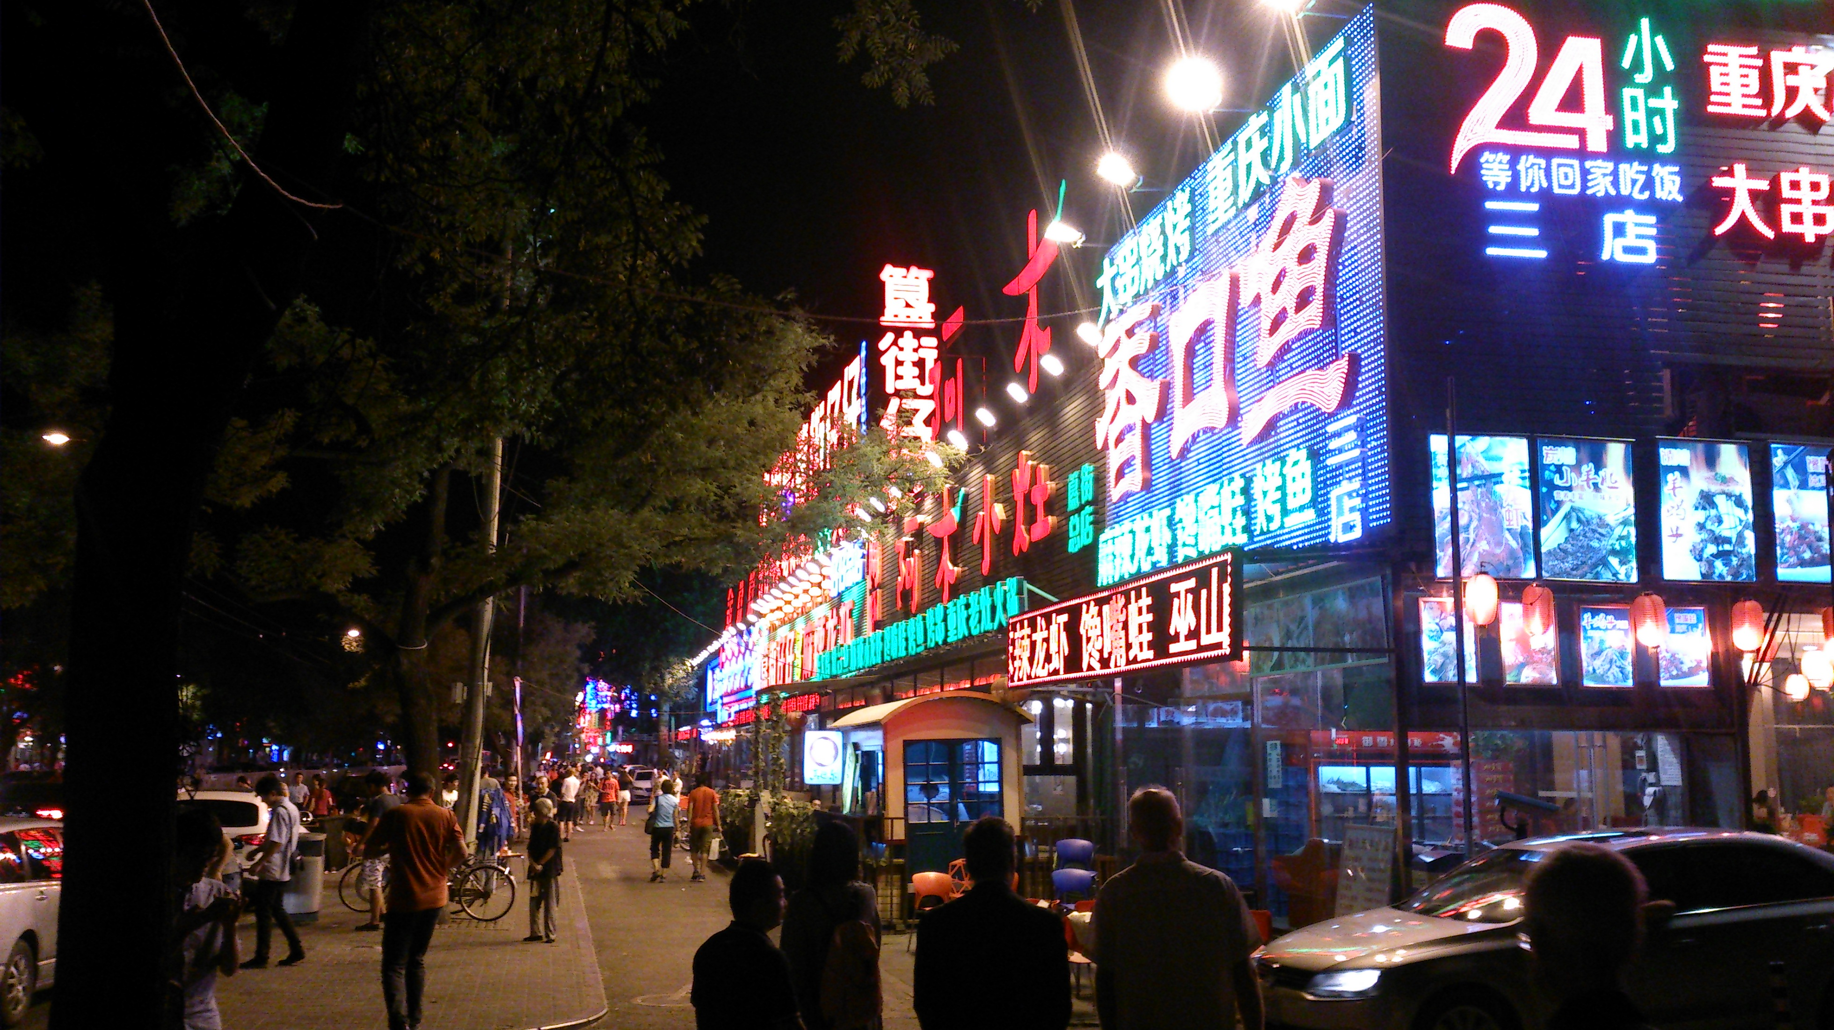
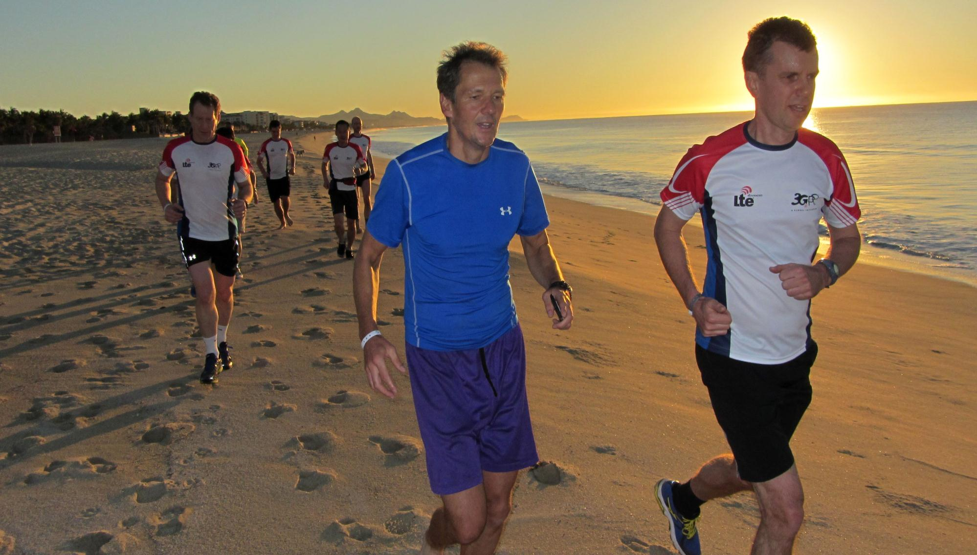
And RAN4 continues
From 3G to 4G to 5G to…
3GPP and RAN4 is an amazing global effort we can all be proud of!

