Slide 1


THANKS FOR 4 YEARS
3GPP RAN3

Slide 2
To Sasha
Dear Sasha,
I am grateful for having had you on board in the RAN3 officers team. These past 4 years have been a success for RAN3 also thanks to your invaluable cooperation: we wouldn’t have been able to make it without you! As Vice-Chairman you took care of some complex topics, which you successfully guided thanks to your competence and common sense. I was confident that I didn’t have to worry about anything about those topics, because it was all taken care of by you.
It amazes me that, in parallel to such a demanding role, you also found the time to edit such a well-organized book on RAN architecture (I guess I didn’t stress you too much… ;) ). I was happy to buy it and I consult it regularly; the book is an additional sign of your role and contribution to RAN3.
I wish you all the best, and I’m looking forward to continuing to work with you in RAN3.
- Gino

Slide 3
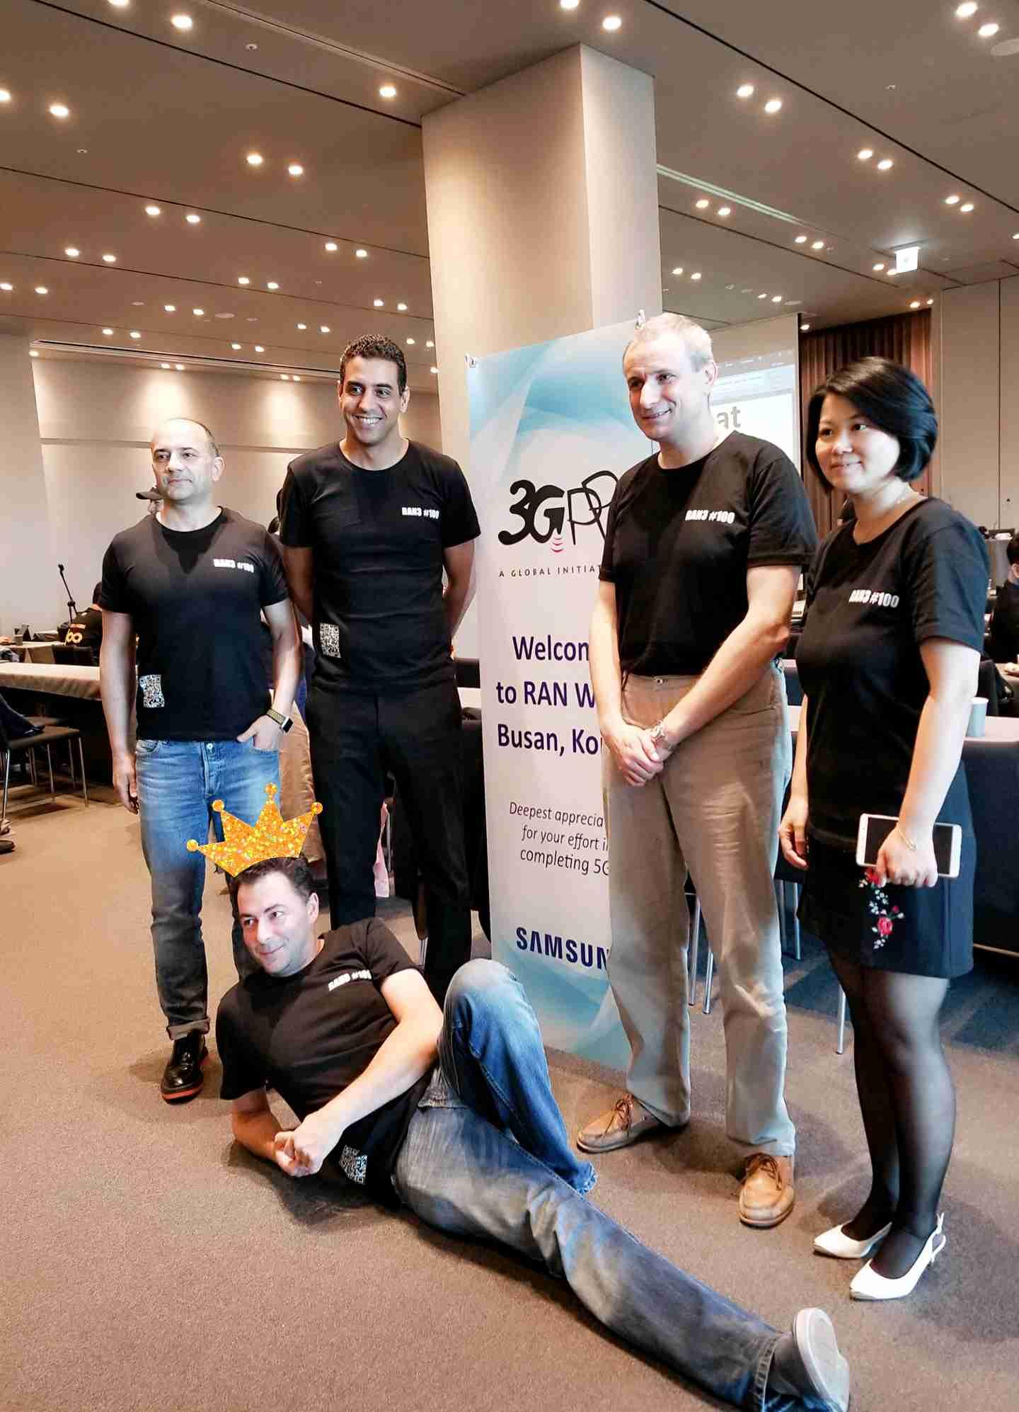
To Sasha
Sasha, thanks for your excellent job for the last 4 years ! Working with you has been a wonderful experience and a privilege!
Wish you the best in the future.
ZTE - Yin Gao
Sasha, it is a great honor to work with you on the SON/MDT project and to complete the challenge in a very short time.
I wish you a happy future.
ZTE – Dapeng Li
Thank you Sasha for your efforts. When are we going to see the dark side of Sasha BTW? Love your book which has brought us a bigger picture of telecom world.
ZTE – Qi Tao

Slide 4
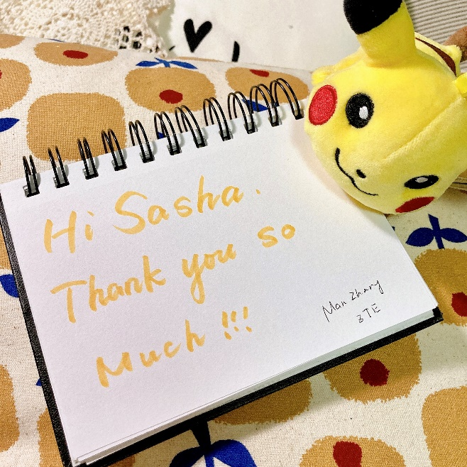
To Sasha
Dear Sasha,
I am a fresher in the RAN3 family. I haven’t even seen you so far, but I can see from the pictures that you are supposed to be a handsome person. ☺
Hope to see you in future meetings. Wish you all the best in the future.
ZTE – Jiajun Chen
Thanks for your leadership in RAN3 session. Feel very happy to work and cooperate with you.
May you have successful career in you future life.
ZTE – Zijiang Ma
Dear Sasha,
Thanks for your contributions to RAN3 in the past four years, especially for your excellent leadership in the SON/MDT WI.
Wish you the best in the future!
ZTE –Jiren Han

Slide 5
To Sasha
Thank you for being the RAN3 Vice Chairman since my first RAN3 meetings in Sanya and Busan back in 2018. It has been a great pleasure to co-work with you and I do appreciate your effort in conducting the meetings and moving the 3GPP releases forward. Cheers!
Google - Jing-Rong Hsieh
Dear Sasha,
I have never met you due to a pandemic situation, but thank you for your hard work as RAN3 vicechair.
I remember that I saw your look with a shaggy beard over the GTW sessions.
It is a pity that we did not have much time to know each other.
I am looking forward to meeting you face to face in 2022 when the pandemic is over.
Cheers,
MCC – Young Ik
Thanks Sasha for helping RAN3 as a always good and magnificent group in 3GPP.
NEC - Chenghock Ng

Slide 6

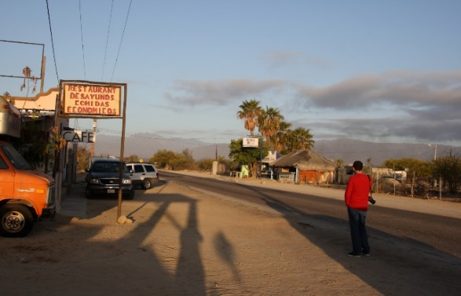
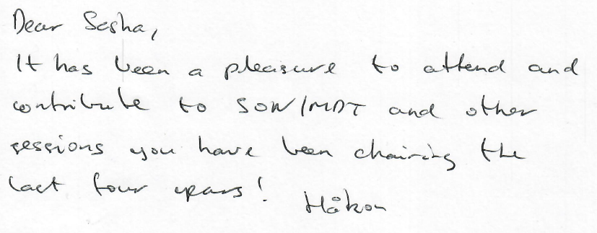

To Sasha
Thank you Sasha for your successful vice-chair term. We have all admired your patience during our controversial and animated discussions.
I hope we can celebrate this event again face to face in our traditional wine party anywhere soon. All the best.
Nokia – Philippe G.
It’s been a journey from those photos to today…
(Do you still remember Nancy’s spectacular lodging?)
Nokia – Kris
Thanks for your outstanding service to RAN3 for the past 4 years!
Nokia - Sean

Slide 7
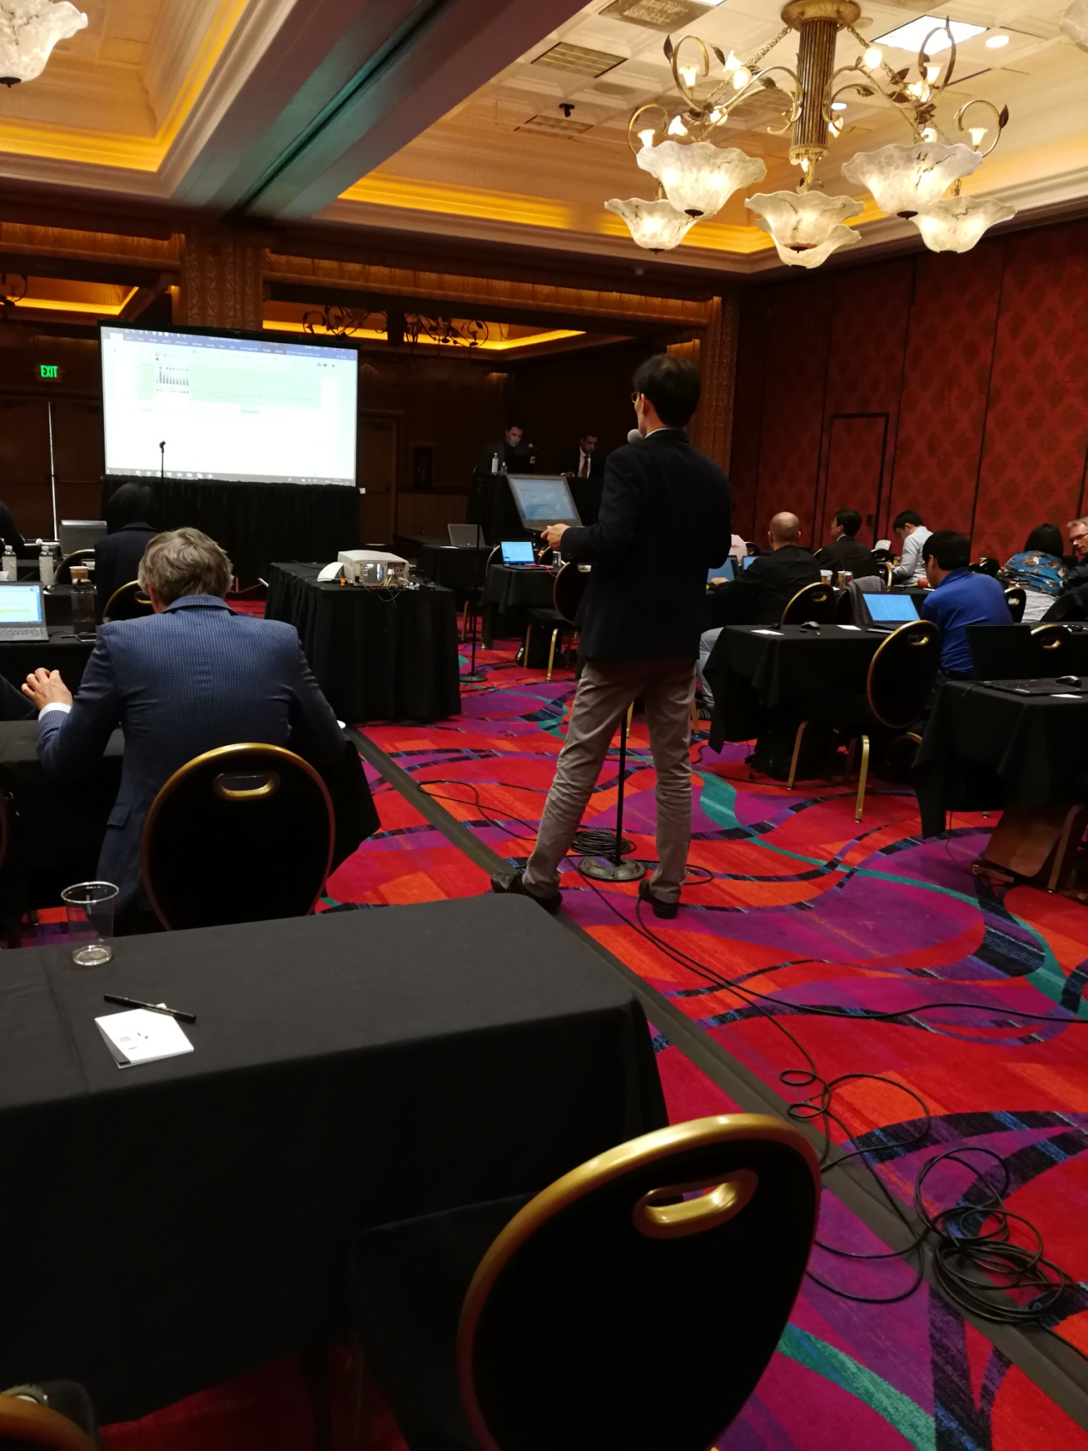
To Sasha
I really appreciate your leadership as RAN3 Vice Chairman in the past four years with fairness, openness and efficiency, especially your great efforts on chairing the SI/WIs lead by China Mobile, including the Rel-16 data collection and utilization SI, Rel-16 SON/MDT WI and Rel-17 SON/MDT enhancement WI.
Your spirit of always respecting the operator requirement and distributing the workload evenly among the companies is impressive.
Wish you happiness and healthy forever.
CMCC – Liang Liu
I really appreciate your chairmanship with the spirit of equality, transparency and efficiency. Wish you happy and healthy life, and hope to meet you face-to-face in the very near future.
CMCC - Xingyu Han
Thanks to Sasha for your leadership in presiding over 3GPP meetings in last four years. Under your leadership, meetings run smoothly and remain orderly, and delegates in all companies work at a consensus in specification decisions. Wish you happiness, and joy in your future life.
CMCC – Miaoqi Zhang

Slide 8
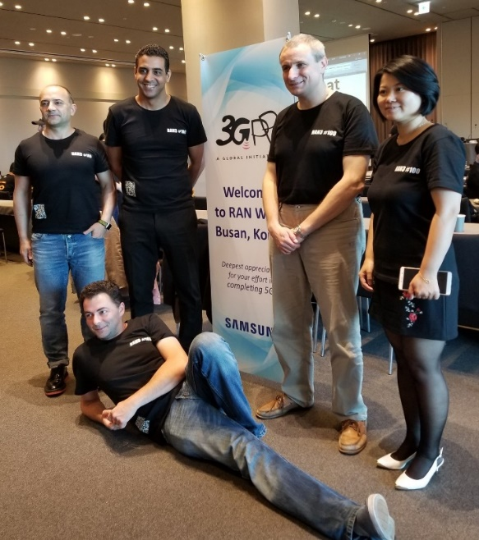
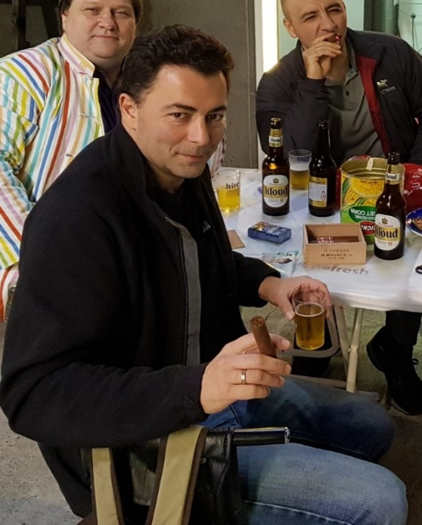
To Sasha
Sasha, many thanks for your contributions to RAN3 as vice-chairman – your pragmatic and calm approach to the job, always trying keep things on a sensible level, and making sure the unruly lot got somewhere and on time.
Very best wishes, and hope we can share a beer soon!
QC - Luis
Anticipating the new football free-kick wall: Sasha calmly taking one for the team!!
Best wishes and many thanks Sasha for your contributions to RAN3 as vice-chairman. Although we couldn’t interact in person during your tenure, I felt at ease in contributing to the online meetings in the SON/MDT sessions you moderated and liked the way you handled the sessions. Hope to meet you soon in the future!
QC - Shankar
Après RAN3 – yet still chairing!

Slide 9
To Sasha
Many thanks for chairing the sessions so efficiently. Also impressed by the sticker you designed for RAN3#100 meeting celebration. It is a lucky for our RAN3 group to have an excellent vice chairman who is also a good designer. ☺
CATT - Aijuan
How time flies, I still remember we knew each other from the “LWI/LWA” project 5 years ago.
In the past few years, we worked together for several topics. It’s a nice experience to work with you.
Thanks a lot for organizing so many activities for RAN3 team, which makes our big family warmer and more cohesive.
Wish everything around you will become better and better. ☺
CATT - Jiancheng SUN

Slide 10
To Sasha
Sasha, thank you for efficient chairing SON/MDT sessions, which make things on a sensible level within TU budget, and thanks for organizing regular interesting RAN3 social events.
All the best wishes to you and your family!
Samsung - Lixiang
Thank you Sasha for your great efforts in the past four years as RAN3 vice chairman.
It is my great honor to work with you on the SON/MDT topic. Your spirit of fairness, openness and efficiency is impressive.
I wish you all the best for your next endeavour!
Lenovo/Motorola Mobility - Mingzeng

Slide 11
To Sasha
Hello Sasha,
Thank you very much for your efficient management of RAN3 as vice chair during the last 4 years..
The discussions were always conducted in peace and serenity.
I also really appreciated your sense of organizing festive events.
All the best for the future period and I hope we will meet soon again in F2F.
Orange - Pascal

Slide 12
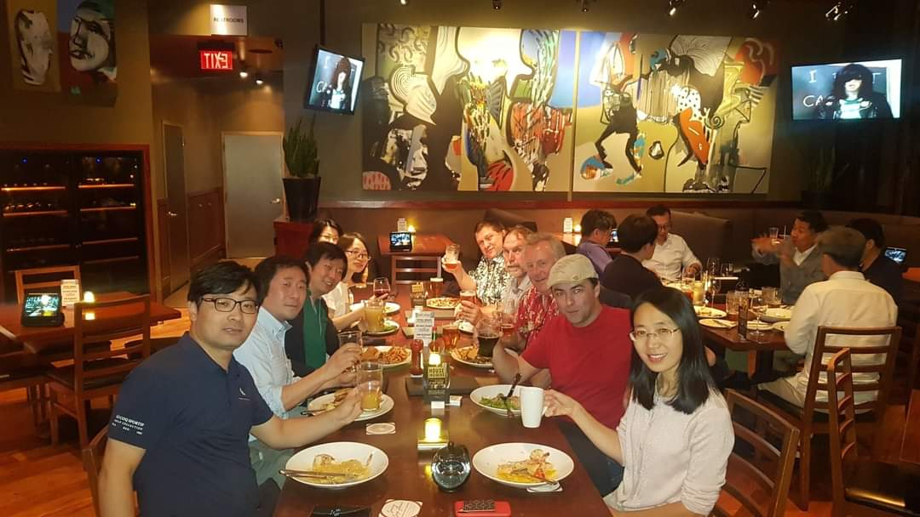
To Sasha
Hello Sasha,
Thank you for your great contribution/leading/Chairing in RAN3 as a Vice Chairman during the past 4 years.
It was great experience to work with you on the V2X SI/WI and thank you for your nice chairing on that.
Hope to see you soon
Best wishes to your future!
LG - James (Jian) Xu

Slide 13

In your day, we will work together, so the OARS will paddle fast and the shore will be clear.
May you have a smooth sailing and successful career in your future life.
- All RAN3 Delegates

